Slide 1
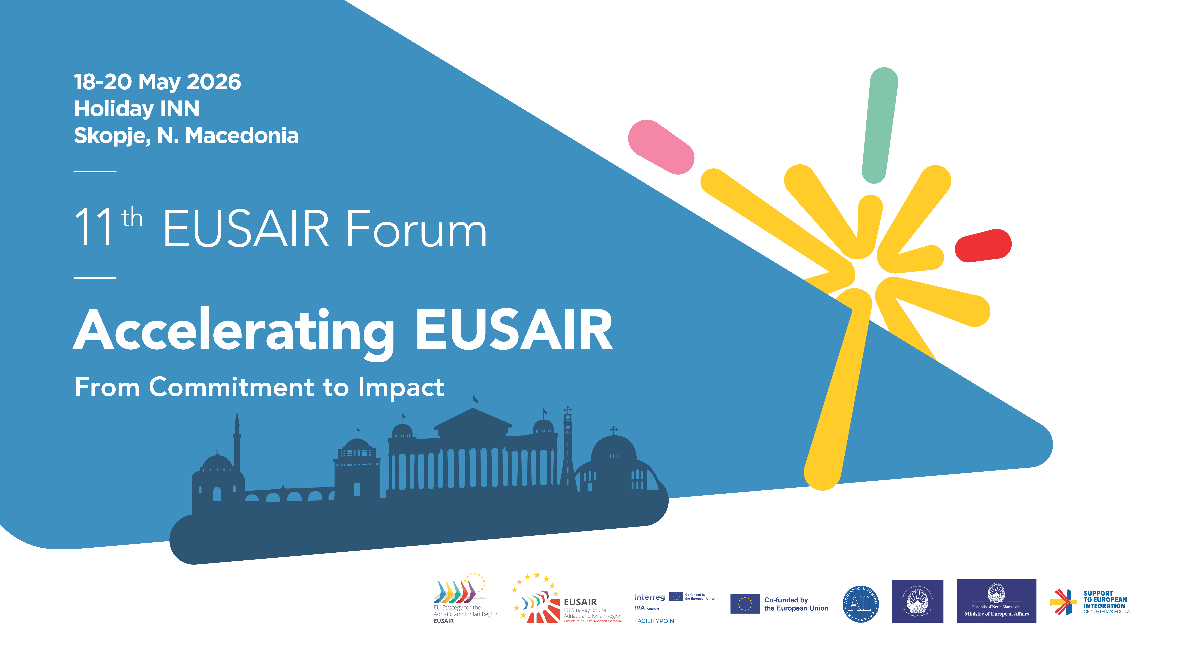

Slide 2
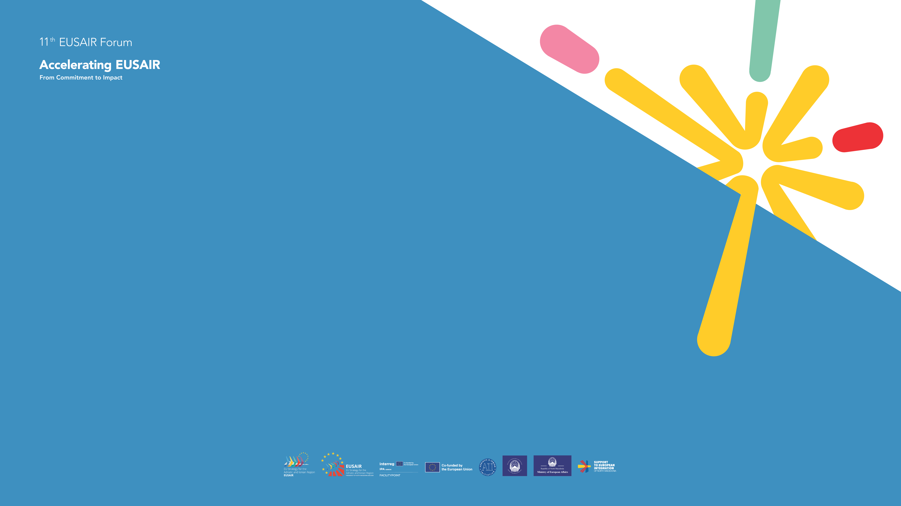
SUSTAINABLE URBAN MOBILITY....WHAT IT MEANS?
Efficient, safe and affordable transport for all citizens
Reduction of air pollution and CO₂ emissions
Encouraging public transport, cycling and walking
Smart traffic and infrastructure management

Slide 3
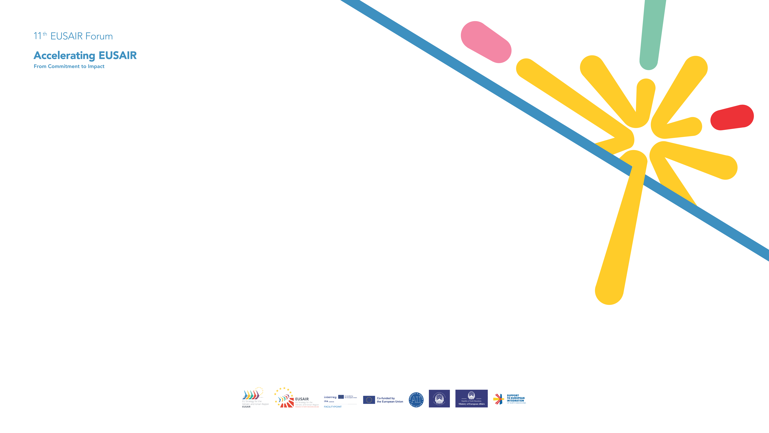
CURRENT SITUATION IN SERBIA
High dependence on cars in urban areas
Traffic jams in cities in Serbia
Insufficiently developed cycling infrastructure
Problems with the qualitz of public transport and pollution
Urban mobility policies in Serbia - especially in Belgrade - have evolved significantly over the past decade, moving from traditionally car-oriented system toward a more sustainable, integrated, and EU-aligned approach.

Slide 4
Key challenges
1. Car dependency and congestion
Rapid increase in private vehicle ownership
High traffic density and frequent congestion
2. Lack of high-capacity rail systems
No metro system yet (planned but delayed)
Overreliance on buses
3. Infrastructure limitations
Narrow streets and historic urban layout
Insufficient parking management
4. Policy inconsistency
Simultaneous investment in:
  Sustainable transport
  Road expansion (car-oriented projects)

Slide 5
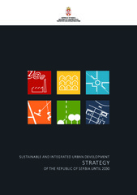
Strategic framework (national level)
At the national level, Serbia’s mobility policies are guided by broader development documents such as:
The Strategy of Sustainable Urban Development of Serbia (to 2030)
Transport and infrastructure policies led by the MCTI of Serbia
These policies emphasize alignment with EU transport and climate goals, reduction of emissions and fossil fuel dependency, integration of transport with spatial and urban planning.

Slide 6
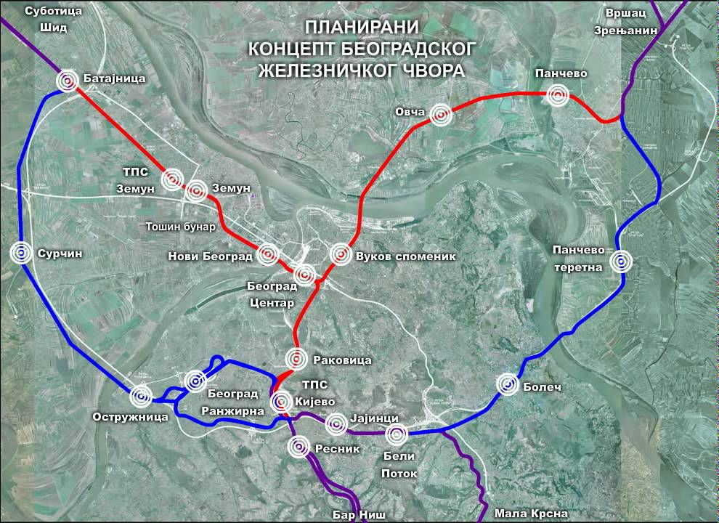
Public transport policy
Urban mobility in Serbia relies on public transport
System characteristics:
Modes: buses, trams, trolleybuses, and suburban rail (BG:train)
Integrated tariff systems (though evolving)
Increasing use of electric and eco-friendly vehicles
Policy directions:
Expansion and modernization of fleets
Electrification (e-buses, charging infrastructure)
Improved service integration

Slide 7

Sustainable Urban Mobility Plans (SUMP)
The most important policy instrument is the Sustainable Urban Mobility Plan (SUMP), widely adopted in Serbian cities, particularly Belgrade.
Key features:
Shift from car-centric planning → people-centric mobility
Integration of:
Public transport
Walking and cycling
Environmental and health goals
Strong stakeholder and citizen involvement
Main objectives:
Improve accessibility and quality of life
Reduce greenhouse gas emissions
Increase safety and efficiency
Promote multimodal transport
Belgrade officially adopted its SUMP in 2020.

Slide 8
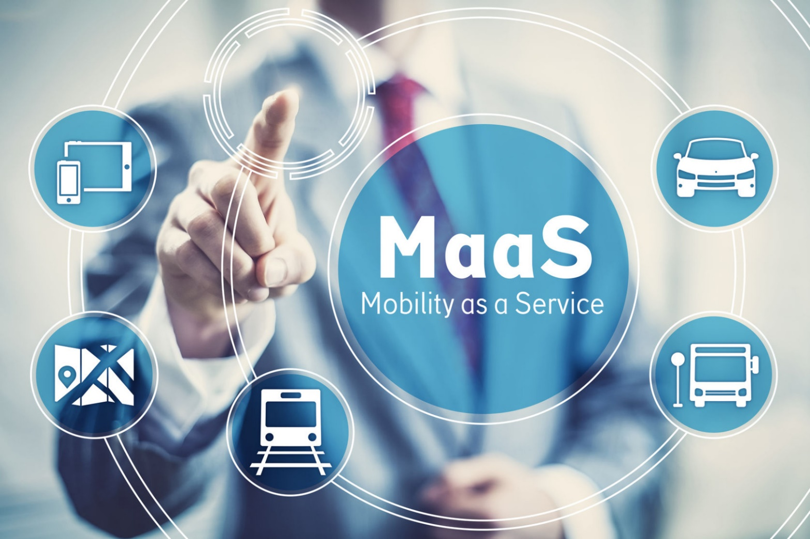
Smart mobility & “Mobility as a Service” (MaaS)
Serbia is gradually adopting smart city concepts, particularly in Belgrade.
Key idea:
Integration of multiple transport modes into one system
Use of ICT platforms for planning, ticketing, and routing
This is known as Mobility as a Service (MaaS):
Combines public transport, taxis, bike-sharing, etc.
Aims to reduce reliance on private cars

Slide 9
Active mobility policies (walking & cycling)
Policies increasingly promote non-motorized transport
Measures include:
Development of bike lanes and infrastructure
Pedestrian zone expansion (especially in central Belgrade)
Traffic calming and safety improvements
Challenges:
Fragmented cycling infrastructure
Limited continuity and safety in some areas

Slide 10

Environmental and climate policies
Incentives for electric vehicles (EV subsidies)
Reduction of air pollution and noise
Energy efficiency in transport systems
These align with EU climate commitments and global sustainability targets.

Slide 11
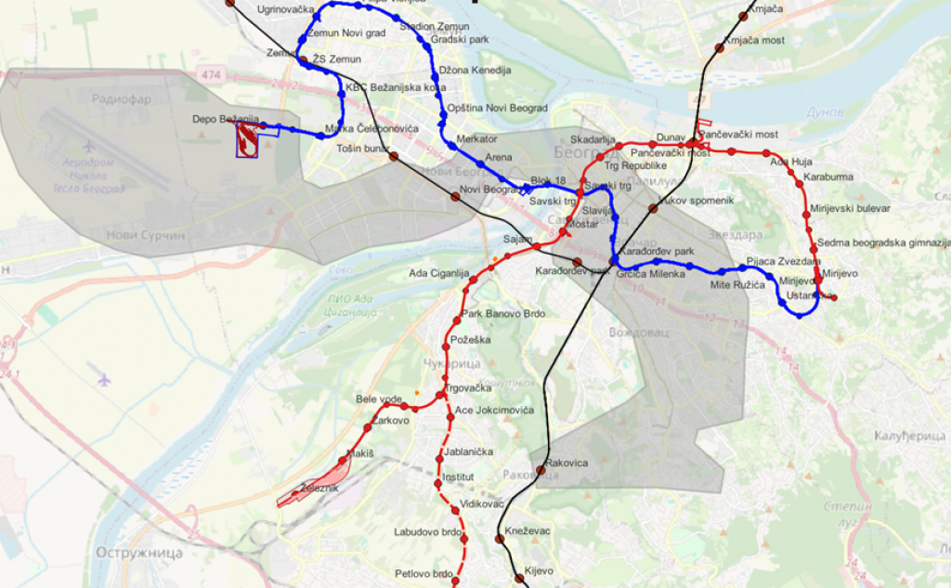
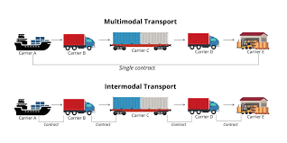
Good practice examples
Belgrade – development of BG:train and new tram corridors
Novi Sad – expansion of bicycle paths
Subotica – investment in intermodal transport

Slide 12
How to improve urban mobility?
Public transport modernization ane bus electrification
Development of metro and railway system
Developmetn safety cycling and pedestrian zones
(promote healthy, low-emission mobility and align the region with EU priorities on sustainable and alternative transport modes)
Using ecological vehicles

Slide 13
Future directions
Urban mobility policy in Serbia is expected to focus on:
Metro development in Belgrade (long-term priority)
Expansion of rail-based urban and regional transport
Full electrification of public transport fleets
Stronger integration with EU transport networks
Adoption of concepts like:
“15-minute city”
Multimodal hubs
Digital mobility platforms

Slide 14

LIID PROJECT
LOCAL INFRASTRUCTURAL AND INSTITUTIONAL DEVELOPMENT
Funding: World Bank and French Development Agency
Project value: 300 million USD
Period: 2023-2028. (5 years)
Strategic framework: Strategy of Sustainable Urban Development of Serbia (to 2030)
STRATEGIC DIRECTION IV: ENVIRONMENTAL QUALITY
STRATEGIC DIRECTION V: URBAN DEVELOPMENT MANAGEMENT
Project Lead Agency :
Ministry of Construction, Transport and Infrastructure
LIID Project Implementation Unit https://liid.mgsi.gov.rs/

Slide 15
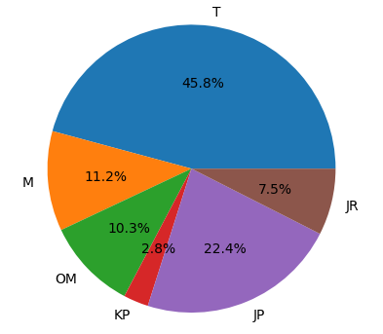
LIID PROJECT
LOCAL INFRASTRUCTURAL AND INSTITUTIONAL DEVELOPMENT
Project components
1. Climate smart mobility (USD 282 million)
1.1. Investment in climate smart mobility (USD 273,5 million)
1.2. Sustainable mobility (USD 8,5 million)
2. Strenghtening capacity for infrastructure service delivery (USD 11.5 million)
2.1. Improved participatory planning and project preparation (USD 6.5 million)
2.2. Strengthened institutions, public financial management and access to finance (USD 5 million)
3. Project management and awareness-raising (USD 6.5 million)
https://liid.mgsi.gov.rs/

Slide 16
THANKS FOR YOUR ATTENTION!
Ms. Marijana Radovanović, Urban Development Specialist, PIU LIID Serbia
Ministry of Construction, Transport and Infrastructure, Serbia

