Slide 1
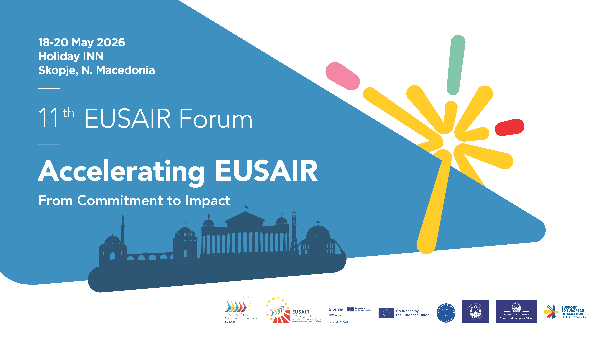

Slide 2


The Sarajevo Experience:
From Public Transport Renewal to Integrated Sustainable Urban Mobility
Ajdin Džananović
University of Sarajevo, Faculty of Traffic and Communications
Skopje, North Macedonia
19.05.2026

Slide 3





PRESENTATION OVERVIEW
Context
Strategy
Framework
Future
Sarajevo's unique urban form and mobility challenges.
Two-phase development of urban mobility infrastructure.
SUMP and Climate City Contract as strategic pillars.
Integration, research, and international cooperation.

Slide 4
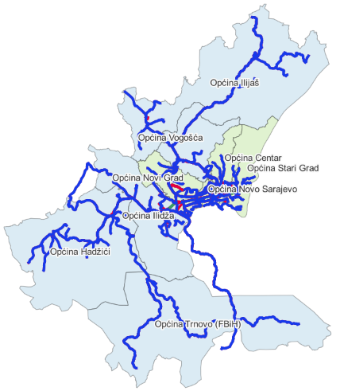
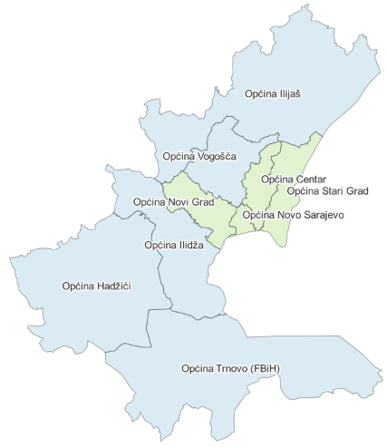
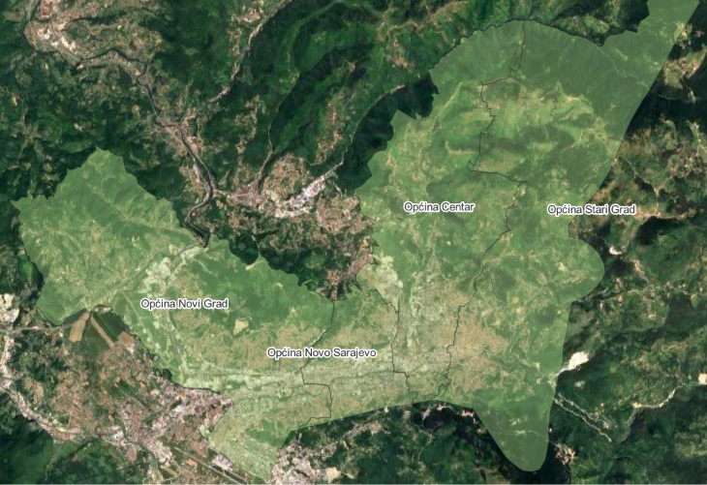
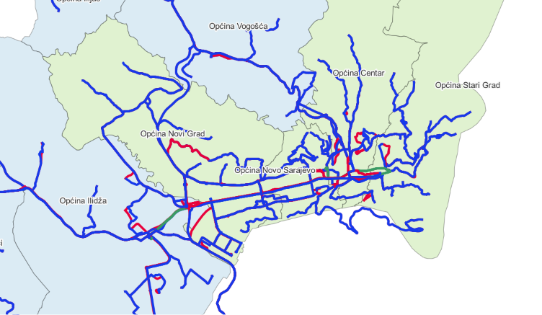

THE SARAJEVO CONTEXT
Sarajevo Canton
City of Sarajevo
Administrative: Sarajevo Canton (9 municipalities); City of Sarajevo (4 municipalities).
Longitudinal City: Physical form strongly influences transport development.
Tradition: Long history of tram systems as a key mobility element.

Slide 5
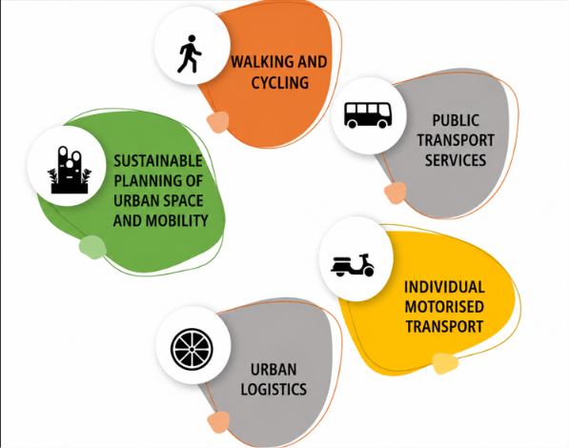


SARAJEVO’S EXISTING SUMP: KEY MOBILITY PILLARS
Strategic Basis
Planning Culture
Framework for interventions beyond infrastructure, focusing on accessibility and safety
Evidence-based thinking and institutional coordination in and across administrative borders

Slide 6





PHASE I: STRENGTHENING THE BACKBONE
~€300 Million
TOTAL INVESTMENT IN PUBLIC TRANSPORT
Fleet Renewal
Infrastructure
35 new trams, 35 trolleybuses, and new bus fleet
10km track reconstruction and 6.5km extension
Trolleybus Network
Smart Systems
8.5km new trolleybus contact network restored
Integrated ticketing and adaptive traffic control

Slide 7
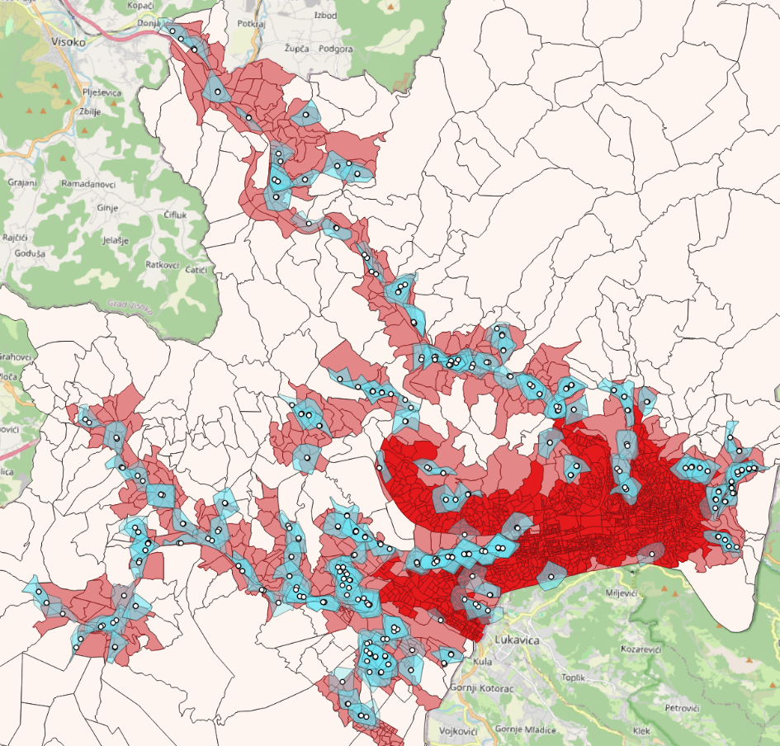
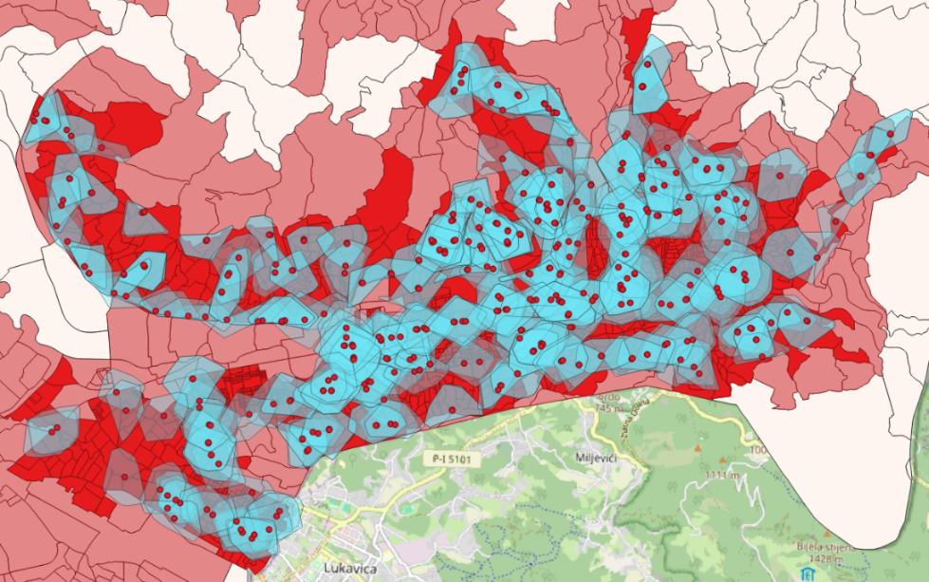
PUBLIC TRANSPORT COVERAGE ANALYSIS
Cluster | Rural | Suburban | Urban
Total area (km²) | 1132.01 | 101.43 | 35.82
Total population | 28,713 | 117,476 | 267,404
Service area of all PT stops (km²) | 62.22 | 45.15 | 28.53
Coverage by area (%) | 5.50 | 44.51 | 79.65

Slide 8



PHASE II: INTEGRATION & USER FOCUS
Infrastructure
Active Mobility
Digitalization
Tram extension to Sarajevo Airport
Cycling and pedestrian infrastructure
Mobility as a Service (MaaS)
Real-time info & integrated payments
Park & Ride solutions
First-mile and last-mile solutions

Slide 9




RESEARCH-BASED APPROACH
Policies must be based on evidence and close to final users
Evidence
Collaboration
Key Focus
Professional studies
International orgs
User satisfaction
Data-driven analysis
Domestic universities
Digitalization & Data
Evidence-based planning
Local experts
Traffic management

Slide 10





NEW POLICIES: SUMP & CLIMATE CITY CONTRACT
New SUMP
Climate city Contract
Shift: From reconstruction to integrated systems
Greening: Electric buses, EV taxis and EV public institutions fleets, urban logistic decarbonization
Focus: Accessibility and low-emission mobility
Active: Cycling infrastructure and shared micromobility
Goal: User-oriented mobility system
Smart: Low-emission zones, P&R systems and smart traffic menagement

Slide 11




INTERNATIONAL COOPERATION
Testing
Exchange
Piloting new mobility solutions through international projects
Aligning with European best practices and knowledge sharing
Synergy
Partnership
Common pilot projects and harmonized regional approaches
Cooperation between cities, universities, and private sector

Slide 12




CONCLUSION: A HOLISTIC VISION
Strong Backbone
Strategic Logic
Integration
Public transport as the core of sustainable mobility
Evidence-based planning and clear frameworks
Combining physical and digital solutions
Thank You!

