Slide 1
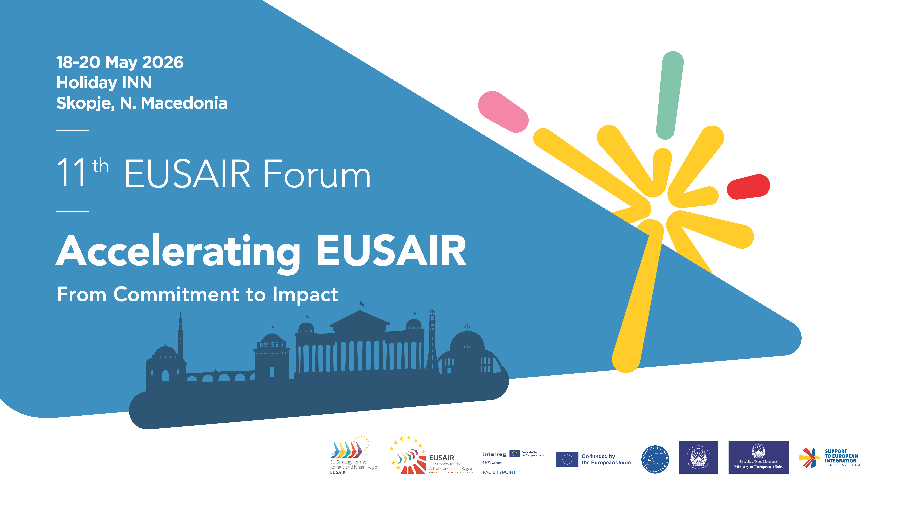

Slide 2

Table of Contents
Table of Contents
Development of the Initiatives
EYC Initiatives
Sustainable and Off-Season Tourism
Interconnected and Accessible Regional Tourism
Final Conclusion & Discussion

Slide 3
EUSAIR Youth Council Initiatives & Regional Priorities
How the Initiatives Were Developed
The initiatives were developed collaboratively by the EUSAIR Youth Council through internal meetings, thematic discussions, and coordination across all EUSAIR pillars.
Process
EYC members proposed initiative ideas connected to regional challenges Discussions were held within Pillar groups and working groups Initiatives were refined through feedback and coordination with Pillar Coordinators and EUSAIR stakeholders. Final priorities were selected collectively through internal consultation and agreement within the Youth Council

Slide 4

Initiative 1 - Reclaiming the Right to the City
This initiative addresses housing as a key issue affecting youth participation, inclusion, and employability in the Adriatic–Ionian region. Young people will work directly with municipalities, organizations, and universities to develop recommendations for more inclusive and sustainable urban development.
What is the initiative?
A youth-led project focused on housing challenges in cities across the Adriatic–Ionian region. The initiative gives young people a chance to discuss housing problems, map local issues, and cooperate directly with municipalities and organizations.

Slide 5
Initiative 1 - Reclaiming the Right to the City
Main Activities
Youth workshops and dialogue sessions, Participatory mapping of housing and urban issues, Cooperation with municipalities and universities Youth-led recommendations linked to Pillar 5
Current Progress
Planned for Greece in Oct–Nov 2026 Cooperation planned with activists, municipalities, and universities Focus on connecting organizations across the EUSAIR region Expected connection with Pillar 5
Why it matters
Housing affects youth employment, education, mobility, and participation in society.
Budget & Timeline €10,000–15,000 | 4-month pilot phase

Slide 6
Initiative 2- EYC Youth Mentorship Network: From Skills to Careers
What is the initiative?
This initiative responds to growing youth uncertainty in the Adriatic–Ionian region, including emigration, labour market mismatches, and limited career guidance. Through online mentoring groups, young people will receive practical support, professional guidance, and networking opportunities from experienced mentors across the region.
How it works
A regional mentorship program connecting young people with experienced professionals from different sectors across the Adriatic–Ionian region. Young participants apply through an online platform. Participants are grouped by interests and career goals. Mentors lead online sessions and discussions. Topics include careers, CVs, financial skills, and workplace guidance

Slide 7
Initiative 2- EYC Youth Mentorship Network: From Skills to Careers
Current Progress
Initiative currently identifying mentors Meeting already held with Pillar 5 Support expressed for future EU funding applications after the pilot cycle Open for additional participants and mentors
Main Goal
Help young people build confidence, practical skills, and professional connections while strengthening opportunities within the Adriatic–Ionian region.
Budget & Timeline Up to €5,000 | 8-month pilot cycle

Slide 8
Initiative 3 - San Marino Hackathon
What is the initiative?
The San Marino Hackathon is a 24–48 hour international event hosted in the historic centre of San Marino. University students from across the 10 EUSAIR countries will work in mixed teams to solve transport, smart logistics, and last-mile mobility challenges through simulation tools and Serious Games, turning San Marino into a temporary Living Lab for innovation.
How it works
Students form international teams, teams will compete during a 24/48-hour event Participants solve real transport and smart mobility challenges Experts from EUSAIR Pillar 2 and the transport sector provide mentoring

Slide 9
Initiative 3 - San Marino Hackathon
Current Progress
Initial work already completed by Francesco Moroni Initiative currently in coordination and organisational phase Cooperation ongoing with Pillar 2 transport stakeholders Event planned for next year, currently in preparation stage
Main Goal
Encourage innovation, regional cooperation, and practical problem-solving among youth.
Budget & Timeline €15,000–30,000 | Main event planned for March 2027

Slide 10
Initiative 4 - EUSAIR Thematic Briefings
What is the initiative?
The initiative introduces short structured dialogues between Youth Council members, Pillar Coordinators, and experts. The goal is to improve youth understanding of EUSAIR priorities and strengthen the quality and continuity of youth contributions within governance structures. A system of short online briefings between EUSAIR Youth Council members, Pillar Coordinators, and experts. The sessions help youth representatives better understand EUSAIR topics and participate more effectively in regional discussions.

Slide 11
Initiative 4 - EUSAIR Thematic Briefings
How it works
60–90 minute online meetings. Focused on current EUSAIR topics and projects Led by experts and Pillar representatives. Follow-up summaries created for future EYC members
Current Progress
Draft proposal shared with Pillar Coordinators. Internal coordination meetings planned for June Briefings expected in October and November

Slide 12
Sustainable and Off-Season Tourism
The Adriatic-Ionian region is one of Europe’s most tourism-dependent areas. Through European Union Strategy for the Adriatic and Ionian Region (EUSAIR), countries cooperate to make tourism:
More sustainable
Less seasonal
Better for local communities
Environmentally safer

Slide 13
Tourism in the Adriatic-Ionian Region
Millions of tourists visit every year
Major source of GDP and jobs
Important for coastal cities and islands
Supports transport, hotels, restaurants, and local businesses
Main Problem Tourism is heavily concentrated in:
Summer months
Coastal destinations
Historic cities
This creates overcrowding and economic instability during the off-season.

Slide 14
Season | Estimated Share of Annual Tourist Activity | Notes
Summer (Jun–Sep) | 65–75% | Peak beach and coastal tourism season; July–August dominate
Spring (Mar–May) | 10–15% | Growing cultural, eco, and city-break tourism
Autumn (Oct–Nov) | 10–15% | Shoulder season, especially strong in southern Greece and Italy
Winter (Dec–Feb) | 5–10% | Limited mostly to cities, business travel, ski tourism, and local events
Source: UNWTO (2023) World Tourism Barometer

Slide 15
Effects of Overtourism
Environmental Impact
Coastal pollution
Marine ecosystem damage
Waste increase
Water shortages
Social Impact
Traffic congestion
Rising housing prices
Pressure on local communities
Seasonal employment only

Slide 16
Off-Season Tourism Solutions
Off-Season Tourism Activities
Cultural festivals
Gastronomy tourism
Wellness tourism
Cycling & hiking tourism
Rural tourism
Wine tourism
EUSAIR Goal
Create a tourism sector that is:
More digital
More sustainable
More resilient to climate change

Slide 17
Interconnected & Accessible Regional Tourism
A Shared Adriatic-Ionian Tourism Model
Instead of competing individually, EUSAIR countries can cooperate to create a connected regional tourism network similar to the Nordic and Scandinavian tourism model.
The goal is to make the Adriatic-Ionian region feel like:
One Connected Tourism Destination
This would allow tourists to move easily between countries while experiencing different cultures, coastlines, and attractions within a single trip.

Slide 18
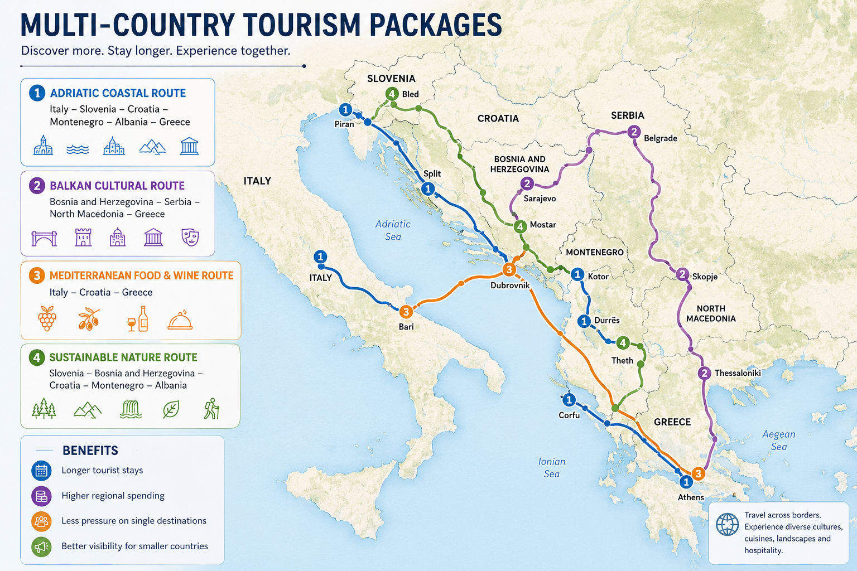
Example Packages

Slide 19
Improving Accessibility & Connectivity
Better Regional Connectivity - Tourism integration depends on easier movement between countries.
Key Priorities
Faster rail connections
Expanded ferry networks
Unified tourism apps
Better regional flight connections
Integrated public transportation systems
Digital Connectivity
A shared EUSAIR tourism platform could include:
One booking system
Regional transport information
Multi-country tourism passes
Sustainable travel recommendations
Goal Make regional travel: Simpler Faster More affordable More sustainable

Slide 20
Sustainable Regional Tourism Vision
A Long-Term Adriatic-Ionian Vision
The Adriatic-Ionian region has the potential to become:
Europe’s Leading Sustainable Multi-Destination Tourism Region
By connecting tourism sectors, countries can:
✔ Reduce seasonal dependence
✔ Share tourism revenue more evenly
✔ Improve transport and accessibility
✔ Promote sustainable travel
✔ Strengthen regional identity
Final Message The future of tourism in the Adriatic-Ionian region is not isolated national tourism models, but a connected, accessible, and sustainable regional tourism system.

