Slide 1

Some Remarks based on GSE experience
Alberto Biancardi

Slide 2

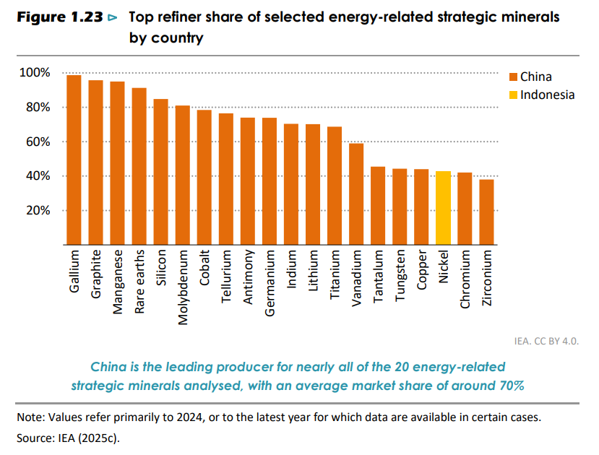
Energy Security
Reliance on Raw materials:
Oil and gas…
… but
(World Energy Outlook 2025)

Slide 3
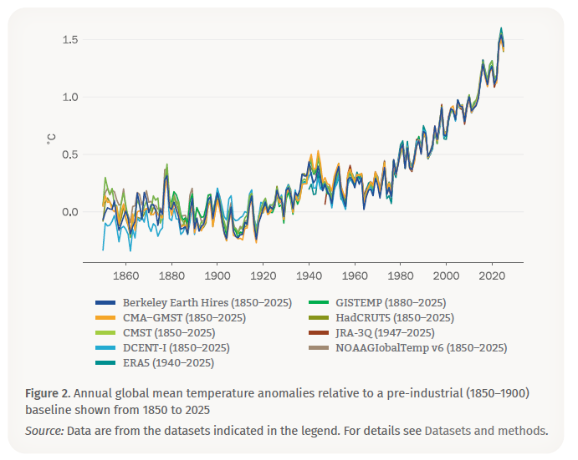
Climate Change
The annually averaged global mean near-surface temperature in 2025 was 1.43°C ± 0.13°C above the 1850-1900 average used to represent pre-industrial conditions
For global mean temperature, the past eleven years, 2015-2025, were the warmest years on record
World Meteorological Organization (State of the Global Climate – 2025

Slide 4
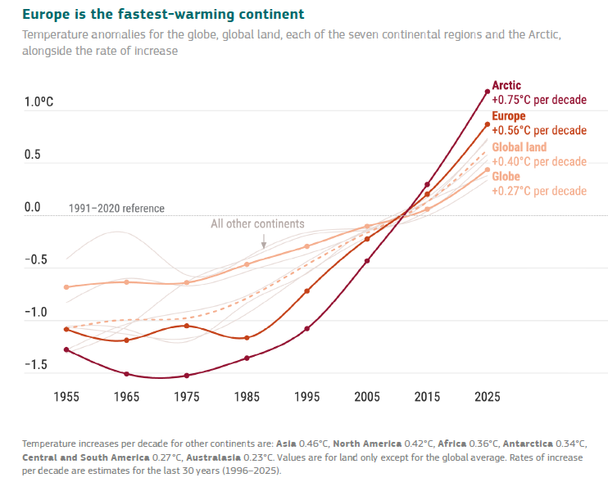
Climate Change in Europe
Europe has warmed by around 2.5°C compared
to pre-industrial levels
Europe is the fastest-warming continent, warming more
than twice as fast as the global average
Source: WMO – European State of the Climate – Report 2025

Slide 5
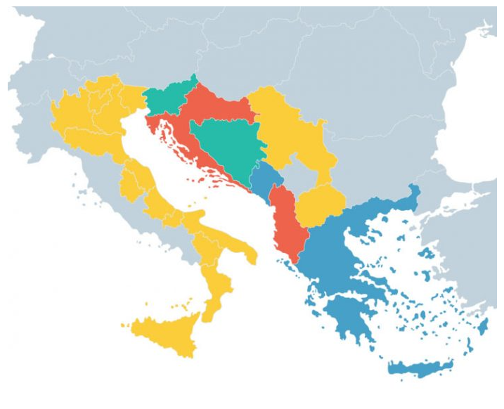
EUSAIR Region
Similar Problems
Common Opportunities:
Grid Connections
Market Coupling
Capacity building – Twinning projects
Investment outside EU - Guarantees of Origin
Integrated Solutions – Role of an Agency
GSE

Slide 6
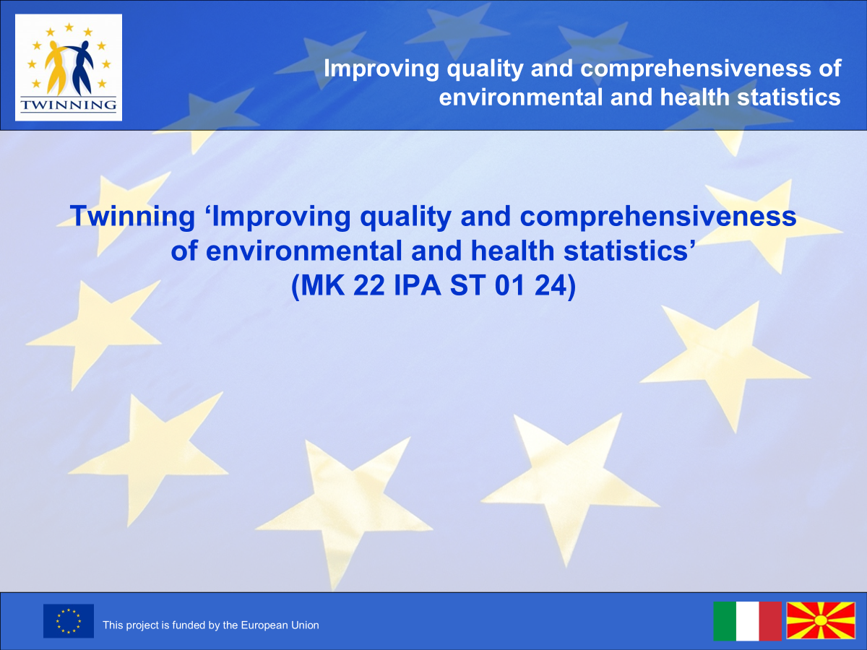
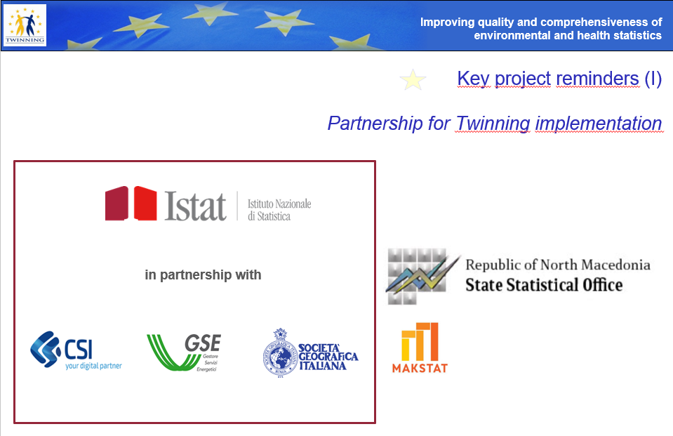
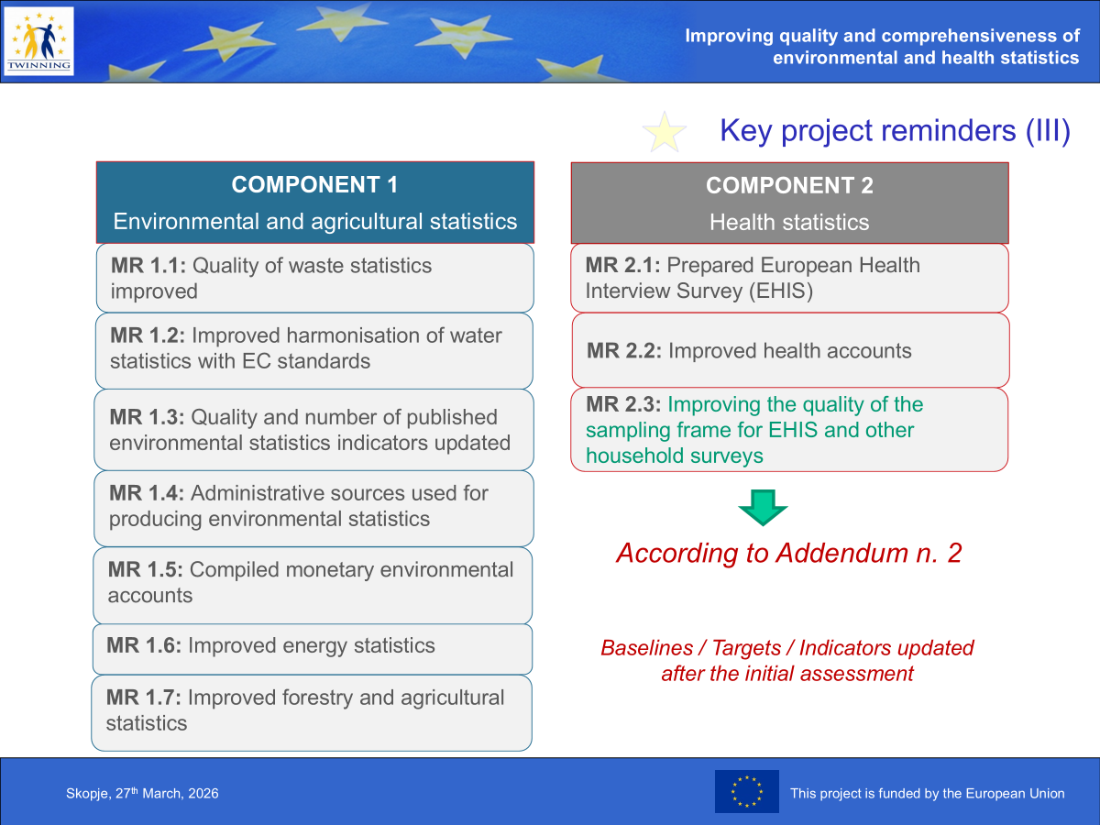
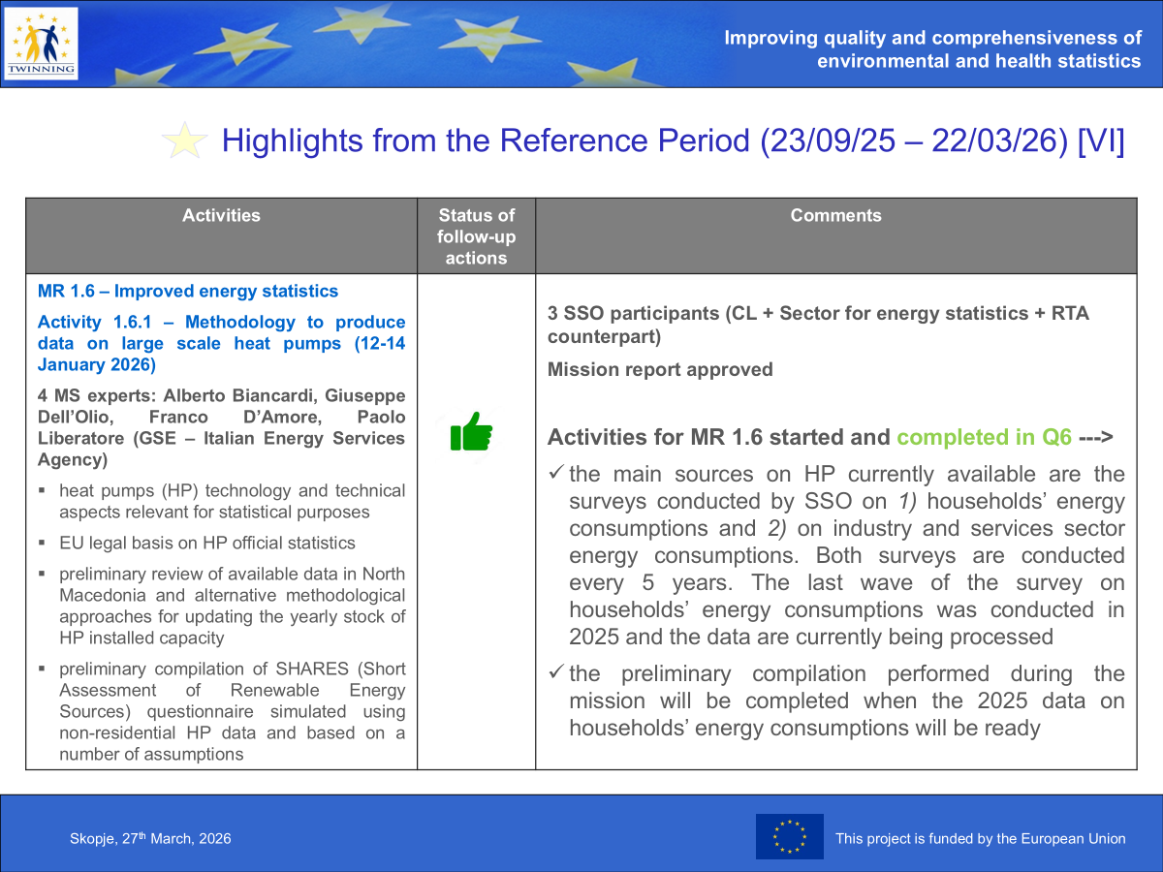
Twinning Projects

Slide 7
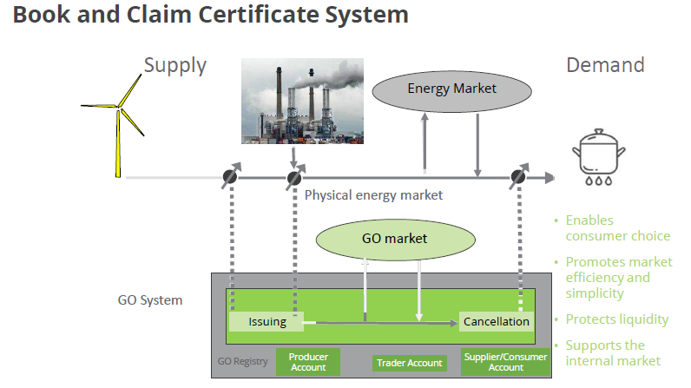
Guarantees of Origin
Transparent certification facilitates decarbonisation
A certificate with extraterritorial validity outside the EU would be an excellent tool for achieving targets agreed at EU level
GSE has been appointed by the Ministry of the Environment and Energy Security as the Competent Authority for issuance, transfer and cancellation of Guarantees of Origin in Italy
GSE is responsible for GO’s Auction System
GSE is the Competent Authority for Disclosure in Italy

Slide 8
The Role of an Agency
Standardized action
-
Homogeneity
Non-standardized action
-
Heterogeneity
Boiler replacement
Building insulation
Payment of the incentive
Auctions design and management
Supporting local authorities
DSM
Building deep renovation (…)
Action/project
Role of the Agency
(In addition to a, b, c)
Information dissemination
A more active role in the preparation of documents

Slide 9

THANK YOU FOR YOUR KIND ATTENTION!
alberto.biancardi@gse.it

