Slide 1
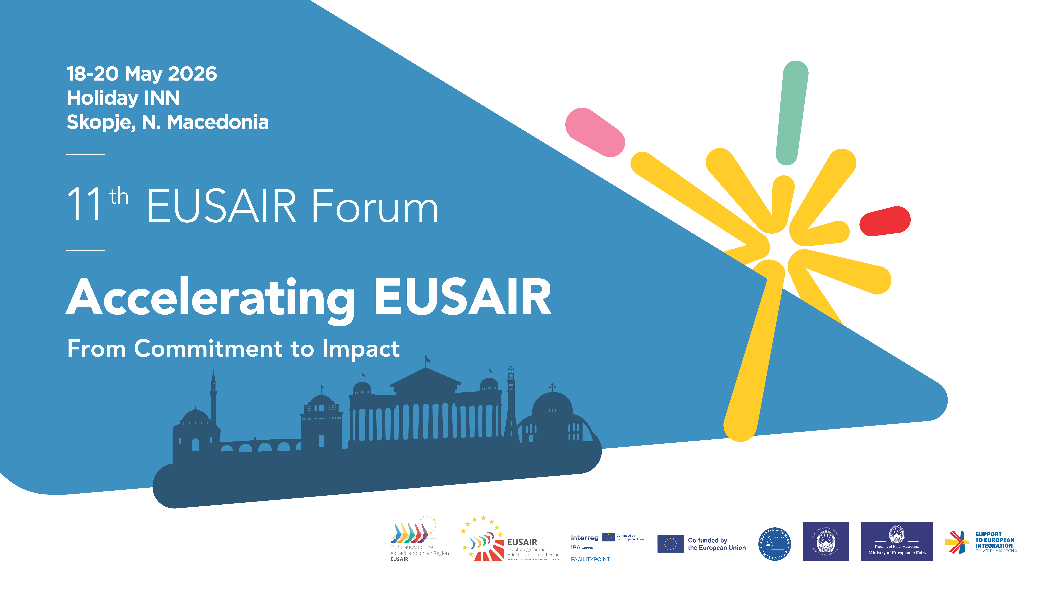

Slide 2

The perception of Mediterranean
in the EUSAIR communities
Mediterranean Diet and Sustainable Tourism
- Cross-pillar flagship
- Publication
Pillar 4 thematic session
From Vision to Action: Advancing Sustainable Tourism in the EUSAIR Region
Mr. Fotis Vlachos, Pillar 4-member, Hellenic Ministry of Culture -
in cooperation with Mr. Dimitris Bloukos, Greek coordinator in Pillar IV, Hellenic Ministry of Tourism
Skopje, North Macedonia
20 May 2026

Slide 3

The perception of Mediterranean in the EUSAIR communities
Context
I. European Commission adopts Revised Action Plan for EISAIR in Pillar 4:
Sustainable Tourism - revision of Priorities
II. Embedding and implementing EUSAIR Revised Action Plan: Priorities with Three Topics and relevant Actions:
III. Cross-pillar flagship
IV. Publication
V. Cultural Tourism as a Priority
Notes:
Action 3: Promoting the Mediterranean Diet and Local, organic and origin production

Slide 4
I. European Commission Adopts Revised Action Plan for the (EUSAIR)
The revised Action Plan introduces a strategic fifth pillar—Improved Social Cohesion
Adding to 4 pillars: Blue Sustainable Economy, Connecting the Region (Transport and Energy), Environmental Quality, and Sustainable Tourism), aimed at addressing socio-economic disparities, boosting youth engagement, and enhancing social inclusion across the region.
Additionally, the Strategy now integrates three horizontal priorities—Enlargement, Capacity Building, and Research, Innovation and Development—alongside three cross-cutting themes: Circular Economy, Green Rural Development, and Digitalization.
A New Era for EUSAIR
The adoption of the revised Action Plan sets the stage for a more resilient and interconnected Adriatic-Ionian region. It represents not merely an update but a strategic evolution, aimed at addressing contemporary challenges with stronger unity and enhanced cooperation. As EUSAIR enters this new phase, the European Commission, together with participating countries, is committed to driving socio-economic progress, environmental sustainability, and deeper EU integration.
With this new framework, EUSAIR is poised to become a model of effective macro-regional cooperation, ensuring long-term prosperity and stability for the Adriatic-Ionian region.
Source: https://www.adriatic-ionian.eu/european-commission-adopts-revised-action-plan-for-the-eu-strategy-for-the-adriatic-and-ionian-region-eusair/

Slide 5
II. Embedding and implementing EUSAIR
Revised Action Plan
Revised Action Plan in Pillar 4: Sustainable Tourism
1.1 Topic – Facilitating the digital and green transition of the tourism and Cultural heritage offer
1.2 Topic – Preparing for the future: knowledge, skills and management
1.3 Topic - Greening of Tourism products and services (new topic)
New Actions:
Action 1: Promoting Agritourism, Ecotourism and fishing tourism;
Action 2: Promoting Rural Tourism,
Action 3: Promoting the Mediterranean Diet and Local, organic and origin production, • By setting an cross-pillar Working Group of interested stakeholders on TSGs: 4, 1 and 5.
Topic 3 - Action 3: Promoting the Mediterranean Diet - Consensus on TSG4 member for the importance of Mediterranean Diet in EUSAIR.
Implementation of Action 3:
- New flagship project as a model for future initiatives
- Working Group on Inter pillar flagship Mediterranean Diet and Sustainable Tourism
- Publication (MD Study)

Slide 6
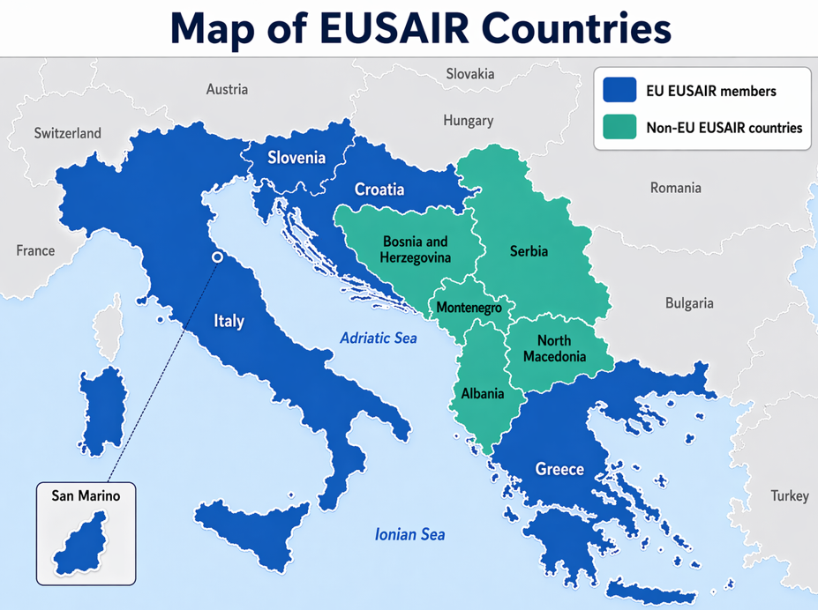
III. Cross-pillar flagship
Mediterranean Diet and Sustainable Tourism
Pillar 1, 4 and 5
MD Initiatives in EUSAIR – Milestones:
EC adopts EUSAIR Revised Action Plan; Pillar 4 new Action: Promoting Mediterranean Diet and local, organic and origin production
TSG4 members proposed thematic session for 10th EUSAIR Annual Forum in Crete, on 7th May 2025; successful organisation and realisation
WORKSHOPS CONTRIBUTING to EUSAIR Partnership and Flagship Project on the Mediterranean Diet, Bari, Italy 29-30 September 2025 – cross-pillar approach methodology: EUSAIR Pillars I, IV and V.
Establised Working Group: 2 online meetings (1 December 2025, 12 February 2026), 3rd meeting announced for 11 June 2026
Notes:
Action 3: Promoting the Mediterranean Diet and Local, organic and origin production

Slide 7
Bari Workshop Sustainable and Innovative Food Systems:
The Mediterranean Diet as a Tool for Tourism and Local Development in EUSAIR Communities
Focus on leveraging the Mediterranean Diet, recognized by UNESCO and FAO, as a strategic tool to support sustainable tourism, rural development, youth engagement and food system innovation across the Adriatic-Ionian region.
Organized by the EUSAIR Presidency of North Macedonia, CIHEAM Bari, DG REGIO, and EGP in cooperation of DG AGRI and DG GROW/DG MOVE this two-day workshop gathered key regional, national and EU-level stakeholders.
Workshop Topics & Outcomes on Guiding Questions for shaping the EUSAIR InterPillar Partnership and the flagship proposal via the Working Groups on Mediterranean Diet

Slide 8
Bari Workshop Conclusions
Workshops 1, 2 and 3
Developing of tourism services and products: thematic trails and routes based on authentic offer, online and onsite offer of products
Destination management to take other consideration an include Mediterranean Diet and Mediterranean lifestyle as a main ecotourism product.
Young people not interested in agriculture and living in rural area – promotion and reshaping the perception of what it is to work in rural area
Lack of practical skills for starting agricultural production and lack of soft skills including entrepreneurial skills
Using StEP platform for sharing of educational/training materials on MD on the level of the region

Slide 9
Working Group on cross pillar flagshop Mediterranean Diet and Sustainable Tourism
1st online meeting 1 December 2025
Working Group members were presented draft of RoP, conclusions from Bari workshop from three Pillars, the broader view on cross-pillar flagship from European Commission
WG meetings activities in two years, 2025-2027: one meeting in person, online meeting every 4 months
2nd online meeting 12 February 2026
Forum AIC expressed interest in hosting meeting in person during EUSAIR Italian Presidency
WG agreed on working on promotion of flagship, on contacting colleagues from Interreg Euro MED programme to build on existing activities and projects, to promote synergies and cross-pillar cooperation
WG agreed on reflect on planned activities proposed in draft Roadmap document
3rd online meeting 11 June 2026
Notes:
Some conclusions

Slide 10
IV. Publication (Study)
Tasting Sustainability: Mediterranean Diet as a Cultural and
Tourism Asset in the EUSAIR Food,Identity and Sustainability
Leveraging the Mediterranean Diet in Adriatic-Ionian Agritourims
Public procurement made by Croatian Ministry of Tourism and Sport
Funded by Interreg IPA ADRION program
Project activity of EUSAIR FACILITYPOINT project
Done by Notitia d.o.o. from Zagreb, Croatia
May 2026 - 1st version of publication

Slide 11
Purpose and approach of the thematic study
Present the Mediterranean Diet not only as a model of diet, but also as a cultural and social practice that embodies the values of sustainability, local community, intergenerational knowledge, and social connectedness.
The approach was multidisciplinary - it connects the fields of sustainable tourism, cultural heritage, gastronomy, agriculture, and regional development
Methodology: policy analysis, comparative analysis, mapping of initiatives and case studies of best practices, formulating recommendations for the development of sustainable gastronomic tourism in the EUSAIR regions

Slide 12
Structure of the study
- Executive summary
- Introduction and contextual framework: The Mediterranean Diet - A UNESCO intangible cultural heritage
- The Mediterranean Diet as a resource for sustainable tourism
- Good practices, synergies, and cooperation models
- Conclusions and policy recommendations

Slide 13

Policy and strategic foundations
Global and EUSAIR
Key international institutions
- Global framework: SDGs, UN Agenda 2030, WTO, Open Planet Global Nutritiion Strategy
- Strategic relevance and alignment with the EUSAIR strategic framework:
EUSAIR Strategy -TSG4 - EUSAIR Action plan 2025 - MD Flagship
EU Institutions
  EU Framework: European Green Deal, EU Strategy for Sustainable Tourism
  Transition Pathway for Tourism, The European Agenda for Tourism 2030
  European Framework for Action on Cultural Heritage....)
National
EUSAIR countries:
  All EUSAIR countries embedded the Mediterranean Diet and sustainable tourism
  into its national development goals
  Horizontal cooperation framework

Slide 14
Policy and strategic foundations – horizontal cooperation framework
Interreg IPA ADRION Programme
European Territorial Cooperation Programme - Interreg Euro-MED programme
Euro-MED Heritage Program
Creative Europe Programme
Digital Europe Programme
European Heritage Label
NextGenerationEU

Slide 15
The Mediterranean Diet as a resource for sustainable tourism
The Mediterranean Diet in the function of tourism – key areas of analysis
  Strategic tool for sustainable, place-based tourism in EUSAIR
  Links culture, food practices, biodiversity, agriculture, hospitality and tourism
  Supports the shift from mass coastal tourism to community-based experiences
  Enables year-round, inland, island and rural tourism
Organic agriculture in EUSAIR countries - innovative and sustainable food chains as drivers of sustainable tourism – key areas of analysis
Organic agriculture in EUSAIR countries – a comparative analysis
  Integration of agrifood systems into tourism value chains
  Role of innovation, circular economy, and sustainable food systems
  Potential of the Mediterranean Diet as a foundation for sustainable tourism products – key areas of analysis
  Integration of food heritage into tourism offers and destination development strategies
  Role of SMEs, local communities, and territorial development

Slide 16
Good practice examples in EUSAIR countries –
a comparative analysis (methodology)
CRITERIA CATEGORY | CRITERIUM | SELECTION METHODOLOGY
Pillar A: Strategic, Governance & Cooperation | Alignment with the EUSAIR Strategy | Initiatives and projects funded under EUSAIR or through European Union programmes that support the implementation of the EUSAIR Strategy.
 | Cross-Sector Cooperation (Tourism, Agriculture, Culture) | The level of integration and partnership among different sectors involved in the development of the initiative.
 | Potential for Interregional and Transnational Cooperation | The possibility of integrating the initiative into wider networks, thematic routes, or projects at the regional and international level.
 | Transferability of the Model to Other Regions (Replicability) | The flexibility to adapt and apply the model or approach in other regions or contexts within the EUSAIR area.
 | Knowledge Transfer and Capacity Building | The initiative’s contribution to stakeholder education, knowledge transfer, and capacity building in the field of sustainable food production and gastronomic tourism.
Pillar B: Sustainability, Green Transition & Inclusion | Sustainability and Environmental Protection | The initiative’s contribution to preserving natural resources, reducing negative environmental impacts, and promoting sustainable practices in tourism and food production.
 | Contribution to Sustainable Food Systems | The initiative’s connection with local food production, short supply chains, and the promotion of organic or sustainable agriculture.
 | Contribution to the Green Transition of Tourism | The initiative’s contribution to the development of sustainable tourism products, reducing the ecological footprint, and promoting responsible tourism.
 | Inclusiveness and Accessibility | The initiative’s contribution to ensuring access to gastronomic and tourism experiences for different social groups, including persons with disabilities, older people, and other vulnerable groups.
Pillar C: Heritage & Territorial Identity | Authenticity and Preservation of Cultural Heritage | The initiative’s contribution to safeguarding and promoting local gastronomic traditions, cultural practices, and community identity.
 | Valorisation of Local Products and Quality Labels | The level of promotion of local products, quality labels (e.g. Geographical Indication, Protected Designation of Origin (PDO), Protected Geographical Indication (PGI)), and the contribution to their integration into the tourism offer.
 | Contribution to Regional Identity and Destination Branding | The initiative’s contribution to strengthening destination recognition through the promotion of local products, traditions, and gastronomic identity.
 | Educational and Promotional Value | The initiative’s contribution to educating visitors and local communities about gastronomy, cultural heritage, and sustainable development.
Pillar D: Innovation & Local Economy | Innovation in the Tourism Product | The introduction of new approaches, models, or concepts linking gastronomy, culture, and tourism.
 | Economic Contribution to the Local Community | The initiative’s potential to generate income, create jobs, and stimulate local economic development.
 | Involvement of the Local Community | The level of participation of local stakeholders, including producers, entrepreneurs, civil society, and local institutions, in the development and implementation of the initiative.

Slide 17
Conclusions and policy recommendations
Key findings:
  - Core value: culture + sustainability + identity + health + local communities
  - EUSAIR opportunity: resilient, inclusive, authentic and sustainable tourism model
The Mediterranean Diet as a resource for sustainable tourism in EUSAIR – the SWOT analysis
Policy recommendations:
  - Governance, cooperation, and institutional support: macroregional coordination, cross-sector platforms, stronger institutional support
  - „Living heritage“ – community engagement; safeguard authenticity; strenghten local value chains; support SMEs, producers, short chains, GI/organic integration, rural entrepreneurship, education, interpretation, hospitality training, youth and women empowerment
  - Digital tools and smart tourism ecosystems: overarching digital platform - smart routes, traceability, storytelling, visitor management, data-based destination planning...

Slide 18
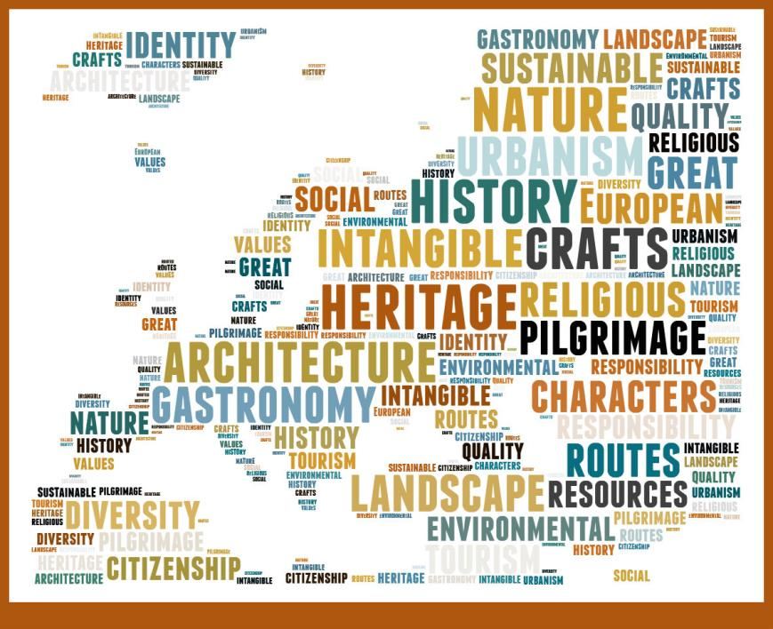
Cultural Tourism as a priority and policy tool in National level
The Hellenic Ministry of Culture and the cultural tourism
Strategy: Promotion of Cultural Routes Program
of the Council of Europe.
EUSAIR, Pillar IV – Sustainable Tourism
Cultural issues, member in TSG-4, Coordinated by the Hellenic Ministry of Tourism.
The Directorate of International Relations and European Union (Department of International Relations), constitutes the focal point in Greece for:
Cultural Routes Program of the Council of Europe.
Greece participates in the Governing Board of the Enlarged Partial Agreement since the EPA’s establishment (1.1.2011). Our country is:
a) keeping track of the transnational latest progress and changes of the Council’s cultural policies
b) promoting Greek proposals (ex: European Routes of Kazantzakis, The Elaia Route - Culture of olive oil)
c)promoting and supporting the participation of Greek entities in CRs passing Greece (ex: “Iter Vitis” - establieshed Greek Network).

Slide 19
Thank you!
Fotis Vlachos, Pillar 4-member
Hellenic Ministry of Culture, fvlachos@culture.gr
Coordinated by: Greek Coordinator in Pillar IV: Mr. Dimitris Bloukos, Hellenic Ministry of Tourism
In cooperation with, Pillar IV Coordinator: Mrs. Iva Čaleta Pleša - Croatia, Ministry of Tourism and Sports

