Slide 1
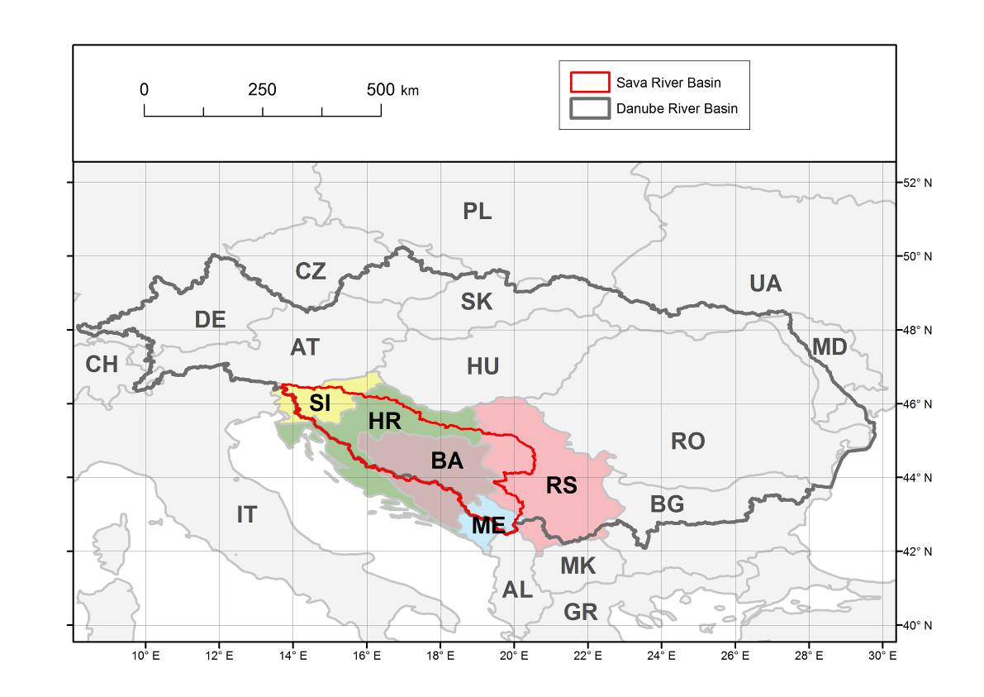
Framework for cooperation
Framework Agreement on the Sava River Basin (FASRB)
Main objectives – to establish:
  Sustainable water management
  Sustainable hazard management
  (floods, droughts, accidents, etc.)
  International regime of navigation
ISRBC (4 member countries + ME, MK-observer status)
Scope of work
Management plans (river basin, flood risk, sediment, CCA, contingency)
Integrated systems (information, forecasting, warning)
Economic activities (navigation, river tourism)
Policy (harmonization, guidelines, protocols to FASRB)

