Slide 1

Water basin management and planning in North Macedonia – implications for downstream conservation and planning measures for the SAIS EBSA
Ljupka Dimoska Zajkov,
Ministry of Environment and Physical Planning,
North Macedonia

Slide 2

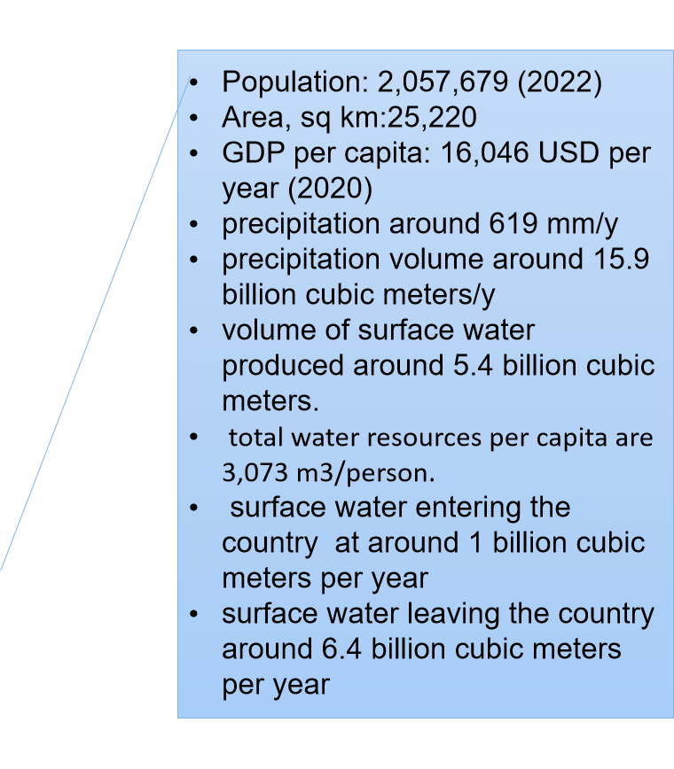
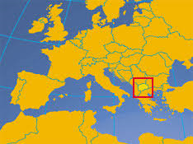
General figures related to
water resources
surface waters: 477 km2 (1,88 % of the
territory)
RNM about: 35 rivers, 53 natural and artificial
lakes and 1.100 larger sources of water
sufficient water resources but their distribution
is quite unequal
landlocked country

Slide 3
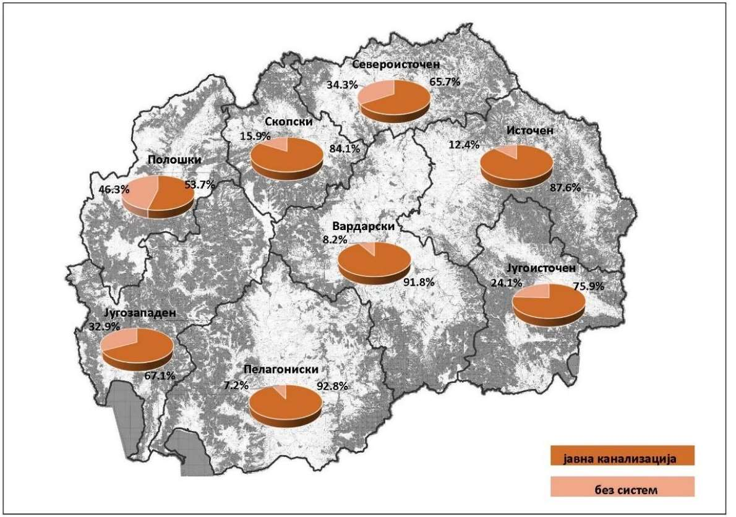
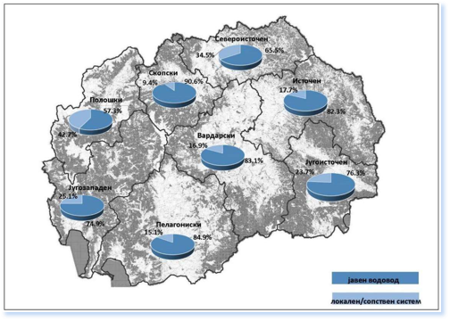

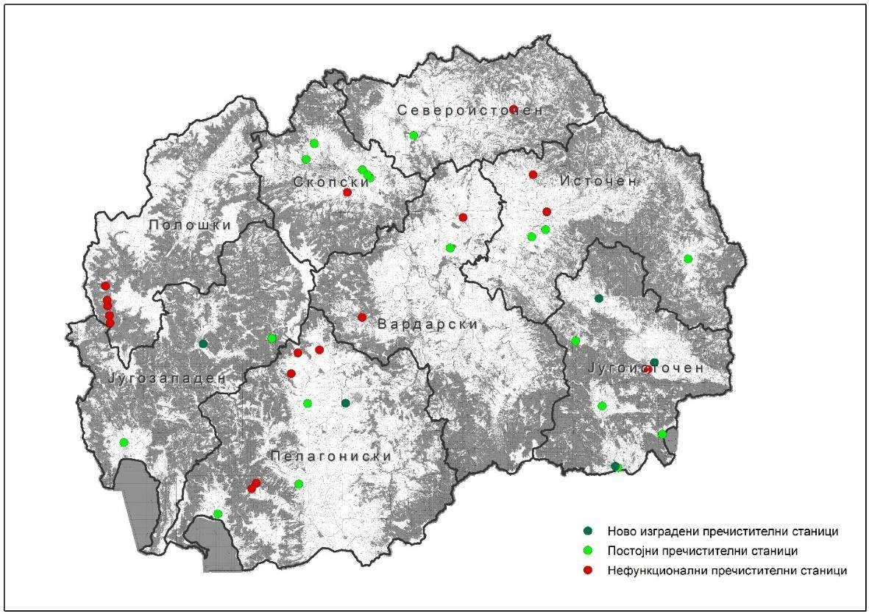


General figures - related water management
>97% Drinking Water Access
37 % Waste water Treatment
63 % Water Losses

Slide 4

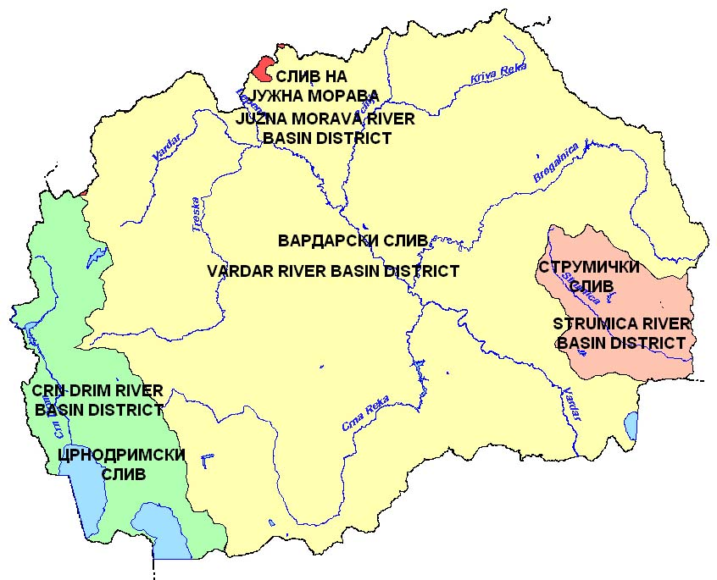
North Macedonia holds a strategically critical geographic position within regional transboundary river systems draining into sensitive marine regions.
Vardar/ Axios Basin
Drains over 80% of North Macedoma's territ a ry, discharge ng directly into the Thermaikos Gulf of the Aegean Sea.
Strumica Basin
Flows eastwards into Bulgaria/Greece, carrying potential transhoundary impacts into regio nal coastal seas.
Drin Basin / Lake Ohrid
Conected direct Iy to the Adriatic and Ionian region v la transbondary
lakes and river chains.
-Black Sea basin - (44 km² or 0.17 %) ;
- Adriatic Sea basin (3359 km² or 13.07 %)
-Aegean Sea basin (22310 km² or 86.76%)

Slide 5
National Governance
EU Alignment & Directives
Strategic harmonisation with European environmental laws forms the backbone of North Macedonia's resource protection strategy.
National water governance is explicitly aligned with the rigorous criteria of the EU Water Framework Directive (WFD).
Integrated Water Resources Management (IWRM) principles are progressively structured across planning bodies.
River Basin Management Plans (RBMPs) serve as our central tools to dictate planning and execution of mitigation measures.
Institutional Actor Network
Successful governance is achieved through structured roles across local, national, and international administrative tiers.
Ministry of Environment and Physical Planning holds central responsibility for policy formulation
Water Management Institutions provide critical technical implementation
Municipalities & Utilities execute urban water treatment and monitor local agricultural runoffs.
Transboundary Commissions synchronize plans with adjacent riparian nations.

Slide 6

From River Basin to Marine Ecosystems
Key inland pressures include nutrient pollution, wastewater discharge, hazardous substances, and hydromorphological alterations.
Downstream impacts include eutrophication, habitat degradation, biodiversity loss, and reduced ecosystem resilience.

Slide 7
Policy Integration
Stronger coordination is needed between the EU Water Framework Directive and the Marine Strategy Framework Directive.
River Basin Management Plans should be linked with marine conservation objectives and biodiversity strategies.
”Good ecological status upstream supports healthy marine ecosystems downstream.”

Slide 8

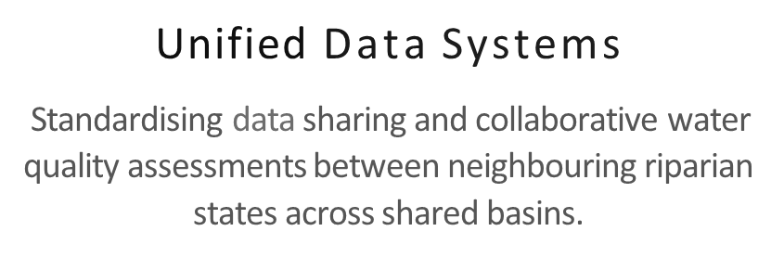

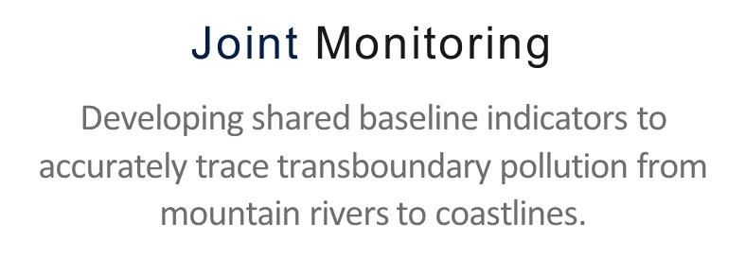

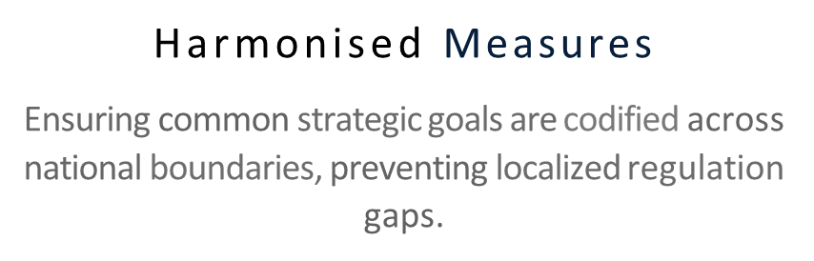
Regional Transboundary Cooperation
SHARED AQUATIC RESOURCES REQUIRE COORDINATE D RES P ONSES

Slide 9
Key Messages
River basin management and marine conservation are interconnected.
Inland pressures affect downstream marine biodiversity.
Integrated source-to-sea governance is essential for ecosystem resilience.
Coordinated action across sectors and borders is critical for protecting sensitive marine ecosystems such as the SAIS EBSA.

Slide 10

Thank You

