Slide 1
What is next for the Southern Adriatic Ionian Strait Ecologically or Biologically Significant Area (SAIS-EBSA)?
Peter Mackelworth, Marine Institute, Croatia

Slide 2
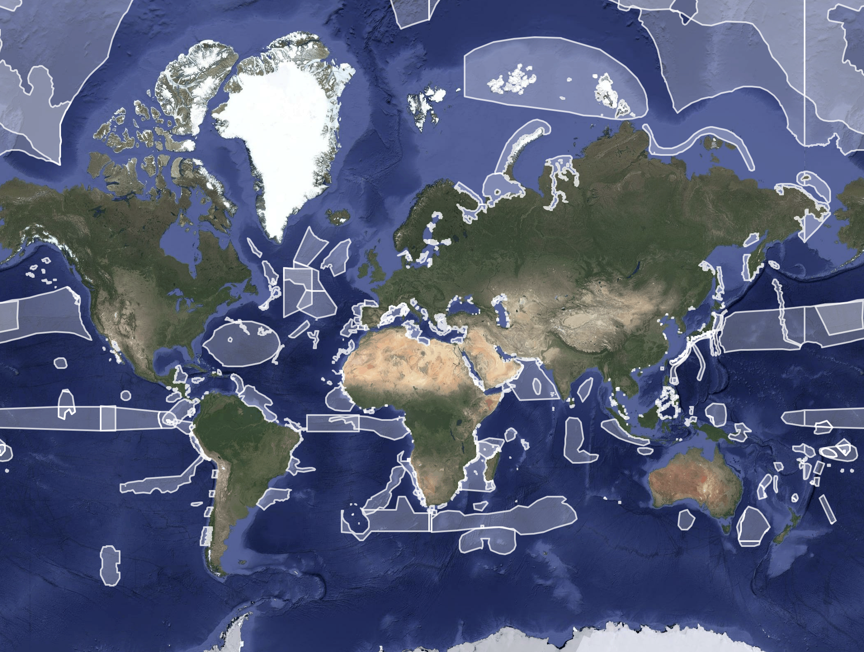
What is an Ecologically or Biologically Significant Area?
Initiated in 2008 under the Convention on Biological Diversity
Developed to identify marine areas of high ecological importance, particularly in the high seas
More than 330 EBSAs globally listed.
However, a major limitation is the lack of consistent global guidance on management, leaving implementation to individual states and regional bodies
Although not originally designed for marine spatial planning, they are increasingly recognized as tools for ecosystem-based management and balancing conservation with growing blue economy development.

Slide 3
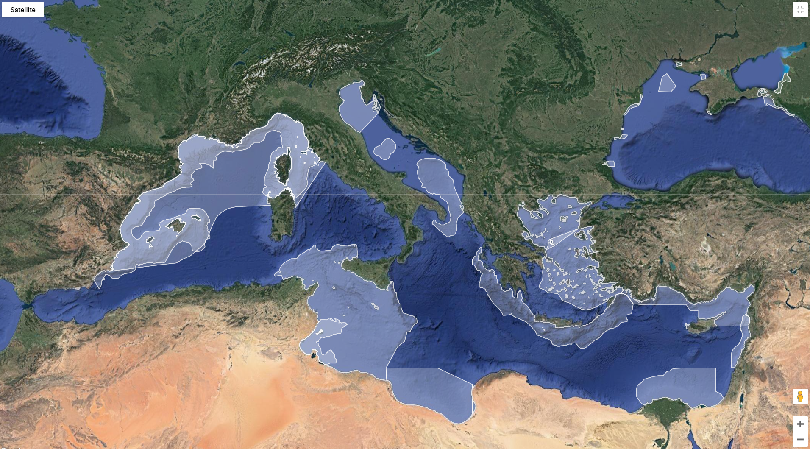
Mediterranean EBSAs
The Mediterranean Sea presents a complex geopolitical governance challenge for the EBSAs.
The first UNEP Regional Seas Programme, the Mediterranean Action Plan (UNEP/MAP), was established in 1975 and legally underpinned the adoption of the Convention for the Protection of the Marine Environment, and the Coastal Region of the Mediterranean (Barcelona Convention, 1976, amended 1995).
The Convention provides a multilateral legal framework for the protection of the Mediterranean Sea.

Slide 4
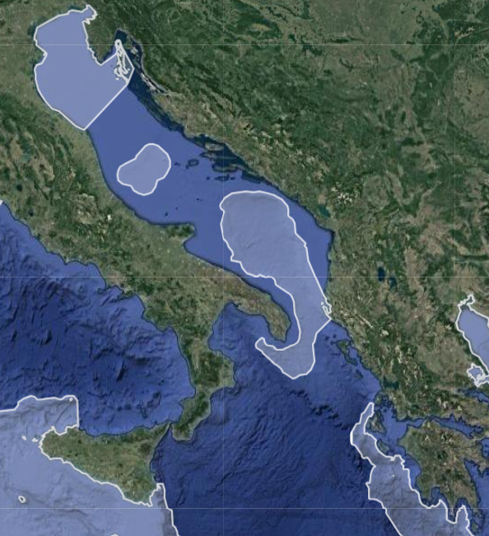
Adriatic-Ionian Region EBSAs
Three EBSAs are wholly within the AIR:
  Northern Adriatic
  Jabuka/Pomo Pit
  South Adriatic Ionian Straight
One partially within AIR:
  Hellenic Trench
One adjacent to the AIR:
  Sicilian Channel
Notes:
The EBSAs in the Mediterranean and Adriatic-Ionian region provide justification for the Contracting parties of the Barcelona Convention and the EUSAIR respectively to investigate the balance of conservation with integration of other industries of the region.

Slide 5
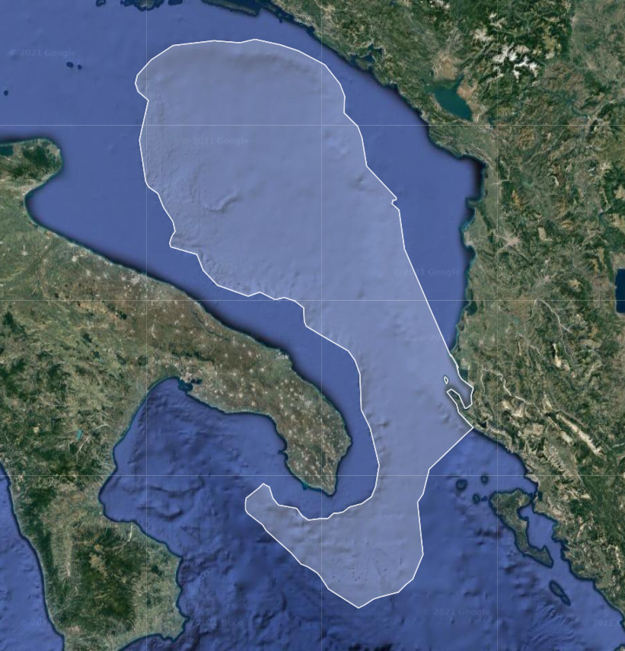
  South Adriatic Ionian Straight
depth ranging between 200 m to 1500 m where southern Adriatic deep water is locally formed.
this area encompasses the Bari Canyon, which facilitates the transport of sediments between the western Adriatic shelf and the southern basin
contains important habitats for species protected under the UNEP/MAP - SPA/BD Protocol of the Barcelona Convention and the Habitats Directive
includes deep-sea cold-water coral communities and deep-sea sponge aggregations representing important biodiversity reservoirs
In 2006, Santa Maria di Leuca area was designated under the General Fisheries Commission for the Mediterranean (GFCM) as a Fishery Restricted Area (FRA)

Slide 6
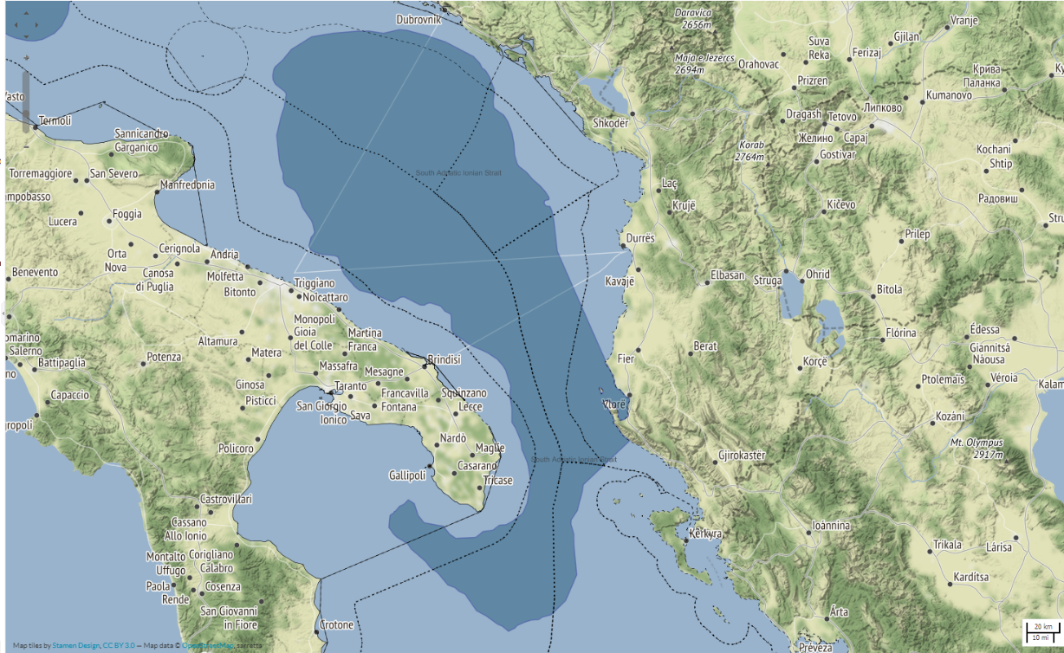
Jurisdictions
Jurisdictions associated with the SAIS-EBSA (Tools4MSP Geoportal).
Area in dark blue identifies the SAIS-EBSA area.
National boundaries, territorial seas and median line are all portrayed to show the various jurisdictions.

Slide 7
Identify a common starting point
There is global recognition that nature conservation is fundamental to key priorities like climate change resilience, food security and the green energy transition.
There remains a perception that the Blue Economy cannot exist alongside conservation, but systematic planning gives certainty to all sectors
The EBSAs provide an entry point for discussion about the development of a systematic conservation planning process within an MSP framework, as the Contracting parties of the Barcelona Convention have already agreed on the importance of these sites.
There is a need to identify key leading bodies and develop motivational hooks, including economic strategies, to ensure meaningful and equitable engagement.

Slide 8
Build on existing networks and address power dynamics
Build on the relationships between the regional authorities, their focal points, and work cross-sectoral and trans-Pillar
The national and sub-national authorities are important decision makers and their role will be critical throughout to ensure the legitimacy of this process.
Often the imbalance of power between partners is ignored to the detriment of the process.
  There are not only differences in State power dynamics, but also between sectors and stakeholders with implications for who gets access to which resources.
  Efforts must be made to balance the SAIS-EBSA initiative with existing governance mechanisms

Slide 9
We seek your help to move from a Commitment to Impact – this is the first effort to reach across sectors and Pillars
Thank you.
Peter Mackelworth, Marine Institute, Croatia

Slide 10
Questions
What are the key factors that has led to the successful engagement with countries and sectoral groups of the Sava River Basin Commission?
What opportunities are there for the tourism sector to engage with nature based solutions? What are the costs and potential benefits to the sector in the long-term?
How do we successfully make conservation strategies relevant to sectoral stakeholders? and What governance mechanism would you propose for the SAIS-EBSA?
How can the EU and the regional seas programme combine to provide guidance on developing governance strategies for the EBSAs of the Adriatic Ionian Region?

