Slide 1

NE Nomisma Energia and SEEC
The Master Plan on Energy Networks for the Adriatic and Ionian Region: Outlook and Proposals
Designing an Energy Green Deal for the Adriatic-Ionian Region to Confront the Challenges of Climate Change and Energy Security
8th EUSAIR ANNUAL FORUM
Sarajevo, 24th May, 2023

Slide 2
Agenda
How we built the three different scenarios
The main results achieved
How they are coherent with other scenarios
What are the main challenges opportunities
The projects on the grids
Conclusions

Slide 3
MASTER PLAN STRUCTURE
General Framework
Sec. 1 – Scope and structure
Sec. 2 – EU and international energy framework
Baseline 2019
Sec. 3 – Energy systems and context of EUSAIR states
Horizon 2030
Sec. 3 – Energy systems and context of EUSAIR states
Sec. 4 – Power system and networks
Sec. 6 – Natural gas supply and networks
Sec. 5 – Power system and networks planning
Sec. 7 – Natural gas system and networks planning
Sec. 8 – Clean fuels for transport
Horizon 2050
Sec. 9 – Carbon neutral EUSAIR
Sec. 10 – Options and means for carbon neutral energy systems
Studies for the Flagship projects
1. Power networks and market for EUSAIR
2. Integrated natural gas corridors and market for EUSAIR
3. Operation and logistics for direct LNG use
Completed
Exectutive summary

Slide 4
EUSAIR Master Plan and its links with other scenarios
In yellow the scenarios took as reference
 | NECPs | European Commission (PRIMES Scenario) | ENTSOs TYNDP 2022 Scenarios | IEA WEO scenarios
1 Current Policy Scenario (2030) | With existing measures (WEM) | EU Reference Scenario 2020 | National Trends | Stated Policies Scenario (STEPS)
2 New Policy Scenario (2030) | With additional measures (WAM) | Fit for 55 (MIX Scenario) |  | Sustainable Development Scenario (SDS)
3 Carbon Neutral Scenario (2050) | n.a. | EU climate-neutral vision¹ | Distributed Energy Global Ambition | Net Zero Emissions by 2050 Scenario (NZE)
¹ COM (2018) 773 - A Clean Planet for all - A European strategic long-term vision for a prosperous, modern, competitive and climate neutral economy

Slide 5
Reduction of final energy consumptions thanks mostly to efficiency
Important delays in the evolution of energy systems of each country

Slide 6
Natural gas replaced by RES

Slide 7
Natural gas replaced by RES
This is also a scenario to be considered, at qualitative level, in case decarbonisation policies are not fully successful.
In 2030 there is the need to check whether the gas structures are still requested.
Hydrogen economy is a solution

Slide 8
Strong electrification ahead

Slide 9
Fast rise of RES thanks to a long tradition and huge potentialities of the region

Slide 10
Coal power generation expected to fall
It is important to raise the question of who is going to pay for the stranded costs which may have negative impact on the economies

Slide 11
There is room for nuclear too, but marginal

Slide 12
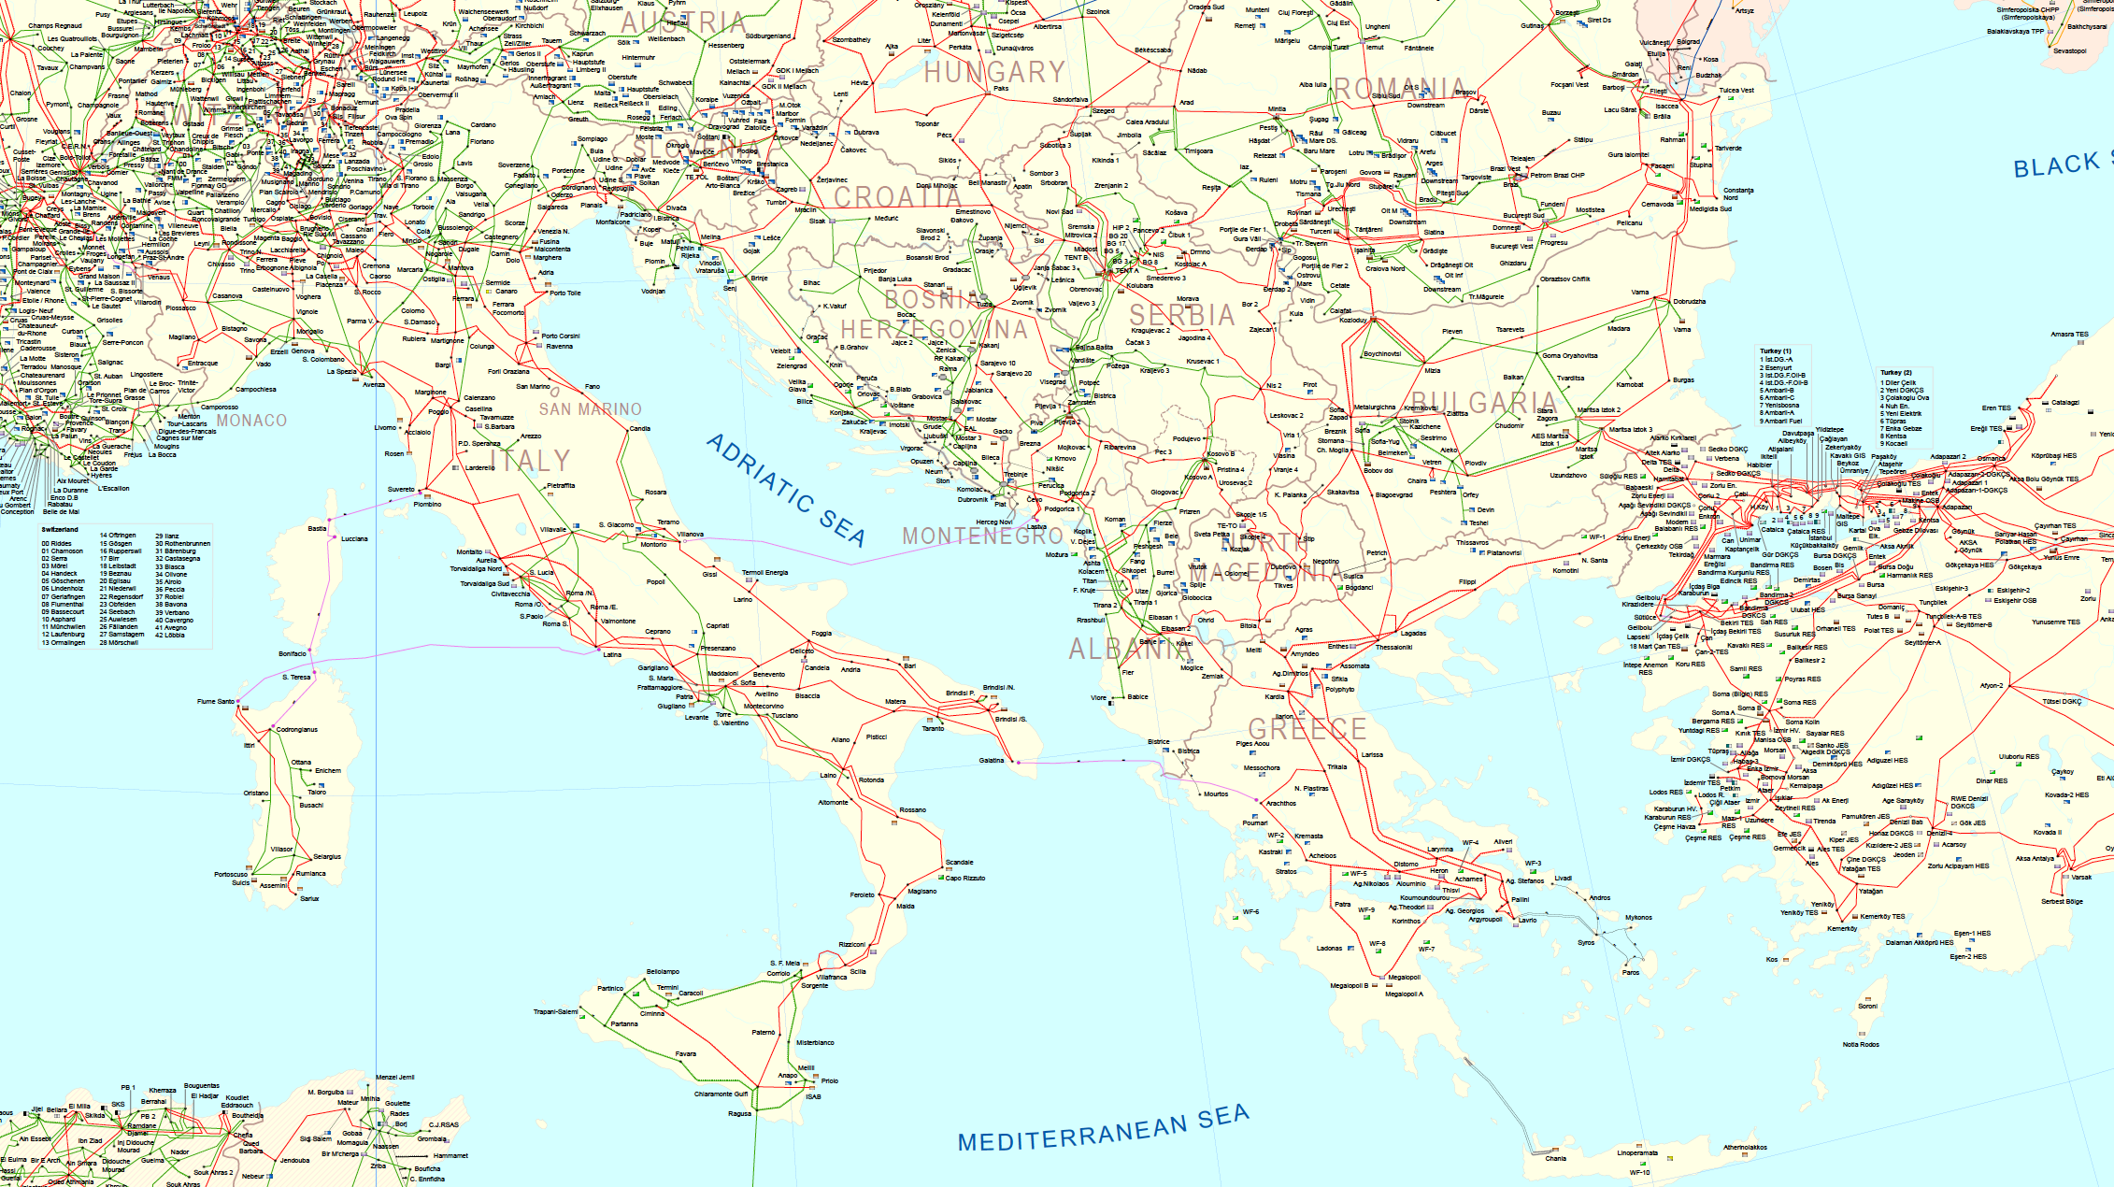
ENTSO-E EUSAIR ELECTRICITY NETWORKS

Slide 13
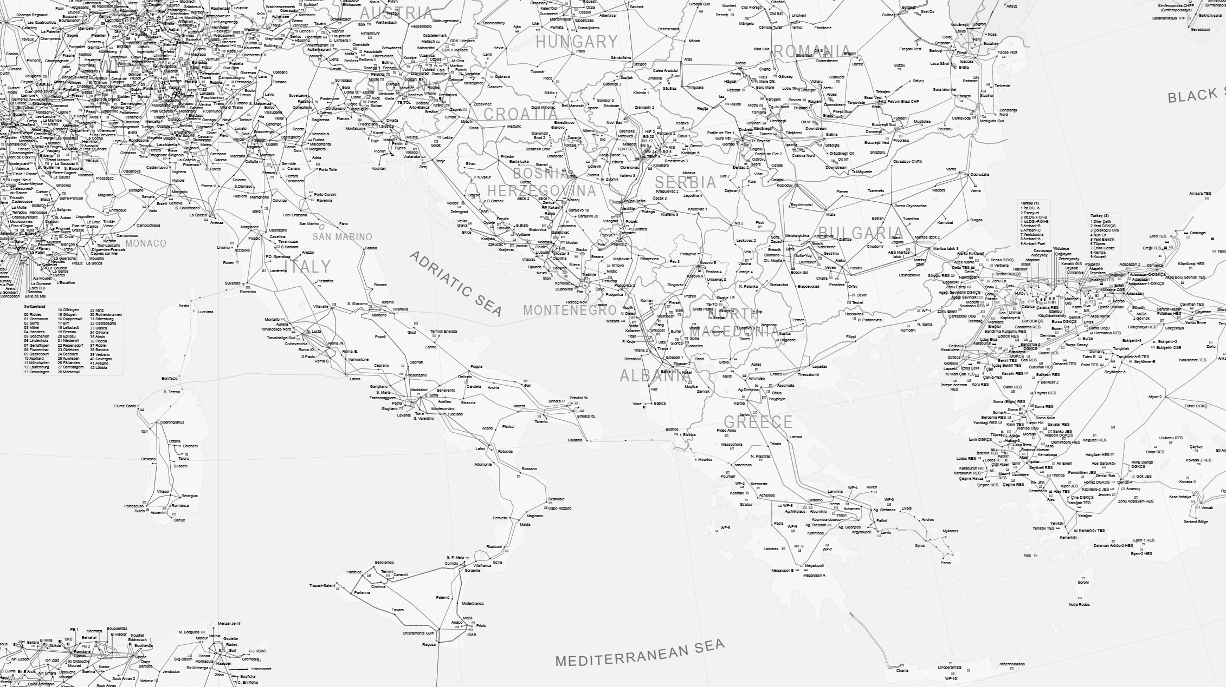
POWER GRIDS PROJECTS
1. Interconnection BA-HR
2. Trans-Balkan Electricity Corridor
1
1
2
3. Interconnection MK-AL
4. Interconnection IT-EL (GRITA 2)
6
5. Trans-Adriatic Power Interconnector
6. Adriatic Power Link
7. Monita
7
3
4

Slide 14
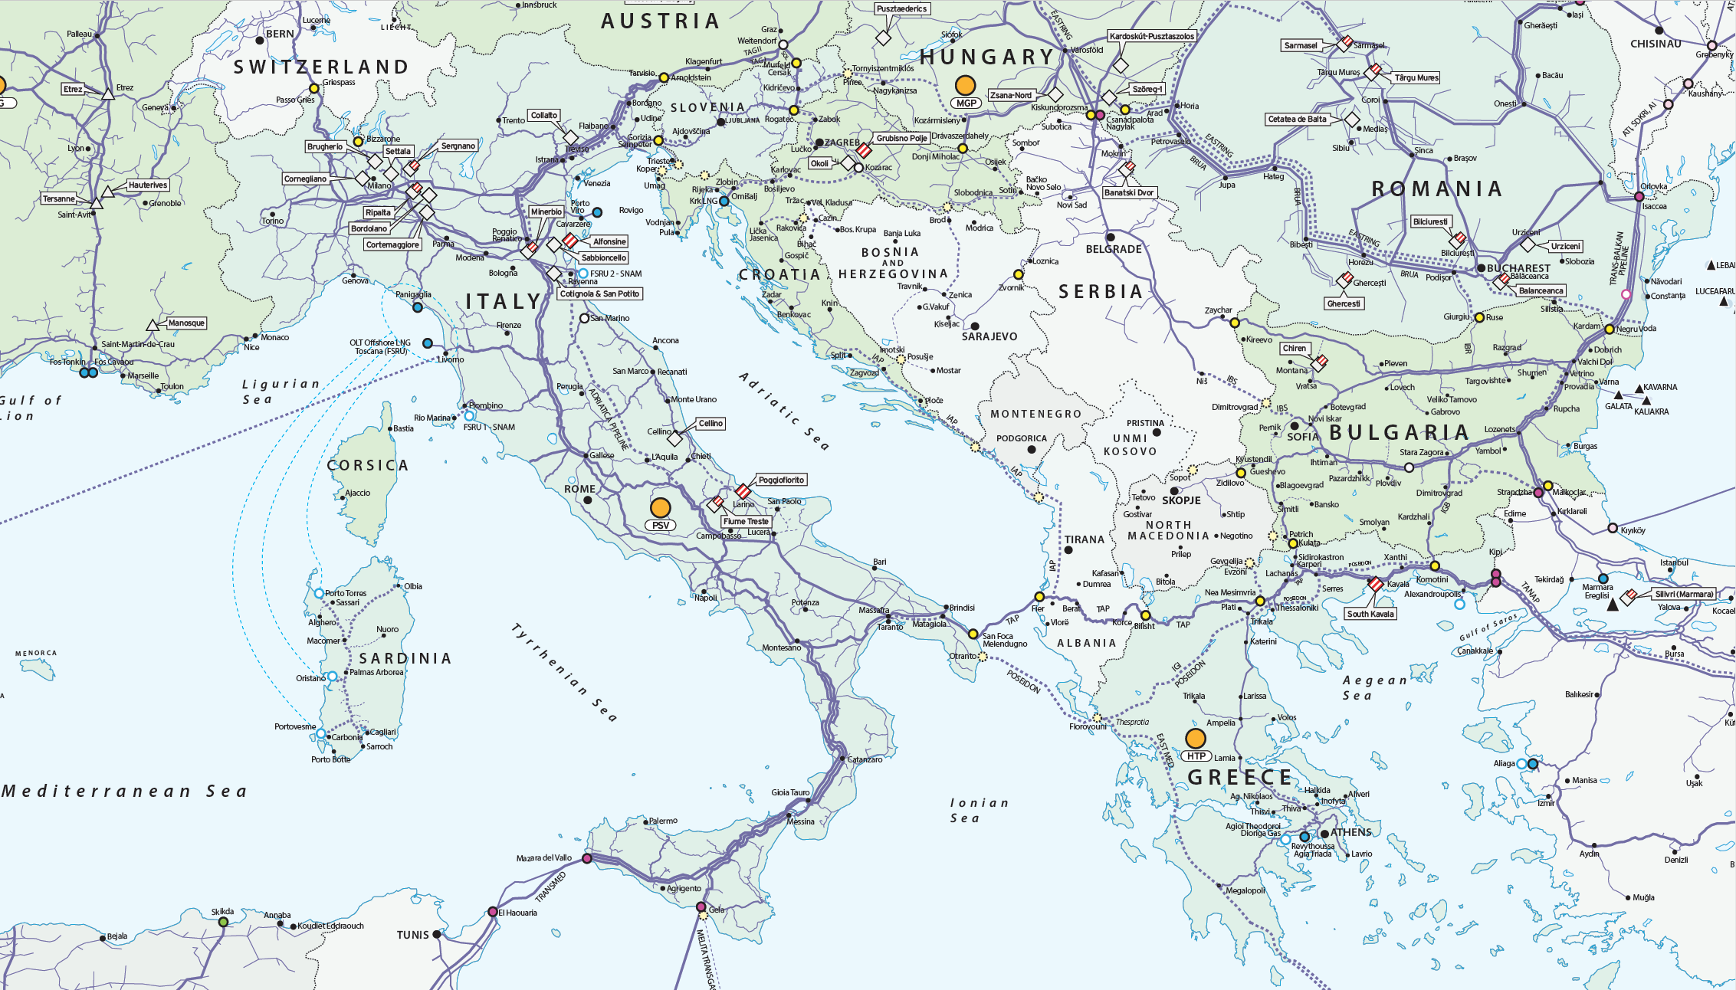
ENTSO-G EUSAIR GAS NETWORKS
EUSAIR NATURAL GAS INFRASTRUCTURE

Slide 15
NATURAL GAS PROJECTS
1. Rogatec interconnection
1
2. LNG evacuation pipeline
3. Gas interconnector RS-HR
2
3
4. Northern Gas interconnection BA-HR
15
5. Southern Gas interconnection BA-HR
14
4
6. Ionic-Adriatic Pipeline
7. Gas interconnector RS-BG
16
5
7
8. Gas interconnector RS-MK
9. Gas interconnector EL-MK
6
8
10. Gas interconnector MK-EL
10
11. Trans-Adriatic Pipeline
9
11
11
12. Poseidon
13. Eastmed
12
17
14. Western Gas interconnection BA-HR
12
15. Krk LNG terminal
16. Ravenna LNG terminal
18
17. Alexandroupolis LNG terminal
19
18. Dioriga LNG terminal
13
19. Revithoussa LNG terminal

Slide 16

CHALLENGES
How to provide security of energy supply
How to achieve energy transition towards decarbonisation
How to guratee that gas structures are needed in the long term
How to phase-out of coal avoiding social negative effects
How to support the investments needed for RES
How to increase cross-sector electrification and storage

Slide 17
OPPORTUNITIES
RES have huge potentiality in the region
Efficiency gives large possibility of demand reduction
Natural gas is expected to be an intermediate fuel
Natural gas system can be used for hydrogen transportation
CCUS could be integrated into industrial clusters
Hydrogen production from renewable power sources

Slide 18
CONCLUSIONS
Difficult scenarios that need to be addressed
Different and delays among countries
Decarbonization and security are achievable targets
Both became more ambitious and urgent after the 2022 crisis
Huge opportunities of energy efficiency with digitalization
Need of investments and innovation
Important to avoid heavy social and financial burdens
Find solution for finance of RES and grids

Slide 19
QUESTIONS?
…thank you!

