Slide 1

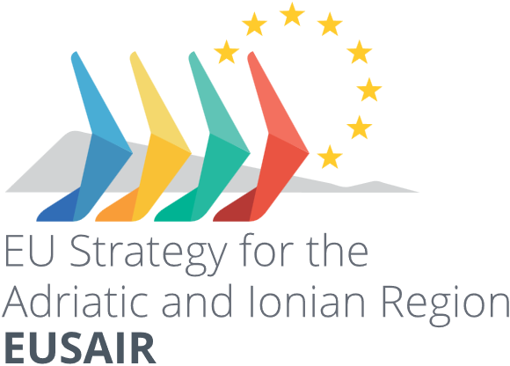

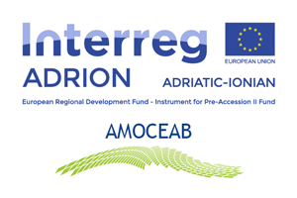


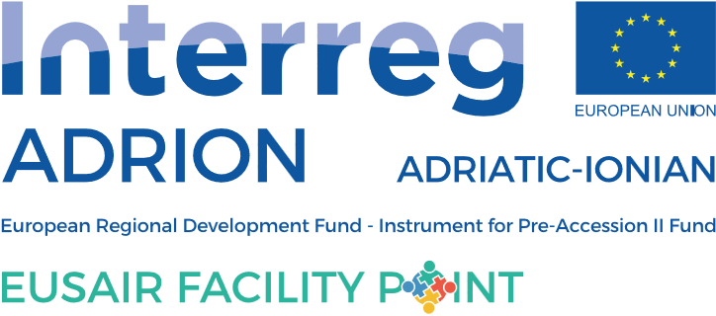
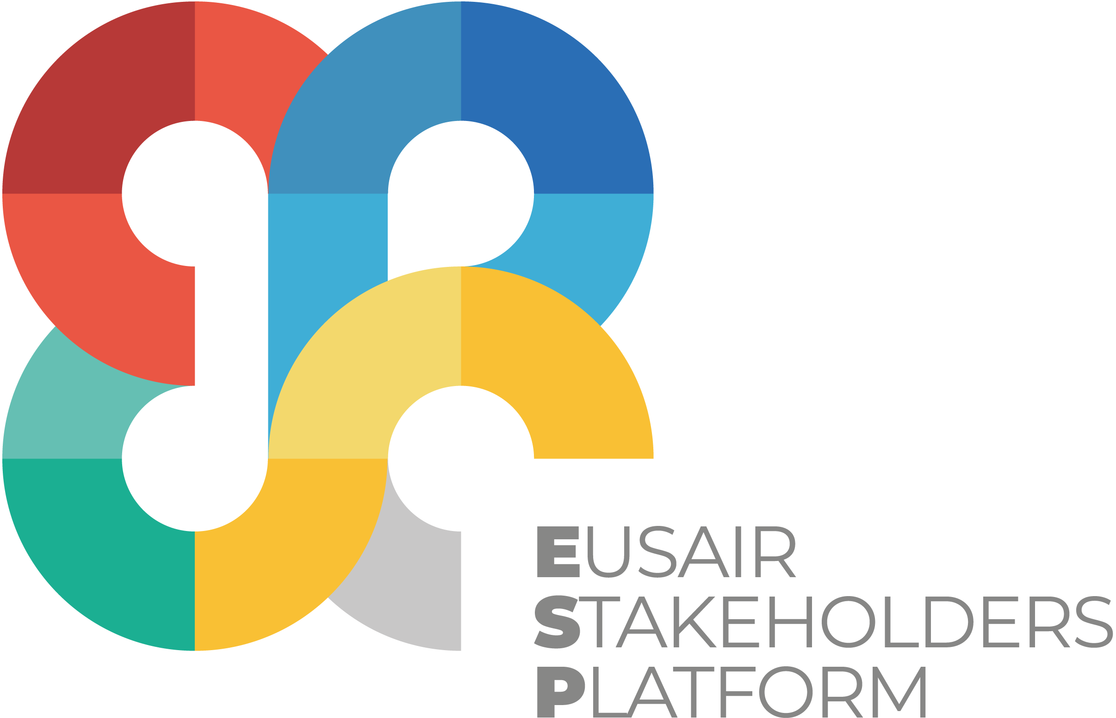
The interface between blue economy and inland water cycle. From desalination to integrated water and wastewater management
Prof. Eng. Francesco FATONE, PhD
Università Politecnica delle Marche
International Water Association Fellow
Water Europe Ambassador
f.fatone@univpm.it

Slide 2
Contents
Inland water in the Mediterranean basin: among scarcity, stress and floods
Fit-for-purpose alternative water sources and water uses: example of regional action plans to face water scarcity in Marche region
Desalination technologies and Water-Energy-Environment nexus
  Case studies
  Challenges
R&D&I topics: decentralized nature-based systems and brine mining in EU-funded innovation actions

Slide 3
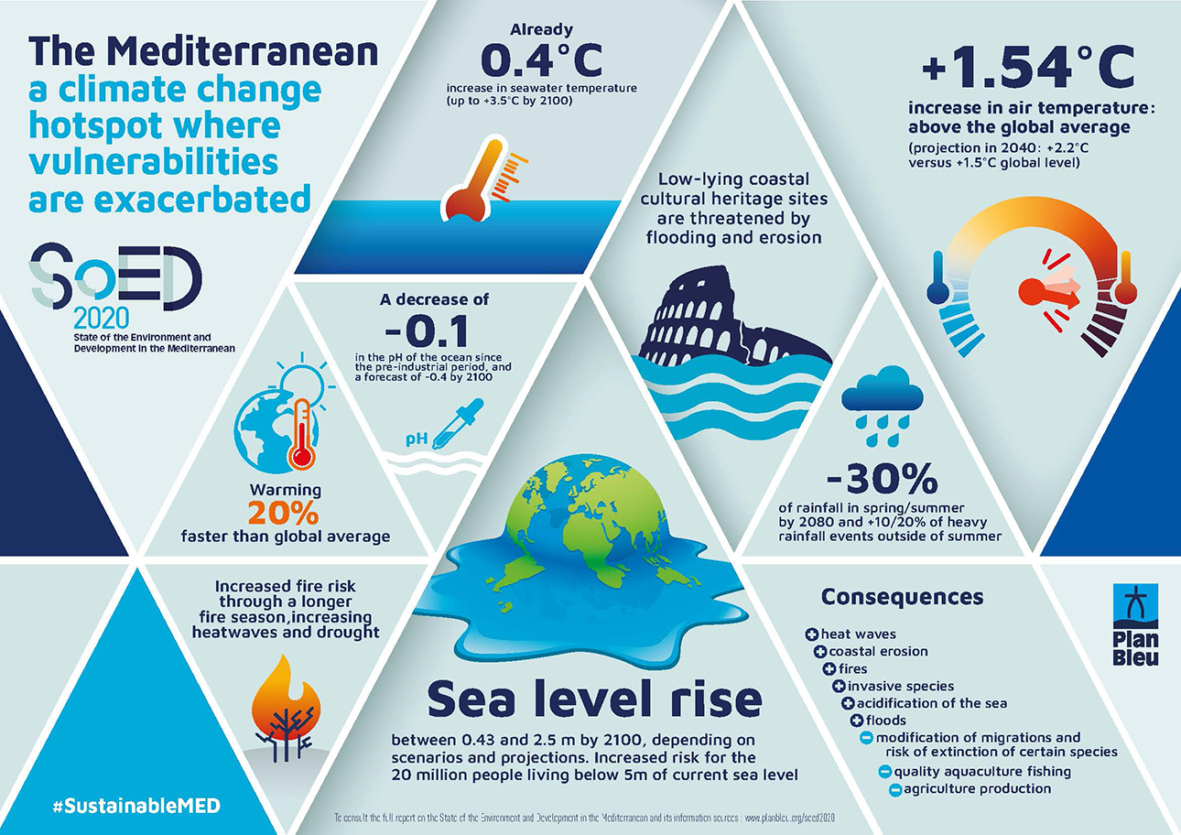
Climate change in the Mediterranean area ?
Notes:
Source: https://www.eea.europa.eu/data-and-maps/indicators/river-flow-drought-3/assessment

Slide 4
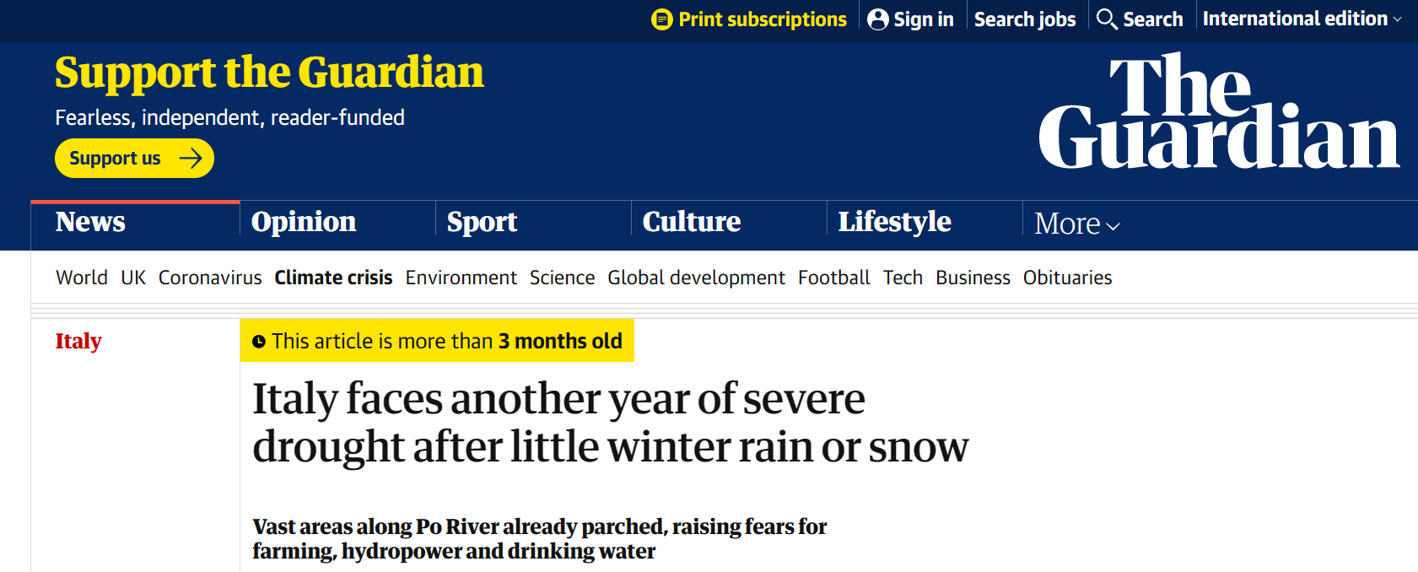
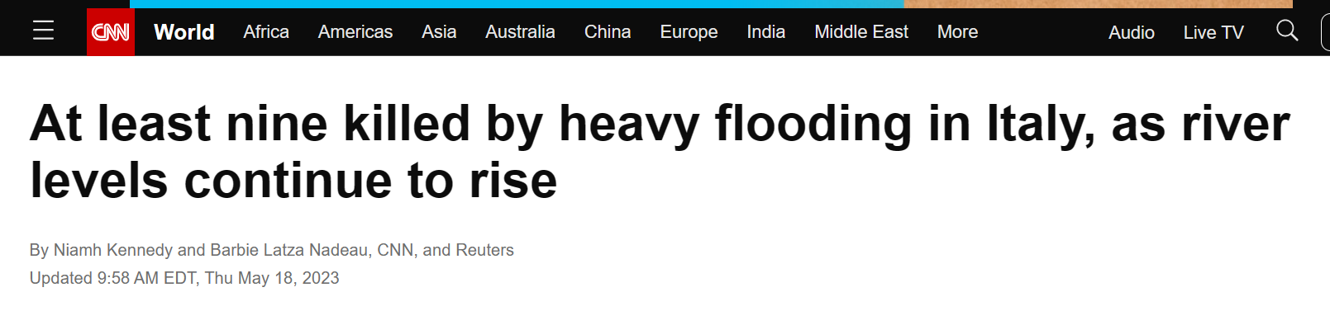
Inland water: too scarce, too much, too polluted ?
WINTER 2023 - DROUGHT
SPRING 2023 – STORM AND FLOOD

Slide 5
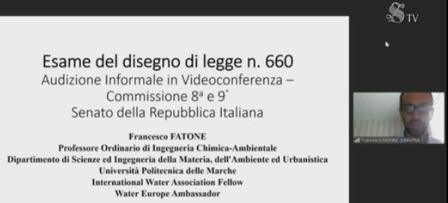
May 2023: Invited as expert to the Italian Replublic Senate to discuss about the national law (Decree 660) for special measures to fight Water Scarcity

Slide 6
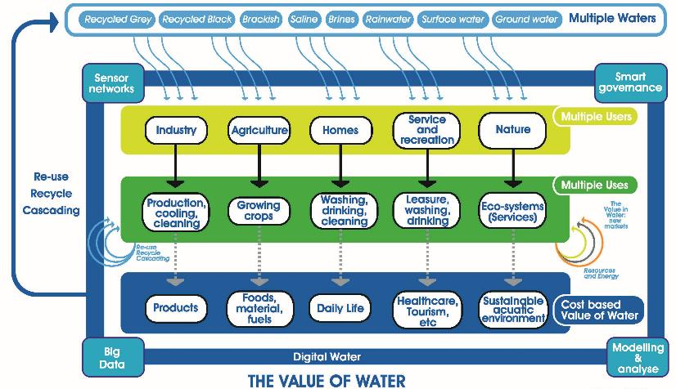
WE Innovation Areas
Multiple Waters
Digital Water
Value in Water
Hybrid Grey-Green Infrastructure (RESILIENCE)

Slide 7
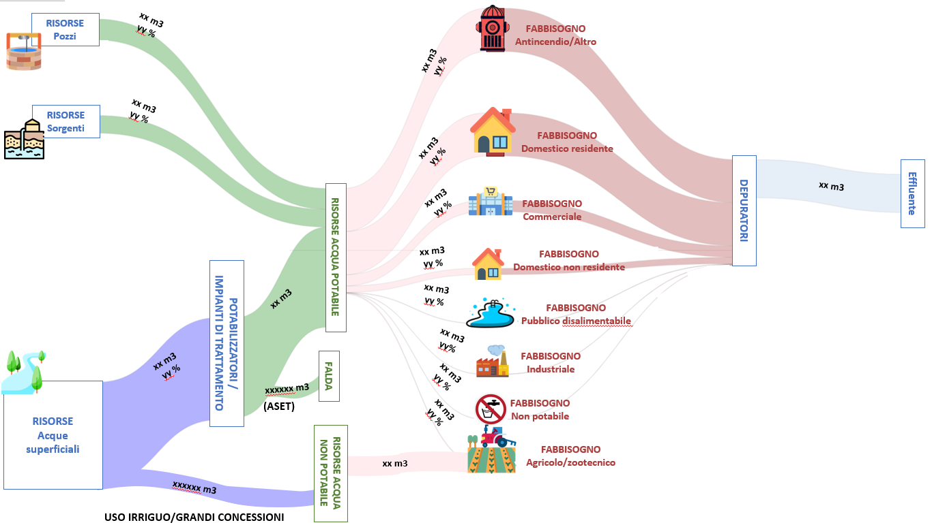
WATER SOURCES AND USES: A TERRITORIAL CASE STUDY IN THE PROVINCE OF PESARO-URBINO
ALTERNATIVE WATER SOURCES??? ONLY IN SYSTEMIC APPROACH AND SET OF SOLUTIONS (figure not in scale)

Slide 8
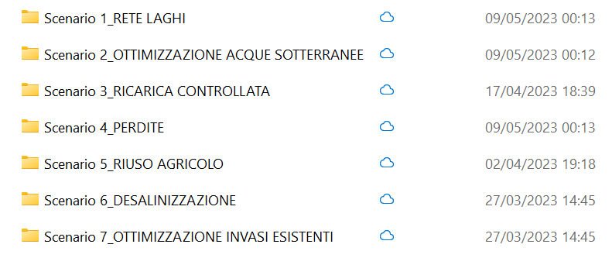
SYSTEMIC APPROACH AND SYNERGIC SET OF SOLUTIONS
RAINWATER HARVESTING IN RURAL AREAS
GROUNDWATER OPTIMIZATION
AQUIFER RECHARGE
WATER LOSSES REDUCTION
WASTEWATER REUSE
DESALINATION
MAINTENANCE OF EXISTING RESERVOIRS

Slide 9
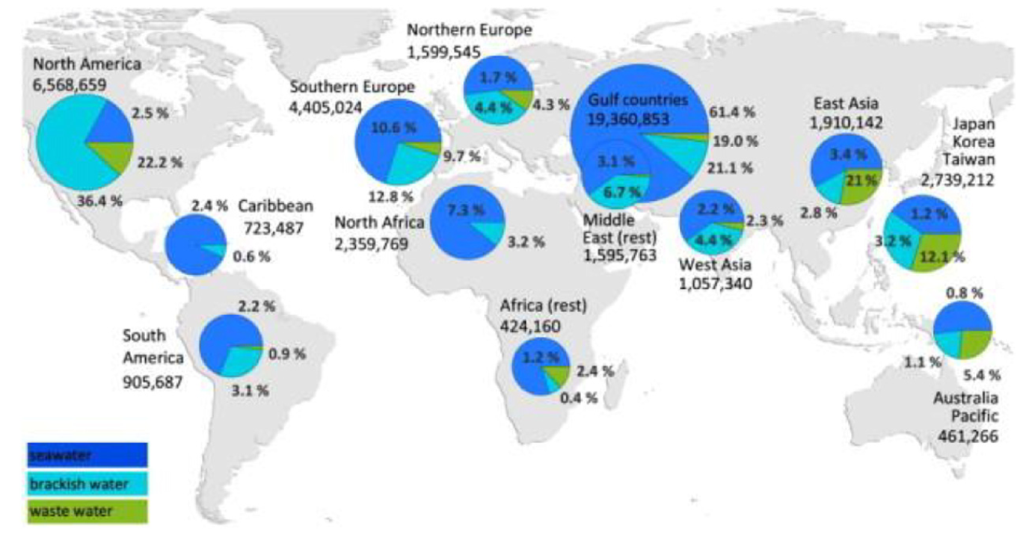
DESALINATION IN THE WORLD

Slide 10
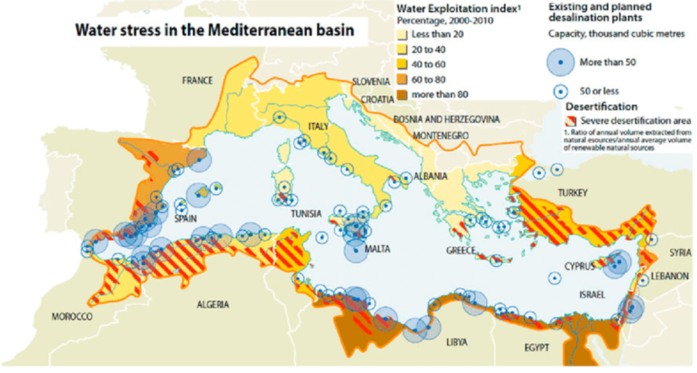
2000-2010
(10-15 YEARS LATER, SOME PLANNED … ARE STILL PLANNED)

Slide 11
DESALINATION TECHNOLOGIES
COMMERCIALLY AVAILABLE METHODS
MAJOR PROCESSES
MINOR PROCESSES
INNOVATIVE AND EMERGING METHODS
SUPPORTING TREATMENT METHODS
THERMAL PROCESSES
MEMBRANE PROCESSES
Multi-stage flash distillation (MSF)
Multi effect distillation (MED)
Vapor compression
DISTILLATION (VCD)
Reverse osmosis (RO)
Electrodialysis (ED)
Freeze desalination (FR)
Forward osmosis (FO)
Nanofiltration (NF)
Electrodialysis reversal (EDR)
HYBRID METHODS
Capacitive deionization (CDI)
Other methods
Nanofiltration
(NF)
Microfiltration (MF)
Ultrafiltration (UF)
RENEWABLE ENERGY PROCESSES
INTEGRATED DESALINATION PROCESSES
MEMBRANE DISTILLATION (MD)
Hierarchy chart for desalination methods
Notes:
Le varie tecnologie di desalinizzazione sono state suddivise in base al loro attuale sviluppo su scala industriale.
I“commercially available methods” sono quei processi impiegati in impianti esistenti a livello mondiale, classificati ulteriormente in “major” e “minor” a seconda del numero di impianti presenti. Sono esclusi da questa categoria gli “innovative and emerging methods”.
Ci sono poi i processi ibridi, cioè quelli che integrano 2 o più tecnologie e quelli che fanno uso di fonti di energia rinnovabili.
Infine, tra i “supporting treatment methods” ci sono quelle tecnologie ausiliarie usate come pre-trattamento per alcuni metodi a membrana.

Slide 12
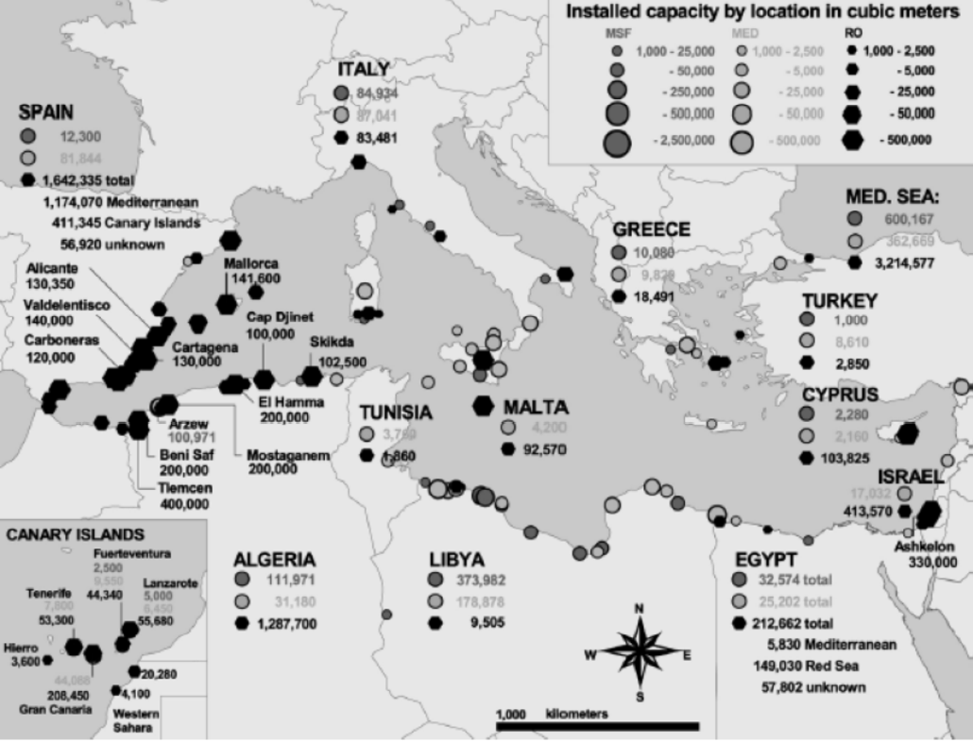

Slide 13
Water-Energy-Environment Nexus

Slide 14
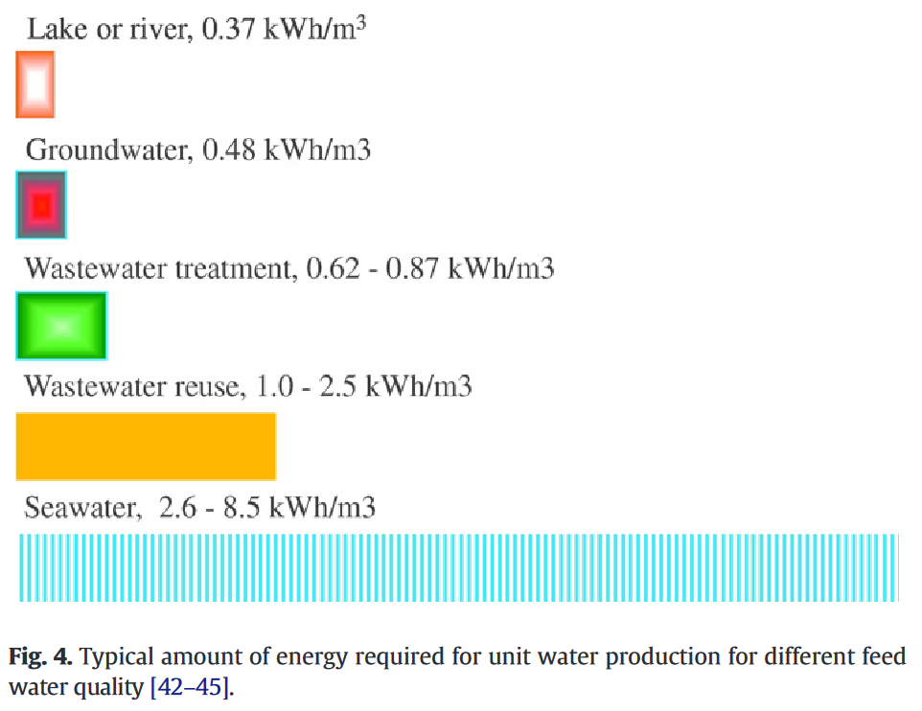

Slide 16
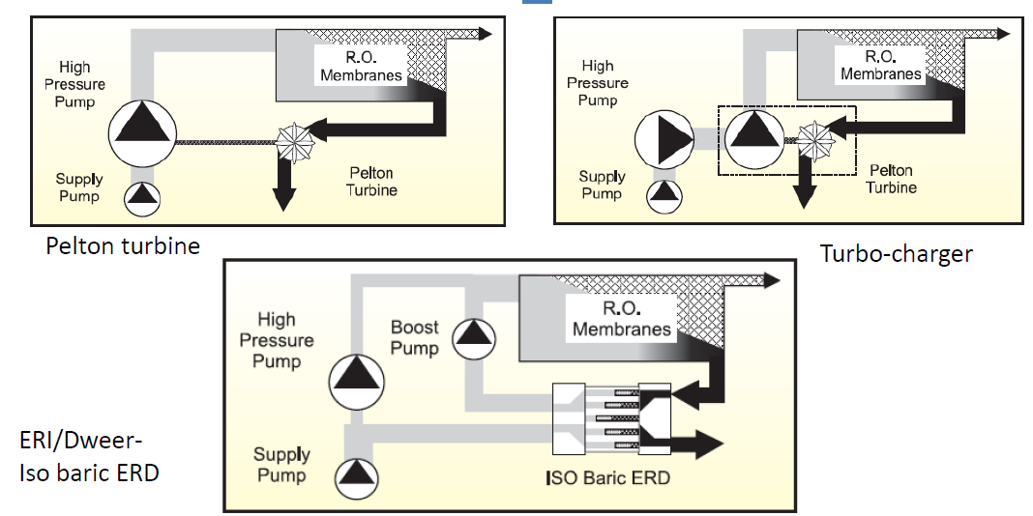
Energy Recovery Devices- main ERD possibilities

Slide 18
Technology Readiness Level of renewable energy coupled with desalination

Slide 19
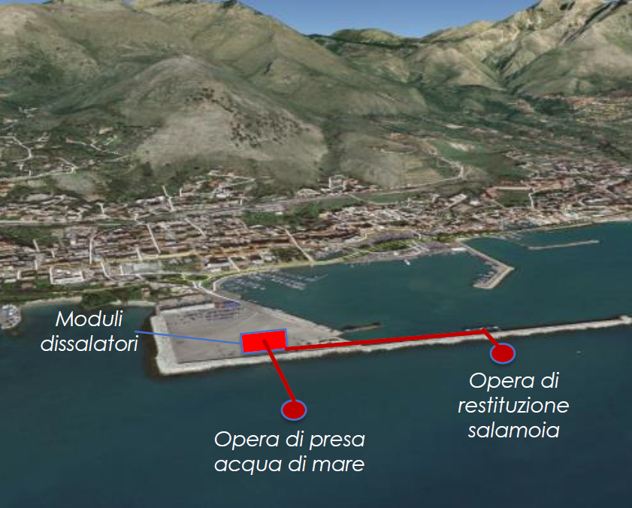
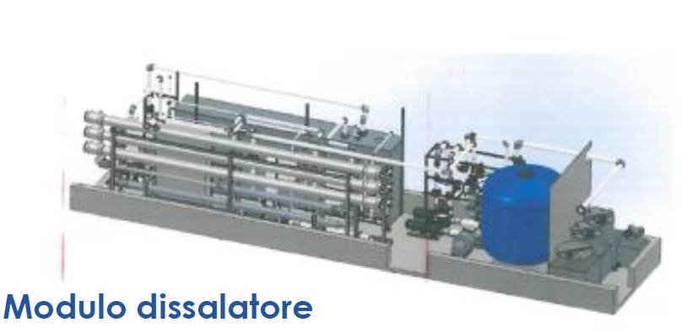
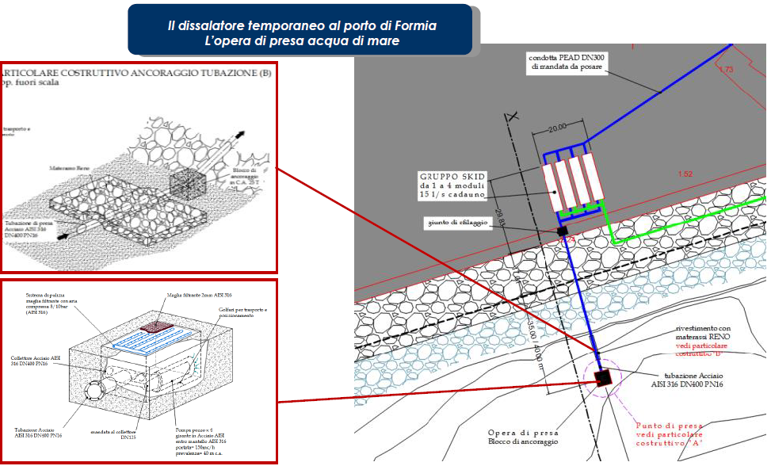
Mobile desalination in Formia seaport
Production cost: 3 €/m3 per 1500 m3/d

Slide 20
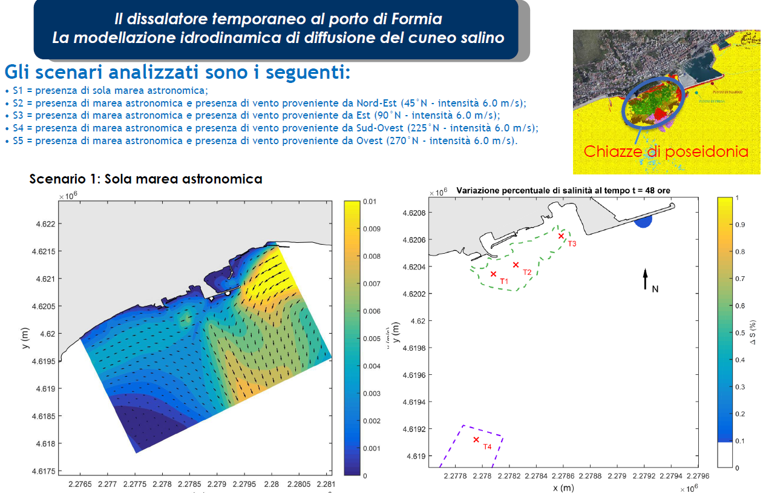
HYDRODYNAMIC MODELLING OF THE SALINITY PLUM

Slide 21
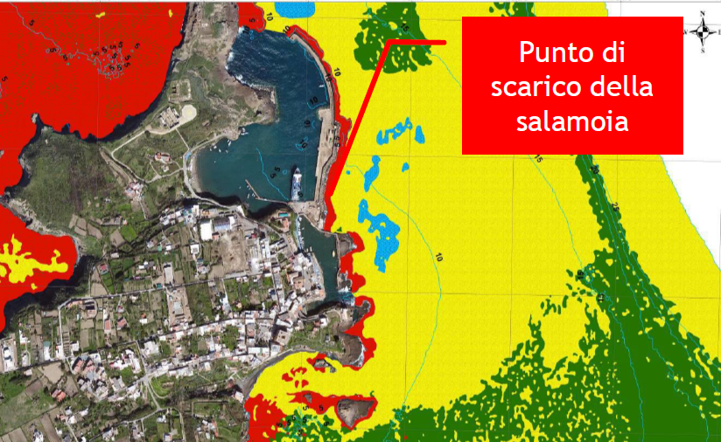
Ventotene desalination plant: monitoring of benthic species
Brine discharge point

Slide 22
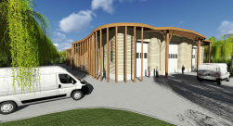
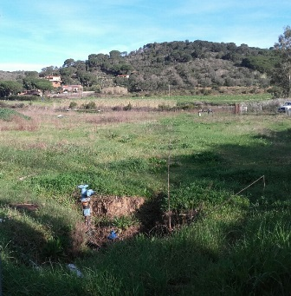
Elba island desalination plant
Water production: 80 l/s
Footprint: 1680 m²
CAPEX (2017): 14,5 M€
Prod day: 6912 m³
Electric energy: 2,5 KWh/m³

Slide 23
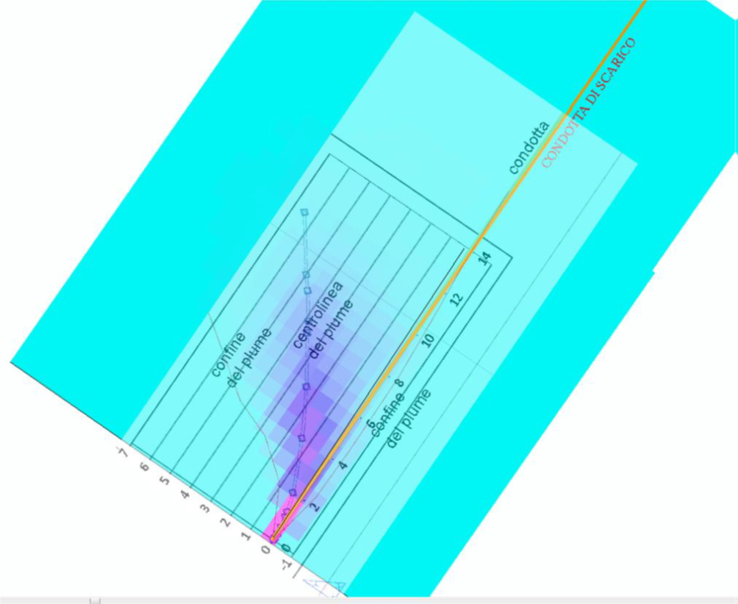
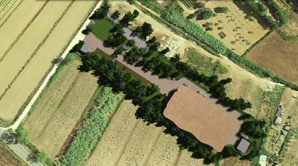
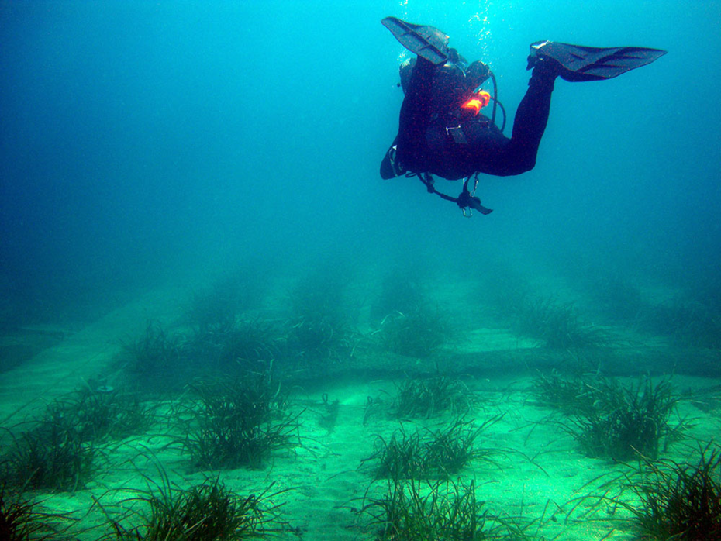
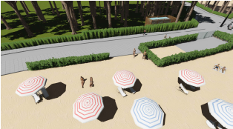
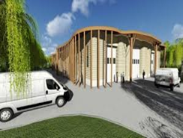
Environmental impact in Elba island desalination
Inlet salinity 38,5 g/L
SOSTENIBILITA’
Energy recovery
Ecosystem monitoring and demo projects
Mitigation of acustic emissions
Mitigation of landscape impact
<42 dBA emitted

Slide 24
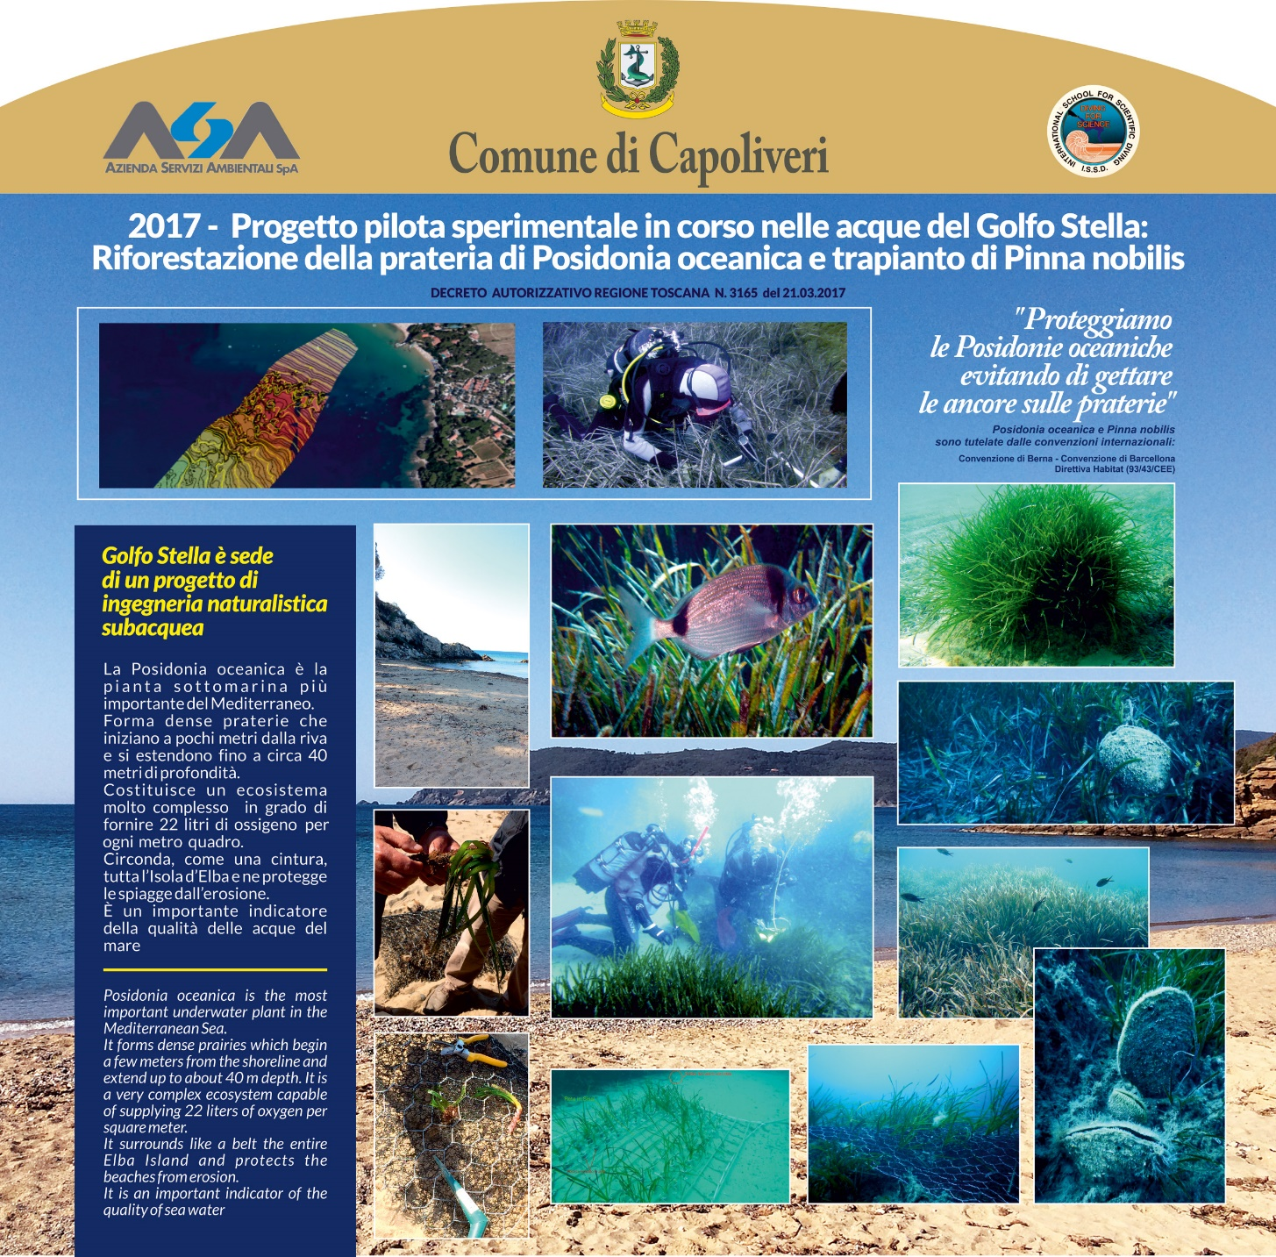
R&D on Posidonia reforestation and transplanting of Pinna nobilis

Slide 25
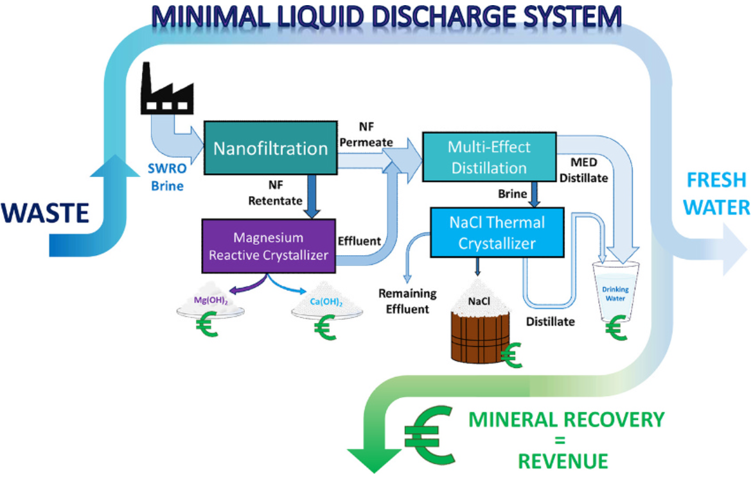
SEA MINING (FROM BRINE)
Desalination plant in Pantelleria island

Slide 26

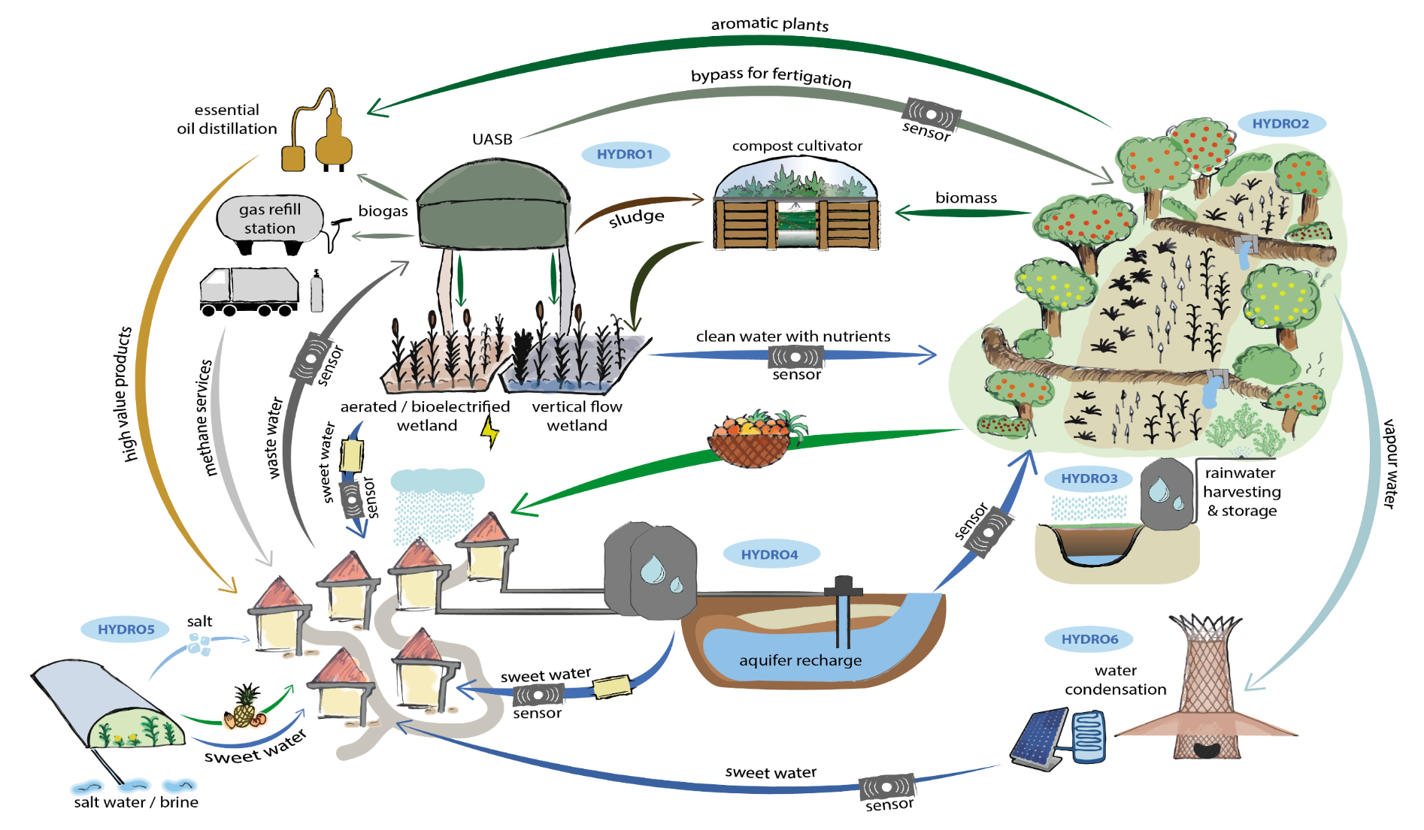
NATURE BASED SOLUTIONS TO CLOSE LOOPS IN ISLANDS AND RURAL AREAS
www.hydrousa.org
Notes:
Raw materials: EUROPEAN COMMISSION COM(2011) 25
Area 1: Chemical process engineering
Area 2: Chemical Environmental Engineering

Slide 27
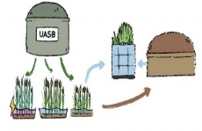
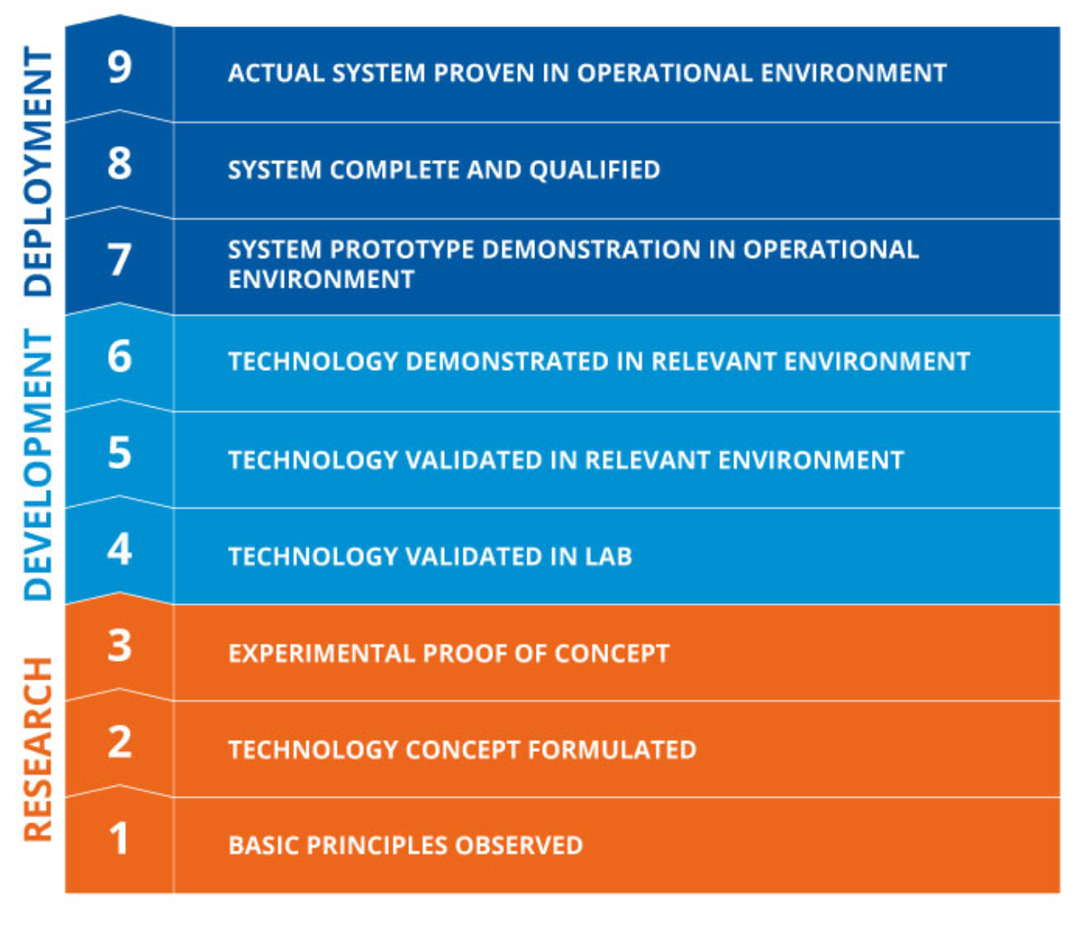
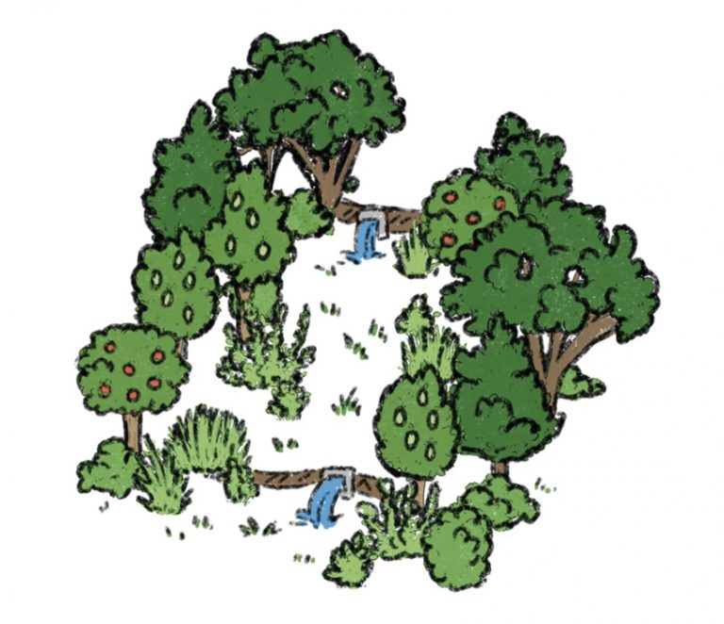
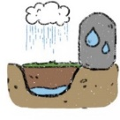
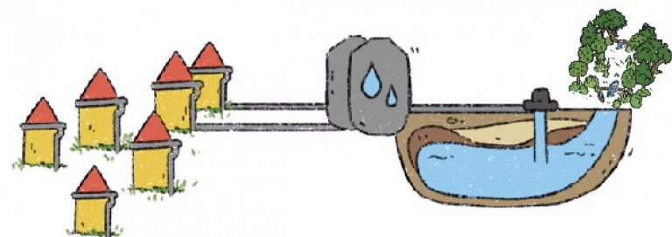
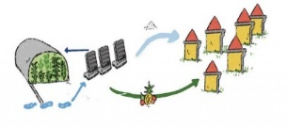
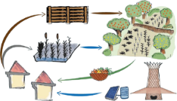

Innovative HYDRO technologies to close the water and water-related loops in decentralized contexts of the Mediterranean Region
10-100 m³/d Nutrient rich water
<0.3 kWh/m³ of energy consumption
10 MWh/year of biogas
10,000 m³/year of water for agriculture
1.5 kg fertilizer/day
1
Municipal wastewater
END
Within the next 2 years after the project
2
Reclaimed water
Compost or
Irrigation of 1 ha of crops/trees
Production of > 10 tons of crops
Nutrient rich water
Within the project
3
Rainwater
800 > kg/year oregano
0.4 ha irrigated
START
Rainwater
Runoff water
10 > m³ /year drinking water
200 m³ /year water stored in aquifer
1000 kg/year lavender
0.2 ha irrigated
4
5
Seawater/brine
0.1 Kg salt/day per unit
2.2 L freshwater/day per unit
1.5> tons tropical fruits
Technologies will reach even TRL 9 together with the resulting business opportunities for all participating beneficiaries.
Rainwater
Grey/Black water
Water vapour
> 20m³ /year condensed vapour water
20 – 30m³ /year of reclaimed water
0.15ha of irrigated crops
6
Notes:
Raw materials: EUROPEAN COMMISSION COM(2011) 25
Area 1: Chemical process engineering
Area 2: Chemical Environmental Engineering

Slide 28
Thank you
Prof. Eng. Francesco FATONE, PhD
Università Politecnica delle Marche
International Water Association Fellow
Water Europe Ambassador
f.fatone@univpm.it

