Slide 1


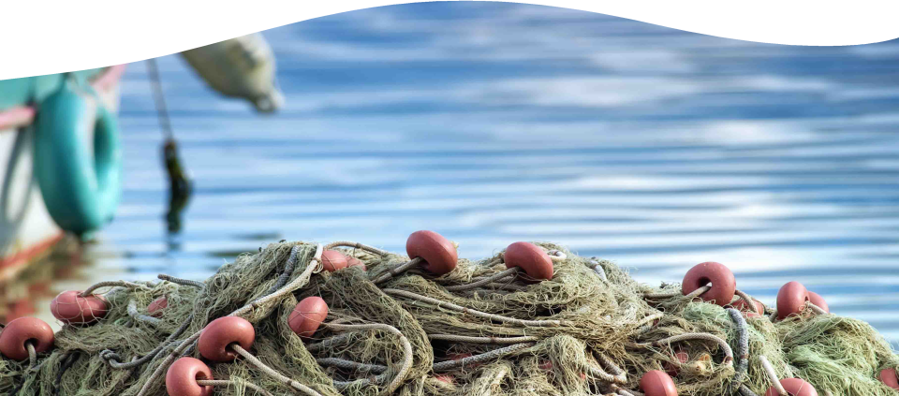
BLUE GROWTH SMART ADRIATIC IONIAN S3
BLUEAIR INNOVATION COMMUNITY
8th EUSAIR FORUM
EUSAIR Pillar 1 Session - Blue growth emerging/promising sectors fostering development and sustainability in the Adriatic and Ionian Region
Sarajevo, 24 May 2023
Peter Medica, Technology Park Ljubljana

Slide 2
The Blueair project
BLUEAIR Innovation Community
Project presentation

Slide 3
The blue economy in AIR

Slide 4
The need for collaboration
Challenges
Opportunities
Actions & Solutions
The lack of cooperation among all Q-Helix actors
Low knowledge capacity on blue technologies
The lack of technology and knowledge transfer
…
R2B, B2R and R2R cooperation and networking
Funding opportunities from EU programmes.
Collaboration projects
Communities of Q-Helix actors in the AIR
…
Setting up transnational project cooperations
Setting up innovation communities
Pooling funding from regional instruments
Establishment of a blue career network
…
Recommendation
Macro-regional innovation community
for strengthening cooperation among all innovation actors

Slide 5
BLUEAIR Innovation Community
The BLUEAIR Innovation Community is
an open platform
that aims to enhance and streamline innovation collaboration
at both regional and macro-regional levels
in order to drive a sustainable blue economy in the Adriatic and Ionian Region.
Based on the following principles:
Collaboration and Co-creation, Inclusivity, Sustainability, Innovation,
Networking, Flexibility, Governance

Slide 6
Objectives of the BLUEAIR Innovation Community
Promoting collective innovation actions
Building strong partnerships across sectors and disciplines
Building innovation capacity
Increasing the visibility of blue innovation
Supporting the development of a macro-regional innovation system
Advocating for supportive policies and practices
Empowering and supporting the next generation of innovators and leaders
Engaging with innovation ecosystems from other sea basins

Slide 7



How the BLUEAIR Innovation Community operates?
Micro-level
Meso-level
Macro-level

Slide 8
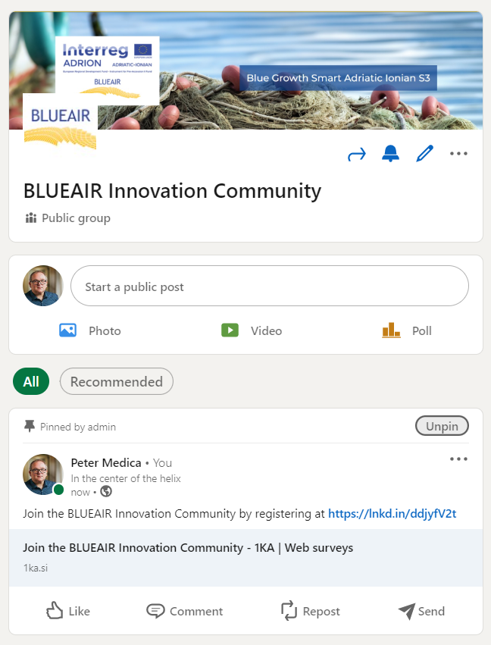
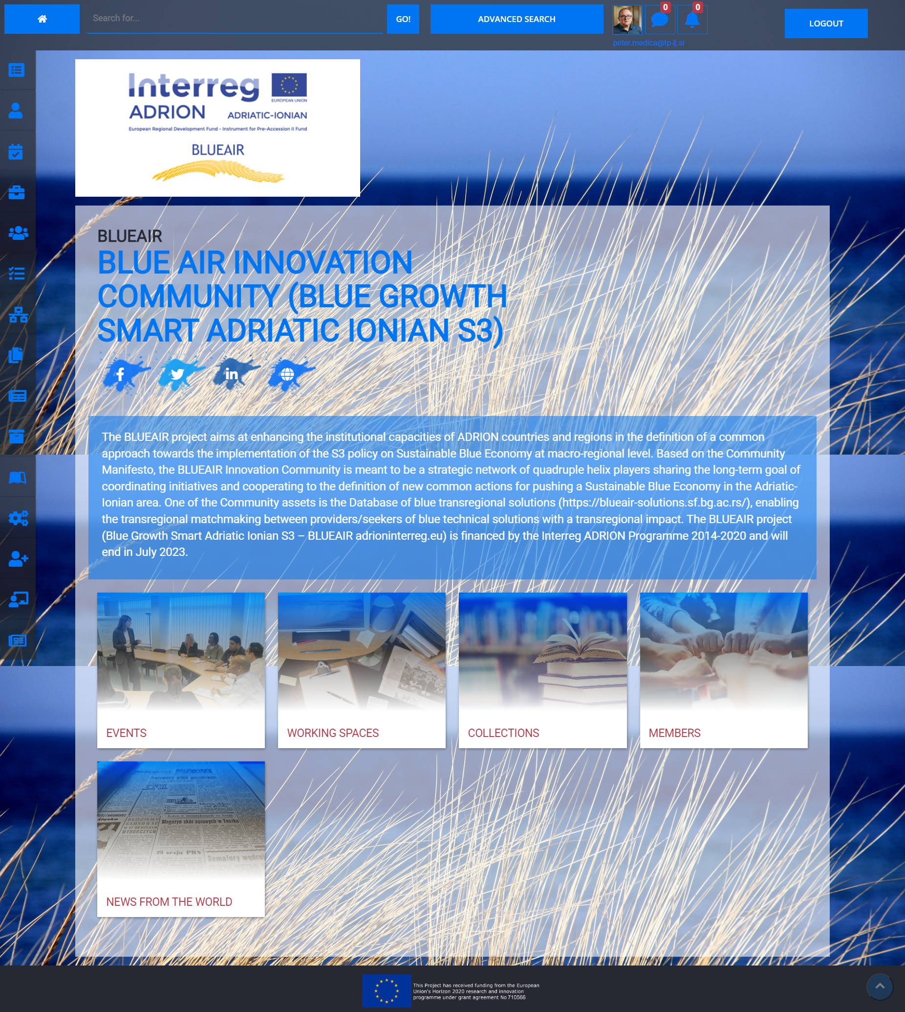
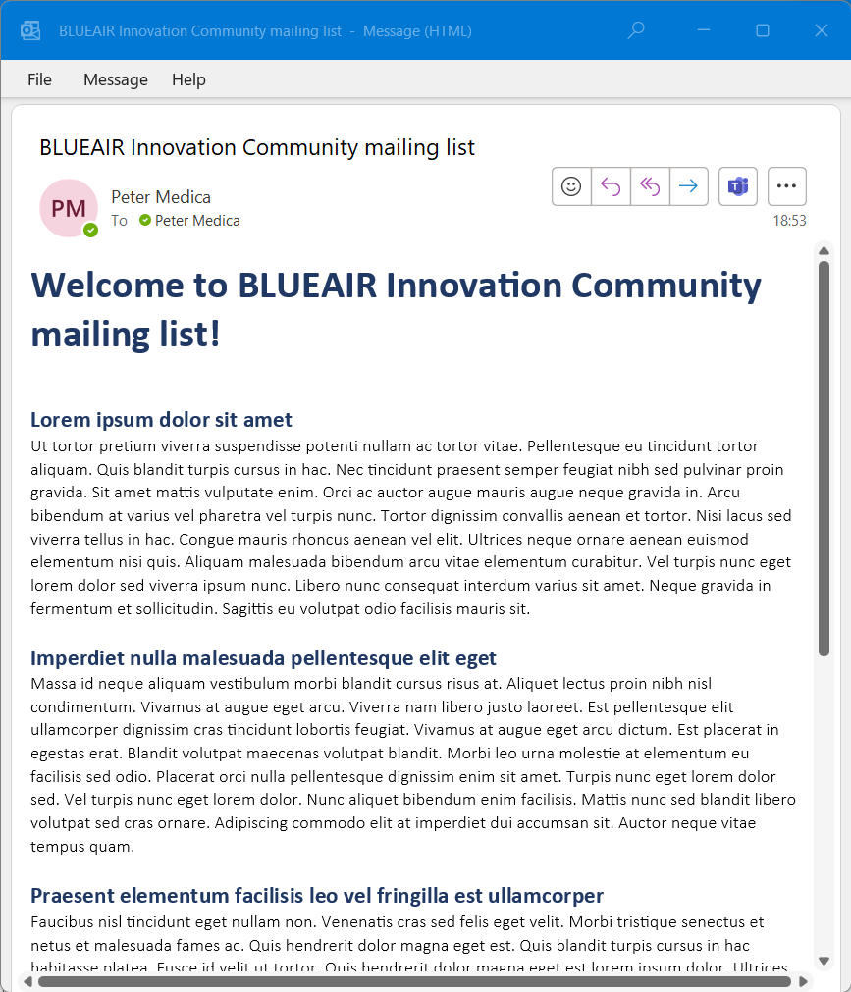
Communication tools
Linkedin group
www.linkedin.com/groups
/9359919/
Marina Platform
www.marina-platform.eu
/registeredarea/community
/viewCommunity/15
Mailing list
www.1ka.si/jointhecommunity

Slide 9
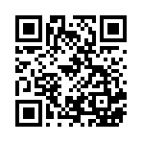
Join the BLUEAIR Innovation Community
www.1ka.si/jointhecommunity

Slide 10











Thank you for your attention!
Peter Medica
Technology Park Ljubljana
peter.medica@tp-lj.si
linkedin.com/in/petermedica

