Slide 1


Urban mobility as an additional key focus area of the Pillar 2:
best practices in sustainable urban mobility planning from the Adriatic-Ionian Region
Prof. Pierluigi Coppola, Pillar 2 Coordinator , Italy
8TH Annual EUSAIR FORUM – Sarajevo, 25th May 2023

Slide 2
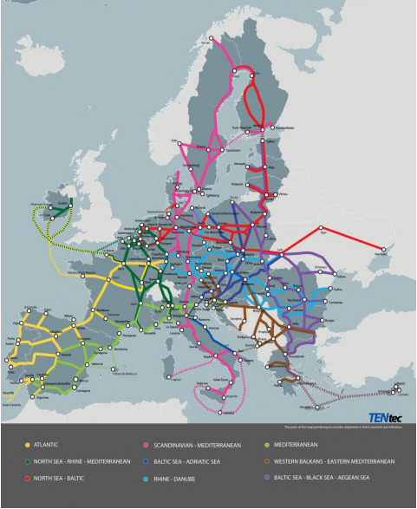
Urban Nodes in the EU Policy
The revised TEN-T Regulation require by 2040, at least one multimodal passenger hub and one multimodal freight terminal allowing for sufficient transhipment capacity within or in the vicinity of the urban node.
In addition, by 2025, the 424 cities identified in the new TEN-T regulation must develop a Sustainable Urban Mobility Plan (SUMP) that includes measures to integrate the different modes of transport, and to promote zero-emission mobility.
424
Urban Nodes
Cities as Innovation hubs
ideal places to seize new mobility opportunities
Notes:
https://ec.europa.eu/commission/presscorner/detail/en/qanda_21_6725

Slide 3
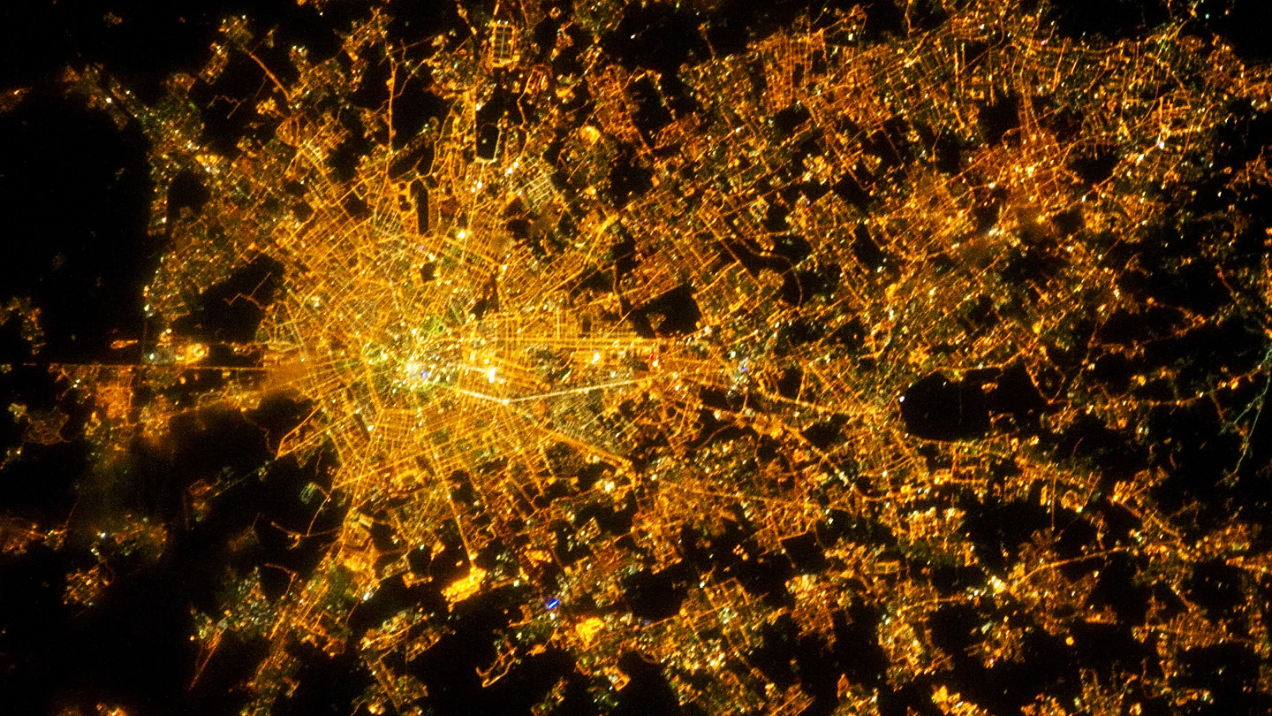
Urban sprawl and auto-oriented cities

Slide 4

Urban sprawl and auto-oriented cities
Urbanization
To date, 55% of the World's population lives in urban areas, it is estimated an increase up to 68% for year 2050
Urbanization is due to the considerable transfer of population from rural areas to urban centers, but also to an overall increase in population which occurs at a higher rate in cities
Traffic congestion
It is a major issue for cities and often a determining factor of connectivity within urban areas and for intra-city interactions
Road safety
Approximately 1.3 million people die each year as a result of road traffic crashes
More than half of all road traffic deaths are among vulnerable road users: pedestrians, cyclists, and motorcyclists
Pollution and climate change
Passenger cars are responsible for around 12% of total CO2 EU emissions
To date, in EU about 96% of private cars have internal combustion engine
Notes:
Urbanization
To date, 55% of the World's population lives in urban areas, it is estimated an increase up to 68% for year 2050
Urbanization is due to the considerable transfer of population from rural areas to urban centers, but also to an overall increase in population which occurs at a higher rate in cities

Slide 5


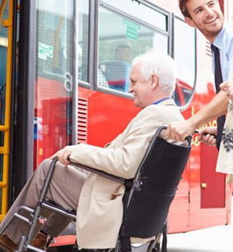
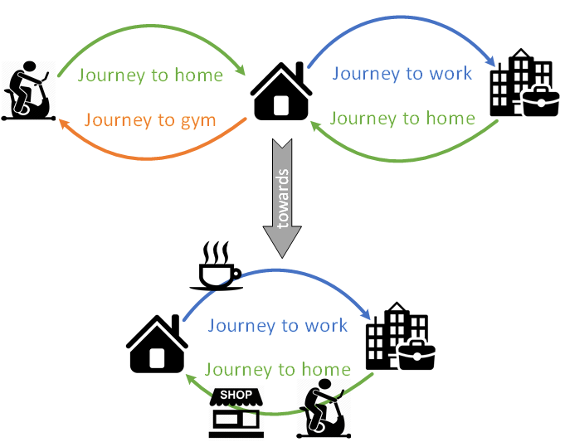
Global trends in urban mobility
Population ageing
  New mobility needs
New Lifestyle
  Digital-oriented
  Connected
New Demand pattern
  Multi – modal
  Multi – purpose
  Multi - city

Slide 6
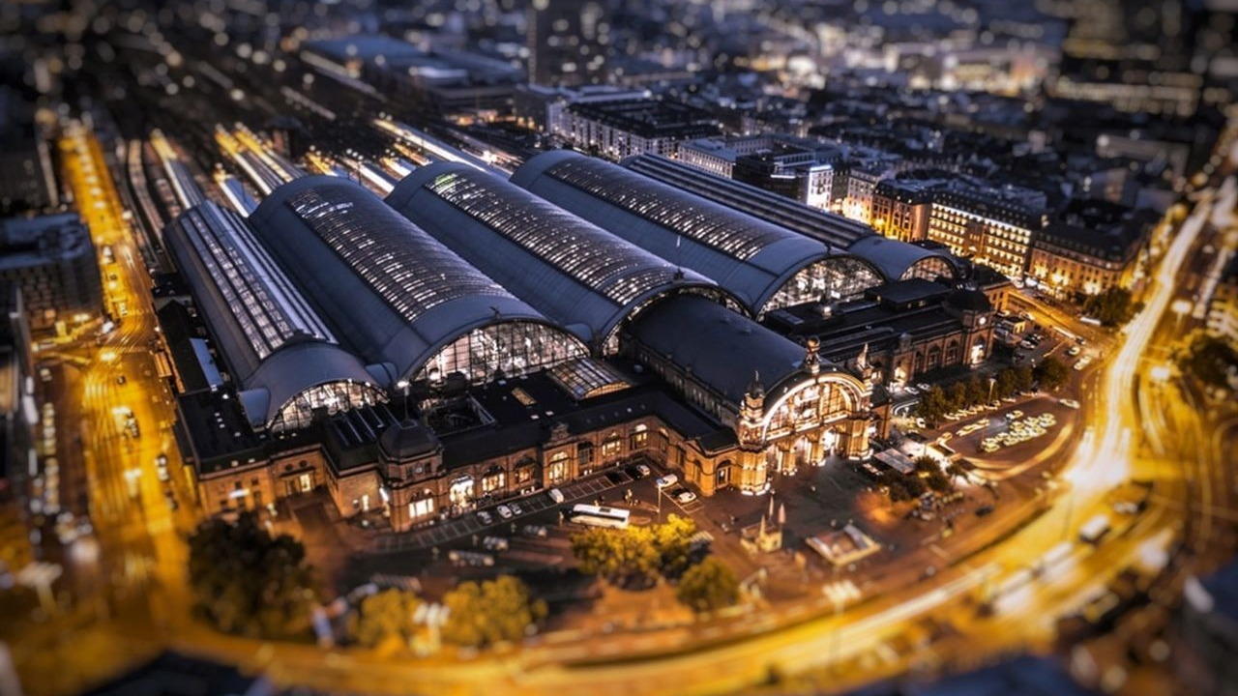
Modal and Service Integration

Slide 7
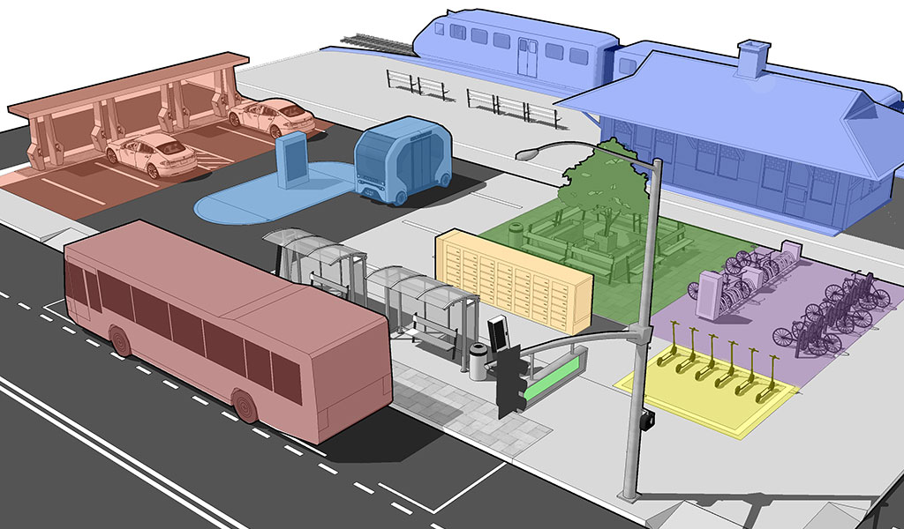
Modal and Service Integration
Parkings & Car sharing
Mobility Hubs
Railway services
Innovative services
(e.g. Autonomous Shuttles)
Bike Sharing
Scooter sharing
LPT services

Slide 8
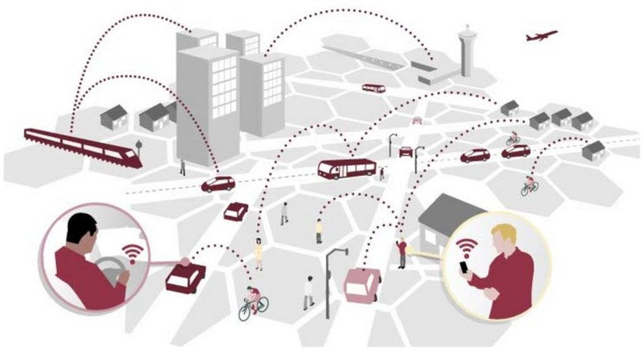
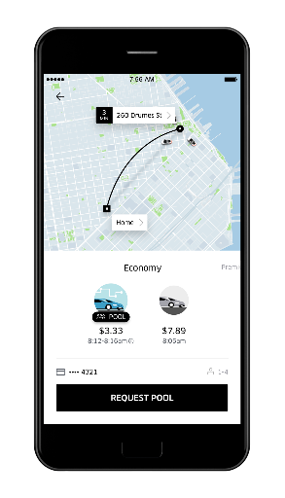
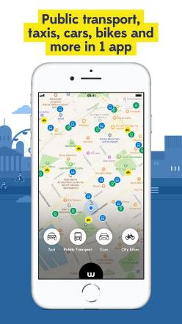

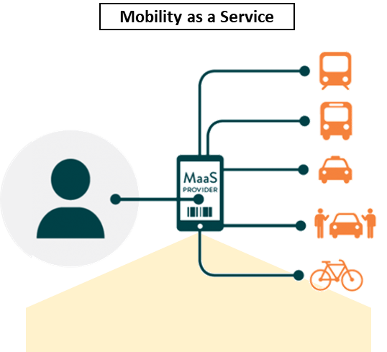
Modal and Service Integration
Big Data Availability
Customized services
Door-to-Door travels
on-Demand services
Tailored classes of service
GPS data smartphone
GPS data (private and public) vehicles
Mobile network data
Mobile Apps

Slide 9
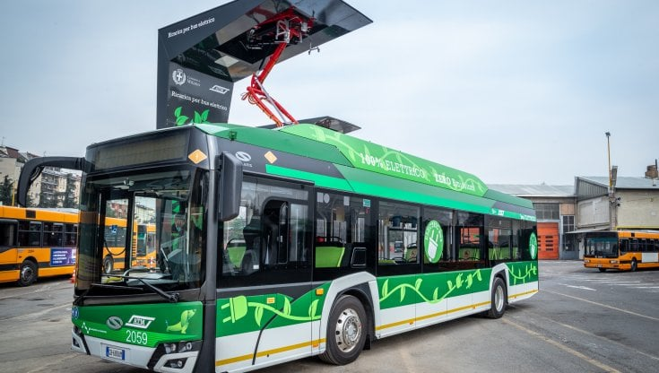
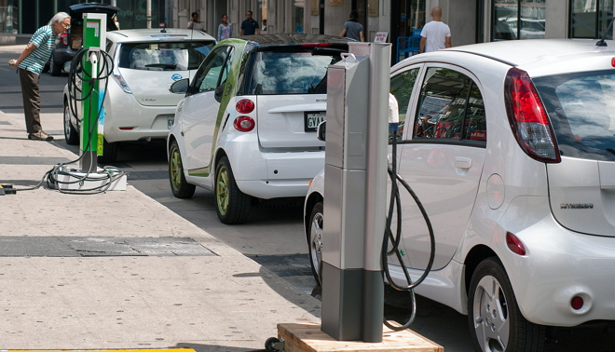
Electrification
cars and buses fleets
  no local pollutants (CO, NOx, PM)
  low noise emissions
  low operating and maintenance costs
charging infrastructure
(depot, opportunity, flash, wireless, …)
Impact on operations and transit service

Slide 10
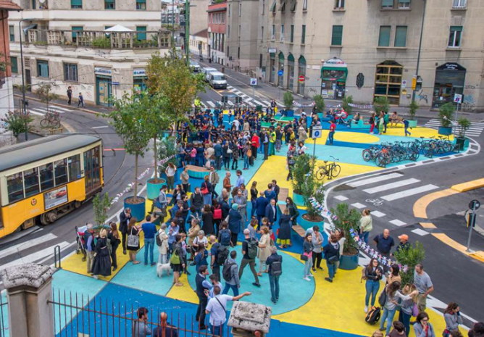
Re-thinking the use of urban spaces

Slide 11
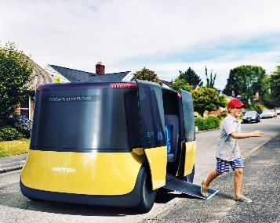
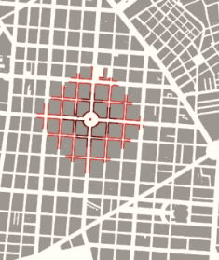
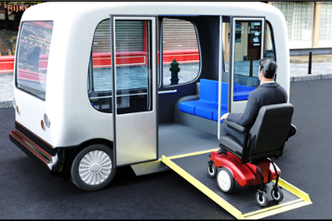

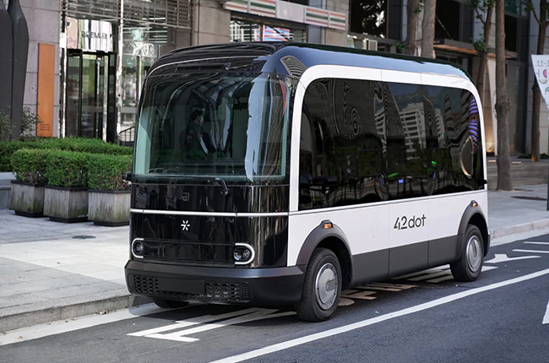
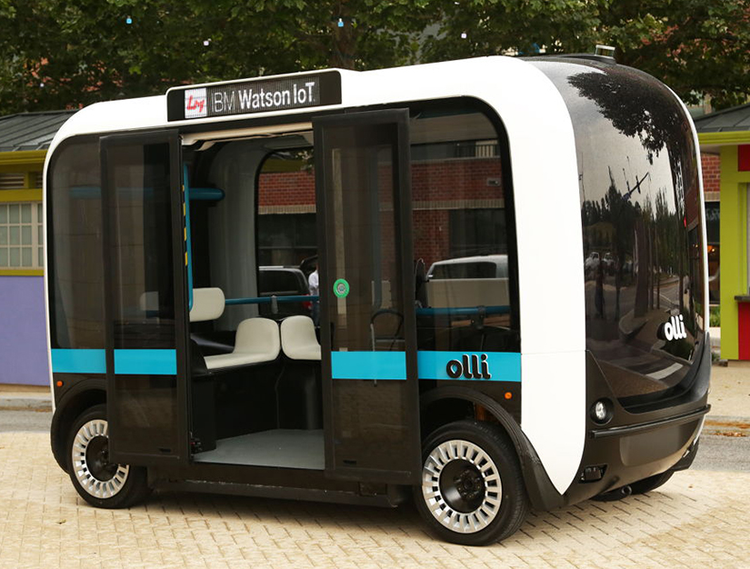
Advanced technological innovations
Connected and Autonomous Vehicles (CAVs)
!

Slide 12
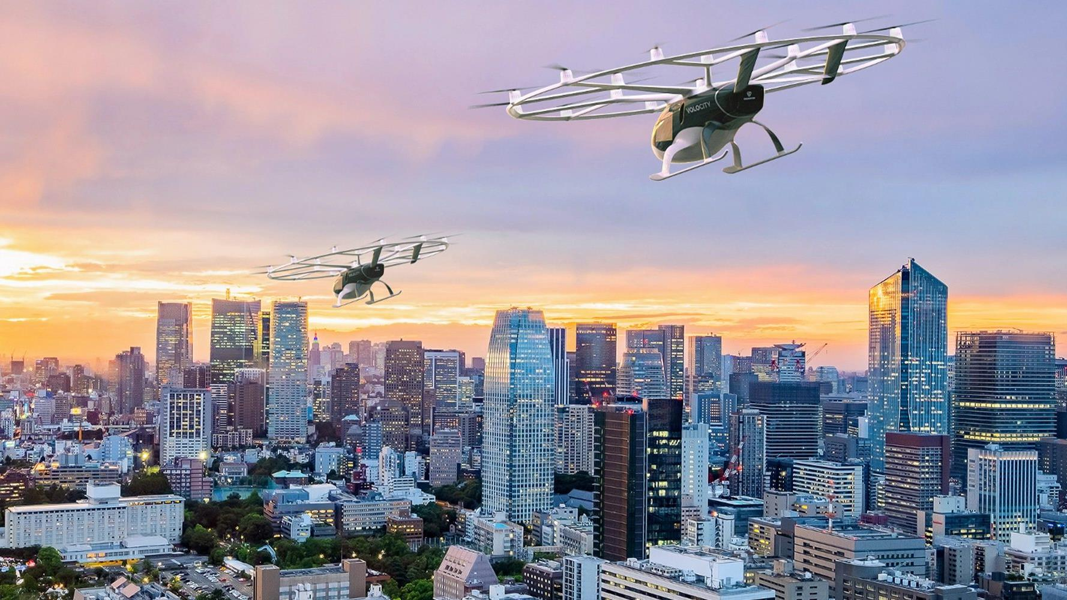

Urban Air Mobility

Slide 13
Common vision in the AI Region
The EUSAIR action plan is under revision which includes urban mobility among the key focus areas for the Pillar 2
Sustainable urban mobility is a topic of cross-pillar relevance for the Adriatic-Ionian Region, with significant potential synergies with the development of sustainable tourism, greener cities and ports
The EUSAIR transport masterplan is under finalization: it will be a strategic document to support a common and integrated development of sustainable urban mobility through innovative transport policies

Slide 14
Thanks for the attention!
Prof. Pierluigi Coppola
pierluigi.coppola@mit.gov.it
8TH Annual EUSAIR FORUM – Sarajevo, 25th May 2023

