Slide 1
Blue growth emerging/promising sectors fostering development and sustainability in the Adriatic and Ionian Region
8th EUSAIR FORUM – Pillar 1 “Blue Growth”
23-25 May 2023, Sarajevo, Bosnia and Herzegovina
Dr ELENI HATZIYANNI
DG MARE, European Commission

Slide 2
Blue economy in the EU (EU Blue Economy Report, 2022)
All sectoral and cross-sectoral economic activities based on or related to oceans, seas and coasts
4.45
million
direct jobs
EUR 667.2
billion annual turnover
Established and emerging sectors

Slide 3
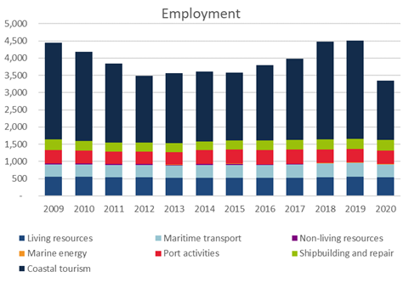
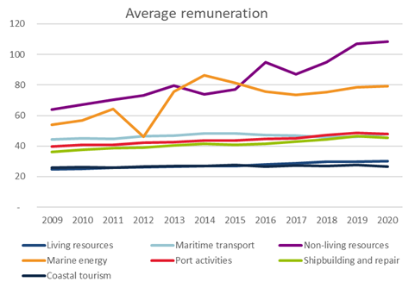
Employment (thousand people) and the gross remuneration per employee (€ thousand) in the EU (EU Blue Economy Report, 2023)

Slide 4
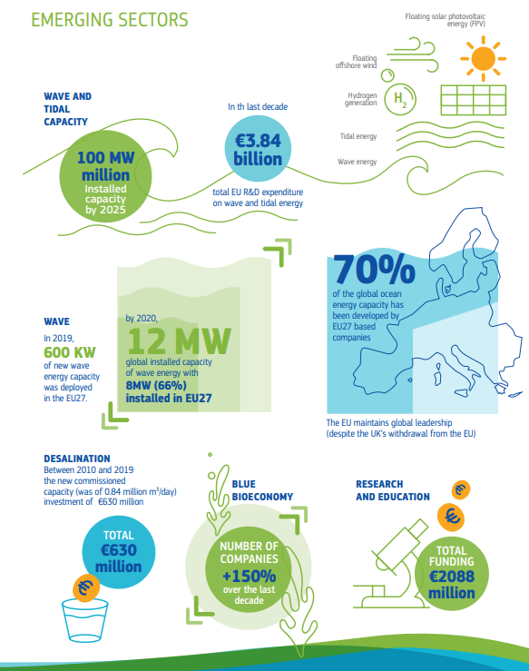
Source: EU Blue Economy Report 2021

Slide 5
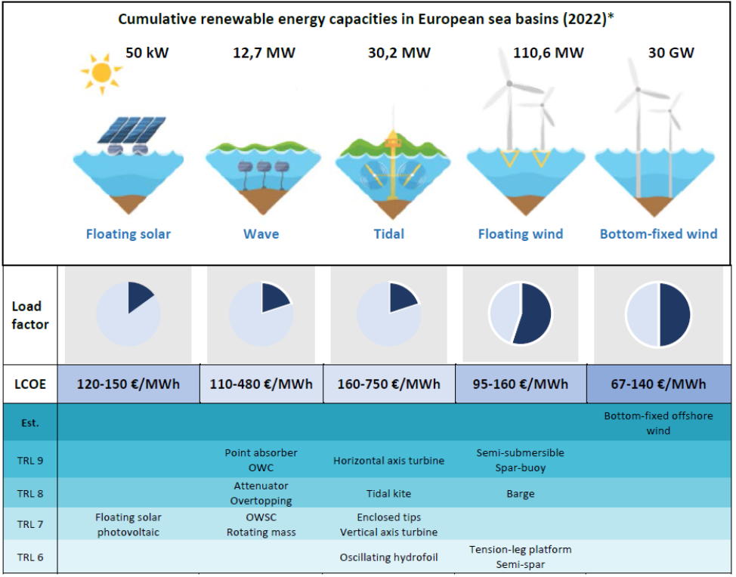
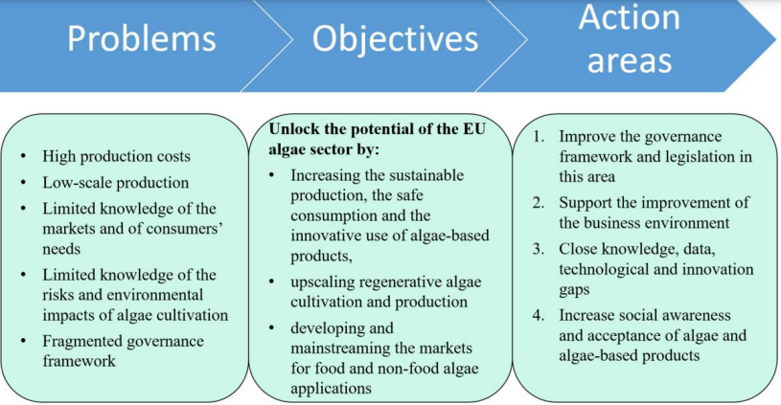
Emerging BE sectors: examples
Blue Energy
Algae Sector

Slide 6
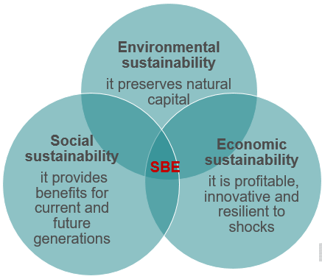
New approach for a sustainable blue economy in the EU (2021)
Enormous Blue Economy growth potential still untapped
Opportunities to be exploited in a sustainable way
2030 Agenda
European Green Deal
There is no green without blue
Support recovery and more sustainable resilient socio economic models
Need for a reinforced multi level/multi sector governance

Slide 7
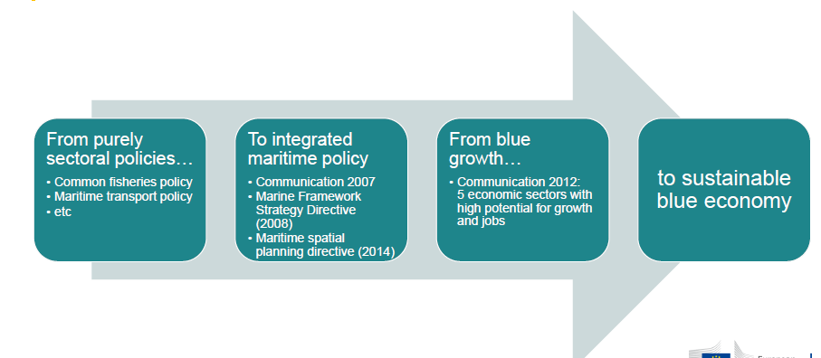
From Blue Growth to the Sustainable Blue Economy

Slide 8
Implementation: Transforming blue economy value chains
Decarbonisation
-Explore the full potential of offshore renewable energy
-Transition to zero emission vessels
- Transform ports in hubs for sustainable development
Etc…
Circularity
- Get rid of macro-plastics
Responsible food systems
- Meet the CFP sustainability standards
-Implement the strategic aquaculture guidelines
-Invest in macro and micro algae
Etc…
Biodiversity and coastal resilience
-Protect and restore coastal and marine ecosystems
-Invest in nature- based solutions
-Value natural capital by promoting sustainable tourism
Etc…
- Invest in circular design of fishing gears
- Develop recycling facilities for ships, recreational boats, offshore platforms and wind farms
Etc…

Slide 9
Implementation: recent initiatives & enablers
Fisheries and Oceans package, February 2023:
1.A Communication on the Energy Transition of the EU Fisheries and Aquaculture sector;
2.an Action Plan to protect and restore marine ecosystems for sustainable and resilient fisheries;
3.a Communication on the common fisheries policy today and tomorrow
4. a Report on the Common Market Organisation for fishery and aquaculture products.
Updated EU Maritime Security Strategy, March 2023
Cross-cutting enablers: regional maritime cooperation, smart specialisation, etc.

Slide 10
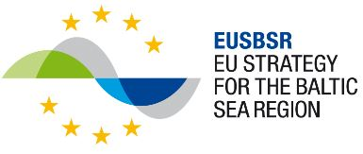
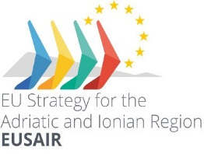
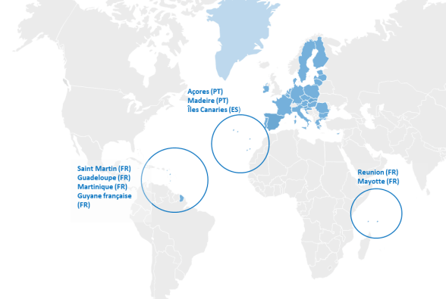
EU Sea-basin and Macro-regional Strategies
Atlantic Strategy
WestMED Initiative
Common Maritime Agenda for the
Black Sea (CMA)
EU Strategy for the Baltic Sea Region (EUSBSR)
OM regions
EU Strategy for the Adriatic and Ionian Region (EUSAIR)

Slide 11
Innovation - Smart Specialisation Strategies (S3)
Key tool for implementing the EU Sustainable Blue Economy Communication
Location-based approach involving all blue economy stakeholders in identification of sectors with competitive advantage to prioritize innovation investments
Enabler for new blue economy value chains, based on interregional innovation partnerships and projects

Slide 12
In line with the 3 pillars of S3
- Localisation
- Prioritisation
- Participation
Mobilising Stakeholders:
5 thematic workshops (May-July 2022):
With a 3fold overall objective
1. inform and mobilise blue economy stakeholders on the opportunities of setting up S3 interregional partnerships, in particular in the framework of the new Interregional Innovation Investments ERDF instrument and related open call
2. with a broader perspective, promote blue economy interregional value chains and related cooperation
3. identify stakeholders’ needs in order to fine-tune the services of the S3 platform for sustainable blue economy.
A follow up hybrid event on 25th October 2022
back to back with CPMR GA and EUSAIR Pillar 1 Conference

Slide 13
S3 Brokerage Workshops: Findings and highlights
Blue Biotechnologies:
Bluebiotechnology : very promising blue economy sector with a significant innovation potential
algae as a contributor for sustainable food
There is willing to upscale both the existing industry on microalgae
Bio products from invasive species
Bioplastics and farming waste materials_ circularity
Aquaculture to go hand to hand with blue biotechnology/research facilities.

Slide 14
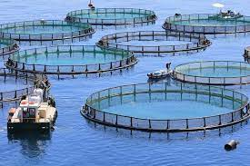
S3 Brokerage Workshops: Findings and highlights
Aquaculture:
New types of energy in Aquaculture can be considered as it is about lowering carbon footprint.
Aquaponics is another area to explore as it provides a “basket of products”
Explore regulatory and business models for IMTA (Integrated Multitrophic Aquaculture).
Space + Investments: identify areas to develop aquaculture
For Mussel farming we need more collaboration to research on the “plastic” that is already
existent in the material used.
Consider including frog farming in the aquaculture sector activities

Slide 15
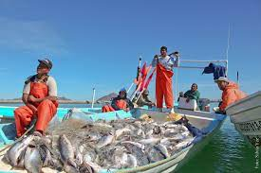
S3 Brokerage Workshops: Findings and highlights
Fishery:
Social innovations: Better governance; organisation of the fishing sector; involvement of fishermen in decision making and adoption of new ways of working; engagement of the young;
Innovations to reduce the environmental impact of fishing:
pollution & marine litter decarbonisation / electric engines; use of biodegradable materials; circular economy;
Marketing and product innovation: short circuits; traceability; product quality; use of under-utilised and/or invasive species; health and biotechnology
Data and digitalisation; robotics; vessel monitoring systems; better use of data.

Slide 16
Smart Specialisation Strategies (S3)
2021
Analysis of blue economy sectors with S3 potential
2022
Brokerage sessions with blue economy stakeholders
2022
Establishment of S3 Thematic Platform for Sustainable Blue Economy
2023 (Mar)
Launch of the S3 Community of Practice and related services (S3CoP)
2023 (next)
Creation of S3 interregional partnerships on sustainable blue economy sectors (matchmaking, call for partnerships, etc.)
2023/2024
New S3 partnerships accessing support services and funding opportunities
2024 (2nd half)
Potential EMFAF call for proposals on S3 in blue economy (tbc)

Slide 17
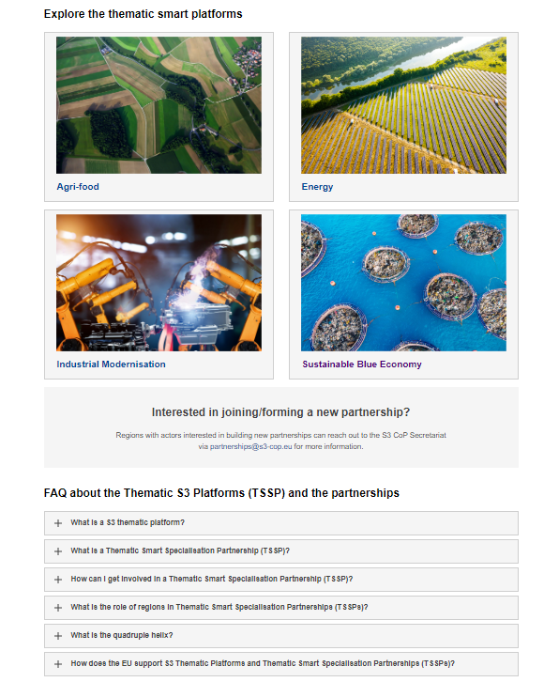
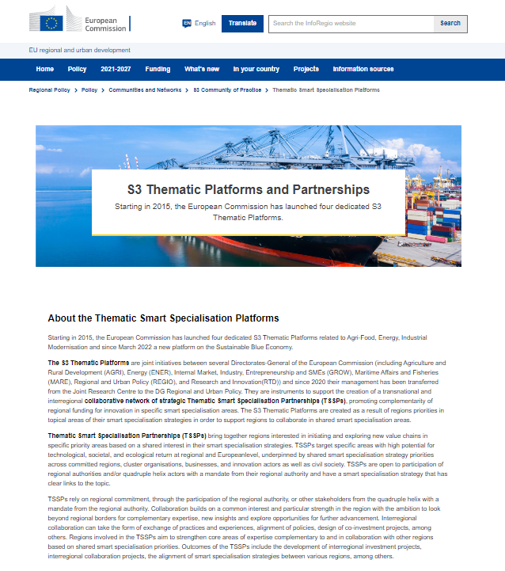
S3 Platform on Sustainable Blue Economy
Inforegio - Thematic Smart Specialisation Platforms (europa.eu)

Slide 18
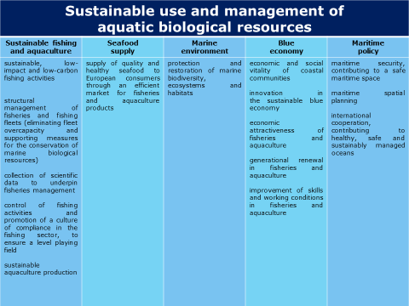
European Maritime, Fisheries and Aquaculture Fund - EMFAF 2021-2027
Scope
The EMFAF supports the EU common fisheries policy (CFP), the EU maritime policy and the EU agenda for international ocean governance. It provides financial support for developing innovative projects ensuring that aquatic and maritime resources are used sustainably.
The EMFAF is programmed for 2021-2027 with a budget of €6.108 billion, broken down as follows:
€5.311 billion (87%) shared management,
€797 million (13%) direct management.

Slide 19
European Maritime, Fisheries and Aquaculture Fund
EMFAF
How does the EMFAF help develop a sustainable blue economy?
The EMFAF focuses on the enabling conditions for the development of the sustainable blue economy and on removing bottlenecks to facilitate investment in new markets, technologies and services.
In particular, it supports:
maritime governance to coordinate human activities at sea in a sustainable manner (e.g. through ‘maritime spatial planning’)
the transfer and uptake of research, innovation and technology in private investment
the development of maritime skills
the dissemination of marine and maritime environmental and socio-economic data
the development of project pipelines to leverage private investment.

Slide 20
EMFAF
Flagship call 2022
Direct Management
2 new topics for the Mediterranean
Sustainable transport and ports in the Mediterranean
Maritime clusters as an innovative enabler for a Sustainable Blue Economy in the Mediterranean
Topics for the other sea basins:
Diversification of fisheries activities in the Atlantic area
Harnessing preparedness and response to marine pollution in the Black Sea
Sustainable maritime and coastal tourism in the Outermost Regions
Regenerative ocean farming in the Baltic Sea Region

Slide 21
Mission: Restore our Ocean and Waters by 2030
Protect and restore marine and freshwaters ecosystems and biodiversity
Protect at least 30% and strictly protect 10% EU’s sea areas
Prevent and eliminate pollution of our oceans, Seas and waters
Make the blue economy carbon- neutral and circular
Net zero maritime emissions
Zero carbon aquaculture,
Reduce by at least 50% plastic litter
Restore 25.000 km free flowing rivers
Marine nature restoration targets (incl. degraded seabeds, coastal ecosystems)
Reduce by at least 30% microplastics
Reduce by at least 50% nutrient losses, chemical pesticides
Low carbon multipurpose use of marine space
Restore our Ocean and Waters by 2030
ENABLERS
Digital Ocean and Waters Knowledge system
Public mobilization and engagement

Slide 22
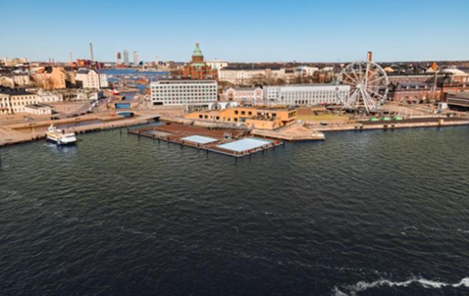
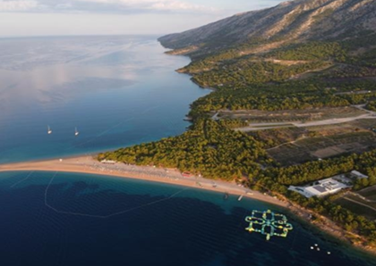
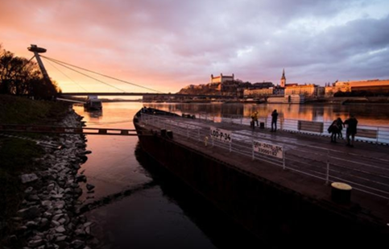
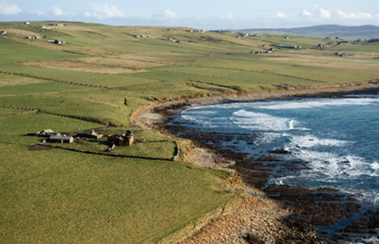
Mission lighthouses: sites to pilot, demonstrate, develop and deploy the Mission activities across EU seas and river basins
Baltic & North sea basin
Mediterranean sea basin
Make the blue economy carbon- neutral and circular
Prevent and eliminate pollution of our ocean, seas and waters
Danube river basin
Atlantic & Arctic coast
Protect and restore marine and freshwaters ecosystems and biodiversity

Slide 23
Horizon Europe – Mission Ocean and Waters Work Programmes & Calls
CALL - EUR 114 million | Grant Agreement signed
117 M€ EU funding (124.4 M€ total project cost)
CALL - EUR 117.9 million | Grant agreement preparation on-going
CALL – EUR 118.7M | WP adopted on 6 December 2022
Calls open!
2021
2022
2023
Notes:
[Roberta]

Slide 24
WP 2023 - Mission Ocean and Waters adopted on 6 December 2022: main features
Follows the impact-driven logic of Horizon Europe and European Missions
Supports major EU policy objectives: EU Biodiversity Strategy 2030, EU Action Plan toward Zero pollution, the Communication on a Sustainable Blue Economy, The Nature restoration Law
Special focus on «lighthouses»: hubs for the development and deployment of transformative innovations (technological, social, business, governance) in 4 basins:
Atlantic and Arctic sea basin
Baltic and North Sea basin
Mediterranean sea basin
Danube river basin
Based on the Mission Implementation Plan, 2023 WP complements WP 2021 and 2022 with further actions and new research & innovation areas
Supports the Mission first phase: «development and piloting» for 2021-2025
Notes:
[Roberta]

Slide 25
WP 2023 - Mission Ocean and waters adopted on 6 December 2022: main features
2023 calls addressing 3 policy objectives as well as the enabling activities:
Protect and restore marine and freshwater ecosystems and biodiversity
Prevent and eliminate pollution of our oceans, seas and waters
Sustainable, carbon-neutral and circular Blue economy
Enabling activities: digital ocean & water knowledge system (DTO) and public mobilisation and engagement
Other actions: common to all Mission (Mission Boards; solidarity corps)
Indicative budget 2023: EUR 87.7 million + EUR 31 million for joint calls
Call opening: 7 December 2022
Call closing date: 20 September 2023
Notes:
[Roberta]

Slide 26
SBE Partnership
As a Horizon Europe Co-funded Partnership, it constitutes a network of 60 partner institutions from 25 countries and the European Commission that enables an unprecedented effort to combine and align pan-European, regional and national investments and the identified socio-political priorities for marine and maritime research and innovation.
It pools research and innovation investments of EUR 450 million over 7 years (with €150 million EU contribution from the Horizon Europe Programme), and aligns national programmes at pan-European scale, taking into consideration the sea-basin dimension (Med, Black Sea, Baltic and North Sea, and Atlantic Ocean)
The SBEP supports R&I in five intervention areas, which are also related to the Mission objectives:
- ‘Development and Validation of Ocean Digital Twin (ODT) at the sub-sea basin scale’
(IA1),
- ‘Blue generation marine structures’ (IA2),
- ‘Planning and managing sea-uses’ (IA3),
- ‘Blue Food’ under a ’One Health’ approach (IA4), and
- ‘Enabling the green transition of ‘Blue Food’ production’ (IA5)

Slide 27
Thank you! Eleni.HATZIYANNI@ec.europa.eu
© European Union 2020
Unless otherwise noted the reuse of this presentation is authorised under the CC BY 4.0 license. For any use or reproduction of elements that are not owned by the EU, permission may need to be sought directly from the respective right holders.

