Slide 1
Regional Innovation Strategy for Smart Specialisation Strategies (S3) in the EUSAIR
ADRIATIC-IONAIN REGION (EUSAIR) S3 NETWORK A PUSH FOR STRENGTHENED INTERNATIONALISATION:
Third EUSAIR Innovation Community Meeting
Roberta Ruggeri
Centre for Innovation and Entrepreneurship: http://c2i.dii.univpm.it

Slide 2
Regional Innovation Strategy for Smart Specialisation Strategies (S3) in the EUSAIR
Aims
Remarks
Data and Methodology
Empirical Results
Background

Slide 3
Aims
Provide an empirical assessment of the actual overlap between the EUSAIR pillars and the S3 areas indicated by EUSAIR countries and regions in the programming period 2014-2020.
Notes:
I will not illustrate the S3, that will take much time. I know the audience know well the approach.
According to the EU Commission Taking into account national contributions and other private investment, the impact of Cohesion Policy for 2014-2020 is expected to be about EUR 450 billion. Intended to meet the goals of the Europe 2020 strategy for smart, sustainable and inclusive growth in the EU
AT 12.35
BE 22.84
BG 75.88
CY 7.36
CZ 219.83
DE 192.35
DK 5.53
EE 35.90
EL 155.22
ES 285.59
FI 14.66
FR 158.53
HR 86.09
HU 219.06
IE 11.89
IT 328.23
LT 68.23
LU 0.60
LV 45.12
MT 7.25
NL 14.04
PL 775.67
PT 214.65
RO 229.94
SE 21.06
SI 30.75
SK 139.92
UK 118.40

Slide 4
Background
The concept of smart specialisation emerged within the “Knowledge for Growth” expert group (Foray et al. 2009)
It was taken by the European Commission as the central pillar of the 2014-2020 cohesion policy (European Commission, 2010).
Ex –ante condition for the allocation of ESI funds under 2014-2020 TO1 (research and innovation)
Notes:
I will not illustrate the S3, that will take much time. I know the audience know well the approach.
According to the EU Commission Taking into account national contributions and other private investment, the impact of Cohesion Policy for 2014-2020 is expected to be about EUR 450 billion. Intended to meet the goals of the Europe 2020 strategy for smart, sustainable and inclusive growth in the EU
AT 12.35
BE 22.84
BG 75.88
CY 7.36
CZ 219.83
DE 192.35
DK 5.53
EE 35.90
EL 155.22
ES 285.59
FI 14.66
FR 158.53
HR 86.09
HU 219.06
IE 11.89
IT 328.23
LT 68.23
LU 0.60
LV 45.12
MT 7.25
NL 14.04
PL 775.67
PT 214.65
RO 229.94
SE 21.06
SI 30.75
SK 139.92
UK 118.40

Slide 5
S3 in cohesion policy
Background
Dissatisfaction for the results of cohesion policy (raising inequalities among regions)
Need for ‘place based’ policy at regional level (2009 - Barca report on cohesion policy)
More effective link between R&D and innovation (Foray et al. 2009)
Structural "gap" between Europe and the USA, as result of a lower economic and technological specialisation and lower ability to prioritize efforts and investments at regional level
Taking into account national contributions and other private investment, the impact of Cohesion Policy for 2014-2020 is expected to be about EUR 450 billion
EU Commission
Notes:
I will not illustrate the S3, that will take much time. I know the audience know well the approach.
According to the EU Commission Taking into account national contributions and other private investment, the impact of Cohesion Policy for 2014-2020 is expected to be about EUR 450 billion. Intended to meet the goals of the Europe 2020 strategy for smart, sustainable and inclusive growth in the EU
AT 12.35
BE 22.84
BG 75.88
CY 7.36
CZ 219.83
DE 192.35
DK 5.53
EE 35.90
EL 155.22
ES 285.59
FI 14.66
FR 158.53
HR 86.09
HU 219.06
IE 11.89
IT 328.23
LT 68.23
LU 0.60
LV 45.12
MT 7.25
NL 14.04
PL 775.67
PT 214.65
RO 229.94
SE 21.06
SI 30.75
SK 139.92
UK 118.40

Slide 6
Background
The Smart Specialisation Strategy (S3) – «pillars»
the concentration of (public and private) resources for R&D and innovation in few technological domains (specialisation)
the specialisation domains must be chosen to complement the research and productive assets in which regions show superior innovative capabilities(smart)
Notes:
I will not illustrate the S3, that will take much time. I know the audience know well the approach.
According to the EU Commission Taking into account national contributions and other private investment, the impact of Cohesion Policy for 2014-2020 is expected to be about EUR 450 billion. Intended to meet the goals of the Europe 2020 strategy for smart, sustainable and inclusive growth in the EU
AT 12.35
BE 22.84
BG 75.88
CY 7.36
CZ 219.83
DE 192.35
DK 5.53
EE 35.90
EL 155.22
ES 285.59
FI 14.66
FR 158.53
HR 86.09
HU 219.06
IE 11.89
IT 328.23
LT 68.23
LU 0.60
LV 45.12
MT 7.25
NL 14.04
PL 775.67
PT 214.65
RO 229.94
SE 21.06
SI 30.75
SK 139.92
UK 118.40

Slide 7
Background
S3 policies as catalyst of innovation and competitiveness.
Key issues
R&D/innovation
Core regions/peripheral regions
Specialisation/diversification
Industry sectors/technological domains
Top down/bottom up
Coherence/relatedness s/connectivity
Notes:
I will not illustrate the S3, that will take much time. I know the audience know well the approach.
According to the EU Commission Taking into account national contributions and other private investment, the impact of Cohesion Policy for 2014-2020 is expected to be about EUR 450 billion. Intended to meet the goals of the Europe 2020 strategy for smart, sustainable and inclusive growth in the EU
AT 12.35
BE 22.84
BG 75.88
CY 7.36
CZ 219.83
DE 192.35
DK 5.53
EE 35.90
EL 155.22
ES 285.59
FI 14.66
FR 158.53
HR 86.09
HU 219.06
IE 11.89
IT 328.23
LT 68.23
LU 0.60
LV 45.12
MT 7.25
NL 14.04
PL 775.67
PT 214.65
RO 229.94
SE 21.06
SI 30.75
SK 139.92
UK 118.40

Slide 8
Background
The Smart Specialisation Strategy (S3): a key concept
The S3 guide (Foray et al., 2012) emphasizes that in designing S3 regions should consider the actual and potential links between the domains
knowledge exchanges between different domains at regional level (relatedness)
knowledge exchanges between different regions specialising in similar or complementary domains (connectivity).
Notes:
I will not illustrate the S3, that will take much time. I know the audience know well the approach.
According to the EU Commission Taking into account national contributions and other private investment, the impact of Cohesion Policy for 2014-2020 is expected to be about EUR 450 billion. Intended to meet the goals of the Europe 2020 strategy for smart, sustainable and inclusive growth in the EU
AT 12.35
BE 22.84
BG 75.88
CY 7.36
CZ 219.83
DE 192.35
DK 5.53
EE 35.90
EL 155.22
ES 285.59
FI 14.66
FR 158.53
HR 86.09
HU 219.06
IE 11.89
IT 328.23
LT 68.23
LU 0.60
LV 45.12
MT 7.25
NL 14.04
PL 775.67
PT 214.65
RO 229.94
SE 21.06
SI 30.75
SK 139.92
UK 118.40

Slide 9
Background
The importance of connectivity
In designing S3 regions they should consider the actual and potential links between the domains
knowledge exchange between different domains at regional level (relatedness)
knowledge exchange between different regions specialising in similar or complementary domains (connectivity).
Innovation
“… smart specialisation is also pointing regions towards more strategic cross-border and trans-regional cooperation to achieve more critical potential and related variety.”
Complementarity
Relations between ‘core’ regions (at the frontier of technology) and ‘peripheral’ regions (applying such technology to specific domains)
The S3 guide (Foray et al., 2012)
Notes:
I will not illustrate the S3, that will take much time. I know the audience know well the approach.
According to the EU Commission Taking into account national contributions and other private investment, the impact of Cohesion Policy for 2014-2020 is expected to be about EUR 450 billion. Intended to meet the goals of the Europe 2020 strategy for smart, sustainable and inclusive growth in the EU
AT 12.35
BE 22.84
BG 75.88
CY 7.36
CZ 219.83
DE 192.35
DK 5.53
EE 35.90
EL 155.22
ES 285.59
FI 14.66
FR 158.53
HR 86.09
HU 219.06
IE 11.89
IT 328.23
LT 68.23
LU 0.60
LV 45.12
MT 7.25
NL 14.04
PL 775.67
PT 214.65
RO 229.94
SE 21.06
SI 30.75
SK 139.92
UK 118.40

Slide 10
Entrepreneurial discovery process
Background
should be the result of a bottom-up process to involve all the main private and public stakeholders according to the 4 helix approach
“… entrepreneurs must be understood in a broad sense (firms, higher education institutions, public research institutes, independent inventors and innovators) and include whoever is in the best position to discover the domains of R&D and innovation in which a region is likely to excel given its existing capabilities and productive assets”
S3 Guide(Foray et al. 2012).
Notes:
I will not illustrate the S3, that will take much time. I know the audience know well the approach.
According to the EU Commission Taking into account national contributions and other private investment, the impact of Cohesion Policy for 2014-2020 is expected to be about EUR 450 billion. Intended to meet the goals of the Europe 2020 strategy for smart, sustainable and inclusive growth in the EU
AT 12.35
BE 22.84
BG 75.88
CY 7.36
CZ 219.83
DE 192.35
DK 5.53
EE 35.90
EL 155.22
ES 285.59
FI 14.66
FR 158.53
HR 86.09
HU 219.06
IE 11.89
IT 328.23
LT 68.23
LU 0.60
LV 45.12
MT 7.25
NL 14.04
PL 775.67
PT 214.65
RO 229.94
SE 21.06
SI 30.75
SK 139.92
UK 118.40

Slide 11
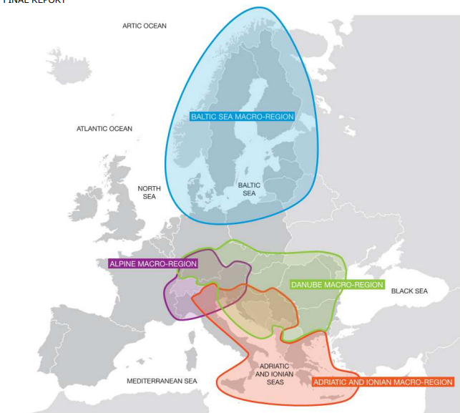
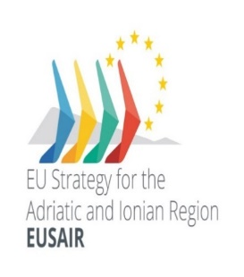
EU Macro-Regional Strategies
Background
2009
emerged as “integrated framework(s) during the same time span
2015
2014
2011
3 main, broad, interconnected priorities in common:
environment and climate change
research & innovation and economic development
connectivity (transport, energy, digital networks)
Notes:
closely connected with key actions of the European Green Deal as well as the European Digital Agenda and “An economy that works for people”. EU COMMISSION. COM(2020) 578 final.
+ North Macedonia
the three, broad, interconnected priorities that all four MRS have in common
These three priorities are closely connected with key actions of the European Green Deal as well as the European Digital Agenda and “An economy that works for people”.

Slide 12
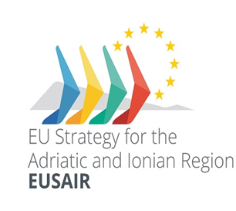
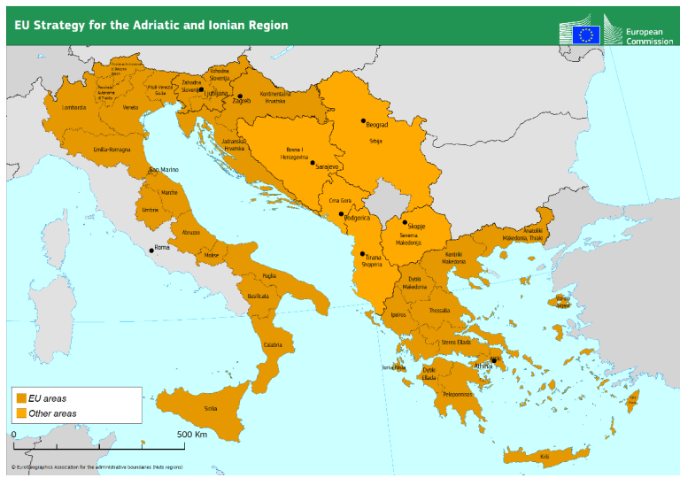
EUSAIR – aims and pillars
Background
To promote economic and social prosperity and growth in the region by improving its attractiveness, competitiveness and connectivity. ….will contribute to the further integration of the Western Balkans.
Covers 10 countries
4 EU Member States (Croatia, Greece, Italy, Slovenia)
6 non –EU Contries (Bosnia and Herzegovina, Montenegro, Serbia North Macedonia- 2020, San Marino -2022)
14 Italian regions
Notes:
The Macroregion which is based on the EU Strategy for the Adriatic Ionian Region (EUSAIR) is not a geographical entity, but a functional area, composed of national, regional, and local bodies pooling their energies to tackle a number of shared issues

Slide 13
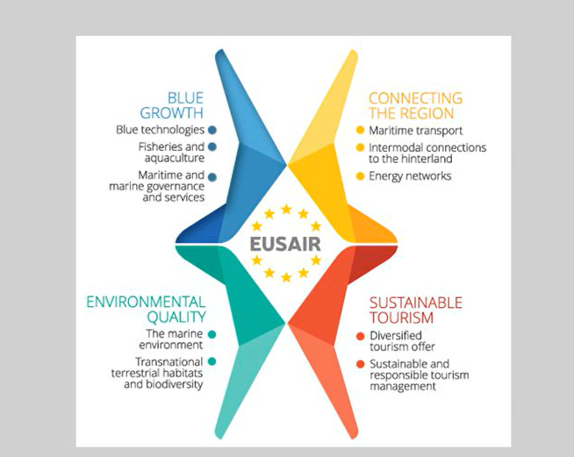
EUSAIR – aims and pillars
Background
4 main pillars
2 Cross-Cutting aspects (capacity-building; research and innovation)
2 horizontal principles for all the four pillars (climate change mitigation and adaptation, disaster risk management)

Slide 14
Background
Ex-ante conditionality
2014-2020 within Europe’s 2020 strategy S3 represented the key feature of reformed Cohesion Policy (Radosevic, 2017)
a major novelty for the allocation of cohesion funds; specifically, funds addressed to foster research and innovation TO1 (research and innovation)
S3 required countries and regions to choose key areas on which to concentrate resources. Public and private investment in R&D and innovation should be focused (Foray, 2014).
Non-EU countries were not required to design S3 to access TO1 ERDF funds. But given the transformative approach of S3 and the interest for the pre-accession countries to align their policies with the “acquis communautaire”, some of them designed development strategies following the requirements of S3 (i.e. Montenegro, Serbia (Capello et al., 2020; Matusiak and Kleibrink, 2018).
Notes:
I will not illustrate the S3, that will take much time. I know the audience know well the approach.
According to the EU Commission Taking into account national contributions and other private investment, the impact of Cohesion Policy for 2014-2020 is expected to be about EUR 450 billion. Intended to meet the goals of the Europe 2020 strategy for smart, sustainable and inclusive growth in the EU
AT 12.35
BE 22.84
BG 75.88
CY 7.36
CZ 219.83
DE 192.35
DK 5.53
EE 35.90
EL 155.22
ES 285.59
FI 14.66
FR 158.53
HR 86.09
HU 219.06
IE 11.89
IT 328.23
LT 68.23
LU 0.60
LV 45.12
MT 7.25
NL 14.04
PL 775.67
PT 214.65
RO 229.94
SE 21.06
SI 30.75
SK 139.92
UK 118.40

Slide 15
Data and methodology
Classification and mapping of EUSAIR pillars
Pillars | Topics | Key-words
1. Blue Growth | 1.1 Blue tehnologies | Shipbuilding Marine technologies Blue economy sectors
 | 1.2 Fisheries and Aquaculture | Fisheries Aquaculture Aquatic ecosystems Seadfood production
 | 1.3 Maritime and marine governance and services | Marine services Marine governance Sea basin governance
2.Connecting the region | 2.1 Maritime transport | Maritime security Marine transports
 | 2.2 Intermodal connections to the hinterland | Terrestrial transports Intermodal connections
 | 2.3 Energy networks | Gas and power networks
3.Environmental Quality | 3.1 The marine environment | Aquatic ecosystems Marine environment Water pollution Waste management
 | 3.2 Transnational terrestrial Habitats and Biodiversity | Coastal environment Marine and terrestrial biodiversity
4. Sustainable Tourism | 4.1 Diversified tourism (Products and Services) | Demand seasonality Cultural industry
 | 4.2 Sustainable and Responsable Tourism | Sustainable tourism Cultural heritage
Identified from the description of pillars
Notes:
How to classify EUSAIR pillars and how to map them into the S3 specialisation areas?
The table provides the list of EUSAIR pillars and topics as they were specified at the setting of the strategy and as indicated in its action plan.

Slide 16
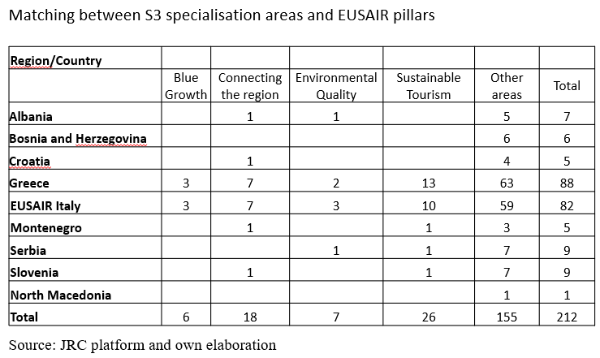
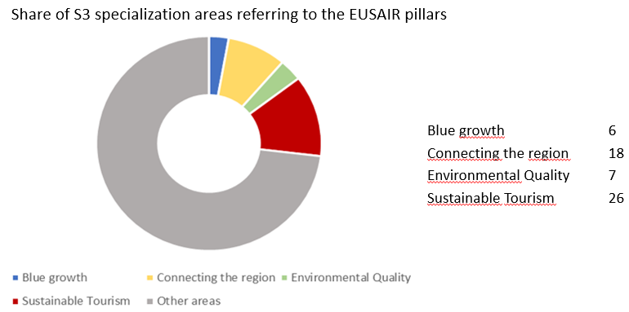
Empirical Results
About a quarter of the specialisation areas indicated by regions and countries in their S3 documents are related to EUSAIR pillars.
The overlapping is mostly observed for the pillars referring to sustainable tourism and connecting the regions (energy and transportations) while blue growth and environmental quality show a low presence in S3 specialization areas.
Notes:
4 territorial entities have not adopted an S3 that presents common themes with EUSAIR - there is no appearing overlap
For no EUSAIR NUTS 2 S3 covers the themes of all 4 pillars

Slide 17
Data and methodology
The analysis covers 33 territorial units (countries/regions) with info at relevant territorial level NUTS 2
S3 Platform + direct examination of S3 documents and the identification of specialisation areas
Two main limitations in collecting information
no common way to indicate S3 areas of specialisation.
no homogeneity in the definition and classification
Further check for validation of the previous analysis;
Opencoesione database - consider the actual allocation of funds rather than the initial intentions declared in S3 documents. Collected information on the actual projects financed under TO1. For Italian regions.
Notes:
IT, GR – at regional level;
SI, HR, AL & BA (only R&I), RS and ME – at national level;
MK – only info at the quantitative mapping of economic, research and innovation potentials in the S3 process at
national level!
In most cases RIS3 has been implemented at NUTS 2 level (as the Italian regions); in some other cases, it has been implemented at country level (NUTS 0)². The Territorial level responsible for the development of RIS3 is only national in Albania, Bosnia and Herzegovina, Montenegro and Serbia (North Macedonia entered EUSAIR in March 2020 and actually is not censed) Croatia and Slovenia and both national and regional for Greece (13 +1) and Italy (21+1). The implementation of 9 national and 34 regional S3 is carried out by national and regional operation programs. So that, in theory the quantitative analysis could be referred to 34 territorial entities in the EUSAIR (including the national level for Greece and Italy).

Slide 18
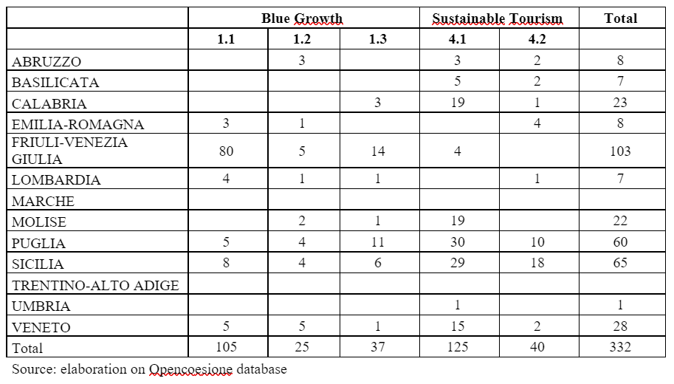
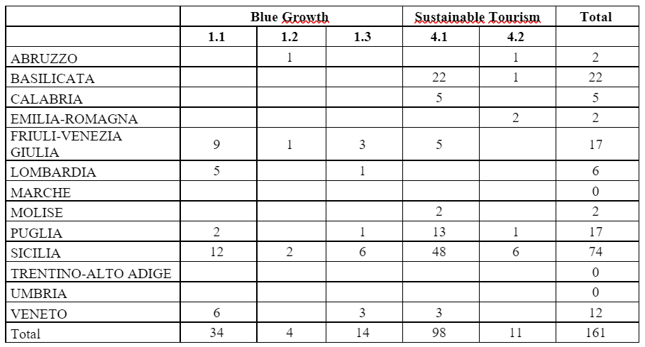
Empirical Results
Italian regions - 14 EUSAIR territorial units out of 33 - The empirical analysis refers to slightly less than 20,000 projects with an overall amount of more than 7 billion euros.
two pillars: pillar 1 (Blue Growth) and Pillar 4 (
Number of projects financed with ERDF-TO1 funds by regions 2014-2020
Amount of public funds allocated to project under ERDF TO1 2014-2020 (million Euros)
Notes:
4 territorial entities have not adopted an S3 that presents common themes with EUSAIR - there is no appearing overlap
no EUSAIR NUTS 2 S3 covers the themes of all 4 pillars
In the case of the blue growth pillar only two regions, i.e. Friuli Venezia Giulia and Veneto, show a significant share of projects and funds dedicated to the topics of this EUSAIR pillar. In the case of Friuli Venezia Giulia this is coherent with the S3 priorities while Veneto did not explicitly prioritise blue pillar topics in its S3 document. On the contrary, the other two regions that indicated blue growth topics in their S3 documents (Puglia and Sicilia) allocated a very small share of funds to these topics.
Topics associated with Pillar 4 (Sustainable tourism) were indicated by almost all the regions. However, only some of them allocated a significant share of funds to these topics: Basilicata, Sicilia, Molise, Friuli Venezia Giulia and Veneto. Here too the regions with no projects are Marche and Trentino Alto Adige.
Overall, three regions, Friuli Venezia Giulia, Veneto and Sicilia show a significant share of their S3 projects with the two pillars considered. Basilicata and Molise show a significant share only in pillar 4 (Sustainable tourism). All the other regions show a percentage of funds around or under 1% of total funds.

Slide 19
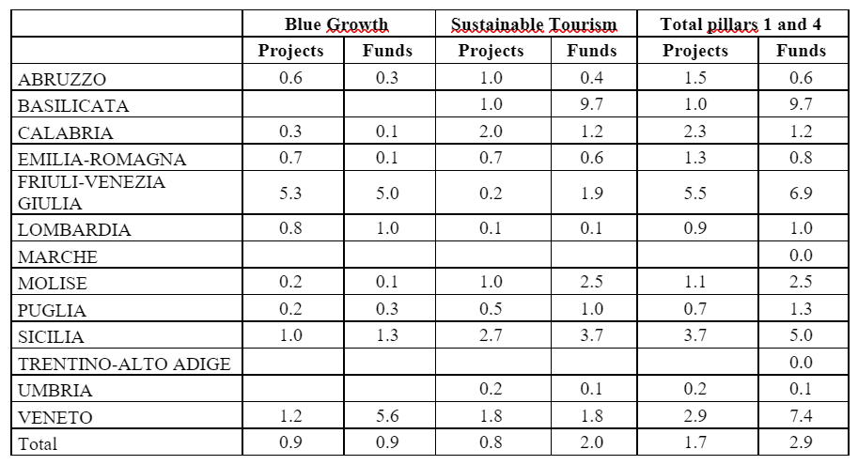
Empirical Results
Share of projects and funds referring to EUEAIR pillars 1 and 4 under ERDF TO1 2014-2020 (% on total)
blue growth pillar 1 only two regions, Friuli Venezia Giulia and Veneto, show a significant share of projects and funds. In the case of FVG this is coherent with the S3 priorities. Veneto did not explicitly prioritise blue pillar topics in its S3 document. Puglia and Sicilia indicated blue growth topics in their S3 documents but allocated a very small share of funds to them.
Sustainable tourism pillar 4 indicated by almost all regions. But only some of them allocated a significant share of funds: Basilicata, Sicilia, Molise, Friuli Venezia Giulia, and Veneto. No projects for Marche and Trentino Alto Adige. .
3 regions, Friuli Venezia Giulia, Veneto, and Sicilia show a significant share of their S3 projects with the two pillars considered. Basilicata and Molise show a significant share only in pillar 4. All the other regions show a percentage of funds around or under 1% of total funds
Notes:
4 territorial entities have not adopted an S3 that presents common themes with EUSAIR - there is no appearing overlap
no EUSAIR NUTS 2 S3 covers the themes of all 4 pillars
In the case of the blue growth pillar only two regions, i.e. Friuli Venezia Giulia and Veneto, show a significant share of projects and funds dedicated to the topics of this EUSAIR pillar. In the case of Friuli Venezia Giulia this is coherent with the S3 priorities while Veneto did not explicitly prioritise blue pillar topics in its S3 document. On the contrary, the other two regions that indicated blue growth topics in their S3 documents (Puglia and Sicilia) allocated a very small share of funds to these topics.
Topics associated with Pillar 4 (Sustainable tourism) were indicated by almost all the regions. However, only some of them allocated a significant share of funds to these topics: Basilicata, Sicilia, Molise, Friuli Venezia Giulia and Veneto. Here too the regions with no projects are Marche and Trentino Alto Adige.
Overall, three regions, Friuli Venezia Giulia, Veneto and Sicilia show a significant share of their S3 projects with the two pillars considered. Basilicata and Molise show a significant share only in pillar 4 (Sustainable tourism). All the other regions show a percentage of funds around or under 1% of total funds.

Slide 20
Final remarks
Research question Background Data and methodology Empirical results Conclusions
Both the implementation of S3 and MRSs are based on a complex architecture of multilevel governance.
Both S3 and MRSs are based on the identification of sectoral priorities - embedding
EUSAIR - has a predefined set of themes (pillars)
S3 - countries and regions are free to choose their specialisation areas
EUSAIR already consolidated framework to develop S3
The overlapping between S3 specialization areas and EUSAIR pillars is less widespread than expected.
Only on quarter of S3 specialization areas may by associated with EUSAIR pillars and topics. Most common association to sustainable tourism (tourism and cultural heritage) and connecting the region (energy and transport).
Only a few of the EUSAIR regions and countries selected topics related to blue growth and environmental quality.
Possible explanations:
S3 was designed before the institutions of EUSAIR
the attention to environmental and marine issues has raised during the last decade
Notes:
Macro-regions are not strictly an instrument of territorial cohesion, if we compare to Ris3 ex ante conditionality or enabling conditions for funds (TO1 “Strengthening research, technological development and innovation”), but EUSAIR is unique in that it involves countries states (Albania, Bosnia - Herzegovina, Montenegro, Serbia, North Macedonia -from April 2020), potentially eligible to join EU and it expressly aims “to contribute to the Western Balkans’ process of integration into the EU” (European Commission 2014a)

Slide 21
Final remarks
In the framework of the 3 No’s’ principle: (no new EU legislation, no new EU institutions, no new EU fundings) on which macro regional strategies are based it is essential to effectively use existing instruments and funds to attain macro-regional objectives. It is important to take advantage of existing instruments and funds.
The integration between macro-regional pillars and S3 specialisation areas is specifically relevant in this regard; the two strategies share important similarities in their objectives and implementation process.
EUSAIR is unique in that it involves countries states potentially eligible to join EU (soft skills – acquis communautaire)
The integration between S3 and the macroregional strategy is specifically important for the non-EU EUSAIR countries to enhance their development policy and speed up the accession process to the EU – transformative logic
Notes:
Macro-regions are not strictly an instrument of territorial cohesion, if we compare to Ris3 ex ante conditionality or enabling conditions for funds (TO1 “Strengthening research, technological development and innovation”), but EUSAIR is unique in that it involves countries states (Albania, Bosnia - Herzegovina, Montenegro, Serbia, North Macedonia -from April 2020), potentially eligible to join EU and it expressly aims “to contribute to the Western Balkans’ process of integration into the EU” (European Commission 2014a)

Slide 22
Centre for Innovation and Entrepreneurship:
http://c2i.dii.univpm.it

Slide 23
Aims
In 2014-2020 programming period, the adoption of the S3 was an ex-ante conditionality for ERDF funding under the Thematic Objective 1 for Research and Innovation.(Regulation (EU) 1301/2021).
After the first piloting phase of S3 implementation, regions are called to design an updated version of S3 for the 2021-2027 programming period (enabling condition).
Given the logic of S3 and the experience gained from the 2014-2020 implementation we expect a better focus on investment priorities.

Slide 24
Remarks
“Smart but not specialized”
The design process (R&D context analysis, EPD, strengths and weaknesses analysis) is well established and better implemented compared to the previous programming period
The prioritization suffers from the enlargement of investment domains and the switch towards a systemic (inclusive) logic.
Notes:
New methodological approaches adopted to delimit the perimeter of the priorities seem to be gradually moving from the “specialisation logic" to a "diversification" one. A diversification of priority investment made within the Region rather than between regions. Indeed, almost all the investigated Italian regions modified the foreseen development trajectories set in 2021-2027 programming period.
Generally, a preliminary indication of the specialisation domains in relatively broad terms is provided. At the first level, the specialisation domains are limited in number (generally less than 10), even for large regions. Several other branching then specifies the priority fields included in the general priority definition. In this respect, while in the 2014 – 2020 programming period, the reference to a technology-driven approach meant a certain degree of comparable standardisation, in 2021, the reference to key enabling technologies is only residual and practically seems to have been lost. Also, the effort the EU made using the Eye@RIS3 platform and classifying each S3 domain according to three dimensions: the economic, the scientific and the policy dimension seems to have been unsuccessful. A lack of quantitative approaches in S3 documents is still present due to a non-standardized language .(D’Adda et al., 2019). The difficulty of harmonizing language was already existent and at the here and now confirmed.
S3 was conceived even before the crisis of 2008/2009 in a completely different context:
post-covid context
instable geopolitical.
new scenarios and the European priority, in particular related to the green and digital transition
context in which the very focused policy was imagined no longer exists
very selective policies do not seem to be favorable to all regions, regardless of the regional dimension

