Slide 1
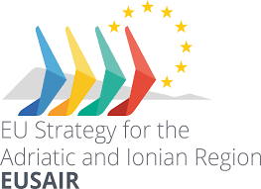



Monitoring and Evaluation of the
European Strategy of Adriatic-Ionian Region (EUSAIR)
Innovative Actions in Sustainable Tourism
EU Strategy for the Adriatic-Ionian Region (EUSAIR)
Daniela Angelina Jelinčić

Slide 2
INTRODUCTION
Innovation in tourism has until recently been relatively neglected
The very changes in the tourism business can generate positive practices that will lead to greater sustainability of the tourism offer
Innovations in tourism most often include:
  production innovations (new products and services),
  process innovations (new ways of delivering tourist services),
  logistical innovations (new ways of providing products/services to tourists), and
  market innovations (new marketing methods or market behavior).
J. Schumpeter: ‘’Innovation is the practical implementation of ideas that result in the introduction of new goods or services or improvement in offering goods or services.’’
Oslo Manual: “innovation is a new or significantly improved product or process (or a combination thereof) that differs significantly from previous products or processes and is available to potential users (product) or available to companies (process) (OECD, 2018). Innovation must be able to replicate at an acceptable cost. Otherwise, it remains at the level of invention (patent and prototype) – in the EUSAIR - creativity not lacking, but “translation” of creative ideas into “production” often fails.

Slide 3
INNOVATION IN SUSTAINABLE TOURISM IN THE EU AND WORLDWIDE
The European Union strongly supports innovation, and in the previous financial period 2014-2020 the EU Research and Innovation Development Strategy had three objectives: open innovation, open science and an open world
In the field of tourism, EU activities have primarily focused on innovations that can influence the digital transformation of the tourism sector in the EU
This will continue also in the current financial period, 2021-2027 to be a priority given the coronavirus crisis, but even after recovery, digital communication and digital solutions are projected to remain key to maintaining business
One of the most common products in this regard in the tourism sector relates to the creation of experiences through augmented reality (AR) devices

Slide 4
Examples of innovations in sustainable tourism in the EU and worldwide (1)
Future hotel Svart, Norway
Special energy principles (produces more energy than it consumes - its energy needs will be 85% less than typical modern hotels)
Opening in 2023
On a wooden structure in the middle of the fjord, circular in shape, a view through large windows from all perspectives

Slide 5
Examples of innovations in sustainable tourism in the EU and worldwide (2)
Faroe Islands
A virtual tour of the island "through the eyes" of a local resident
The tool allows remote touring - the tourist connects using a mobile phone, tablet or computer with a video camera carried by a local resident of the Faroe Islands and visits locations according to the wishes of tourists, even from a bird's eye view (from a helicopter)

Slide 6
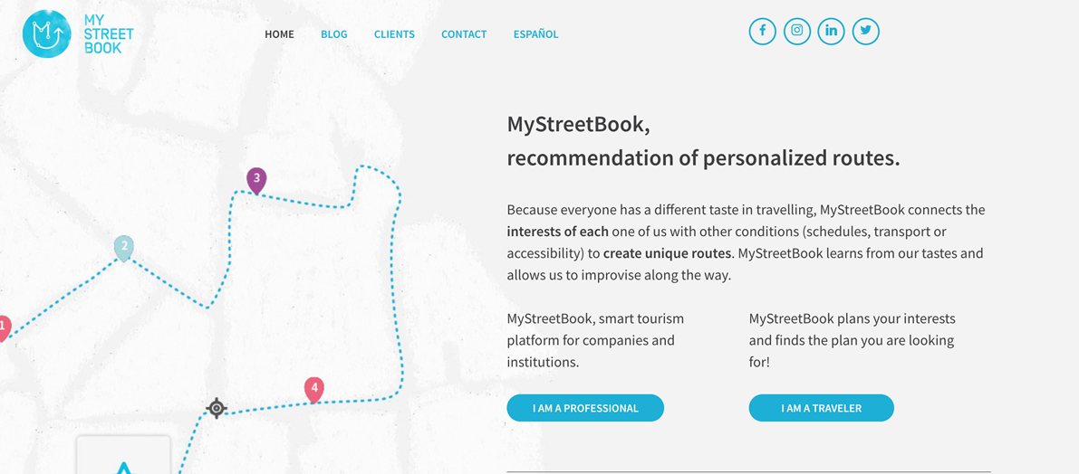
Examples of innovations in sustainable tourism in the EU and worldwide (3)
MyStreetBook, Madrid
Personalized solution for touring the city
Connects the personal interests of tourists with external conditions (means of transport, accessibility, timetable, etc.)

Slide 7
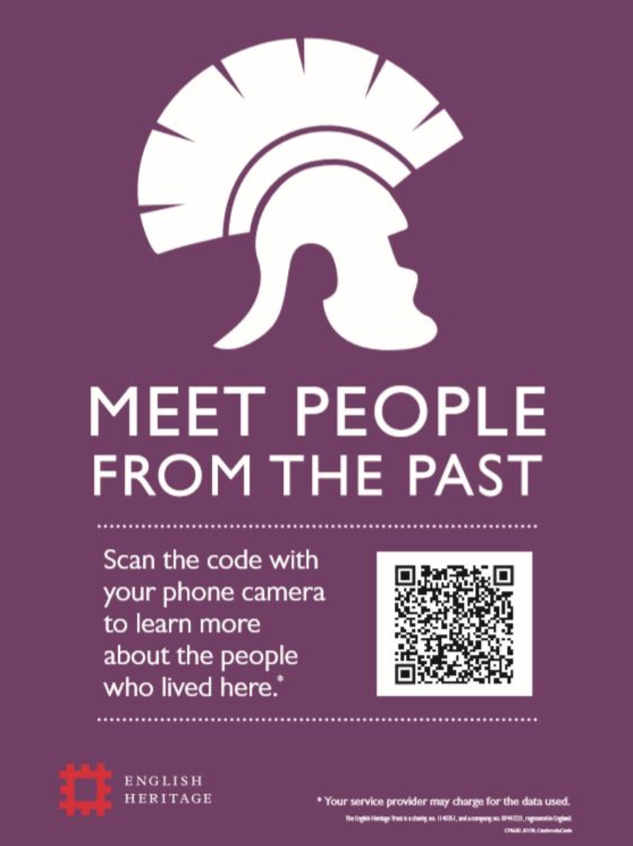
Examples of innovations in sustainable tourism in the EU and worldwide (4)
Agile Interpretation - English Heritage
QR codes that allow tourists to independently load interpretive messages using mobile phones, all with the aim of reducing physical contact

Slide 8
INNOVATION IN SUSTAINABLE TOURISM IN THE AIR
Pillar 4 Sustainable Tourism is focused on the development of sustainable and responsible tourism potential in the Adriatic-Ionian region through innovative and quality tourism products and services.
Innovation and innovative processes in the EUSAIR destinations:
  planning and stimulating the content of destinations - in the sustainable use, evaluation, presentation and interpretation of natural and cultural attractions,
  the infrastructural contents of the destination - in accommodation, catering, traffic, informative contents, new technologies in application
  supporting activities of destinations - in activities in destinations,
  relations with the local community through participatory and interactive models of cooperation.
Does innovation always have to be complicated?

Slide 9
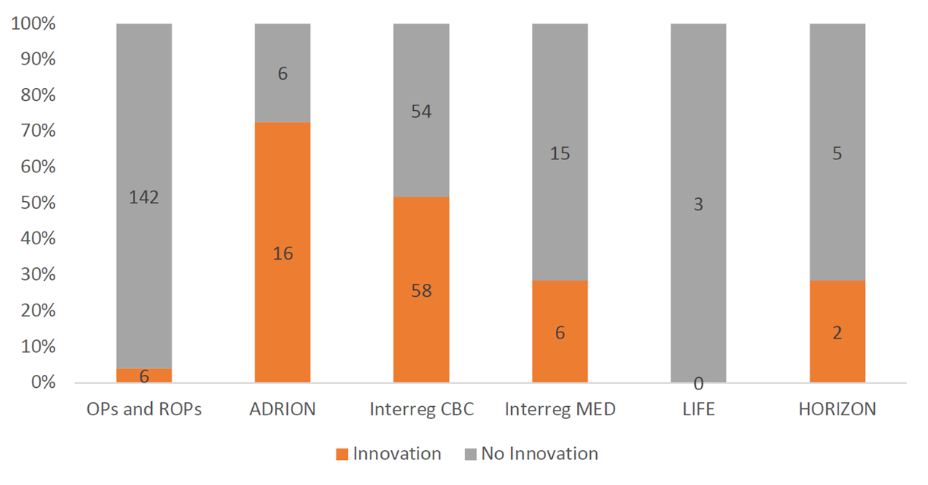
Key research findings
24 programs and 313 projects analysed
Out of 313 analyzed projects related to sustainable tourism in the EUSAIR area, 88 projects introduce innovations

Slide 10
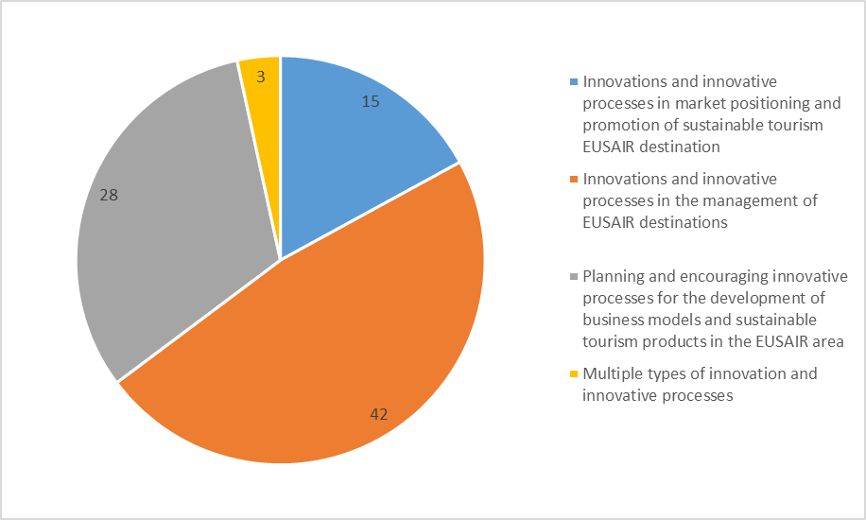
Innovative mechanisms in sustainable tourism projects in the EUSAIR area

Slide 11
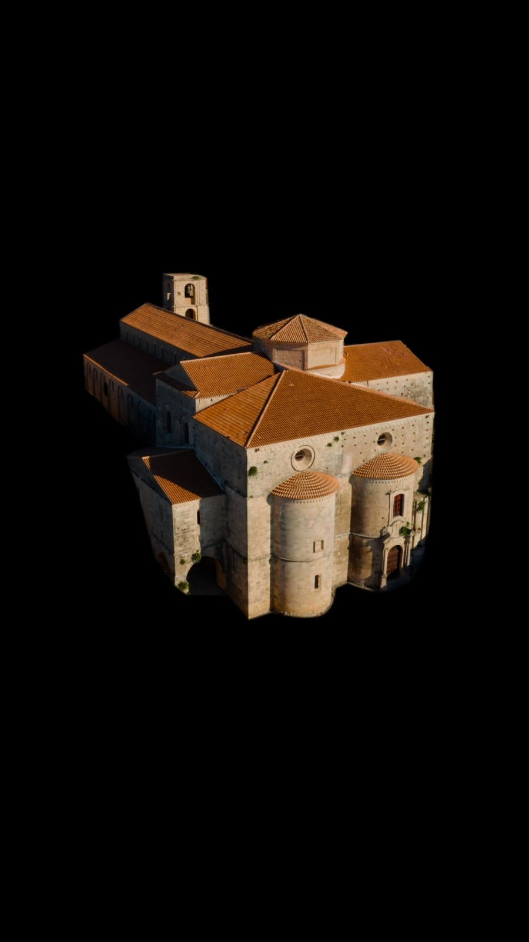
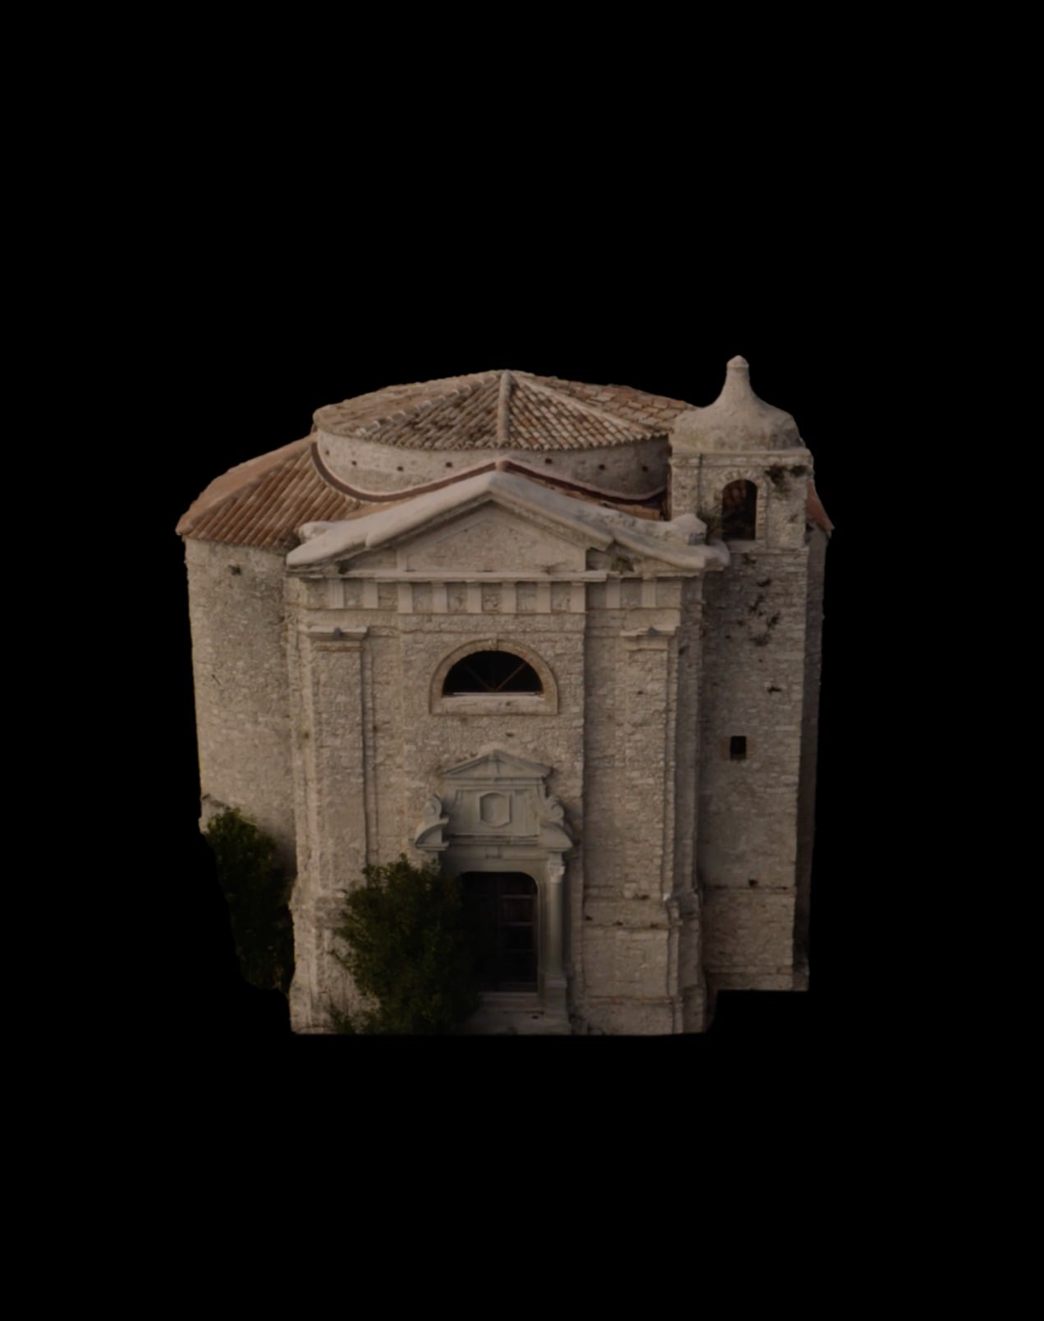
Examples of innovation – SMART Heritage
ADRION
Objectives: to promote, valorise and protect cultural heritage in the AIR, to raise tourism attractiveness and reduce tourism seasonality in the project area
The scope of the project is to generate a deeper awareness of the cultural heritage by applying and implementing multimedia ICT tools, as well as by creating unique tourism products that unify the Programme Area.
Creation of the SMART HERITAGE cultural route – an innovative and unique cultural tourism product
Digitalisation of cultural heritage: Safeguarding and promoting the less known cultural heritage assets that often remain hidden.

Slide 12
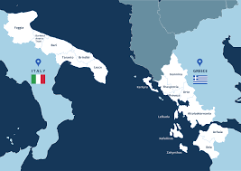
Example of innovation – InMed-Tour
CBC Interreg Italy – Greece
“Innovative Medical Tourism Strategy” promotes an innovative and increasing kind of tourism - “health tourism”
The so-called "medical" tourism represents an innovative touristic offer, because it gives the possibility for the patients’ relatives, to enjoy the area by considering the needs of patients and tourists.
Creation of a modern e-Cluster, where medical information from both countries will be stored for the exchange of know-how and good practices.

Slide 13
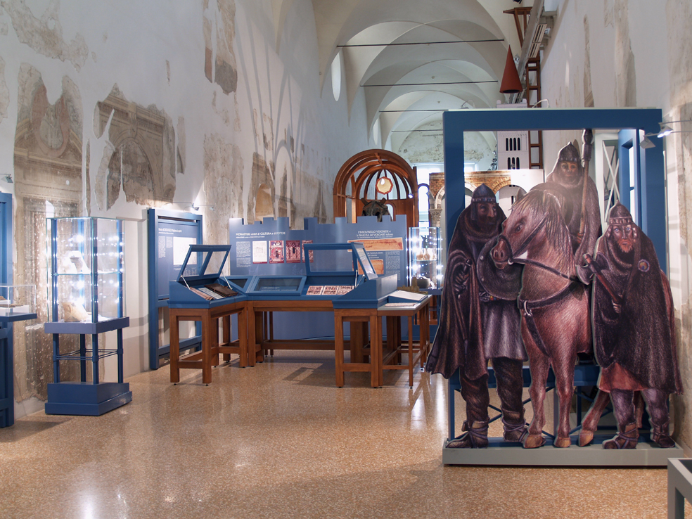
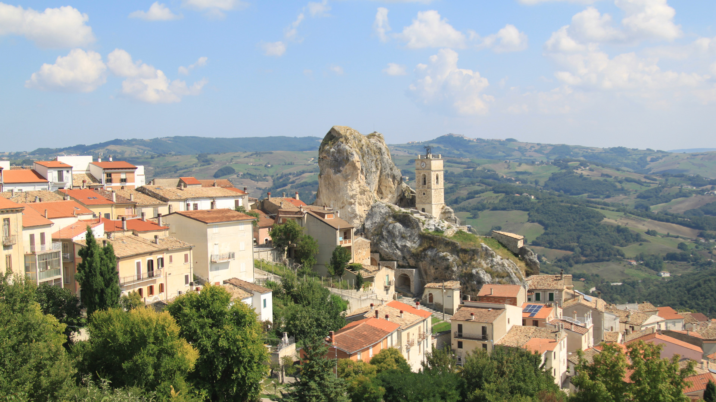
Example of innovation – INNOCULTOUR
CBC Interreg Italy – Croatia
Aim: to increase the visibility and immediate identification of 8 less-known cultural heritage sites.
The activities are focused on active involvement of creative industries, local population and major stakeholders dedicated to the preservation of natural and cultural heritage
Supports the integration of traditional cultural offer with ICT and improving the virtual accessibility of the natural and cultural destinations involved in the project

Slide 14
Coronavirus crisis and entreperneurial innovations in tourism

Slide 15
Coronavirus, tourism and heritage – Changes and trends
Market change / product change / consumption change
Soft tourism: creative tourism, green tourism, experience tourism and long-distance tourism (without physical travel) – greater resilience
Market: “staycation”
Product: “well-being”
Consumption: out of season (mass avoidance)
How can entrpereneurs deal with the changes in tourism due to corona virus?

Slide 16
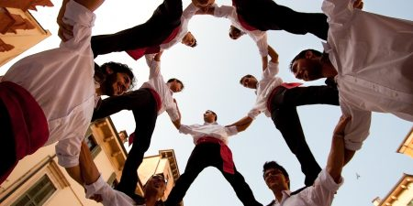
Market change – Example
Tocatì Festival, Italian Association of Traditional Games of Verona
New markets – orientation to the domestic and not always classic tourist market
Instead of tourists - games for socializing in isolation - proposing that in time of lockdown games are played at home, which can have
a positive impact on reducing stress and anxiety while preserving and reviving authentic
intangible cultural heritage
Well-being for citizens + preservation and revitalization of intangible cultural heritage
New audience development

Slide 17
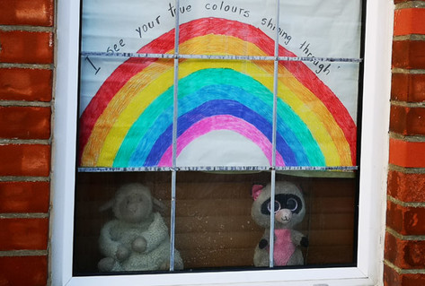
Product change – Example
Numerous museums (e.g. Victoria and Albert Museum in London) - initiatives to collect exhibits related to the pandemic
COVID-19 – focus of exhibitions
The House of European History’s project documents responses to the crisis - rainbow posters in European cities - solidarity

Slide 18
Consumption change – Example
Traveling "from home"
Is it tourism? (remote tourism)
"Solo" tours - specific interpretation

Slide 19
Other entrepreneurial innovations in tourism (1)
How can a change of perspective help?
Tourism-related business innovation
  A hotel owner decreases the price of a room rental when the booking is made later in the day since the probability of failure to rent a room increases
  Such a strategy proved to be successful both in good and bad times and led to more than 90% occupancy
Culture-related business innovation
  Ticket fees for the show: artists give away (do not charge) for the show, but the audience pays for purchase of equipment, arranging the scene, tour, artist's pensions

Slide 20
Other entrepreneurial innovations in tourism (2)
How can a change of perspective help?
Tourism-related business innovation
Diffused hotel - use of the empty houses renovated with the funds of the post-earthquake of Friuli for tourist purposes
Giancarlo Dall’Ara, tourism marketing professor; legally recognized in 1998
Today - hotel accommodation facilities located in the smaller historic centres, characterised by the centralisation in a single building of the common services and the dislocation of the housing units in one or more separate buildings. The units are equipped with furniture, equipment and homogeneous services.

Slide 21
Conclusions and recommendations

Slide 22
Conclusions
Development of sustainable tourism faces many obstacles
  Inadequate knowledge and skills about the forms of sustainable tourism
  Lack of innovative activities
  Inadequate quality of tourism
  Poor implementation of sustainable development policies and responsible tourism concepts
  Low level of accessibility to attractions for visitors with special needs
  These weaknesses are even greater with regard to current global threats, such as climate change, COVID-19 pandemic, and the seismically sensitive areas
There is still a low level of application of innovations in tourism
  Lack of knowledge about innovations and their role in sustainable tourism development (e.g. digital is not necessarily innovative)
  Weak cooperation at all levels
  Lack of effective incentives for innovation
  Neither geographical distribution of innovative projects is cohesive nor is the distribution of funding (non-EU countries lagging behind)
COVID-19 positively affected innovations in sustainable tourism?

Slide 23
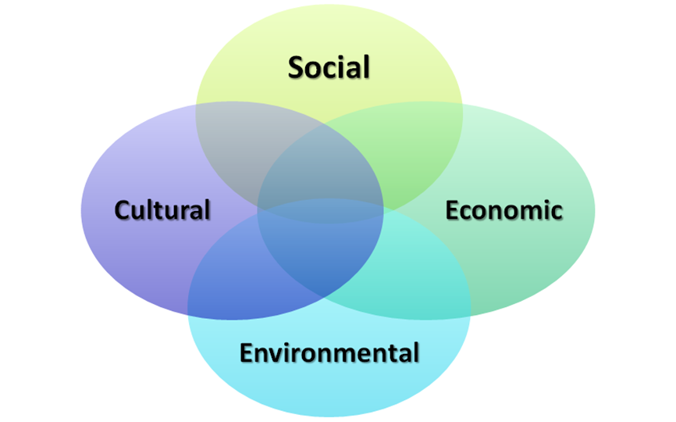
Recommendations
Invest in the development of knowledge and education about innovations and innovative processes in sustainable tourism
Develop and strengthen cooperation between entrepreneurs and country and between entrpreneures themselves
Follow the web pages of regional development agencies in order to apply for projects related to your business
Think about changing the perspective - use the COVID-19 pandemic to seek for the opportunities on the changed market
Use innovations not to obtain funds but to make a change
Think about simple solutions
Sustainability is a key concept!
LEADERSHIP

Slide 24
Thank you!
Institute for Development and International Relations, IRMO
Daniela Angelina Jelinčić
Lj. F. Vukotinovića 2, 10000 Zagreb, Croatia
daniela@irmo.hr
+385 1 4877487
https://www.adriatic-ionian.eu/

