Slide 1
Innovations in Nature Protection Management
Matjaž Harmel

Slide 2
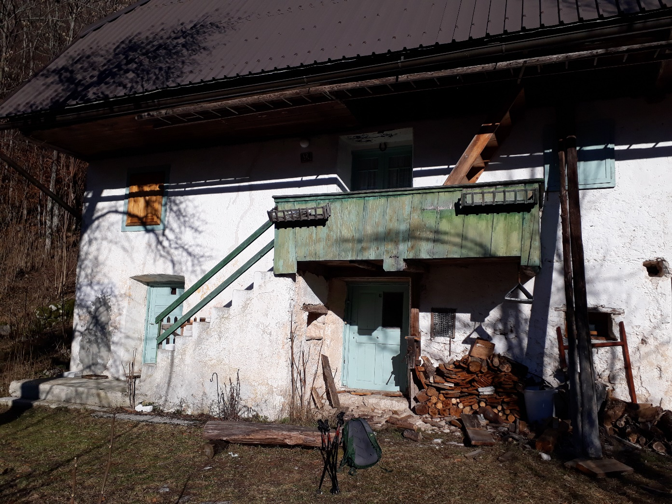
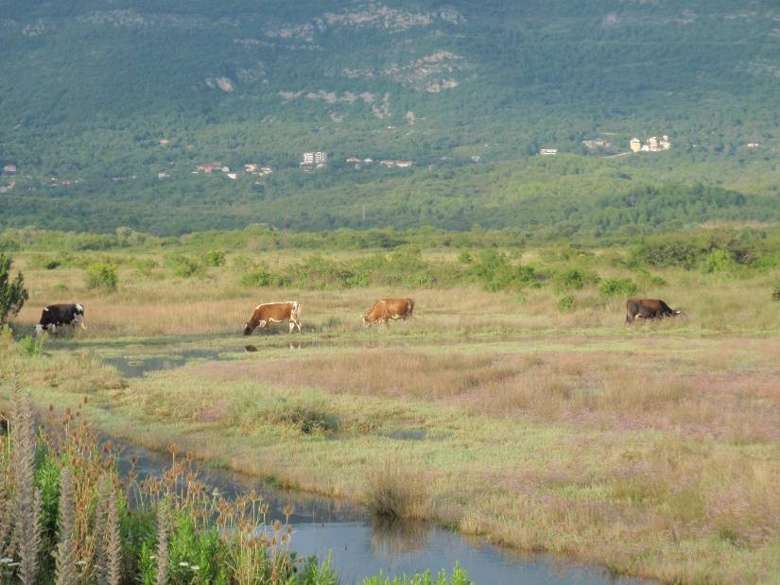
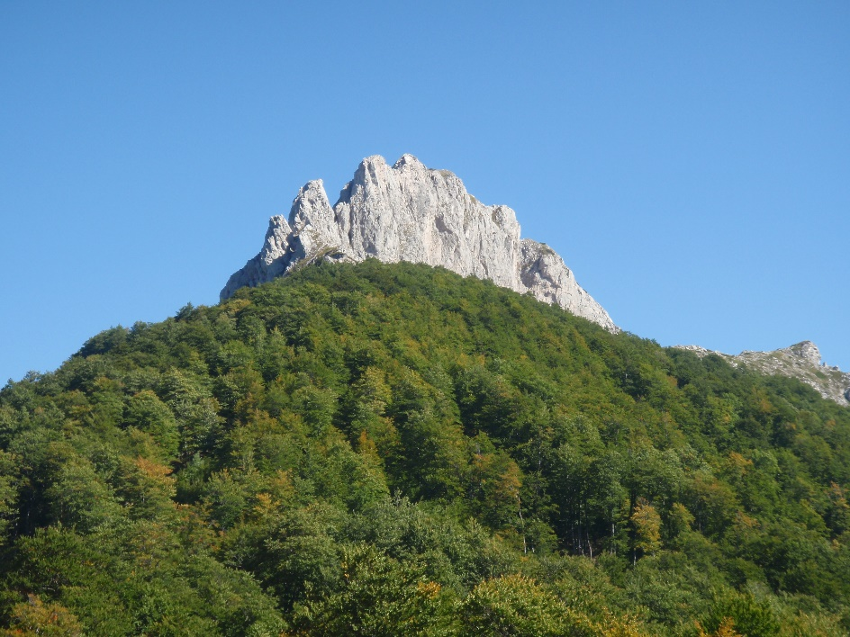
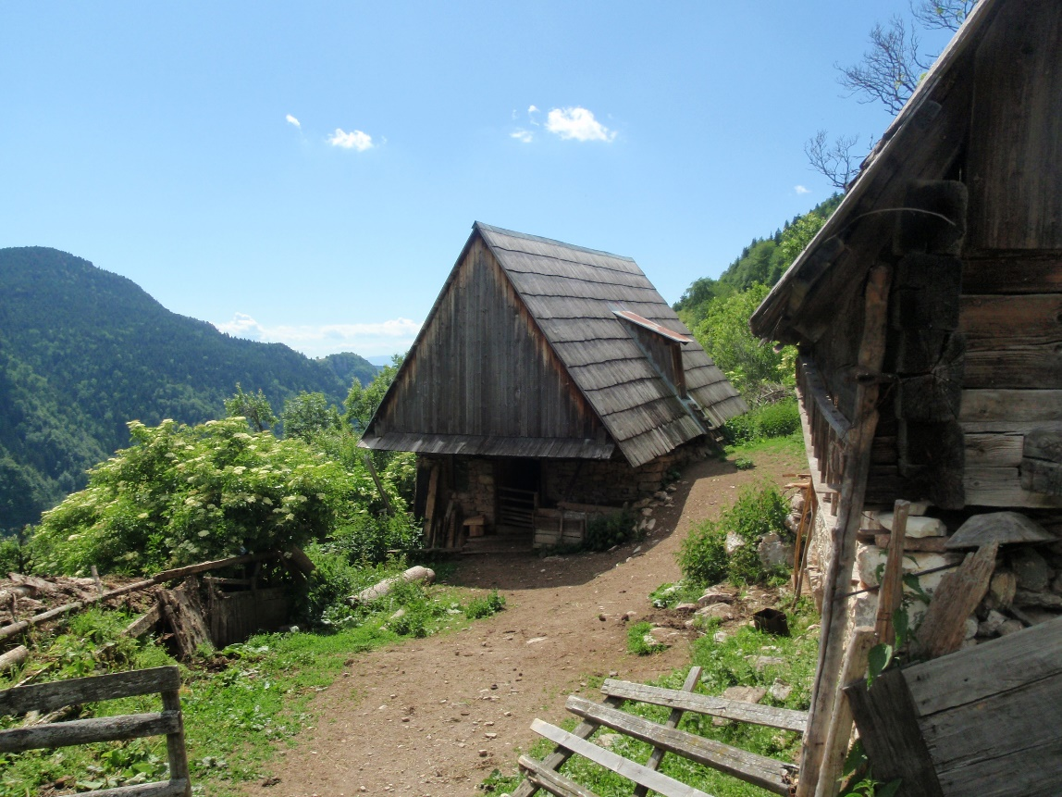
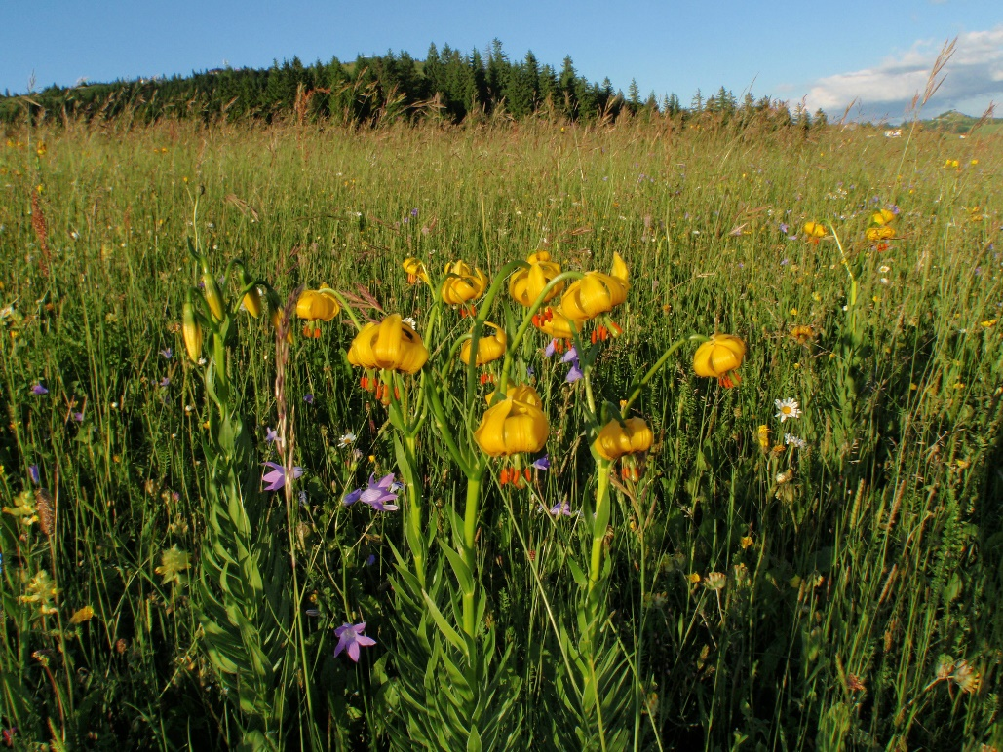
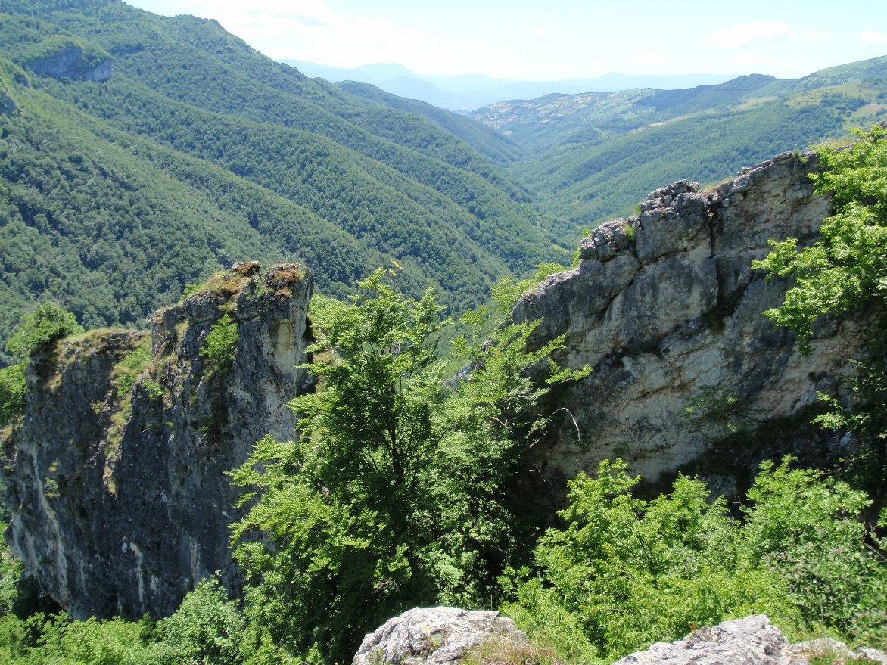
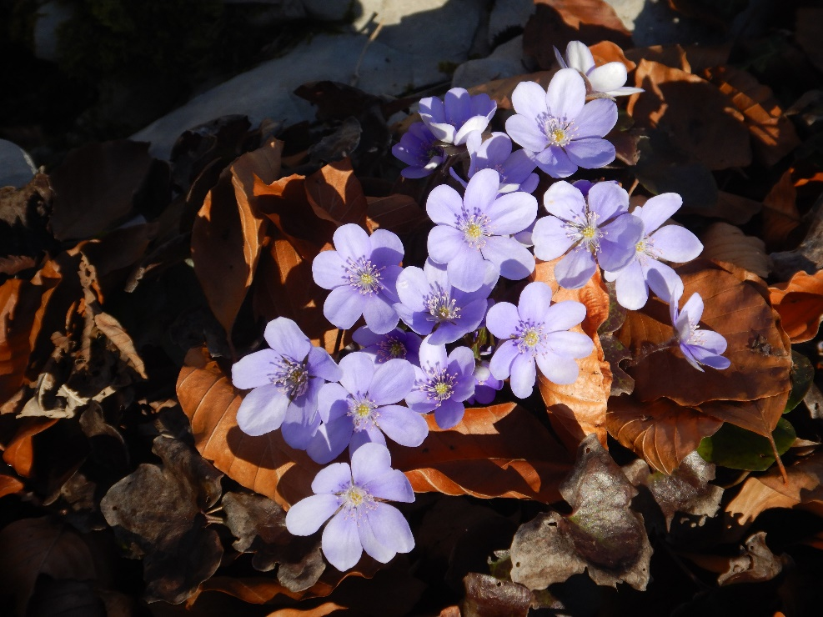
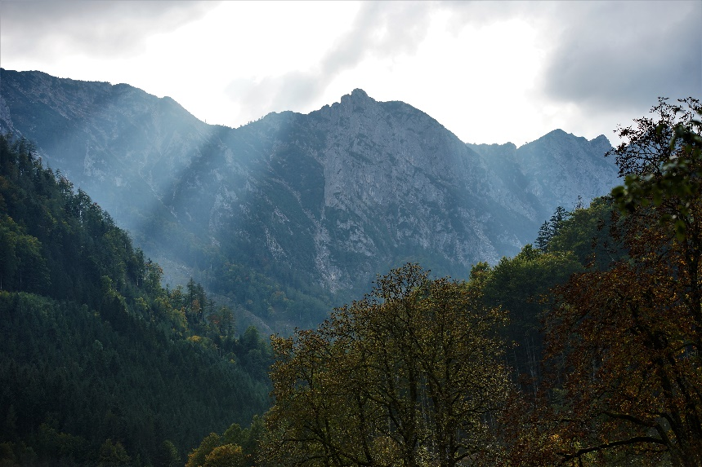
Characteristics of Protected areas

Slide 3
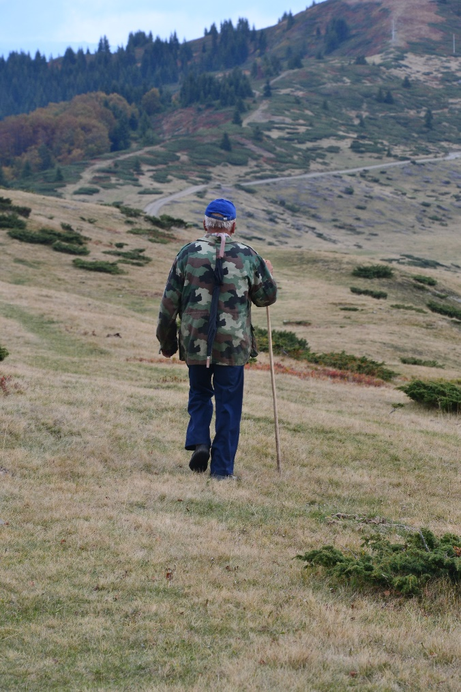
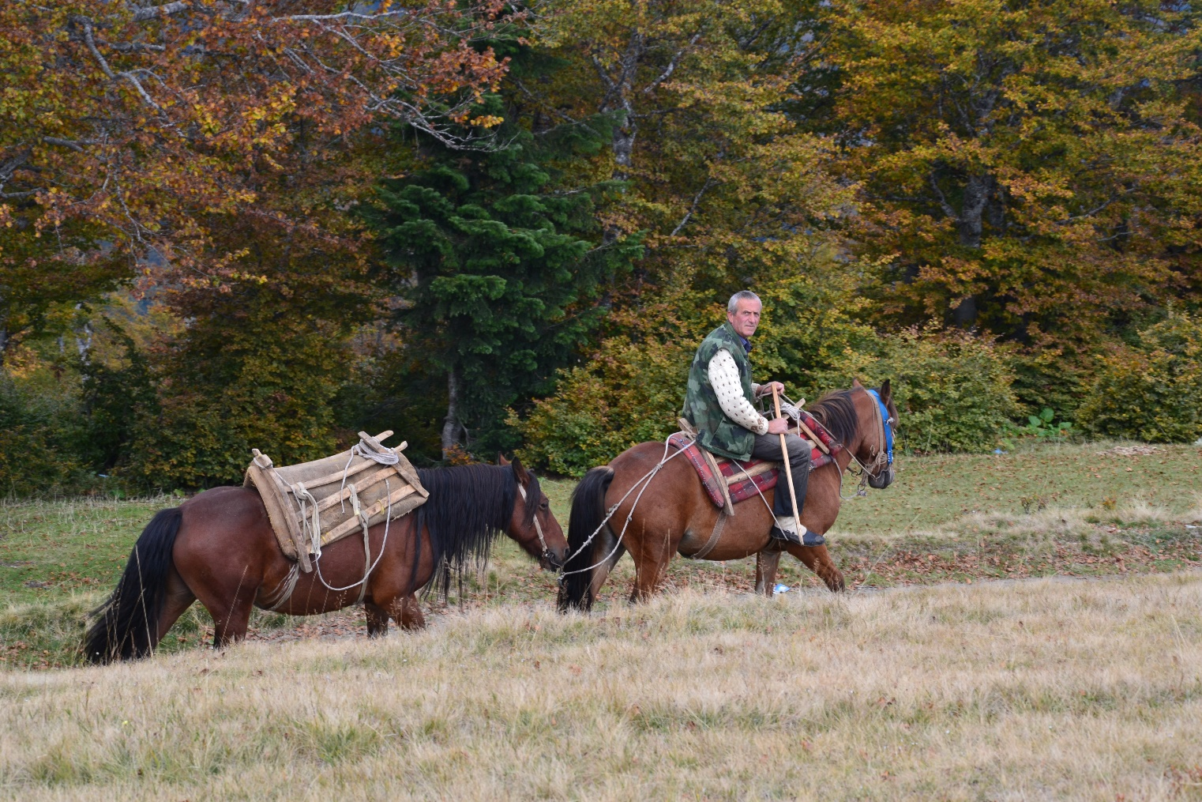
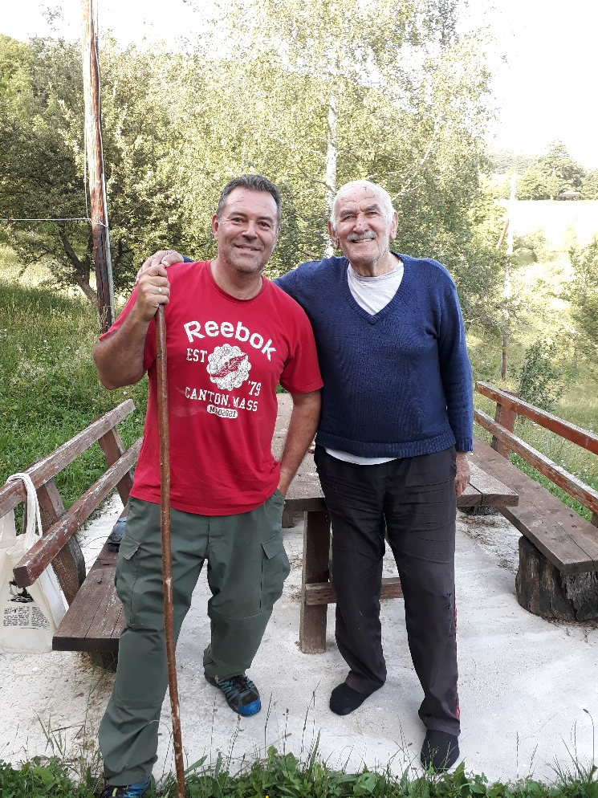
Who preserved those areas?
International organizations?
States with the legislative framework ?
NGOs ?
Protected areas mannagers?

Slide 4
How can we preserve those areas?
Through enforcement of protection regimes?
Through control?
Through sustainable management?
Who has to implement sustainable management?

Slide 5
What is Sustainable Management?
Manual work ?
Limited development ?
Extensive management ?
Close to nature management ?
Management where local community have benefits

Slide 6
What are the innovations here?
The crucial innovation is communication
If local community have benefit from protection, they protect their resources
You have to protect local community from foreign investments that are not linked to local community needs (e.g. investment into new hotels,…)

Slide 7
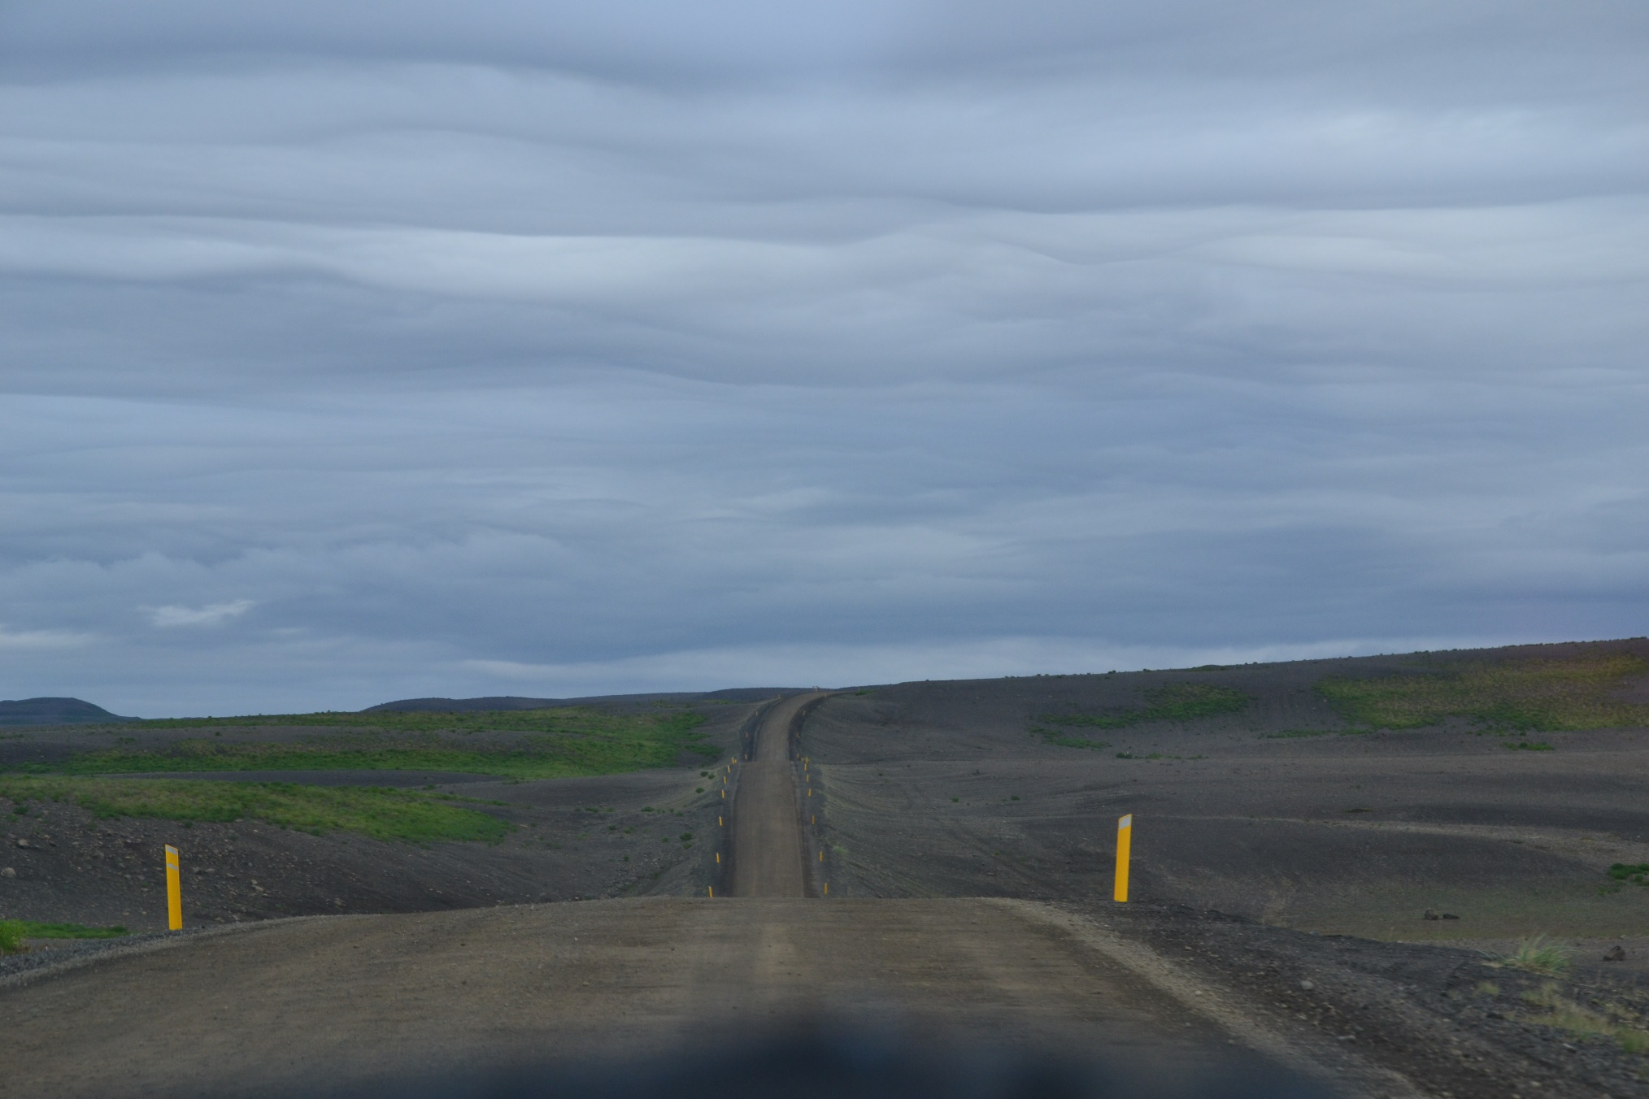
Usual approach
Management Authority set by the government
High political influence
Employment of people form other regions, low motivation for employees,
No communication to local community
Low salaries
„Sustainable“ tourism development
Destruction of the real estate market

Slide 8
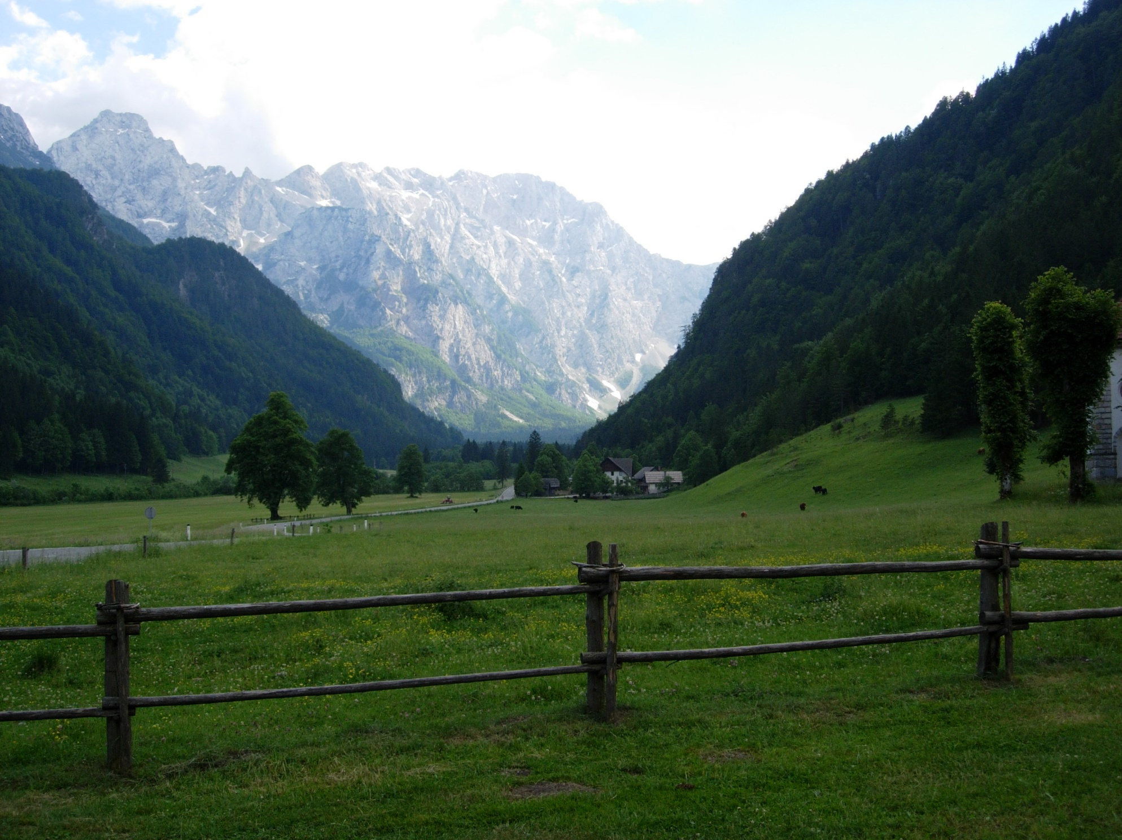
Some examples of good practice
Logarska dolina
Local community managing the PA
Local inhabitants have their own tourist accommodation
Local inhabitants take care about traditional management of forests and agricultural land
What they produce they sell to the tourists

Slide 9
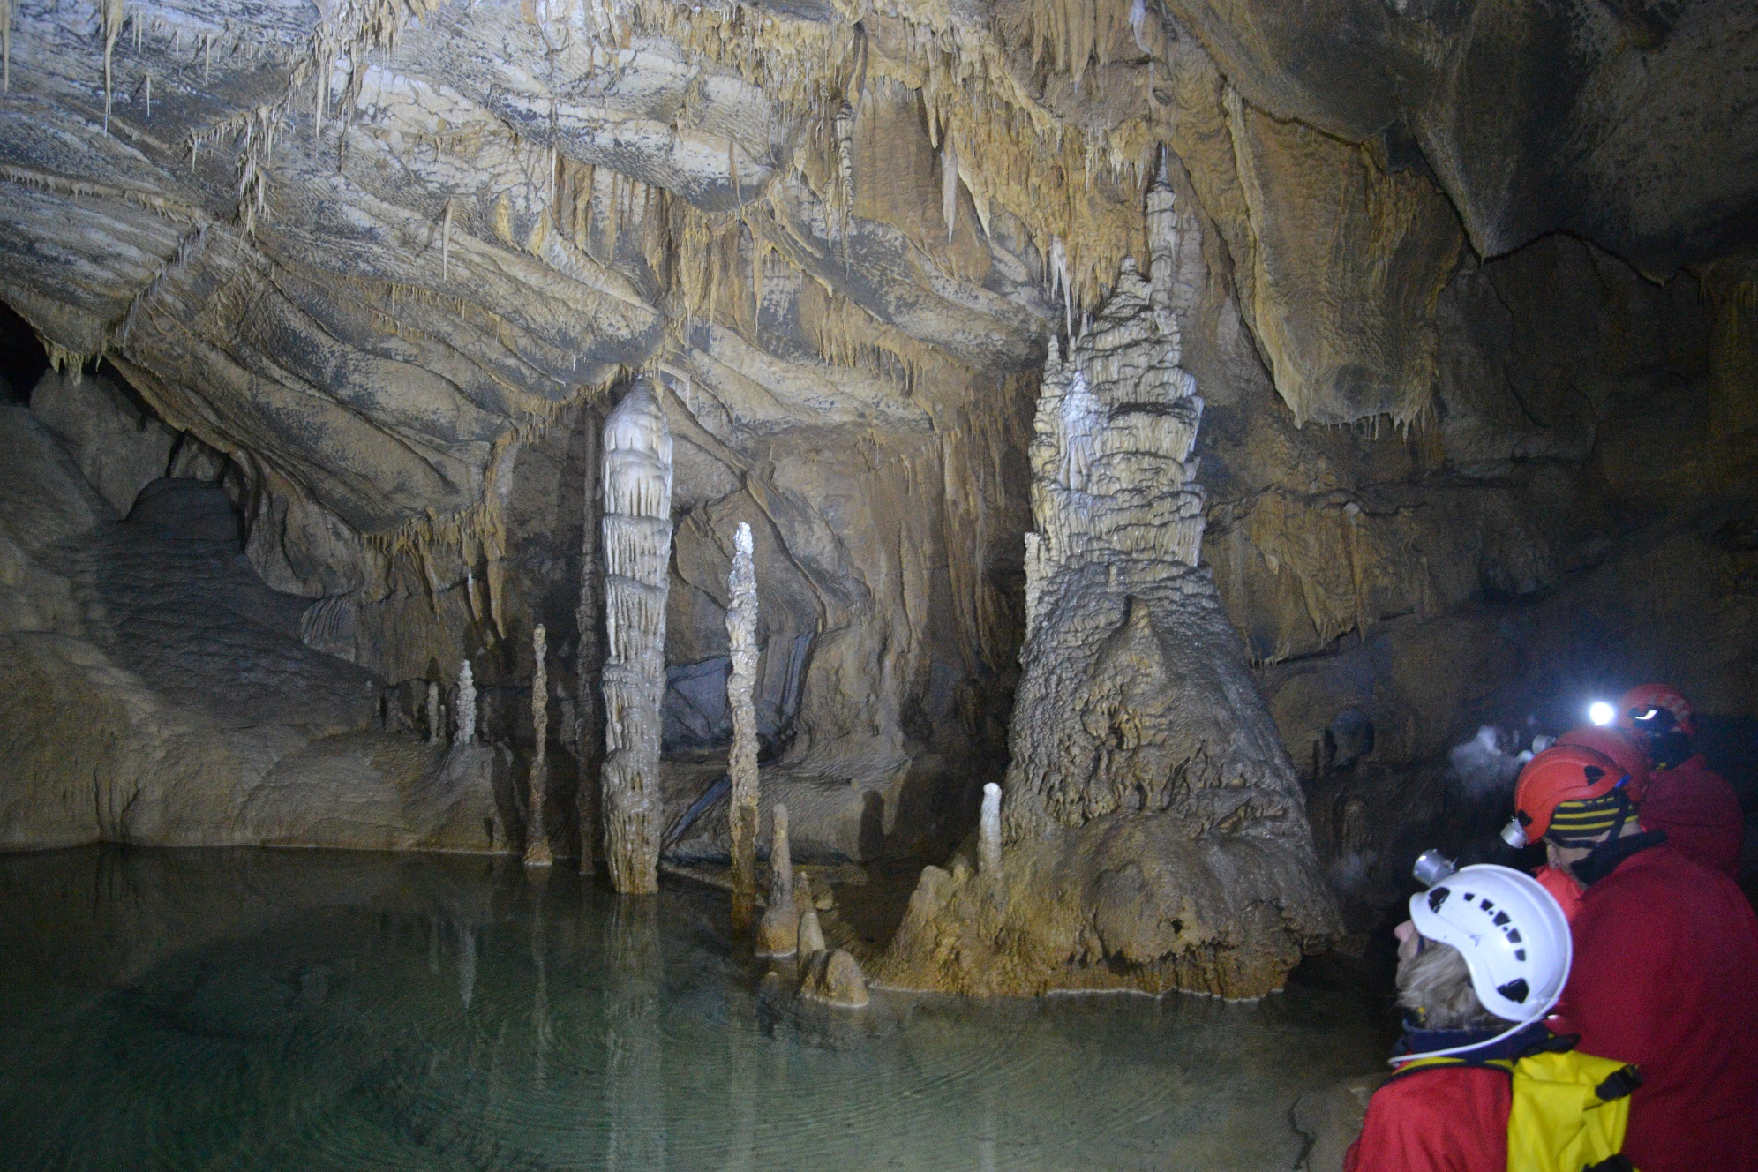
Križna jama
Local NGO is managing the visitors, based on the concession
Clear rules:
First part no limitations
Second part 4 persons per day, 1000 per year
Third part – 100 persons per year
Linkage to other local services

Slide 10
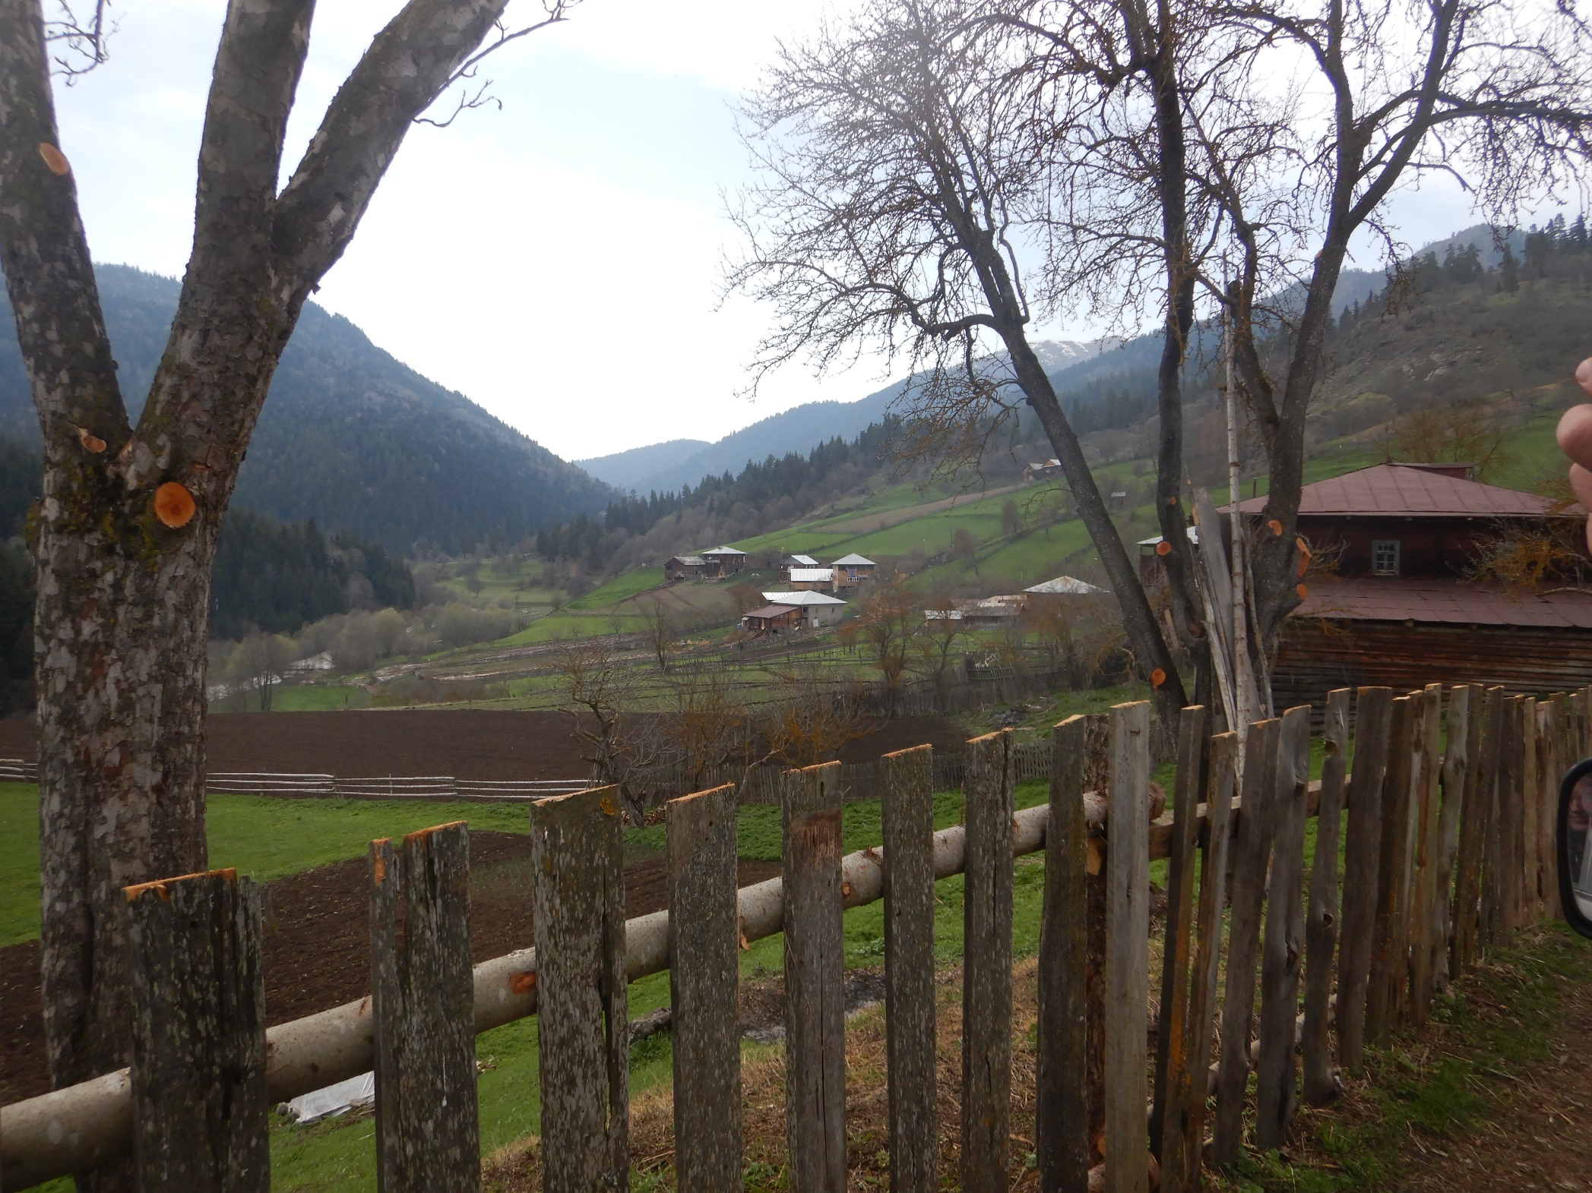
Financial Participatory Approach – Adigeni, Georgia
Financial support to local comunities to implement protection measures
They agree among the landowners how to implement protection measures and how to divide the money.
Money is available based on the implemented work

Slide 11
Thank you for your attention for any information write on
matjaz@zavita.si

