Slide 1

SUBTEXT

Slide 2

The impact of the COVID-19 pandemic on the airports of the macro-region
Giuseppe Siciliano

Slide 3
Contents
Overview of the impact of COVID-19 globally and in Europe
Air transport in the Adriatic-Ionian region in 2019
The impact of the two pandemic waves in the macro-region
Outlook

Slide 4
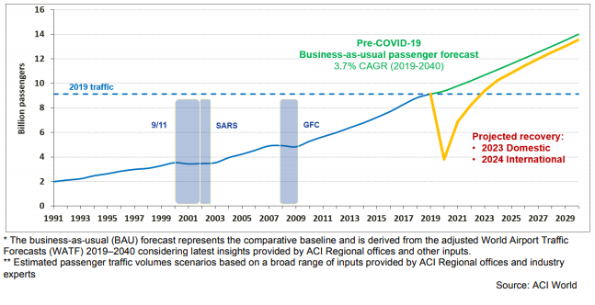
The impact of COVID-19 on global aviation

Slide 5
The impact of COVID-19 on European aviation
2020 vs 2019
PTSCLAS elaborations on EUROCONTROL data
1.7 billion fewer passengers and €56.2 billion net losses
for airlines, airports & ANSPs
-55%
Total European flights
-59%
Europe – rest of the world
flights
-54%
Intra-European flights

Slide 6
2019: air transport in the Adriatic-Ionian region
Until 2019, air traffic in the EUSAIR region was fast growing
PTSCLAS elaborations on data from airports

Slide 7
2019: air transport in the Adriatic-Ionian region
Country | Biggest airport (2019 pax mln) | Fastest-growing airport (CAGR 2015-19)*
 | Milan Malpensa ** (28.8) | Milan Malpensa (+11.6%)
 | Athens (25.6) | Naxos Island (+20.3%)
 | Belgrade (6.2) | Niš (+84.7%)
 | Zagreb (3.4) | Pula (+21.3%)
 | Tirana (3.3) | Tirana (+13.7%)
 | Skopje (2.4) | Ohrid (+31.0%)
 | Ljubljana (1.7) | Portorož (+5.9%)
 | Tivat (1.4) | Podgorica (+14.7%)
 | Sarajevo (1.1) | Banja Luka (+60.1%)
* above 25,000 pax in 2019
** in EUSAIR regions
PTSCLAS elaborations on data from Airports

Slide 8
2020: the impact of the pandemic – Pax (spring)
Pax in April 2020 vs April 2019
PTSCLAS elaborations
AI region total pax
Apr’19: 7,134,950
Apr’20: 151,459
YoY: -98%
-97%
-98%
-89%
-89%
-99%
-99%
-98%
-99%
-96%

Slide 9
2020: the impact of the pandemic – Pax (summer)
Pax in July 2020 vs July 2019
PTSCLAS elaborations
AI region total pax
Jul’19: 11,981,519
Jul’20: 3,142,360
YoY: -74%
-81%
-74%
-41%
-65%
-77%
-87%
-90%
-74%
-73%

Slide 10
2020: the impact of the pandemic – Pax (autumn)
Pax in October 2020 vs October 2019
PTSCLAS elaborations
AI region total pax
Oct’19: 9,034,868
Oct’20: 2,871,750
YoY: -68%
-64%
-51%
-89%
-71%
-74%
-73%
-89%
-68%
-65%

Slide 11
2020: the impact of the pandemic – Yield (spring)
EUR/1000RPK in April 2020 vs April 2019
PTSCLAS elaborations
AI region total
Apr’19: 76.5
Apr’20: 3.8
YoY: -95%

Slide 12
2020: the impact of the pandemic – Yield (summer)
EUR/1000RPK in July 2020 vs July 2019
PTSCLAS elaborations
AI region total
Jul’19: 74.5
Jul’20: 18.8
YoY: -75%

Slide 13
2020: the impact of the pandemic – Yield (autumn)
EUR/1000RPK in October 2020 vs October 2019
PTSCLAS elaborations
AI region total
Oct’19: 71.9
Oct’20: 21.1
YoY: -71%

Slide 14
2020: the impact of the pandemic – Airlines (spring)
AI region total no. of airlines
Apr’19: 201
Apr’20: 78
YoY: -61%
No. of Airlines in April 2020 vs April 2019
PTSCLAS elaborations

Slide 15
2020: the impact of the pandemic – Airlines (summer)
AI region total no. of airlines
Jul’19: 241
Jul’20: 154
YoY: -36%
No. of Airlines in July 2020 vs July 2019
PTSCLAS elaborations

Slide 16
2020: the impact of the pandemic – Airlines (autumn)
AI region total no. of airlines
Oct’19: 217
Oct’20: 154
YoY: -29%
No. of Airlines in October 2020 vs October 2019
PTSCLAS elaborations

Slide 17
2020: the impact of the pandemic – Airlines (spring)
AI region total no. of destinations
Jul’19: 383
Jul’20: 296
YoY: -23%
No. of destinations in July 2020 vs July 2019
PTSCLAS elaborations

Slide 18
2020: the impact of the pandemic – Destinations (spring)
AI region total no. of destinations
Apr’19: 341
Apr’20: 142
YoY: -58%
No. of destinations in April 2020 vs April 2019
PTSCLAS elaborations

Slide 19
2020: the impact of the pandemic – Destinations (summer)
AI region total no. of destinations
Jul’19: 383
Jul’20: 296
YoY: -23%
No. of destinations in July 2020 vs July 2019
PTSCLAS elaborations

Slide 20
2020: the impact of the pandemic – Destinations (autumn)
AI region total no. of destinations
Oct’19: 273
Oct’20: 378
YoY: -28%
No. of destinations in October 2020 vs October 2019
PTSCLAS elaborations

Slide 21
2020: the impact of the two pandemic waves
Pax per month per country (istogrammi per country raggrupp per mese di calo %)
Revenues per month per country
No of airlines per month per main airport
No of destinations per month per main airport

Slide 22
2021: the outlook
European traffic for the whole of 2021 is expected to recover to 51% of 2019 levels, with faster recovery expected from the summer onwards.
Decarbonisation funding must be increased.
Regional connectivity must be maintained.
It is necessary to innovate and invest in future technological solutions in all aviation domains.
The opportunity to ‘build back better’ cannot be missed.

Slide 23
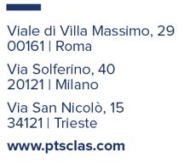
Thank You.
g.siciliano@ptsclas.com

