Slide 1
Sustainable tourism of tomorrow EU perspective
5th Forum EUSAIR
Thematic session: Sustainable Tourism
New trends in sustainable Tourism
28 January 2021
Ramunė Genzbigelytė Venturi, Policy officer for Tourism
Unit for Tourism, Textiles and Creative Industries
DG Internal Market, Industry, Entrepreneurship and SMEs

Slide 2
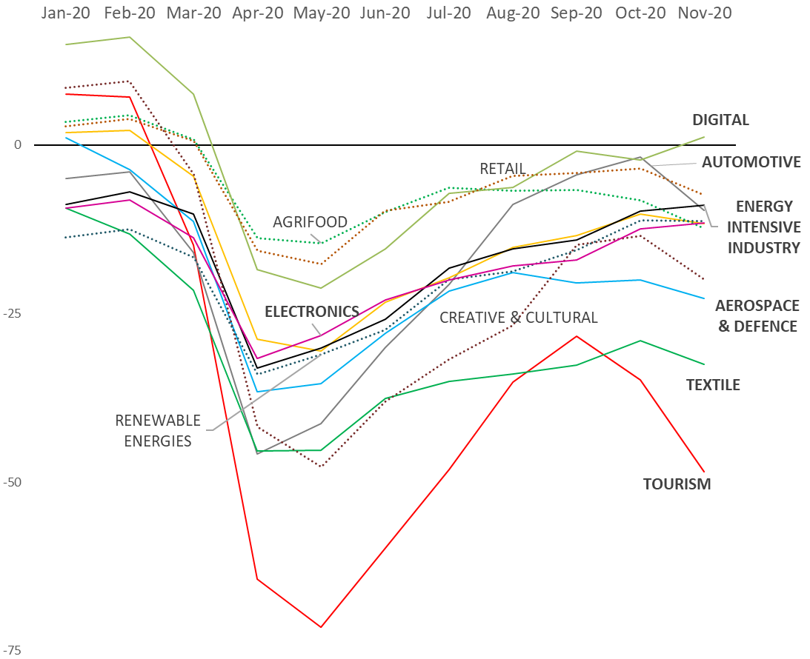
Tourism ecosystem facing enormous challenges
Very high level of indebtedness and low business confidence indicator
High investment gap: EUR 161 billion for 2020-2021 - highest of all industrial ecosystems
Unpredictability about international travel market
New consumer trends post-Covid
Reduced capacity of tourism segments to invest in the future (resilient supply chains, new services, green and circular business models, new technologies)
Evolution of the Confidence Indicator by Ecosystem: Jan. –Nov. 2020
Source: GROW.A1 elaborations on data by the Joint Harmonised EU Programme of Business and Consumer Surveys

Slide 3
Short-term priorities: crisis management, building confidence for businesses and citizens
Safe travel - confidence for businesses and tourists
Real-time information to citizens (Re-open EU)
Monitoring impacts
Protecting businesses and jobs in tourism

Slide 4
Long-term priorities
Recovery – economic and social resilience
Greening tourism and sustainability
Digital transformation – innovation and data
Skills (European Skills Agenda, EU Pact for skills)
Global competition - EU sustainable, quality destination
Roadmap to the future - European Agenda for Tourism 2050
European Tourism Convention 2020: http://www.tourism-convention.eu/

Slide 5
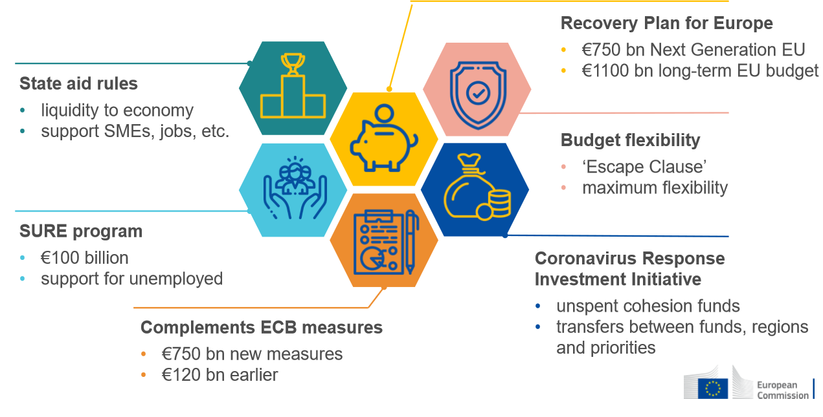
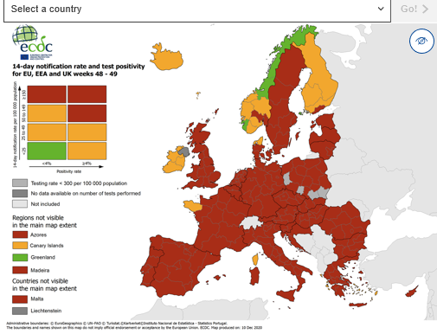
EU response in restarting tourism: from crisis management to the recovery support
Re-open EU mobile app https://reopen.europa.eu/en/

Slide 6
Traveller sentiment in the coming months
People want to travel
The joy of vacation planning stronger than ever, travelers spend more time researching 2021 trips. But also reduced disposable income.
Trust and peace of mind – safety first concern
Intra-European (40%) and domestic travel (36%)
*ETC survey on travel sentiment, January 2021. Tripadvisor, Jan 2021

Slide 7
Trends transforming tourism, accelerated by the pandemic
Innovation and digitalisation
Flexible working arrangements
Health and safety, seamless travel
Carbon-neutral travel
Tailored, unique experiences

Slide 8
Thank you and keep in touch!
DG GROW. F4 Unit - Tourism, Textiles and Creative Industries: GROW-F4@ec.europa.eu
DG GROW website: https://ec.europa.eu/growth/sectors/tourism/offer_en

