Slide 1
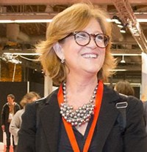
Building back better italian tourism
FLAMINIA SANTARELLI, DIRECTOR GENERAL FOR TOURISM
Ministry for cultural heritage and tourism, italy
5TH EUSAIR FORUM – 28TH JANUARY 2021 - new trends in sustainable tourism what does the modern tourist want?

Slide 2
What’s happened?

Slide 3
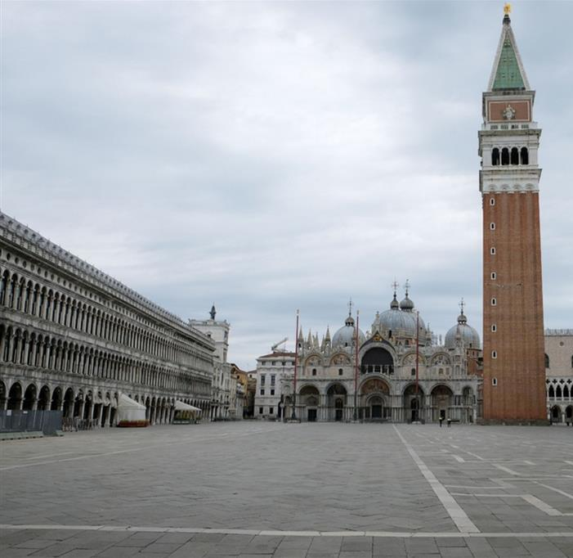
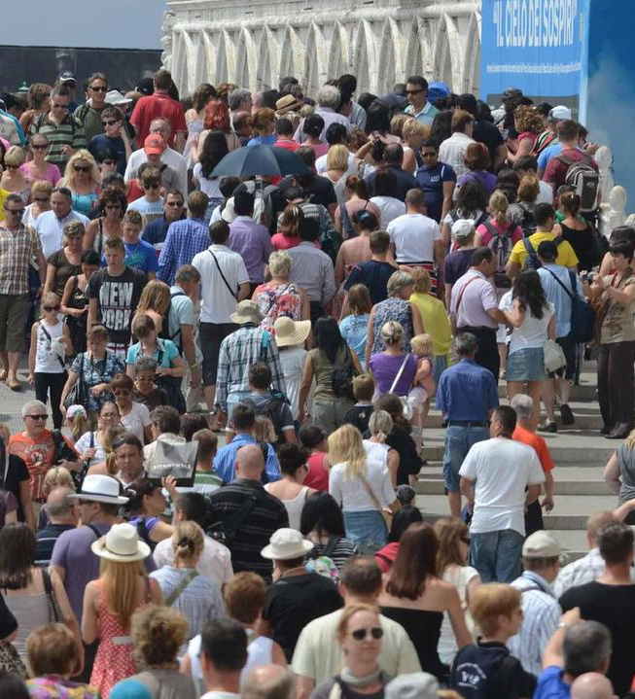
Venice
Building back better by promoting the integral recovery of urban destinations through modernisation and revitalization of commercial activities in the cities of art most affected by the decline in visitors

Slide 4
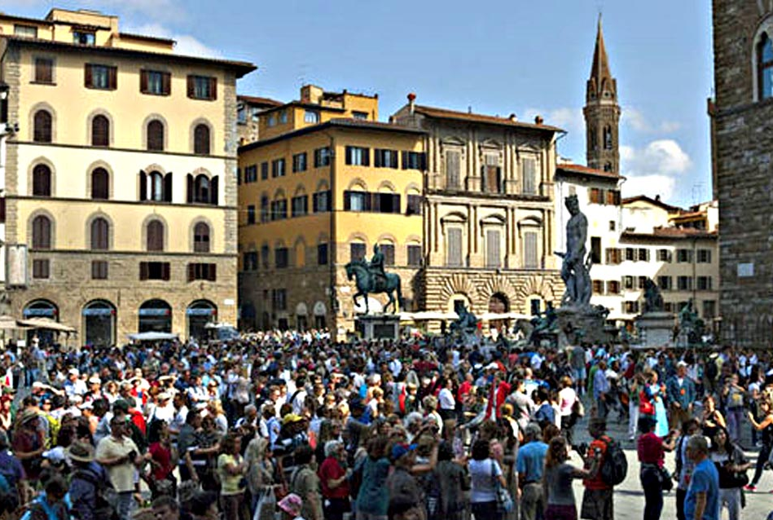
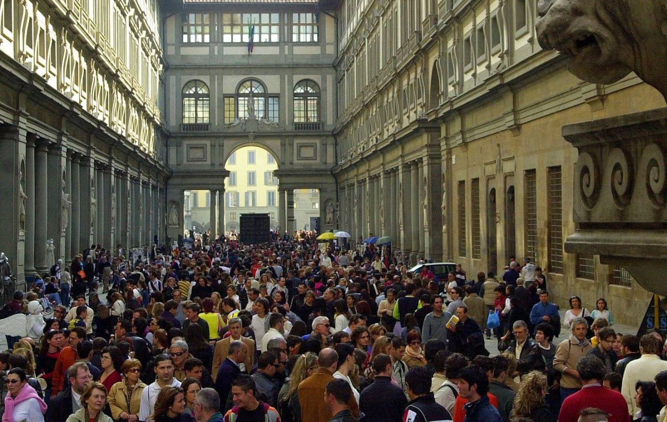
FLORENCE
Building back better by promoting the integral recovery of urban destinations through modernisation and revitalization of commercial activities in the cities of art most affected by the decline in visitors

Slide 5
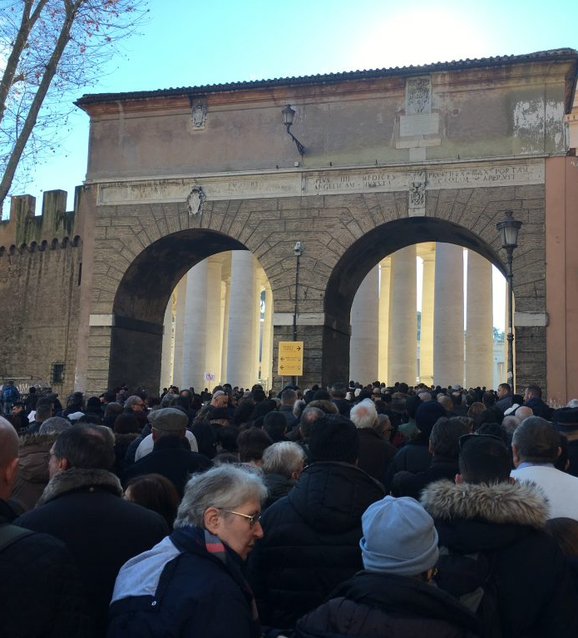
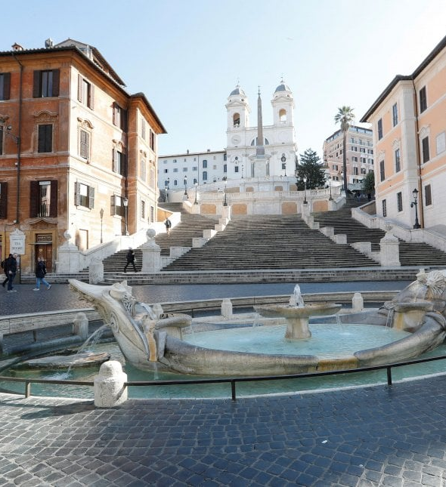
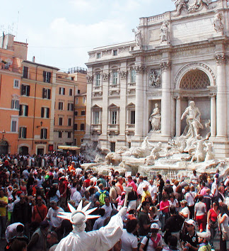
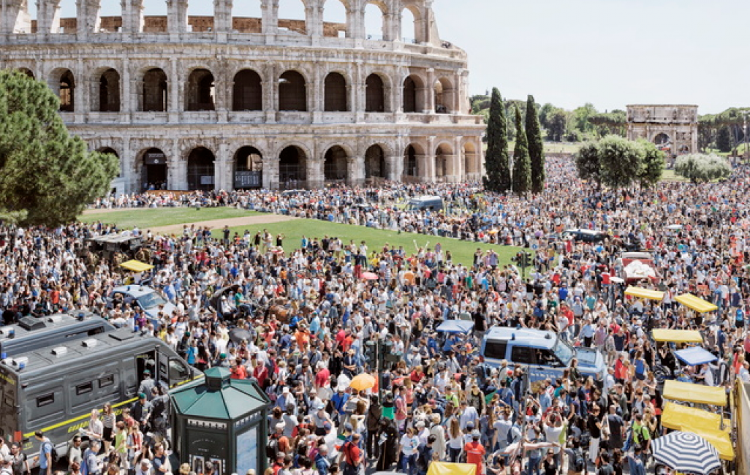
rome
Building back better by promoting the integral recovery of urban destinations through modernisation, digitalization and revitalization of commercial activities in the cities of art most affected by the decline in visitors

Slide 6
2020 has turned out to be an annus horribilis
Source: ENIT - Forward Data, 2020

Slide 7
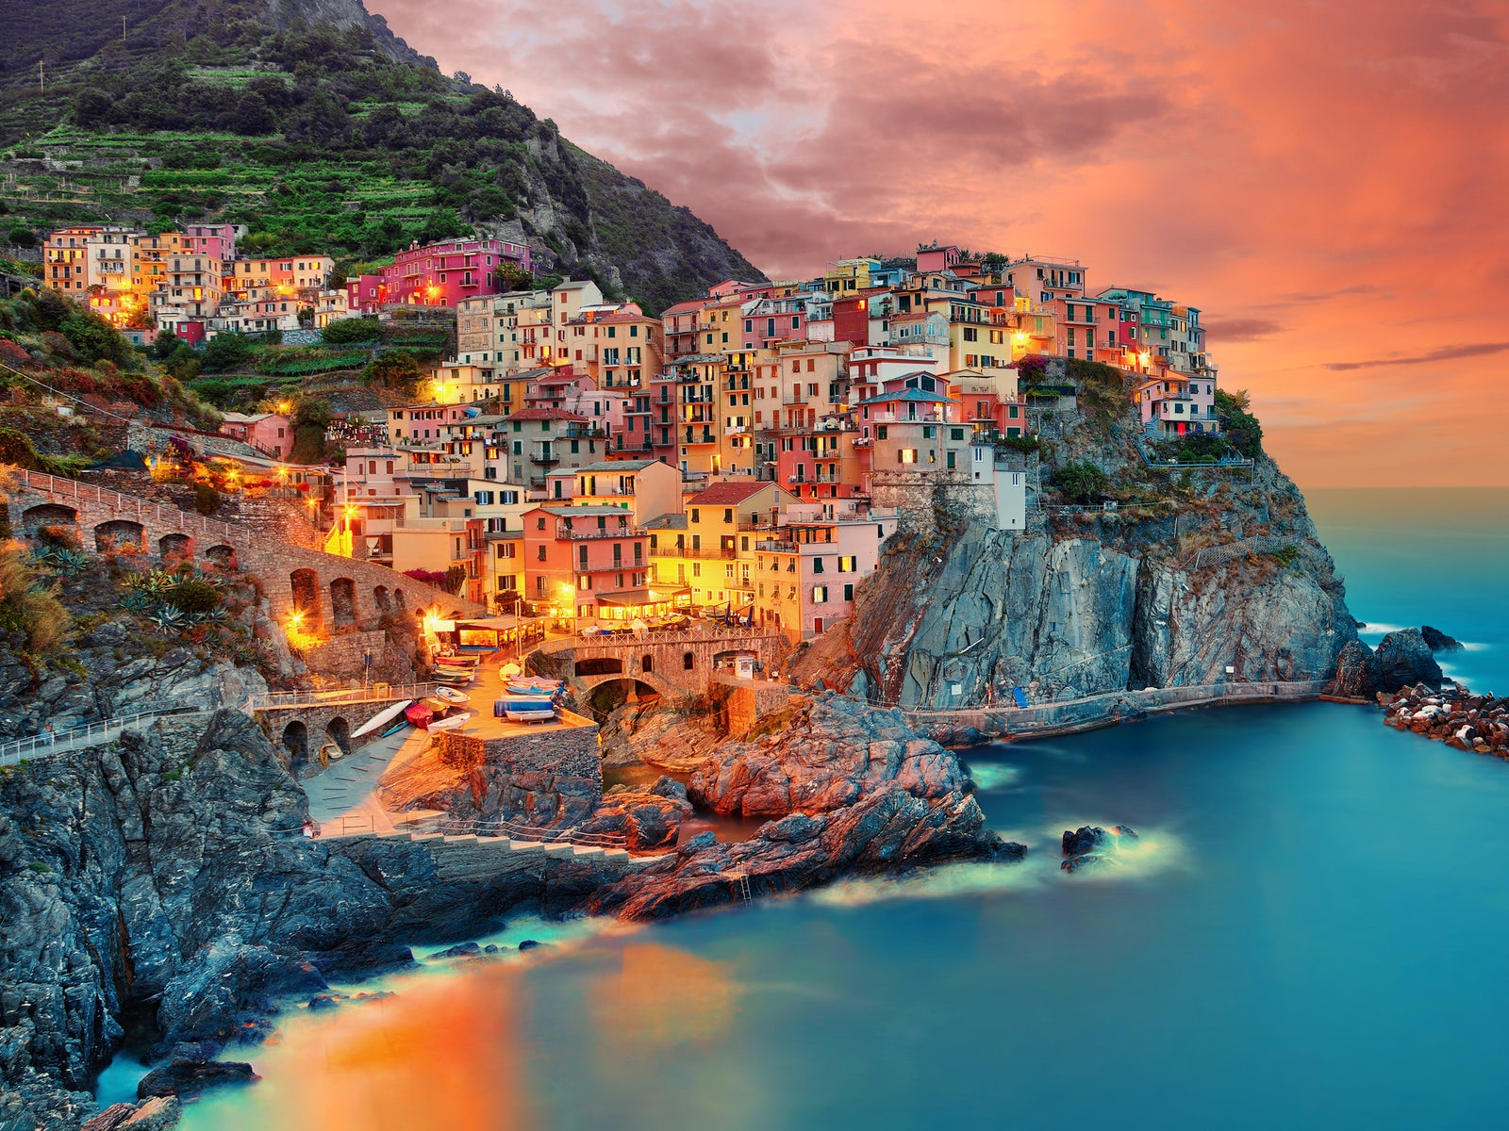
What we know so far….
Domestic demand
will recover sooner
than international demand.
The slowest recovery
will be in long-haul
rather than
short-haul travel
Recovery will be slow
COVID-19
Impact will not
be the same
for all destinations
Preference will be given to natural over urban environments (cities of art)
Combining cultural heritage, traditional food and wine products with active tourism and «true nature» is key to industry recovery

Slide 8
Building back better
Greener
Tourism industry
Implement sustainability including social, economic
and territorial sustainability of tourism
Promote slow tourism, itineraries and rural village destinations and strengthen the integration between cultural heritage and tourism
Improve the quality
of tourism offer
Support digital tourism
innovation, data and trace apps
Develop upskill and reskill education programmes for
tourism industry
and SMEs
Support tourism SMEs and industry with dedicated financial measures
7 Billion EUR for tourism
Provide real-time information on border procedures, available means of transport, travel restrictions, public health and safety measures.
Support to the
EU comon approach to mobility

Slide 9
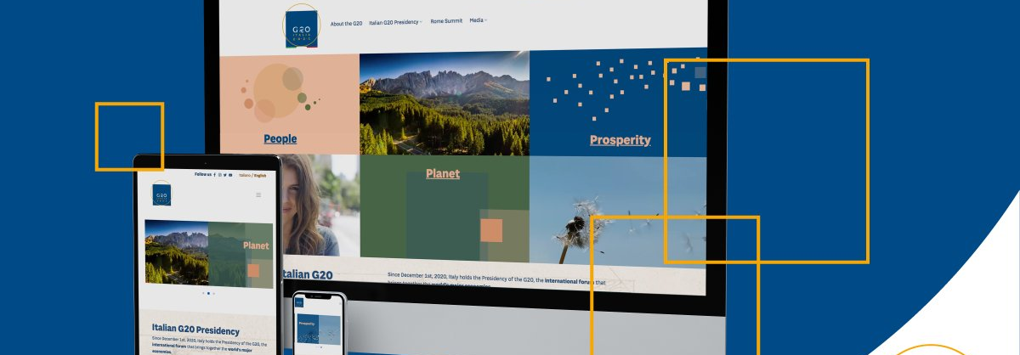
Thank you
www.turismo.beniculturali.it
www.g20.org/it

