Slide 1
SUBTEXT

Slide 2
Bread, Salt and a warm heart”
Participatory tourism – A dance with everyone invited in
5th EUSAIR forum
28th January 2021

Slide 3
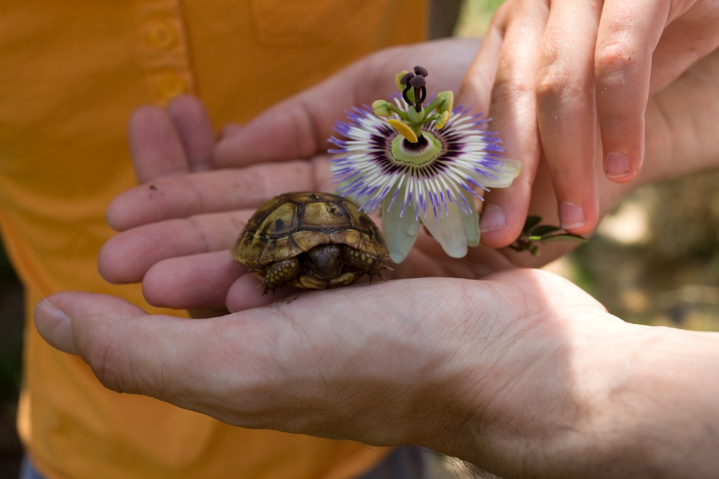
Our coast – a land of hospitality! But which future!?
What we offered to the visitors!?Products for travelers or for tourists!?
What the visitors wanted!? Understanding who’s looking for what!?
What we learned!? Hands on experiences.
What can still be done!? Sustainability trends.
How will visitors react in postcovid travel era!?
Some perspectives and some questioning marks.

Slide 4
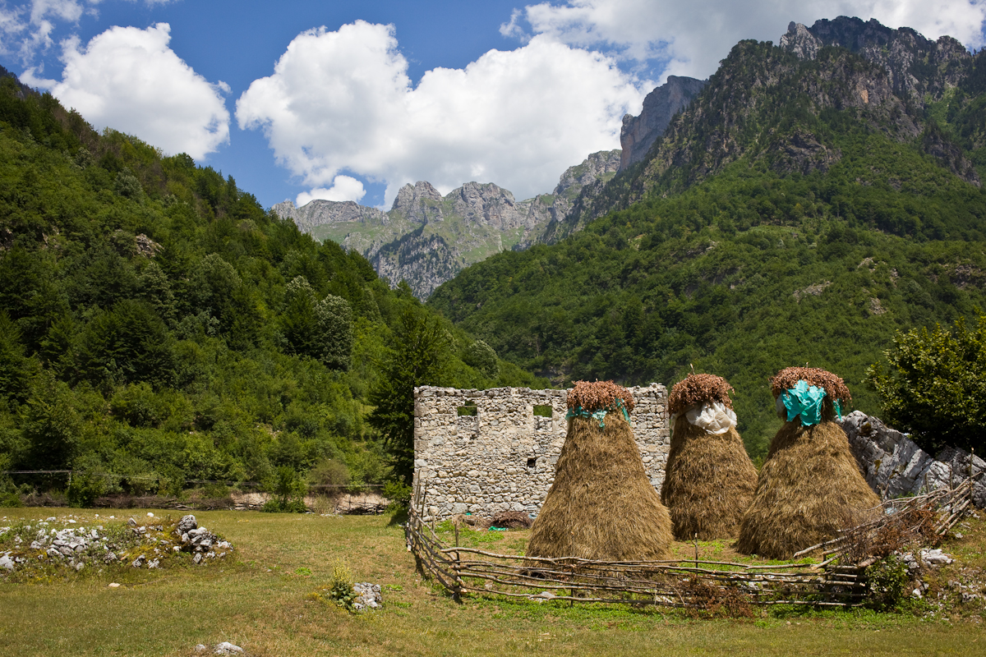

Slide 5
The trends in travel and tourism
Smaller scale travel is what seems will trend in post-covid era.
Less touristy offers and more educational. experiences seem to be the future of tourism
The region is still authentic and has a lot to offer.
Creativity is called to action.
We’ve learned a lot but we are far from pretending to have done our best.

Slide 6
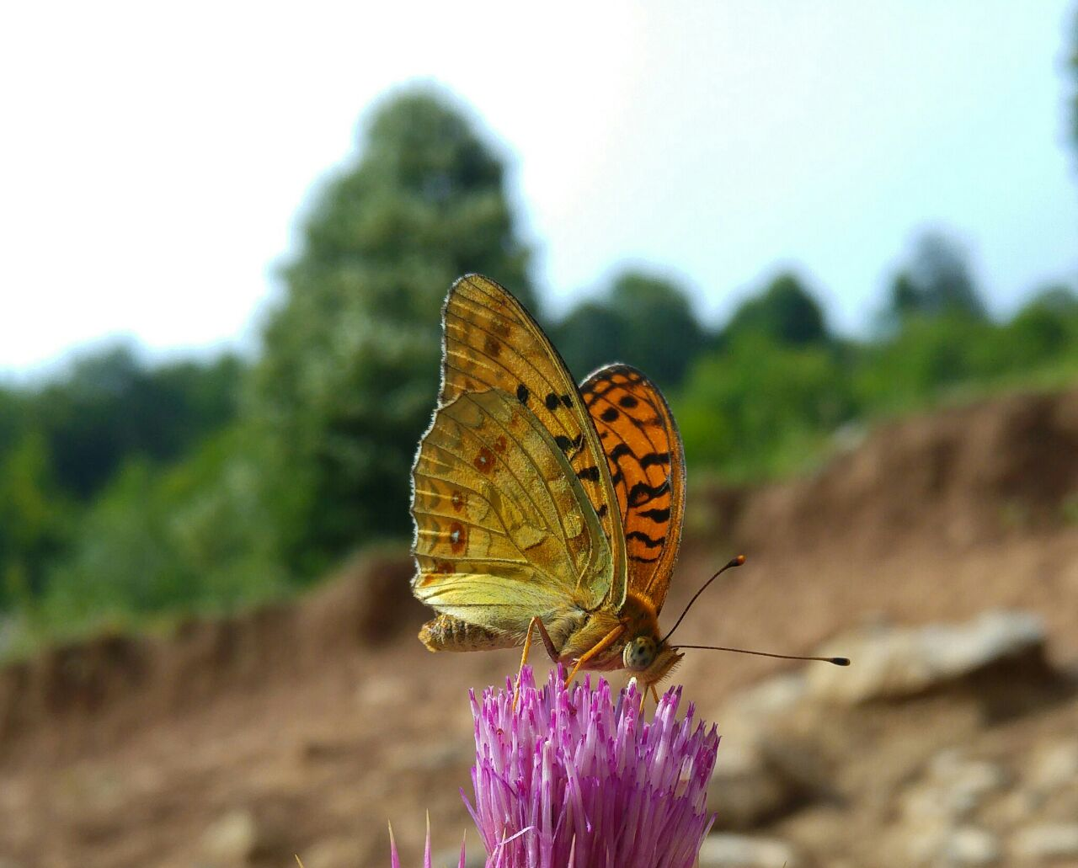

Slide 7
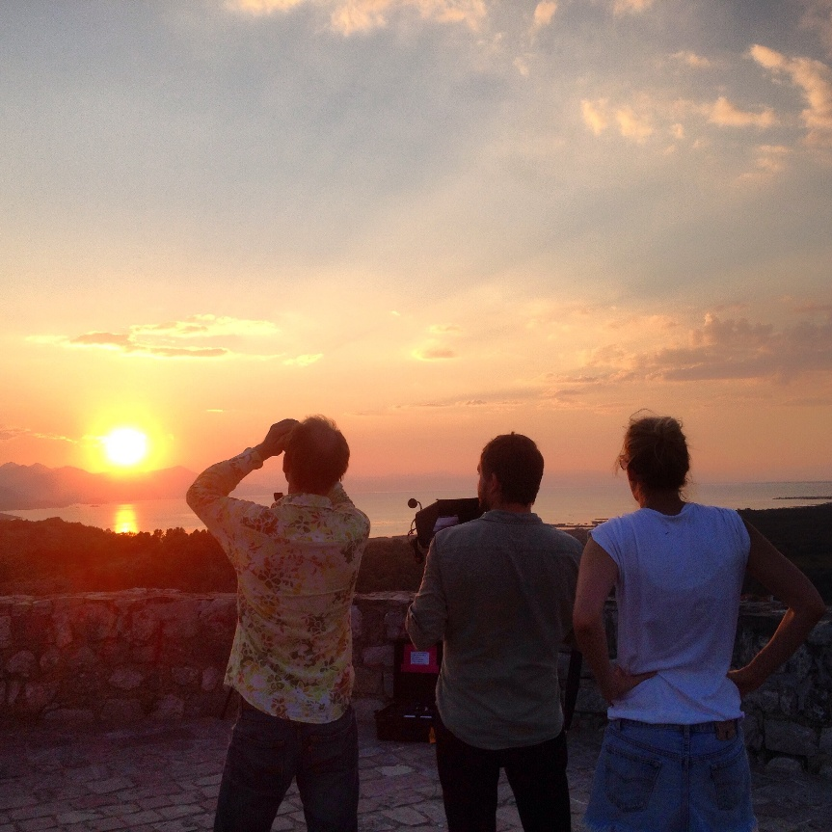
Conclusions
Trends go towards slower travel and more time to understand & learn about the destination
Trends go towards smaller groups and a lot of dedicated private or family travel
Trends go towards a more participatory travel experience
Trends go towards a more nature and rural oriented interest
Trends go towards decreasing the ecological footprint on the destination
Do less, teach more!
Care about the traveler! Care about the host!

Slide 8
Thanks Everyone! Mirupafshim

