Slide 1
SUBTEXT

Slide 2
Virtual Reality and Sustainable Tourism
Almir Peštek, PhD
University of Sarajevo
School of Economics and Business
almir.pestek@efsa.unsa.ba

Slide 3
Virtual Travel
Virtual travel (VT) is a complementary to conventional tourism.
VT enables tourists to “feel” destination without the need to actually visit it.
Virtual reality (VR) offers the potential to create substitute and interactive experiences that may be useful for heritage and threatened sites preservation and for destinations where sightseeing increases the risk of damage through human exploitation.

Slide 4
Virtual Reality
VR is becoming more mainstream, but the existing studies indicate that VR as a trend in tourism industry still needs significant work and improvement.
VR and “telepresence” allow the user to experience the feeling of “being there” and captures tourism destinations in a memorable and immersive way.
VR can cause strong emotions.

Slide 5
Virtual Reality (2)
Thanks to “try before you buy” option VR can positively influence tourist decision making processes and can be used as an efficient promotional tool.
VR shortens the process of decision making and has more impact on tourists than traditional media (at lower cost).
People with disabilities may go for virtual traveling.

Slide 6
Virtual Reality (3)
VR market in 2022 – 209 billion USD (gaming, marketing, social application).
VT remains a comparatively small niche – 12% share (25,1 billion USD).
Statista (2019) – 20% of travel brands will be investing in VR.

Slide 7
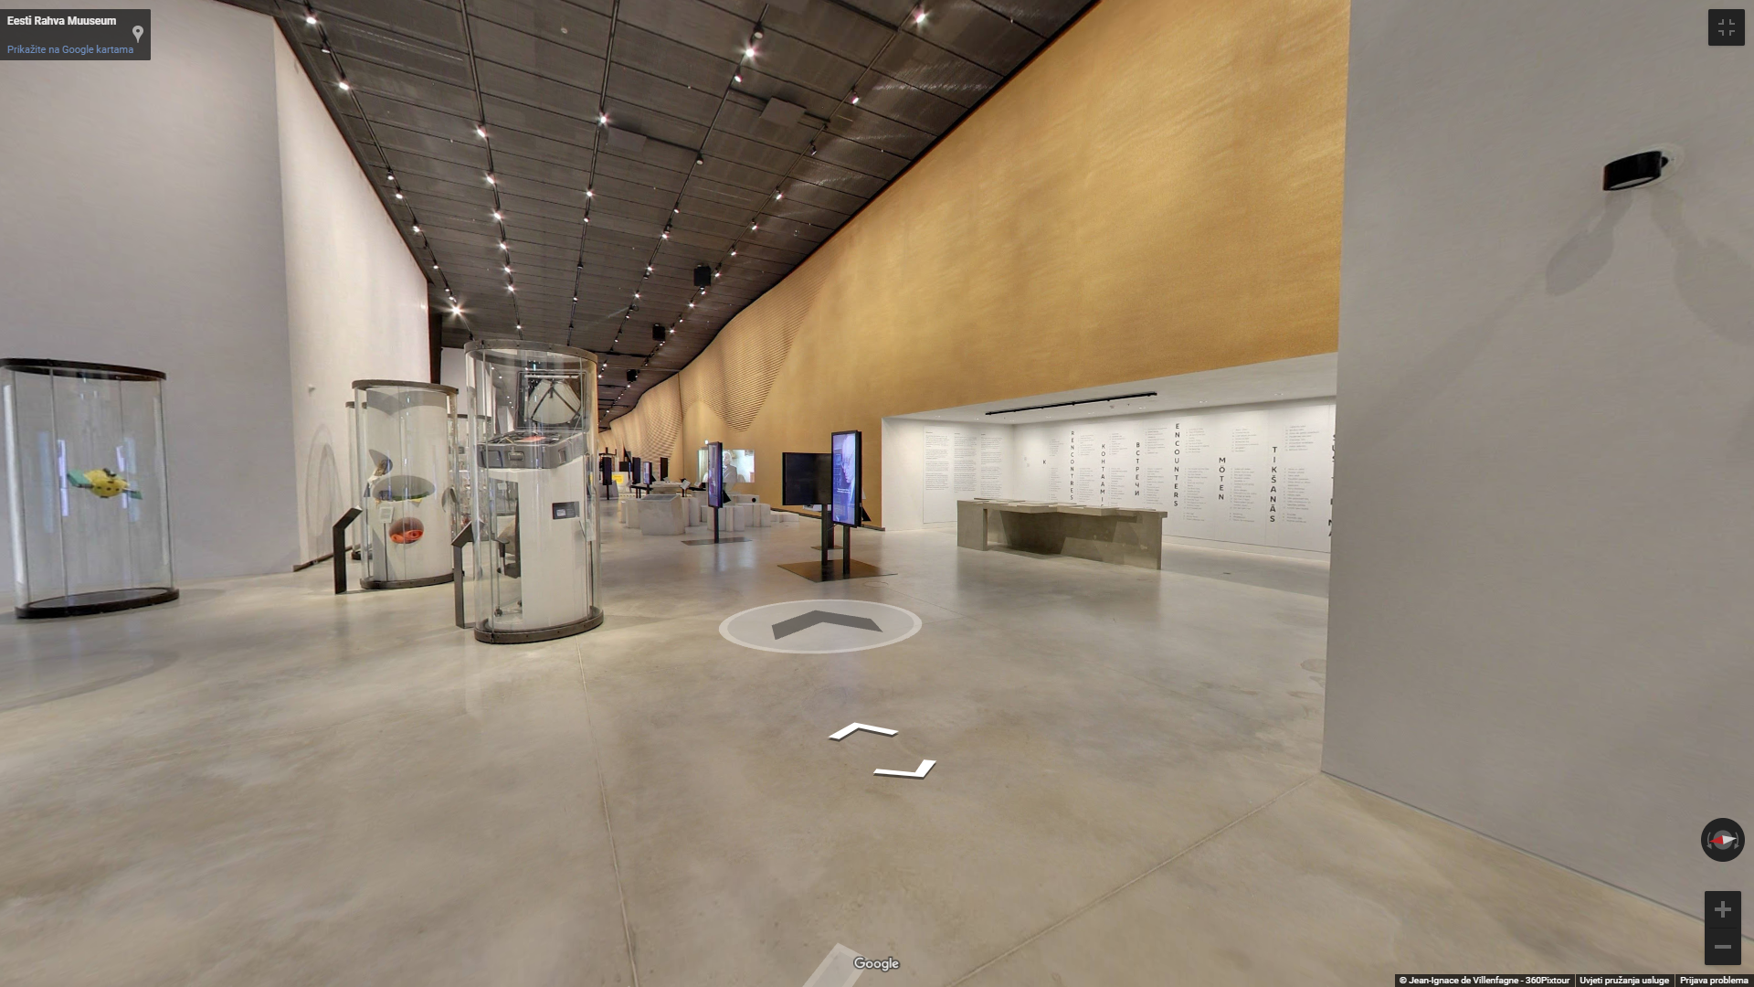
Estonian National Museum
Source: https://erm.ee/en/content/virtual-tour

Slide 8
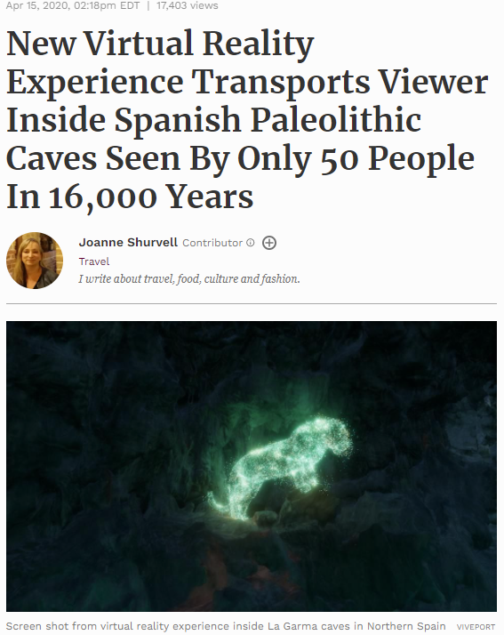
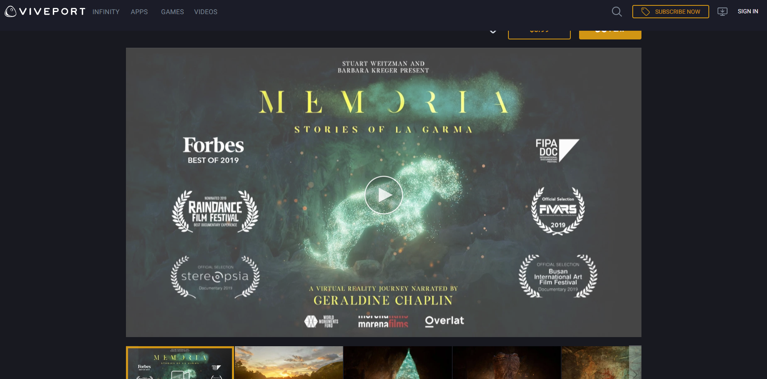
La Garma, Spain
Source: https://www.forbes.com and https://www.viveport.com/63790c59-83b6-412a-93f8-ca9360eab84f

Slide 9
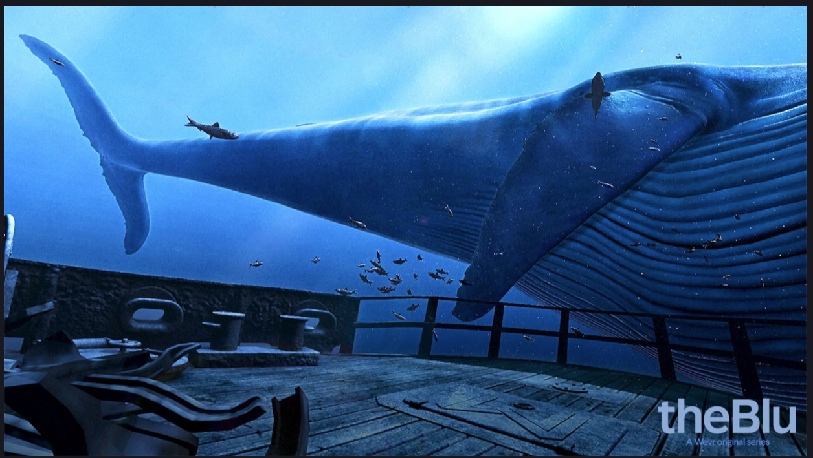
TheBlu
Source: https://www.viveport.com/1b591122-7ab7-4c27-9d31-cbaf9ef8e1e1

Slide 10
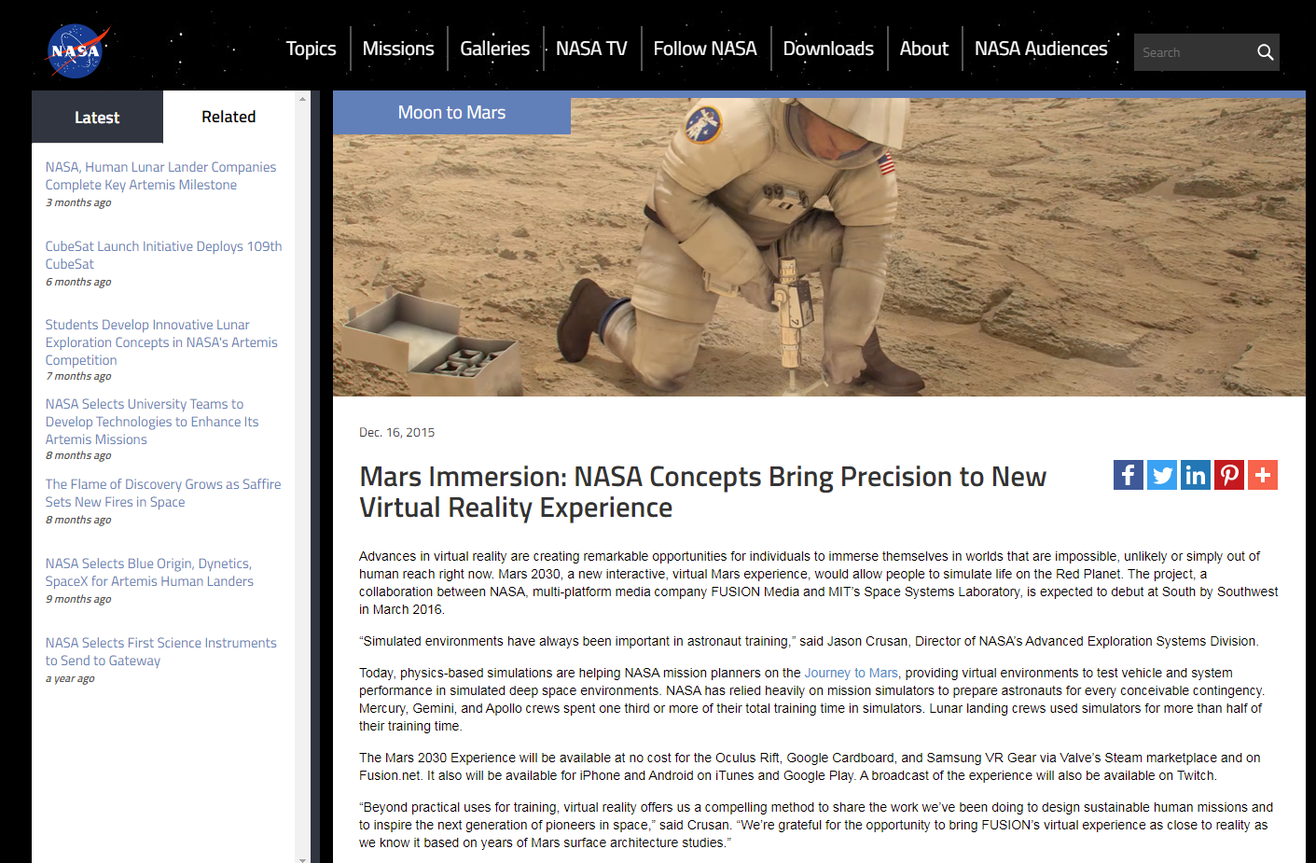
Nasa Mars 2030
Source: https://www.nasa.gov/feature/nasa-concepts-bring-precision-mars-to-virtual-reality

Slide 11
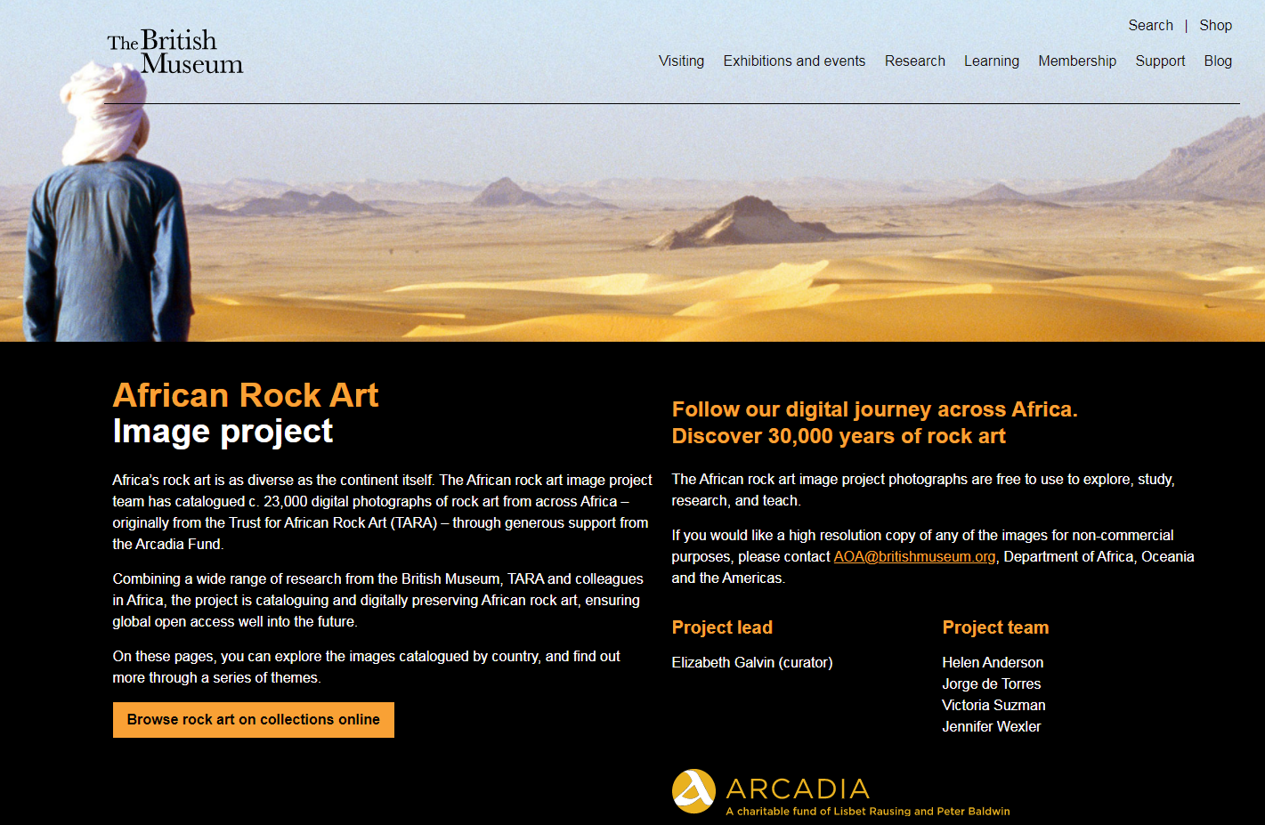
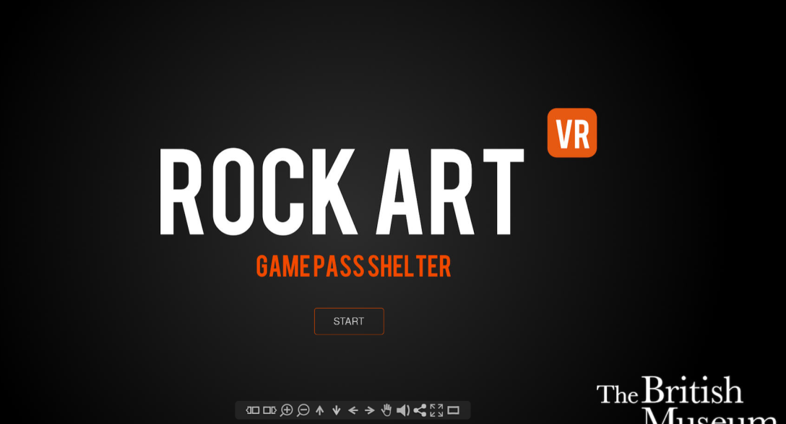
African Rock Art Project
Source: https://africanrockart.britishmuseum.org/#/article/rockartvr

Slide 12
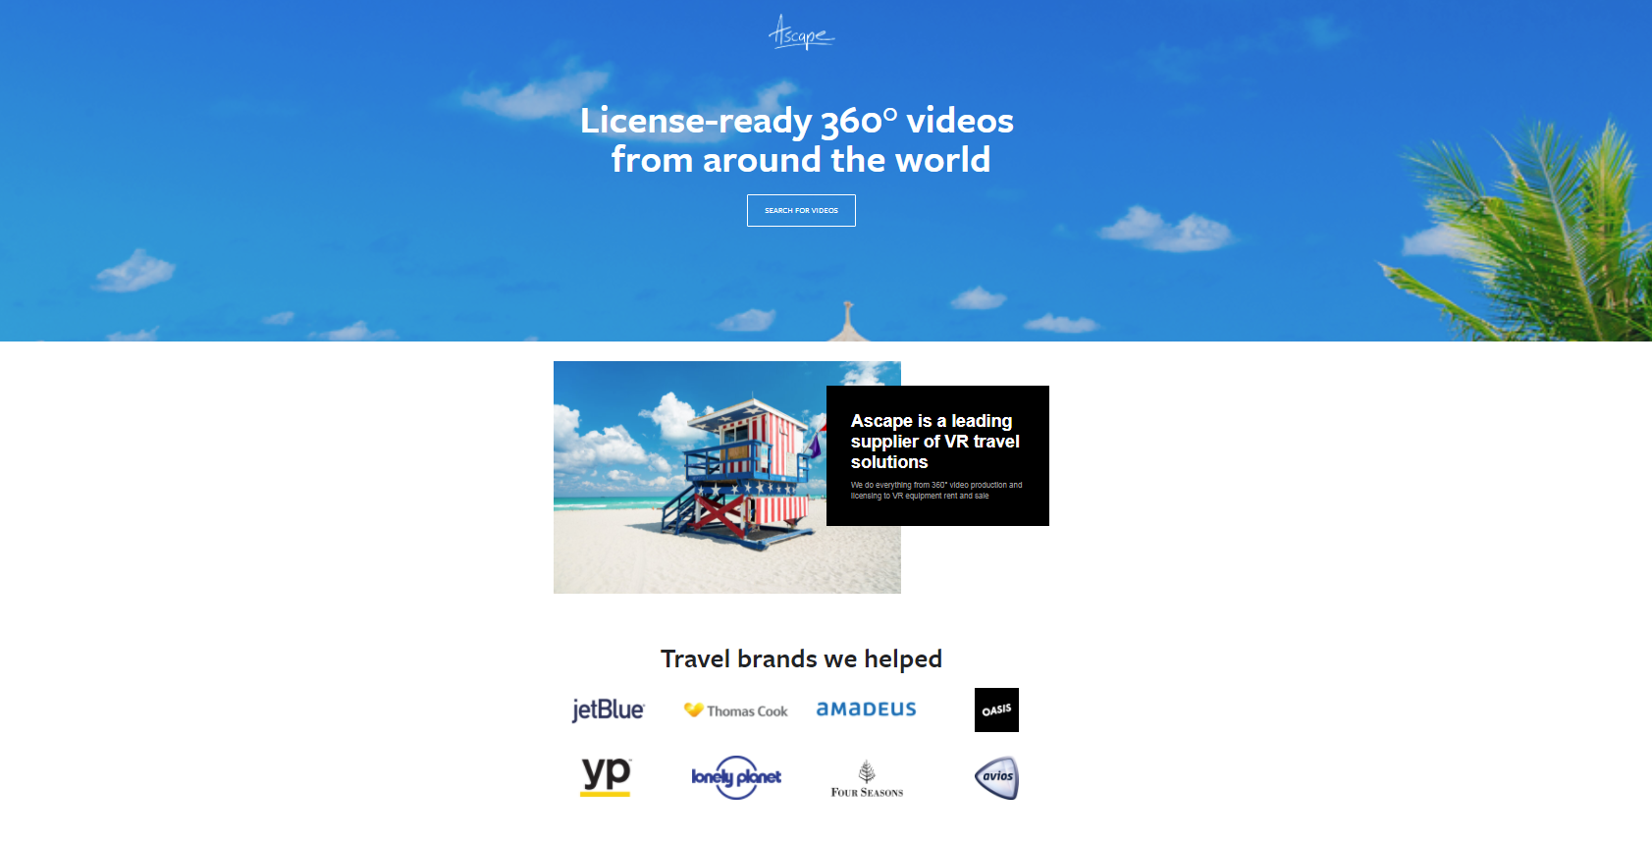
Ascape
Source: https://ascape.com/

Slide 13
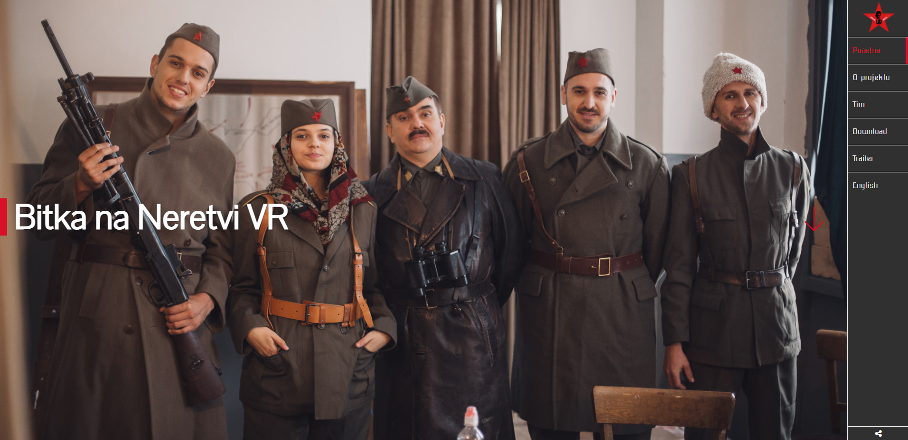
Digi.ba – Bitka na Neretvi
Source: http://h.etf.unsa.ba/bitkananeretvivr/

Slide 14
Digi.ba – Roman Heritage
Source: http://h.etf.unsa.ba/romanheritage/

Slide 15
Conclusion
VR makes the relations between individuals and tourist space more complex.
Tourist experience could become a mixture of reality and virtual reality.
Through creation of various types of simulators for virtual experience, potential tourists are able to experience a destination and make a less pressure on environment.
VR seems to promote tourism, rather than discourage it.

Slide 16
Thank You

