Slide 1
Circular economy:
A transformative Covid-19 recovery strategy
How policymakers can pave the way to a low-carbon, prosperous future
Date: November 2020

Slide 2
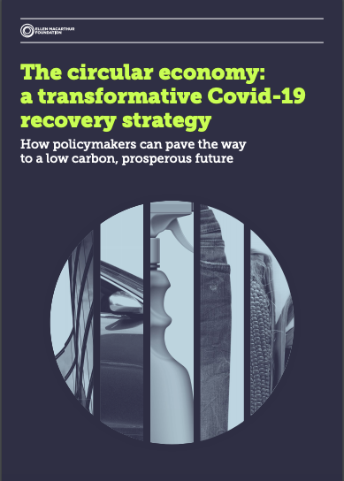
Circular economy: a transformative Covid-19 recovery strategy
How policymakers can pave the way to a low-carbon, prosperous future
Published in October 2020
Main ambition:
Showing how CE is key to building back better
Identifying top quick wins for public investment
Outcome:
10 circular investment opportunities that spread across 5 key sectors and help shape a low carbon and prosperous recovery
Notes:
References:
Xi Jinping commitment: https://www.theguardian.com/environment/2020/sep/22/china-pledges-to-reach-carbon-neutrality-before-2060

Slide 3
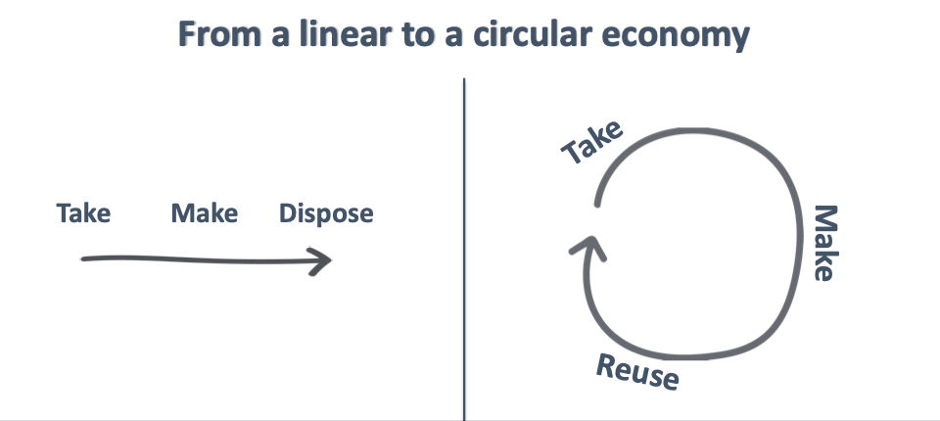
What is the circular economy?
Notes:
References:
Xi Jinping commitment: https://www.theguardian.com/environment/2020/sep/22/china-pledges-to-reach-carbon-neutrality-before-2060

Slide 4
The economic opportunity
Notes:
References:
Xi Jinping commitment: https://www.theguardian.com/environment/2020/sep/22/china-pledges-to-reach-carbon-neutrality-before-2060

Slide 5
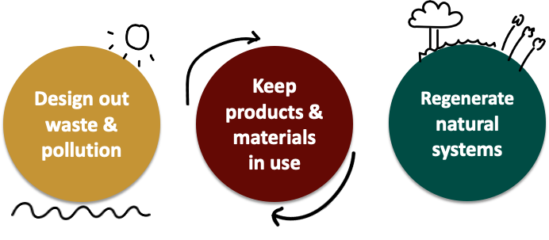
The circular economy is based on three principles:
Notes:
References:
Xi Jinping commitment: https://www.theguardian.com/environment/2020/sep/22/china-pledges-to-reach-carbon-neutrality-before-2060

Slide 6
The Covid-19 pandemic and the need for a transformative economic recovery strategy
The pandemic has exposed the vulnerabilities of our current linear economy, laying bare the urgent need for a system redesign
Many voices from governments, businesses, and civil society have called for a response that does not turn attention away from other global challenges such as climate change
The circular economy is instrumental for achieving a resilient recovery that is: prosperous, low-carbon, and mitigates the risk of future crises
Helping meet multiple policy objectives, both in the short- and long-term
Notes:
Example: a circular economy approach for the plastic sector by 2040 has the potential to:
Create 700,000 net additional jobs
Generate savings of USD 200 billion per year
Reduce the annual global volume of plastics entering our oceans by over 80%
Reduce greenhouse gas emissions by 25%

Slide 7
Policymakers have a fundamental role to play
Setting a common direction of travel: a resilient recovery with the circular economy
Fostering collaboration to obtain system-level solutions
Shaping incentives to enable a low carbon economic recovery
Unlocking circular investment opportunities to meet key public priorities
Notes:
These are critical if policymakers are to deliver more jobs and equitable growth in the short-term, while reducing long-term risks linked to climate change and biodiversity loss.

Slide 8
Trillions in economic stimulus are being unveiled by governments all around the world: But, where to start?
10 attractive circular investment opportunities
Sector | Reuse strategies Enabling infrastructure
Built environment | Renovation and upgrade of buildings | Building materials reuse and recycling infrastructure
Mobility | Multimodal mobility infrastructure | Automotive refurbishment, remanufacturing, and repair infrastructure
Plastic packaging | Innovative reuse business models for plastic packaging | Plastic collection, sorting, and recycling infrastructure
Fashion | Rental and resale business models for clothing | Clothing collection, sorting and recycling infrastructure
Food | Tools enabling farmers to shift to regenerative agricultural | Food surplus and by-product collection, redistribution, and valorisation infrastructure

Slide 9
Why these 10 circular investment opportunities?
Provide solutions to key challenges created by the pandemic
(e.g. increase resilience and enable access to vital goods and services)
Meet key priorities for economic recovery
(e.g. stimulate equitable growth, create jobs, meet SDGs and climate targets)
Offer circular economy growth potential
(driven by e.g. innovation, policies, and evolving customer preferences)
Reduce the risk of future shocks
(e.g. those relating to climate change)

Slide 10
10 attractive circular investment opportunities to build a more resilient recovery
Sector | Opportunities
Built environment | Renovation and upgrade of buildings | Building materials reuse and recycling infrastructure
Mobility | Multimodal mobility infrastructure | Automotive refurbishment, remanufacturing, and repair infrastructure
Plastic packaging | Innovative reuse business models for plastic packaging | Plastic collection, sorting, and recycling infrastructure
Fashion | Rental and resale business models for clothing | Clothing collection, sorting and recycling infrastructure
Food | Tools enabling farmers to shift to regenerative agricultural production | Food surplus and by-product collection, redistribution, and valorisation infrastructure

Slide 11
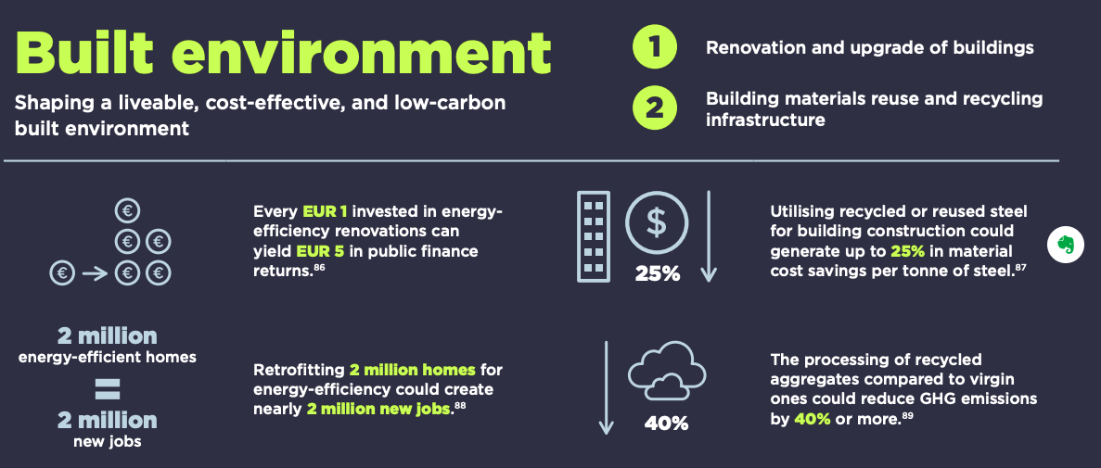

Slide 12
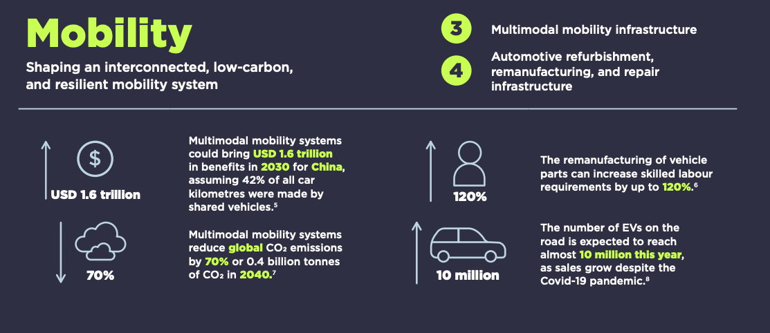
Date: November 2020

Slide 14
The circular economy is key for achieving a resilient recovery
“We need to be bold, and invest in a green and circular recovery. Taken together, the Green Deal and the circular economy action plan show us exactly what needs to be done. They are like a powerful vaccine that can help us become more resilient and protect us when other crises will appear or existing ones may worsen. The transformation is already under way, and businesses, consumers and public bodies are endorsing and supporting the sustainable model. It will be vital to draw on that momentum, and use the circular economy to define a new structure for rebuilding the economy.”
Virginijus Sinkevičius, European Commissioner

