Slide 1
5th ANNUAL EUSAIR FORUM
MRS. ESPON TOOL ON TERRITORIAL MONITORING AND TERRITORIAL SCENARIOS FOR EUSAIR IN 2050
28-29 January 2021, Belgrade, Serbia
Sandra Di Biaggio, ESPON EGTC

Slide 2
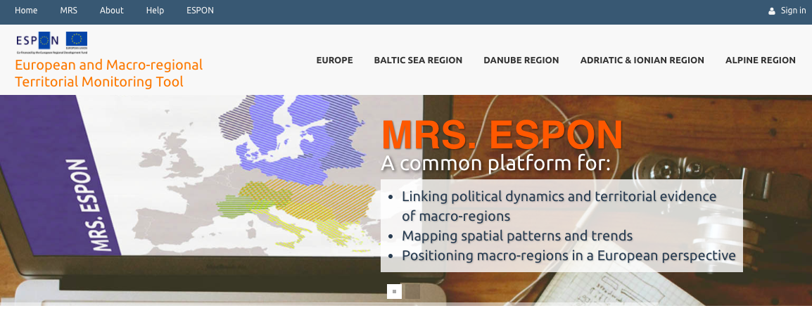
MRS. ESPON: https://mrs.espon.eu/

Slide 3
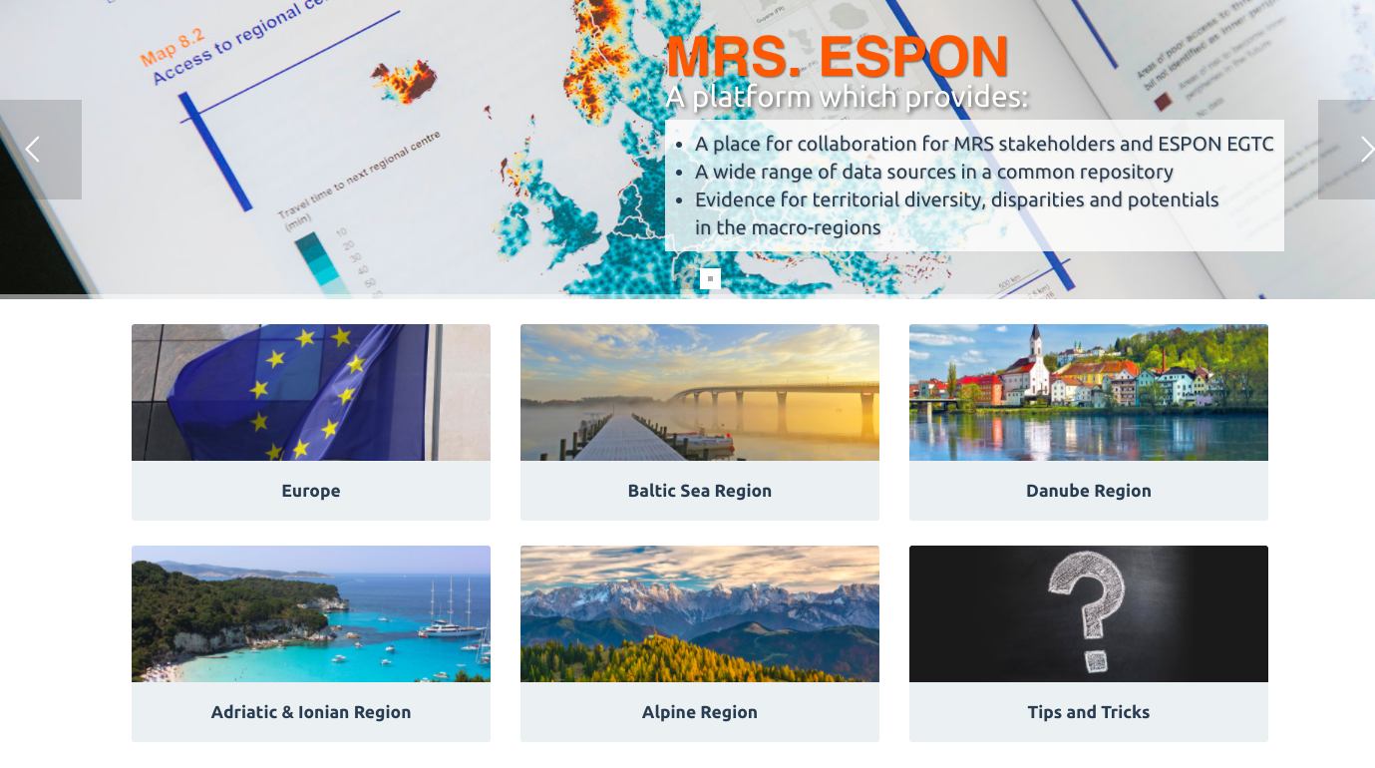

Slide 4
EUSAIR in a European context: Smarter Europe
Variation of GDP (NUTS 2)
2005-2015
EUSAIR: 11,4%
EUSALP: 21,1%
EU: 23,6%
EUSBR: 42.5%
EUSDR: 44,4%

Slide 5
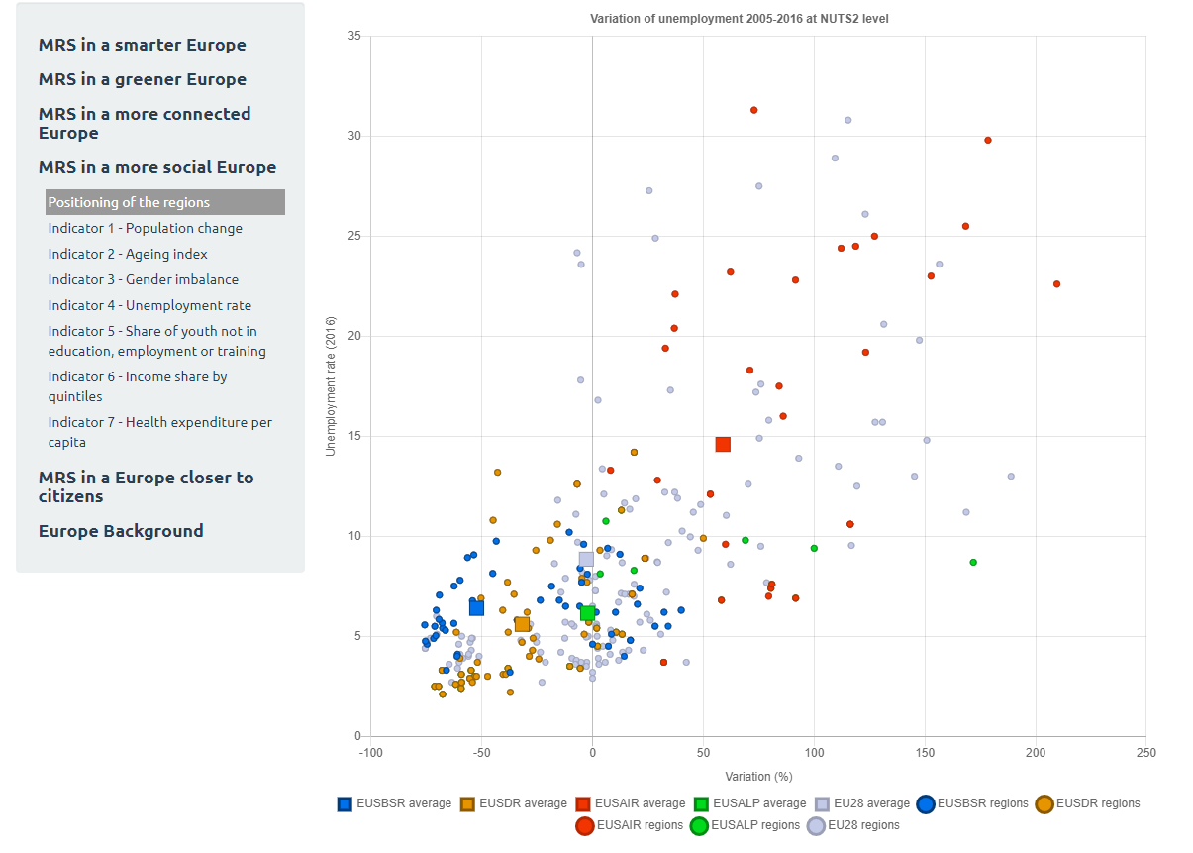
EUSAIR in a European context: More Social Europe
Variation of unemployment
(NUTS 2) 2005-2015

Slide 6
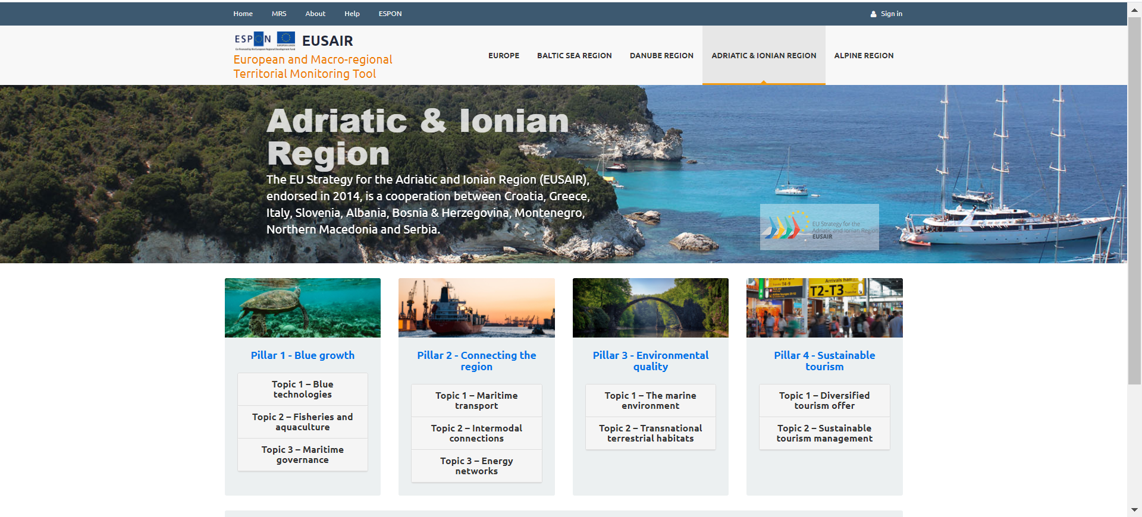
Adriatic & Ionian Region

Slide 7
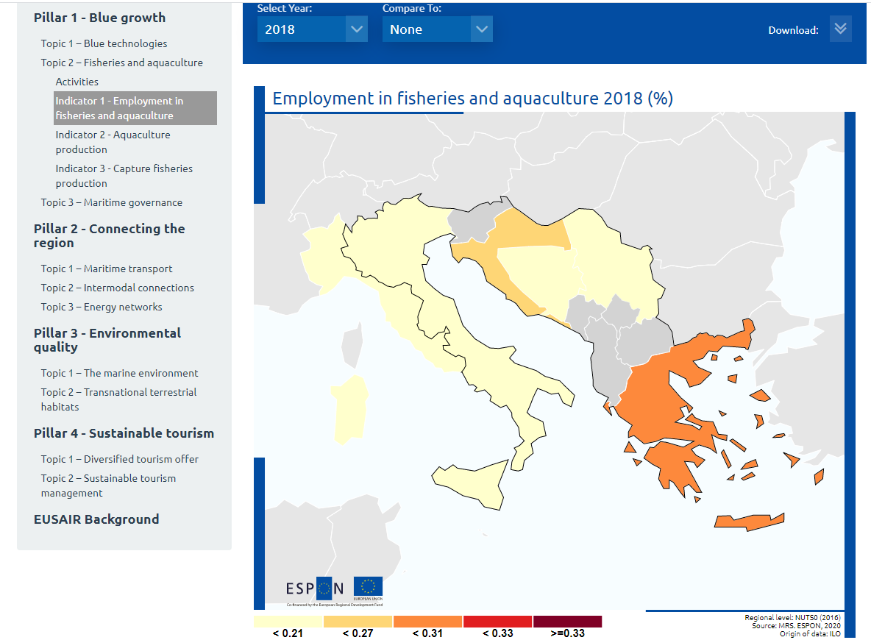
Adriatic & Ionian Region: blue growth
Employment in the fisheries,
aquaculture and processing sectors
in relation to all employed persons
Below 1%, with the highest share
of 0,3% for 2018 in Greece.
The share has decreased over
the recent years in all countries.

Slide 8
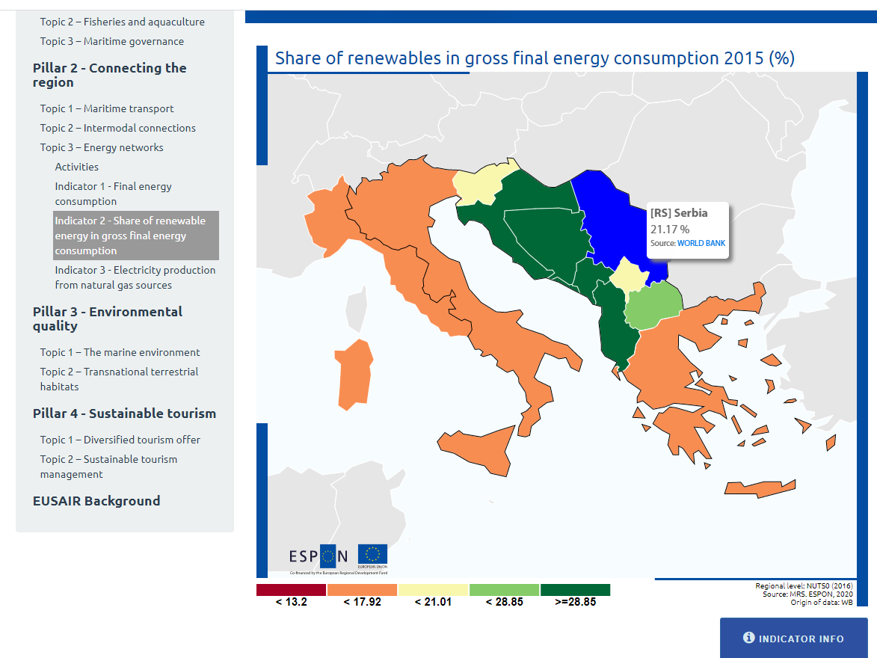
Adriatic & Ionian Region: connecting the region
Share of renewable energy (%)
in total final energy consumption
on country level.
The natural potential for
renewable energy in this region is
high and is seen as an important
contribution to economic
prospering and to the greening
of the economy.

Slide 9
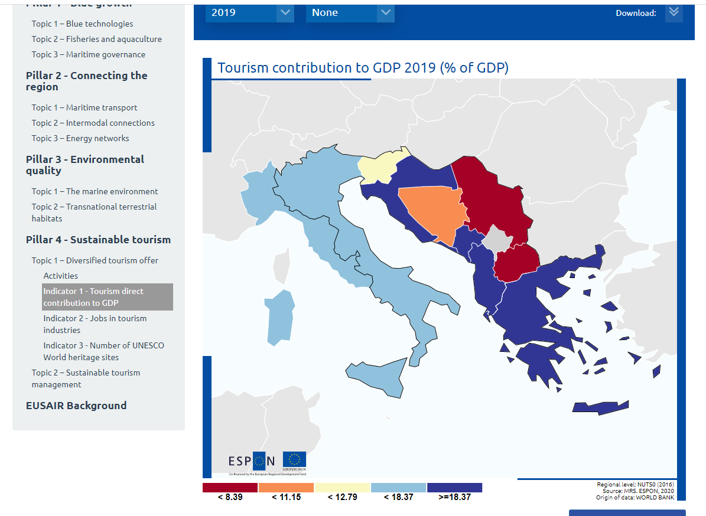
Adriatic & Ionian Region: sustainable tourism
Share of touristic activities to
the total GDP (%)
Croatia, Montenegro and
Albania show the highest values
with more than a 25% of the GDP,
which shows the high dependence
of the national economy on the
touristic sector.
Serbia and North Macedonia,
yet, only have low shares which
might be read as a high potential.

Slide 10
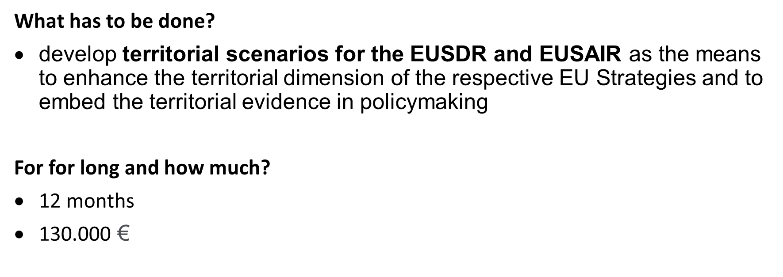
Territorial Scenarios for the Danube and Adriatic Ionian Macro-regions (TEVI 2050)

Slide 11
Territorial Scenarios for the Danube and Adriatic Ionian Macro-regions (TEVI 2050)

Slide 12
Territorial Scenarios for the Danube and Adriatic Ionian Macro-regions (TEVI 2050)
State of affairs:
Call opened on 10 December 2020 : https://www.espon.eu/tender-TEVI2050
Deadline for submission of tenders by 1 February 2021 at 16h00 (CET)
Technical Evaluation of tenders by March 2021
Starting of the contract (award letter) by April 2021

Slide 13
// Thank you sandra.di.biaggio@espon

