Slide 1
General Overview of the Electricity Market in Serbia

Slide 2
Agenda
Liberalization of Electricity Market in Serbia – Already Completed Activities
General Overiew of Electricity Market in Serbia
Further Activities in a Proces of Liberalization of Electricity Market in Serbia

Slide 3


Liberalization of electricity Market in Serbia
1. Unbundling of energy sector
2004 Adopted Energy law
1. Unbundling of energy sector
2005 designated transmission system operator (EMS)
1. Unbundling of energy sector
2005 established Serbian Regulatory Agency (AERS)
2. Energy Licence
2006 AERS issued first licence
2. Energy Licence
2015 AERS issued the first license to foreign legal entities (for the activity of wholesale supply)
Serbian Market model fully in compliance with Third Energy Package
3. Transmission system access
2005-2008 single price for the use of electricity and access to the system
3. Transmission system access
2008 established tariffs for access to the transmission system - separate price of access to the system from the price of delivered energy

Slide 4
Liberalization of Electricity Market in Serbia
4. NTC Callculation
4. NTC Callculation
  2005 bilateral data exhange between EMS and other transmission system operators
  2010 On the level of Regional technical group SEE, TSO's set up unique methodology for capacity calculation, based on common model and NTC methodology
5. Capacity Allocation
2005-2006 allocation of 50% NTC (FCFS method)
5. Capacity Allocation
2011 first joint auctions (held on Hungarian-Serbian border)
5. Capacity Allocation
2018 first coordinated auctions (EMS joined the auction office JAO)
2007 first split auction
6. ITC mechanism
2005-2007 Regional cost compensation mechanism due to transit of electricity
6. ITC mechanism
2007 Serbia joined the European ITC mechanism

Slide 5
Liberalization of Electricity Market in Serbia
7. Ancillary services
2005-2008 one regulated price (single cost) for ancillary services and engaged balancing energy
7. Ancillary services
2008 prices of ancillary services (for frequency regulation, voltage regulation, system start-up in case of blackout) were separated from the price of engaged energy.
8. Market Code
2013 EMS adopted the first Market Code
8. Balance Responsibility
2013 Established concept of Balance Responsibility
9. Balancing Market
2005-2013 balancing market operates based on regulated principles
9. Balancing Market
2013 balancing market operates based on market principles
9. Balancing Market
2015 crossborder balancning market within SMM control blok
2017 crossborder balanscing market on BARS border

Slide 6
Liberalization of Electricity Market in Serbia
10. Electricity Market for end consumers
2013 Opening market for end consumers on transmission level
10. Electricity Market for end consumers
2014 Opening market for end consumers on distribution level
10. Electricity Market for end consumers
2015 Opening market for households and small consumers
11. Transparency of Electricity Data
2009 EMS and other transmission system operators has started the process of publishing key market data
11. Transparency of Electricity Data
2016 EMS adopted the Rules on the Publication of Electricity Market fundamental Data and has started to submit data to the European Transparency Platform
12. Guarantees of origin
2016 EMS established an Electronic register of GO
12. Guarantees of origin
2018 EMS issued the first GO
12. Guarantees of origin
2015 EMS joined the AIB Association as an observer
2017 Government adopted GO Regulation
2019 EMS became a full member of AIB
2018 EMS callculated first Residual Mix

Slide 7
Serbian Electricity Market Rolle Model
7
Cross-border flows
Independent producers
Privileged producers
Producer
EPS
*
*
EMS
Transmission System Operator
Balancing and bilateral market administrator
EPS Distribucija
Distribution System Operator
SEEPEX
Market Operator
Wholesale supplier
Wholesale Suppliers
Customers under guaranteed supply (3.5 mil)
Active eligible customers (91072)
Supplier
In the open market
Guaranteed supply
Reserve supply
Suppliers
Energy Flows
Energy Trade
*
Loss Recovery

Slide 8
Day-ahead Market Development Status
SEEPEX – Market Operator
in operation from February 2016

Slide 9
The Size of Internal Serbian Market

Slide 10
Balance Responsibility Parties in Serbian Electricty Market
PRP – Production Responsible Party
CRP – Consumption Responsible Party
TRP – Trade Responsible Party

Slide 11
Balancing Market Overview - Imbalance Settlement Price
Imbalance prices (monthly average values) in Serbian market for period 2019-2020

Slide 12
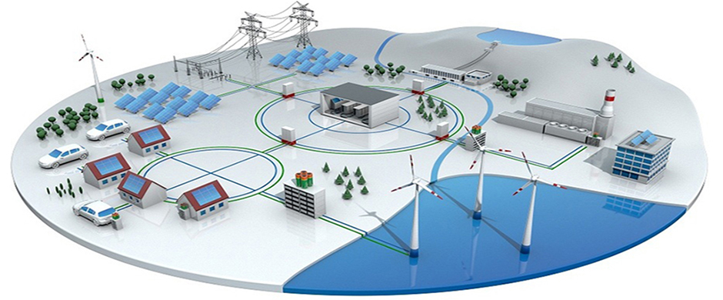
European Roadmap of Further Liberalization of Electricity Market
Two main strategic directions of development
Integration of RES and distribution resources on the electricity market
Centralization of Market Roles

Slide 13
Deregulation and Centralisation of Energy Sector
Deregulation of Energy Sector
Liberalization of Electricity Market
Centralisation of Market Roles
National Electricity Market
National Legislation
Single EU Electricity Market
(SAP, MRC, RCC,
Single Balancing Platform)
EU Legislation (CACM, FCA, SOGL, GLEB...)

Slide 14
Drivers of Further Market Development
Remaining obligations under national legislation
Implementation of best European practice
Transponsition of new EU regulations

Slide 15
Remaining Obligations Under National legislation
Ancillary Services based on market principles
Implementation of smart grids on DSO level
Selection of guaranteed supplier based on market principles

Slide 16
Main Activities in According with New EU Regulations
Capacity calculation by regional security centers
Determination of trading zones in accordance with structural congestion in the network
Introduction of HAR and accession to a single auction platform on all borders
Introduction of financial transmission rights
Accession to the European Balancing market (EU balancing platforms)
Day-ahead Market Coupling
Designation of NEMO in Serbian electricity market
XBID - access to the single European intraday market

Slide 17
Implementation of best European practice
SEEPEX
;;
Implementation of intraday market
RES
ff
Integration of RES into the balancing market market
Transmission Access
Introduction of the G component in transmission system tariff

Slide 18
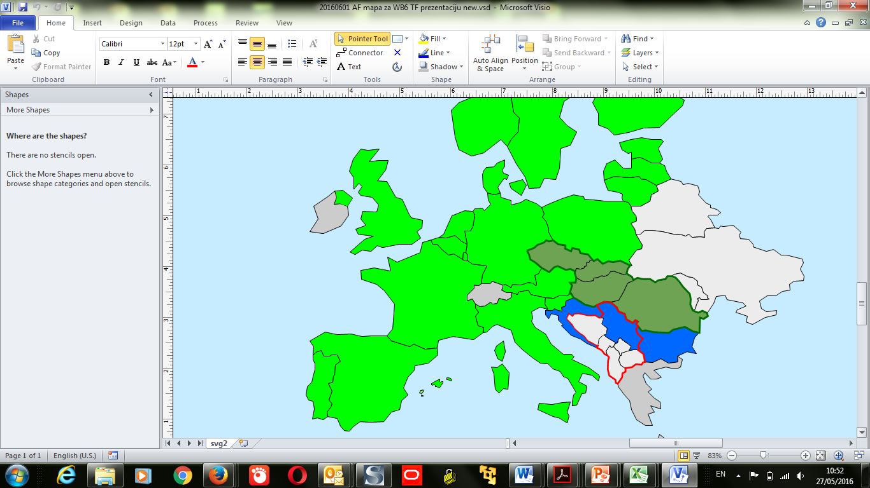
Day-ahead Market Coupling Overview
New PX
4MMC
MRC
Non coupled
EMS SEEPEX
WB6

Slide 19













http: //www.ems.rs
Notes:
19

