Slide 1


CONNECTING THE REGION: ENERGY NETWORKS FOR A GREEN ADRIATIC-IONIAN REGION – Paralell Session II
5th Forum of the EUSAIR- Strengthening the resilience of the Adriatic and Ionian Region through cooperation
Belgrade, 28-29 January 2021
Janez Kopač
Director
Energy Community Secretariat
Janez.Kopac@energy-community.org

Slide 2

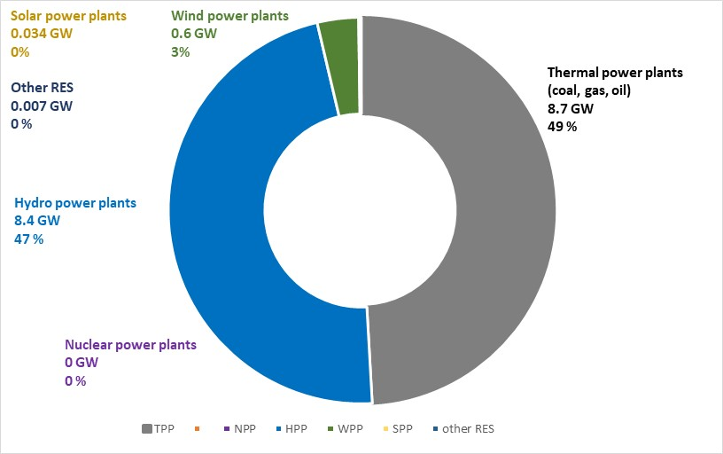
GENERATION MIX IN THE 6 CP COUNTRIES
Generation mix of the 6 EnC CP countries (Balkan)
Still relies on the fossil fuels, mainly coal
Almost 50 % share of HPPs
Limited integration of renewables, mainly wind power plants
Carbon pricing → coal phase-out until 2050
LARGE RES INTERGRATION IS EXPECTED !!!
Belgrade, 28-29 January 2021
5th Forum of the EUSAIR Belgrade, 28-29 January 2021
The Energy Community Secretariat

Slide 3

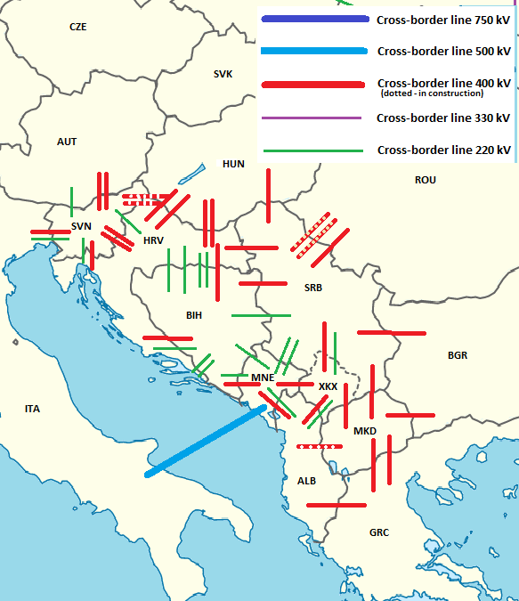
POWER TRANSMISSION NETWORK
Cross-border power transmission lines of the
Adriatic and Ionian Region
Transmission network well developed (400 kV, 220 kV, 150/110 kV lines)
Restricted NTC values → limited trading, cross-border congestions
5th Forum of the EUSAIR Belgrade, 28-29 January 2021
The Energy Community Secretariat

Slide 4
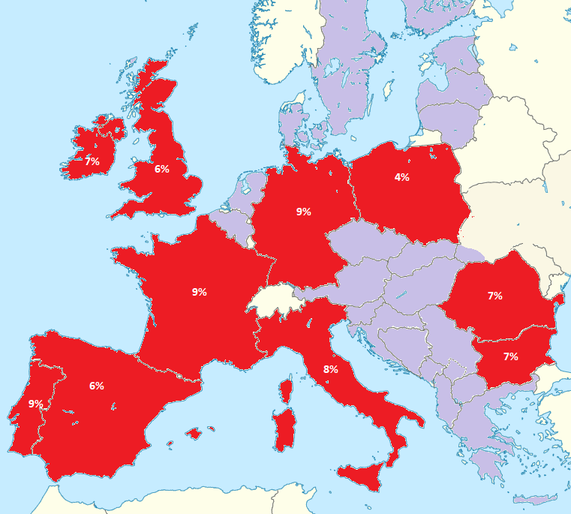
INTERCONNECTIVITY TARGET 2020
Ratio between the NTCs and installed generation capacities should be at least 10% by 2020
Red (<10%)
Purple (>10%)
All 6 CP countries meet the electricity interconnectivity target 2020 despite low NTC values
5th Forum of the EUSAIR Belgrade, 28-29 January 2021
The Energy Community Secretariat

Slide 5
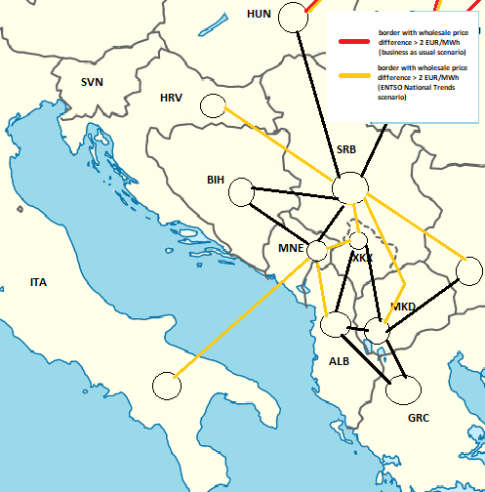
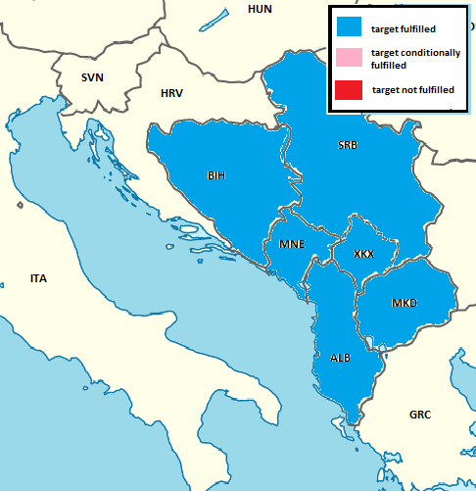
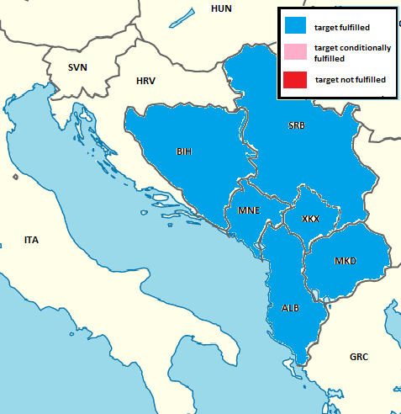
INTERCONNECTIVITY TARGETS 2030 IN THE 6 CPs
Wholesale electricity price difference target -
indicative threshold of max 2€/MWh difference between countries, regions or bidding zones
Nominal transmission capacity of interconnectors compared to the peak load in the country shall be above 30%
Nominal transmission capacity of interconnectors shall be more than 30% of installed renewable generation capacity in a country
2 out of 3 interconnectivity targets for 2030 are going to be fulfilled even with the existing cross-border lines only
Wholesale electricity price target might be unfulfilled on certain borders due to unnecessarily low NTC values → MORE EFFICIENT USAGE OF THE EXISTING INTERCONNECTORS NEEDED
(at least 70% according to Regulation 2019/943 on the internal market for electricity)
5th Forum of the EUSAIR Belgrade, 28-29 January 2021
The Energy Community Secretariat

Slide 6

CONCLUSIONS ON ELECTRICITY
MORE EFICIENT USAGE OF THE EXISTING INTERCONNECTORS
SIGNIFICANT NUMBER AND NOMINAL TRANSMISSION CAPACITY OF THE EXISTING INTERCONNECTORS
NEW NEW INTERCONNECTORS ONLY IF ECONOMICALLY VIABLE
INTERCONNECTIVITY TARGETS 2020 AND 2030 FULLFILED BY ALL 6 COUNTRIES
MORE EFFICIENT USAGE OF THE EXISTING INTERCONNECTIONS SHOULD BE PUT IN FOCUS
NTC VALUES ARE GENERALLY TOO LOW TODAY – EXPECTING ELECTRICITY REGULATION
ATTENTION SHOULD BE DIRECTED TO INTERNAL NETWORKS REINFORCEMENTS
The Energy Community Secretariat 5th Forum of the EUSAIR Belgrade, 28-29 January 2021

Slide 7

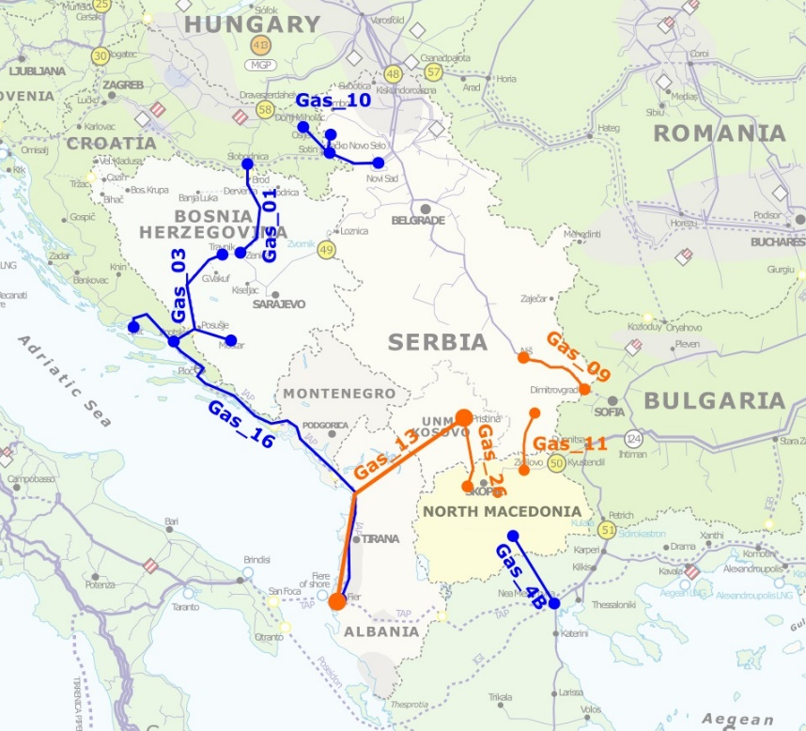
NATURAL GAS PROJECTS IN THE 6 CPs PECI-PMI
The Energy Community Secretariat 5th Forum of the EUSAIR Belgrade, 28-29 January 2021

Slide 8
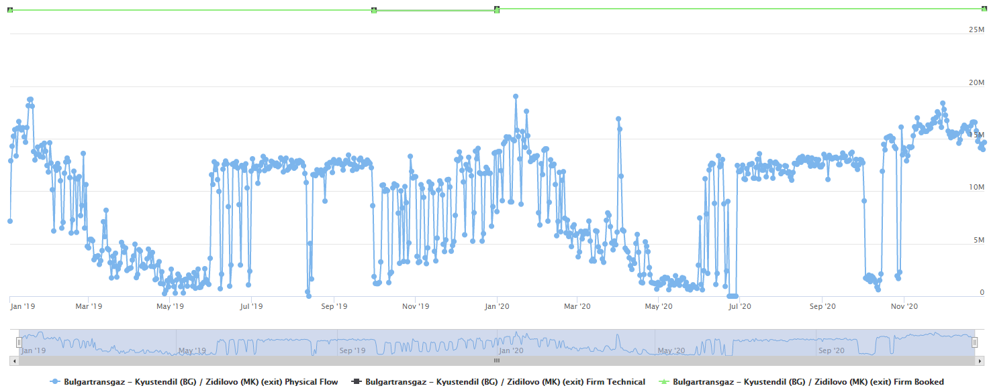
CURRENT GAS INFRASTRUCTURE UTILISATION
SR → BiH
Technical capacity: 20,526,314 kWh/day
Booked yearly capacity 2019: 17,578,440 kWh/day – 85,6% (15,420,000 kWh/day allocated to BH Gas based on a LTC)
Booked yearly capacity 2020: 17,883,647 kWh/day – 87,1%
Annual physical flow: 2,585,440,428 kWh/y – 34,5% - ca. 2/3s in winter → peak utilization can be 80%+
Source: ECRB
BG→MK 2019/2020
(mKWh/d)
Source: ENTSOG TP, BGTG EXIT
100% booked, under peak conditions 50% physical utilization
The Energy Community Secretariat 5th Forum of the EUSAIR Belgrade, 28-29 January 2021

Slide 9
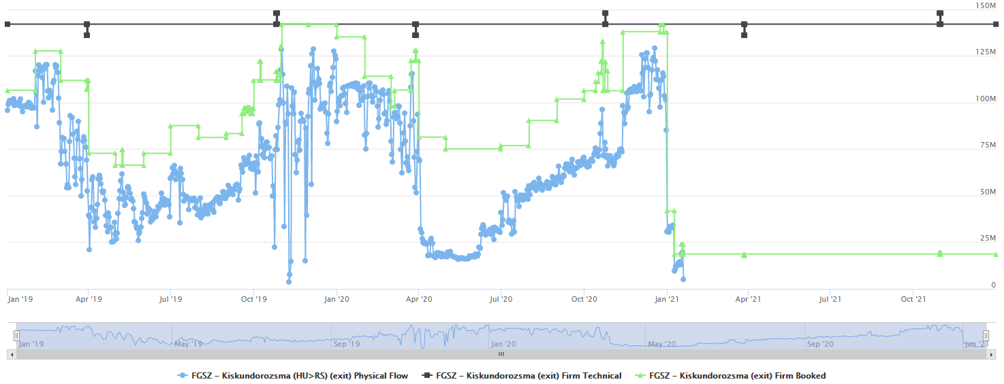
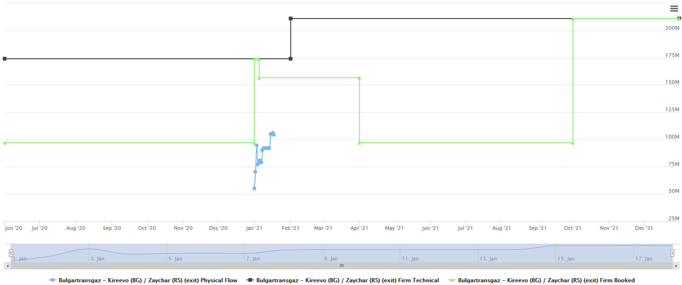
CURRENT GAS INFRASTRUCTURE UTILISATION
HU→SR 2019/2021
(mKWh/d)
Very significant drop in booking and physical flow after the start-up of the new BG-SR Interconnector (TurkStream)
Utilization and booking of FGSZ Exit at Kiskundorozsma fell back to ca. 15- 20%
Source: ENTSOG TP, FGSZ EXIT
BG→SR 2020/2021
(mKWh/d)
Source: ENTSOG TP, BGTG EXIT
Investment into rule of law is much cheaper than investment into new pipelines

Slide 10

THANK YOU
FOR YOUR ATTENTION
www.energy-community.org
Ener_Community
/company/energy-community
/Ener.Community
/EnergyCommunityTV
GET IN TOUCH

