Slide 1

Integrating the Adriatic Energy Markets: Italy’s Experience and the Role of Regulation
Fabio Tambone, Director, Head of External International Relations
ARERA, Regulation Authority for Energy, Networks and Environment
Connecting the Region: Energy Networks for the Green Adriatic-Ionian Region through Co-operation
EUSAIR 5th FORUM
Belgrade, 28th January 2021

Slide 2
Today’s Presentation Contents
Introducing ARERA
Integration beyond the EU: Italy as an Energy Hub?
Promoting Markets Integration: the Role od Regulation
Sharing Regulatory Principles: Western Balkans and KEP
Regulatory Convergence in Practice: the MONITA interconnection
Conclusions

Slide 3

Italy’s Regulatory Authority for Energy, Networks and Environment (ARERA)
  Is an independent authority, established by law in 1995
  Performs economic and quality-of-services regulation in the sectors of electricity, gas, water, district heating, municipal waste
  Applies uniform principles in any of the regulated domains (cost-reflectivity, transparency, efficiency and effectiveness)
  Promotes the interests of users of regulates assets and energy consumers, while ensuring financial stability for industry
  Involves stakeholders in the decision-making process
  Co-operates with the Government and the Parliament on relevant issues
  Is a party to the EU’s Agency for Co-Ordination of Energy Regulators (currently Chaired by a Member of ARERA’s Board)
  Works together with other Regulatory Authorities in Regional Associations

Slide 4
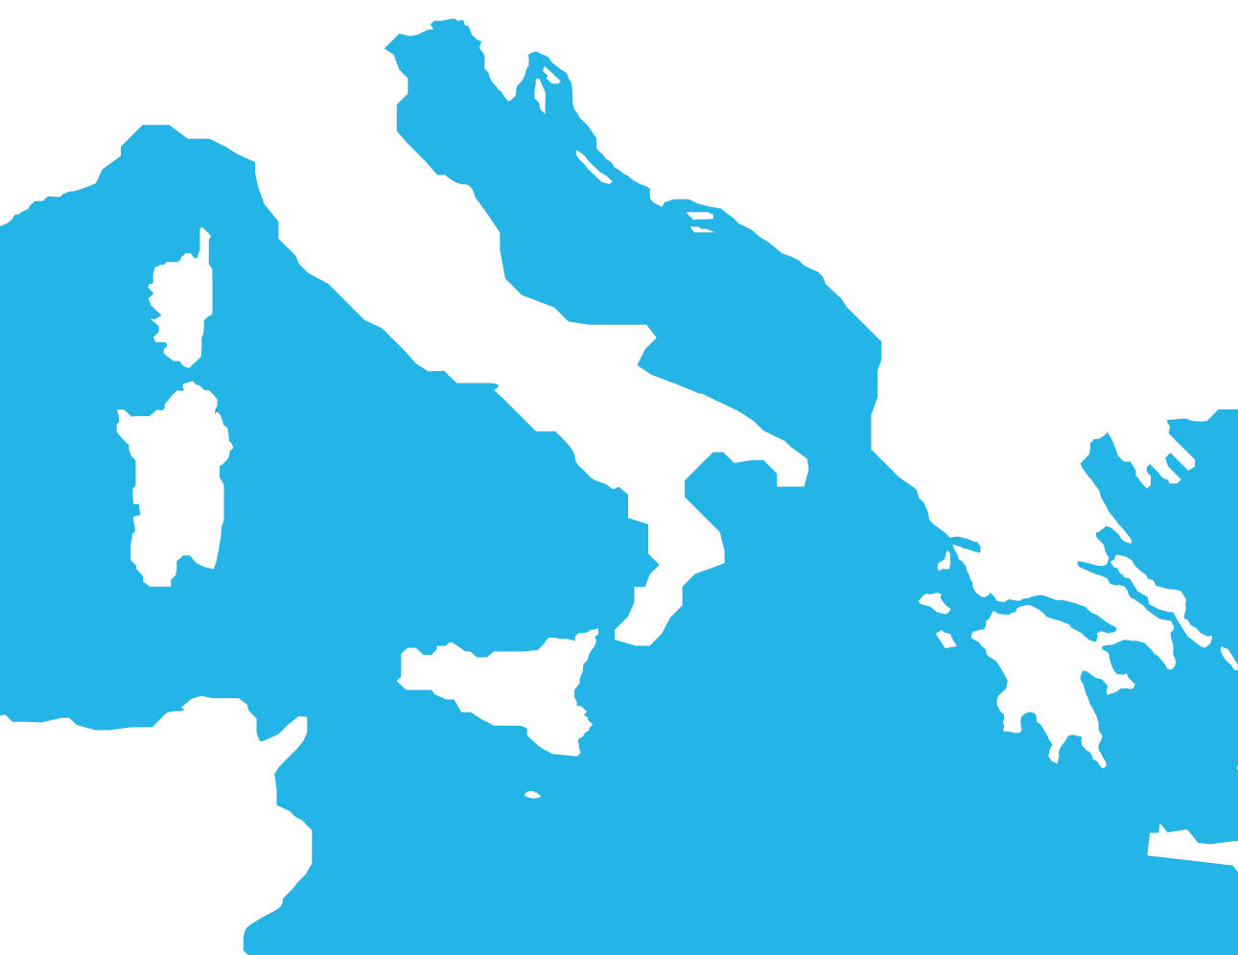
Structural Change to Build an Energy Bridge
Increased electricity interconnection capacity
Structural change in generation mix
Gas import capacity likely to exceed internal demand
MONITA (Montenegro – Italy), Undergoing Scrutiny for Market Coupling
Shift from a “High-price, heavily importer” electricity market to a contributor to the EU security of supply
Significant electricity export observed in the last two years, mainly due to “exceeding generation” from RES
Reverse flow studied also for gas interconnections: gas transport capacity no longer viewed as a mere security-of-supply tool
TAP, 10BM/Y as from 2020, linked with TANAP and BLUESTREAM
Greece – Italy, Market Coupling Underway
GALSi Project
Italy – Tunisia Interconnection Project (2025?)
Italy is and will be more and more at the crossroad of most electricity and gas highways within the Mediterranean Area

Slide 5
Promoting Regulatory Convergence
What Regulators do, and how they can help
While EU common framework has resulted in an increasingly stable set of rules and procedures to promote and regulate cross-border infrastructures and exchanges, energy relations with and among non-EU Countries require dialogue, mutual understanding and institutional co-operation
Designing, building and operating interconnections require parties’ confidence among parties
Faced with huge investments, market actors and stakeholders need transparency and accountability on the long term
Regulators independently run cost-benefit analysis to evaluate projects, establish rules for capacity allocation and investment cost recovery criteria
As it ensures certainty and stability, a common set of transparent rules “de-risks” investments and fosters smooth market functioning
In short, regulation provides for “software tools” to promote competition and sustainability via markets integration

Slide 6
Establishing a Regional Energy Community
Both on bilateral and multilateral basis, Regulators’ dialogue in the Region has proved to be a success story and paved the way towards a co-operation model that foster integration
Exchanging views, studying experiences and comparing models help building consistency and preparedness for Regional Markets integration
ARERA is strongly committed to promote co-operation in the Adriatic – Ionic Area
Through the Energy Community Regulatory Board, ARERA contributes to the East-West pan-European Energy Integration
Regulatory convergence to promote physical interconnection and markets integration
Italy’s Regulator led the “Support for Strengthening Energy Regulatory Authorities in the Western Balkans” Capacity Building Project”
Co-financed by the Central Europe Initiative’s Know-how exchange programme (KEP), the Project aimed at promoting regulators’ competencies in view of electricity market coupling of Albania, Montenegro and Serbia with Italy
Spreading best practices, sharing regulatory know-how

Slide 7
Strengthening Regulators in Western Balkans – KEP
The Central Europe Initiative Know-how Exchange Programme (KEP) focused on providing Energy Regulatory Authorities from involved Countries with process knowledge and technical skills in the domain of Markets Coupling
Market Coupling, i.e. establishing a single price on neighboring markets whenever possible (no transfer constraints), is a qualifying feature of the Internal Electricity Market architecture
Achieving Market Coupling means making the most of electricity market potential efficiency – Yet, it require regulatory convergence and mutual recognition of market procedures and outcomes
Perspective key role of Market Coupling in effective integration
Awareness of Regional Integration importance, provided that single national markets are not liquid enough
Common background knowledge on market coupling legal aspects, procedures and technicalities
Adoption of Capacity Allocation Mechanisms under the Energy Community’s legal framework
Preliminary conditions to introduce a supranational management process and governance
How did KEP delivered: promoting regulatory convergence in non-EU Countries

Slide 8
Regulatory Convergence in Practice: Integrating the EU and the Balkan Region
The Montenegro-Italy Electricity Interconnection (MONITA) is a significant step towards market integration and regulatory convergence between EU and its neighbours
Italy-Montenegro interconnection project MONITA is part of the Transbalkan corridor due to connect Montenegro, BH and Serbia, and has been included in the “Projects of Common Interest” (PCIs) according to the EU Regulation on cross-border electricity transactions
Interconnections Croatia-Serbia and Croatia-BH expected to support market integration; Bulgaria-Serbia, part of the Central Balkan corridor; 2 further interconnectors between Romania and Serbia expected to serve increasing flows from RES
MONITA fosters a larger integration programme, including support to RES development throughout the whole Region
Projects included in the ENTSO-E Ten Years Network Development Plan (TYNDP) to enhance integration between the EU and the Balkan area...
Montenegro is one of the four Balkan Countries candidate to EU enlargement, together with Albania, Bosnia-Herzegovina, and Serbia. Kosovo and North Macedonia declared the willingness to join
ARERA has not only been involved in the project assessment, as established by the EU regulatory framework for PCIs, but has closely co-operated with Balkan Countries’ Regulators – for instance by promoting rules and procedure for effective markets coupling
…In a favorable context including pre-accession dialogue, energy co-operation and the co-ordination of Regulatory Authorities

Slide 9
Linking South-Eastern Electricity Systems and Italy
The start of operation of the first part of MONITA Project (600 out of 1200 MW NTC) by the end of 2019 was the first step towards true Regional Integration. Market coupling is expected shortly
Average use of available capacity grew from 45% to 65% from January to December 2020 (yearly average use 57%). 100% capacity use was approached in four months out of 12
Allocation mechanism’s revenues amount to 14,2 millions euro in 2020, of which 9,6 M€ for exporting capacity and 4,6 M€ for importing capacity. Capacity price averaged 2,85 EUR/MWh
Revenues were distributed to project’s promoters as follows: 5,5 M€ to each participant TSOs (TERNA for Italy and CGES for Montenegro, a member of ENTSOE) and 4,2 to MONITA, the Company representing the exempted share*
The interconnection resulted in effective market integration between Italy and Montenegro, with perspective benefits for the whole area based on potentially increasing cross-border flows
*The Interconnection project was a “mixed” one, i.e. partly TPA and partly exempted with capacity reserved to private promoting parties
Data Source: Courtesy of TERNA

Slide 10
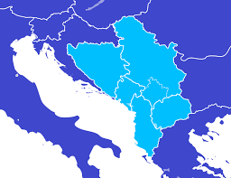
Adriatic Region: a high Potential for Integration
The MONITA Project has been developed in a context of high interconnection potential already available in the Balkans Region
Bosnia and Herzegovina 0.7
Serbia 0.5
Montenegro 1.6*
Kosovo 1.0
Albania 0.4
N. Macedonia 0.8
(Interconnection capacity as a percentage of gross installed capacity)
*Excluding MONITA
HU
Interconnection capacity in the Balkans Region - MW
600
HR
600
800/1000
RO
700
550
SR
BH
200/500
550
300
600
BG
ME
400
KO
0/250
500
400
350
600
200
MK
850
AL
250
GR
Source: Elaboration on Energy Community and South East Electricity Roadmap (SEERMAP) data

Slide 11
Conclusions
Italy’s energy system has undergone dramatic changes in the last decade
Security of supply concerns and EU pushing interconnections to favor competitions led to significantly enhanced cross-border capacity both in gas and electricity
All these factors, together with the “RES-driven” shift in generation mix, make Italy a potential electricity and gas hub for the Mediterranean Region
Most importantly, Italy’s energy crossroad might and should serve the Adriatic and ionic Region as a powerful tool for markets integration
Regulators played a key role in promoting a favorable institutional environment, both within and outside the EU legal framework
Regulators’ co-operation in the area aimed at stability, transparency and markets’ efficiency will enable energy markets integration

Slide 12
Thank you for your attention
ftambone@arera.it
The Italy’s Regulatory Authority for Energy, Networks and Environment – ARERA
Institutional and External Relations Directorate (DREI) – International Relations Unit

Slide 13
Back-up: Interconnection Capacity over Time, and the MONITA Project Technicalities

Slide 14
The Role of Interconnections in the EU Policies : from Liberalisation to Market Integration
As liberalisation proceeds, the need to coordinate and interconnect national markets becomes more and more evident
1996: Open energy markets
2003: Second Wave
2009: Third energy package
2013/2017: Networks matter
2018: Clean energy for all
The first directives on liberalisation of energy markets mainly focus on opening national market to competition
The second electricity market directive introduces “transparency and non discrimination” principles for access to interconnections
Introduces legal unbundling obligations for TSOs
Focus on co-ordination and cross-border issues
Deep change to system governance (ACER, ENTSO-E), integration and long-term planning, more stringent unbundling criteria
New regulation on cross-border networks: free access if no congestions
Based on the 8% average figure of interconnection capacity, the EU pushes to plan and build new interconnection capacity, so that any MS reaches at least 10% objective by 2020
Project of Common Interest promote increasing cross-border capacity
Energy governance process established, policies more and more focused on sustainability
Pillars are now security of supply, competition and decarbonisation
Market integration and consistent interconnection policy viewed as a tool to encourage and promote RES

Slide 15
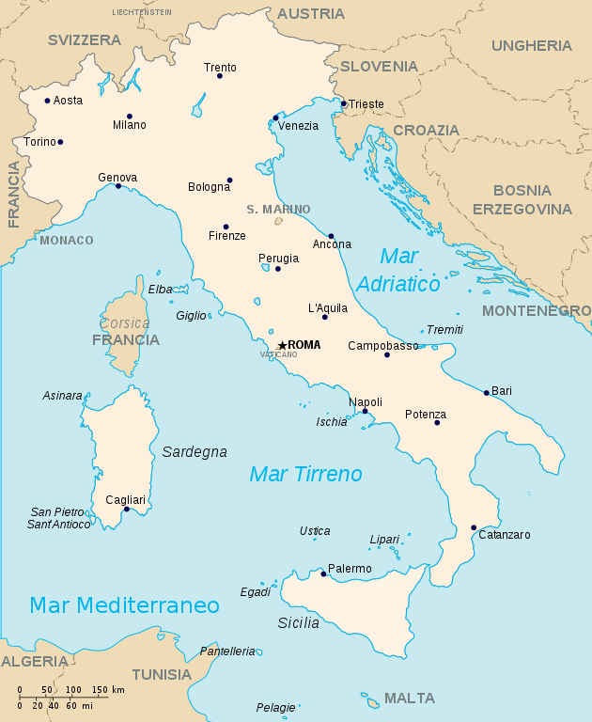
Enhanced Interconnection Capacity for a truly Integrated Electricity Market (IEM)
Currently on target as for the EU’s objective of interconnection capacity at 10%, Italy is on track to reach the medium-term “advised” target of 15%
Update of existing interconnections (Italy-France current 3 GW to be increased by 1,2 GW; Italy-Austria interconnector will add 300 MW)
Partly undersea, the new 1 GW interconnection project with Slovenia will double current NTC on this border
Beyond the EU market integration: Italy-Montenegro interconnector MONITA, already partly in operation, will provide a 600+600 MW of NTC
New 600 MW interconnection with Tunisia will be the first step on the way towards promoting a Mediterranean South-Shore Electricity system
These new interconnection projects amount to ca 5% of Italy’s gross installed capacity
As the EU’s “Clean Energy for All” Package foresees more ambitious LT objectives (30% of both peak load and of RES capacity), Italy prepares to bridge electricity from neighbouring Regions
Switzerland
Austria
Slovenia
France
Montenegro
Montenegro
Tunisia

Slide 16
A diversified and more secure Gas Supply
Thanks to its favourable position and to gas market reform, “Italy can become a Mediterranean Hub for natural gas and compete with Northern Europe’s liquid markets” (“Indagine conoscitiva sullo stato della liberalizzazione del mercato del gas”, ARERA’s Survey on Gas Market Developments, 2004)
Security-of-supply concerns: in late 90s, the European Commission launched a debate on how to overcome the high dependence of EU on a few (third Countries’) suppliers
Competition concerns: though the 1998 EU Directive on Gas Market Liberalisation provided for progressive market opening, consumers appeared to be able to choose no other supplier than the national incumbents
Industry concerns: as natural gas appeared to effectively contribute to GHG emissions reduction, a steady rise in gas demand required a corresponding increase in offer
Potential benefit: the favourable geographical situation of Italy, close to new potential gas routes from Southern and Eastern producer Countries was seen as an opportunity to develop an interesting “trading position”, in contrast with the traditional role of importer/consumer
Gas import capacity over time, BCM/Year
TAP (2020)
24,0
10,0
11,7
39,7
18
+42%
Adriatic GNL Rovigo (2009)
OLT Livorno (2013)
3,6
92,0
Panigaglia
Existing Pipelines, 2009
Existing GNL, 2009
Added Capacity to existing pipelines
Added GNL Capacity
TAP
Total added Capacity 2009-2020
Forthcoming added capacity from new LNG projects

Slide 17
The MONITA Project
The Montenegro-Italy Interconnection (MONITA) is a significant step towards market integration and regulatory convergence between EU and Balkan Region
First intergovernmental agreement between Italy and Montenegro on building the ME-IT interconnection dates back to 2007
HVDC interconnection joining the Hv stations of Villanova in Italy (Municipality of Cepegatta, Abruzzo Region) and Lastva in Montenegro (Municipality of Kotor)
445 km long (of which 423 undersea)
Two cables with maximum transfer capacity of 600 MW each
The first part of the project has been completed in late 2019 and it is already operational (works for the building of the second infrastructure’s part are expected to start in 2020)
Overall investment cost for the whole infrastructure amounts to (estimated) 1.5 B EUR – of which, 1,15 spent to build the first part of the interconnection
The infrastructure has been built and will be operated by TERNA, the Italy’s TSO (ownership unbundling applies)
200 MW out of 600 MW capacity of the operating infrastructure are reserved to a syndicate representing private investors under the exemption regime
Montenegro (Lastva)
Italy (Villanova)
423 km Undersea

