Slide 1
GSE
Gestore dei
Servizi
Energetici
5th Forum of the EUSAIR, Belgrade, 28-29 January 2021 – Virtual Conference
Parallel Session 2 _ Connecting the Region: Energy Networks for a Green Adriatic-Ionian Region

Slide 2
CONNECTING THE REGION: WHAT DOES IT MEAN?
Integration with the European/Italian Electricity and the Gas Networks
Italy – Montenegro Interconnection
import/export
market coupling
renewables
Trans Adriatic Pipeline
a new market for Western Balkans
security
export from Italy
Electricity
Natural
gas

Slide 3
CONNECTING THE REGION: WHAT DOES IT MEAN?
Normative Integration
Transposition of the Third Energy Package (Energy Community)
Regulatory body
Regulatory framework
Etc.
Energy Transition
Planning and Regulation
Stakeholders’ Involvement
Transparency
Stability
Trust
RESHAPING
OUR COMMON FUTURE
CLIMATE CHANGE CHALLENGE

Slide 4
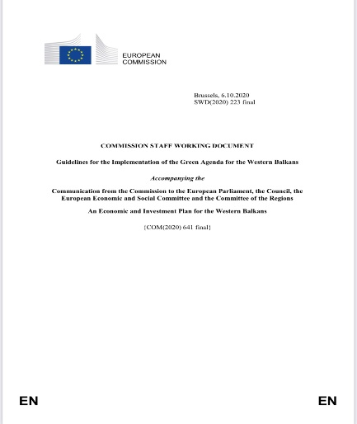
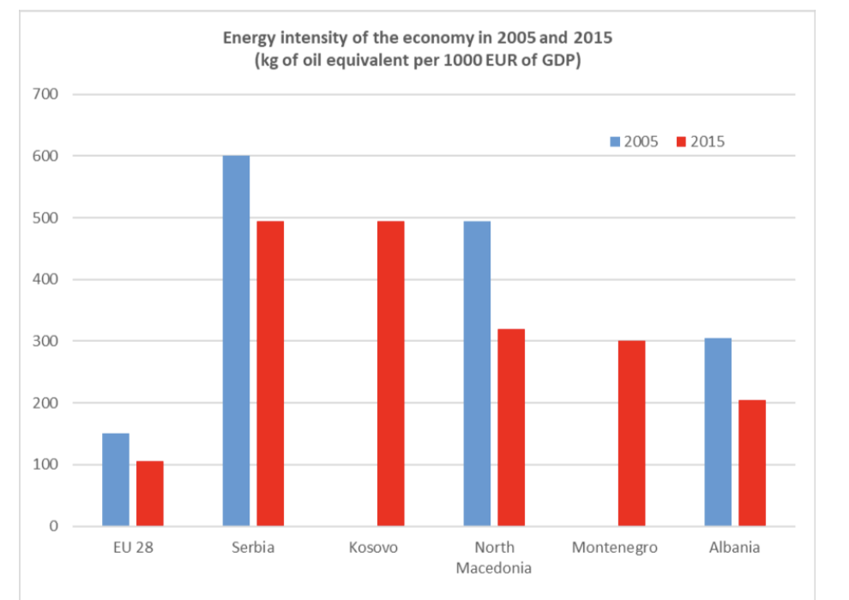
GREEN AGENDA FOR THE WESTERN BALKANS
Table of Contents
Decarbonisation: climate, energy, mobility
Circular economy projects and synergies (e.g.:
waste and sustainable biofuels)
Depollution: air, water and soil
Sustainable food systems and rural areas
Biodiversity: protection and restoration of ecosystems
Financing Instruments

Slide 5
THE GSE GROUP
Ministry of Economic Development
Ministry of Economy and Finance
Regulatory Authority for Energy, Networks and the Environment
100%
Decisions
Strategic guidelines
GESTORE DEI SERVIZI ENERGETICI
100%
100%
100%
AU
Acquirente Unico
GME
Gestore dei Mercati Energetici
RSE
Ricerca sul Sistema Energetico

Slide 6
THE GSE GROUP
Acquirente Unico - AU S.p.A. is responsible for buying electricity on the market at the most favourable terms and to resell it to distributors or retailers of the standard offer market for supplying small consumers of the protected market. AU also manages the Consumers’ Help Desk (supporting end customers and providing a mediation service for disputes with operators), operates the Integrated Information System to manage information flows on electricity and gas customers and is the Italian Central Storage Entity (OCSIT) for managing security stocks of oil.
Gestore dei Mercati Energetici – GME S.p.A. is responsible for the economic management of the wholesale power market (IPEX), as well as the gas and environmental markets, under principles of neutrality, transparency, objectivity and competition. GME also operates a platform for registering OTC transactions (fixed-term energy trade agreements).
Ricerca sul Sistema Energetico - RSE S.p.A is specialized in analysis, study and research in the energy sector, with a particular focus on strategic national projects of general public interest, financed by the Italian System Research Fund and, for specific projects, by EU and national institutions. RSE supports GSE in the evaluation and certification of energy saving projects.

Slide 7
GSE – MAIN ACTIVITIES
GSE manages more than 10 national incentive mechanisms aimed at promoting the development of energy efficiency and renewable sources in Italy. GSE allocates about 15 billion Euros in incentives every year, equal to 1% of the Italian Gross Domestic Product. GSE purchases the electricity fed into the grid produced by renewable energy plants to then resell it in the electricity market. GSE certifies the renewable origin of the electricity produced and it inspects the plants to assure a fair distribution of public resources. Moreover GSE disseminates the culture of sustainability through communication activities, studies, statistics and meetings addressed to all the protagonists of the energy transition at national and international level.
PROMOTION OF ELECTRICITY FROM RENEWABLE SOURCES
Qualifying RES plants
Granting incentives, collecting and selling energy, “green origin” certification
On site verification of plants
Metering and forecast of energy production
White Certificates
High-efficiency CHP
Heating & Cooling support schemes
Biofuel support scheme
On site verification of plants
PROMOTION OF ENERGY EFFICIENCY, ReS for Heating & Cooling, BIOFUElS FOR TRASPORT
Studies, statistics, institutional support for national energy planning
PA Support
ETS auctions to sale the Italian CO2 allowances
Promotion and communication
International Activities at European level (i.e. MED Cooperation Projects) and in International fora (i.e. IEA, IRENA and Mission Innovation supporting the Italian Ministries)
INSTITUTIONAL ACTIVITIES
INTERNATIONAL RELATIONS

Slide 8
HOW CAN GSE HELP?
Two Memoranda of Understanding already signed: with Albania and Georgia
Provide assistance on the tools used for financing renewables, energy efficiency and new technologies deployment (included ETS)
Assist Countries in the development of National Integrated Energy and Climate Plans
Assist in developing building renovation schemes, thus extending the “EU renovation wave” to the Western Balkans
Assist in addressing energy poverty in the region
Assist in defining smart cities digital platforms for sustainable urban mobility
Support the region in planning sustainable mobility solutions, including alternative fuels infrastructure, charging/filling stations etc., in line with EU directives requirements

Slide 9
THANK YOU
FOR YOUR KIND
ATTENTION

