Slide 1
SUBTEXT

Slide 2
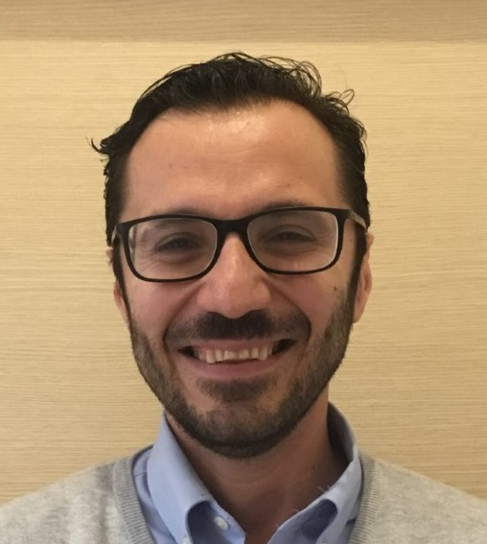
Alessio Bonaldo
University of Bologna, Italy
Tools and Strategies for a Sustainable, Resilient and Innovative European Aquaculture
https://www.newtechaqua.eu

Slide 3
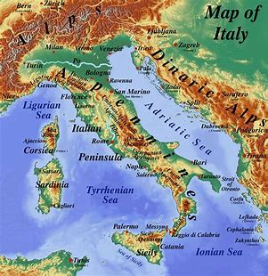
Italian aquaculture factsheet
Long tradition and history
High levels of specialisation and know-how, a high degree of industrialisation
Species: Mediterranean mussel and Japanese carpet shell
Rainbow trout
European sea bass and gilthead sea bream
Production: 157 109 tonnes
Molluscs (100 000t) and finfish (57 000 t)
Traditional extensive aquaculture is still carried out in the “valli”
More modern aquaculture techniques for marine species and intensive trout farming

Slide 4
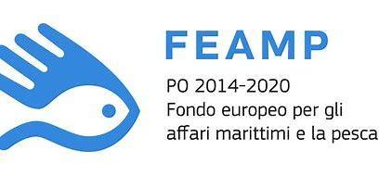
The European Maritime and Fisheries Fund Operational Program 2014–2020, managed by the Ministry of Ministry of agricultural food and forestry policies and Regions aimed to promote:
Environmentally sustainable aquaculture
Higher production competitiveness and profitability of aquaculture enterprises
Increase in aquaculture diversification

Slide 5
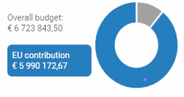
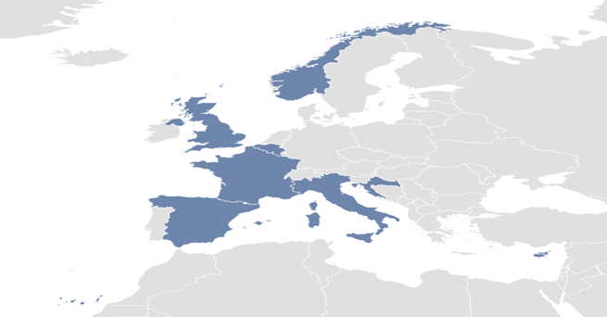
NewTechAqua Project information​
Programme and funding scheme​
H2020-EU.3.2.3.2. - Developing competitive and environmentally-friendly European aquaculture​
IA-Innovation action​
​
Call for proposal and topic​
H2020-BG-2019-1​
DT-BG-04-2018-2019 - Sustainable European aquaculture 4.0: nutrition and breeding​
​
Grant agreement ID 862658​
Lenght 4 years​
Start date 1° January 2020​
End date 31° December 2023​
​
Coordinated by​
ALMA MATER STUDIORUM – UNIVERSITA DI BOLOGNA (Italy)​
https://cordis.europa.eu/project/rcn/225156/factsheet/en

Slide 6
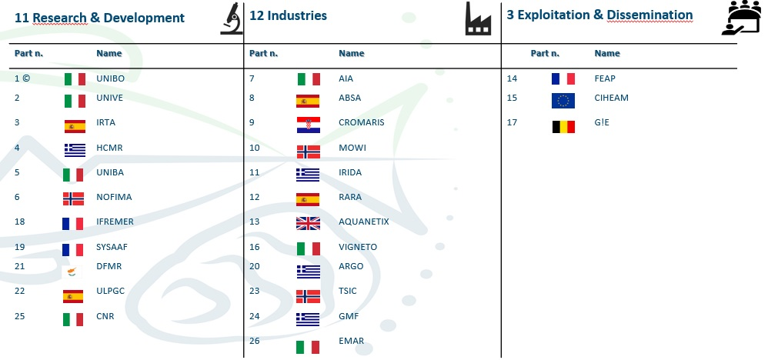
The consortium

Slide 7
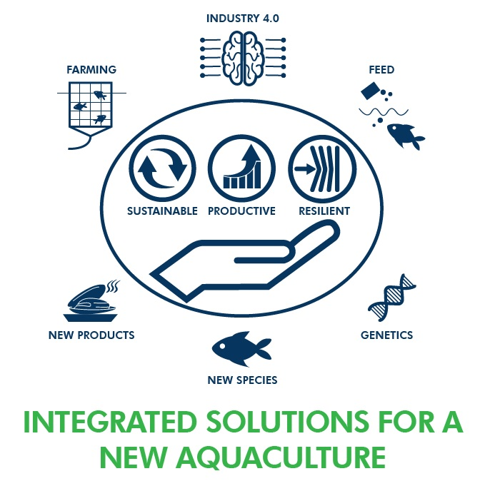
The strategy
To expand and diversify aquaculture production of finfish, molluscs and microalgae by developing and validating technologically-advanced, resilient and sustainable applications
4 commercially most important finfish species
(salmon, trout, seabass and seabream)
4 economically emerging new species (amberjack, meagre, sole and mullet)
2 molluscs (oyster and mussels)
3 microalgae species

Slide 8
Challenges/1
Three innovative sets of aquafeeds, each targeting a specific issue (pro-health, organic, zero waste)
Monitoring systems will aggregate and combine spatiotemporal information (Big data) in dynamic complex statistical and Artificial Intelligence models for disease prediction and health management
Welfare indicators, and microbiome analyses (NGS) will be used to evaluate the impact of different rearing systems (RAS, biofloc technology, aquaponics, ELOXIRAS) on fish condition
Satellite imagery by the development and validation of biosensors for supporting shellfish industry

Slide 9
Challenges/2
Innovative breeding programmes to improve performance, robustness and quality of farmed fish, mollusc and microalgae, using different genomics methods.
Enhanced know-how of the reproductive physiology and on the reproductive dysfunctions of three emerging species: greater amberjack, meagre and Senegalese sole under rearing conditions.
Development of innovative high-quality seafood products and of tailored sustainable techniques for valorisation of by-products through the preparation of functional ingredients.

Slide 10
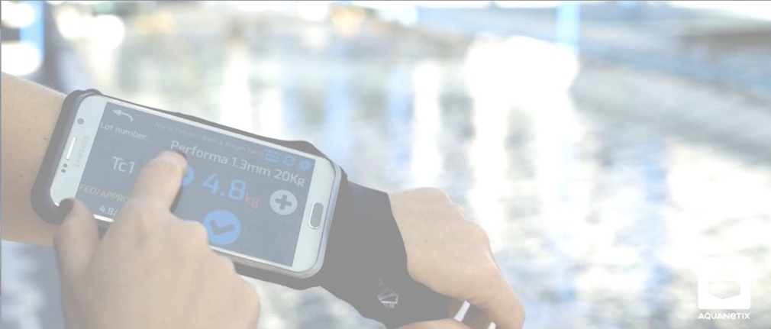
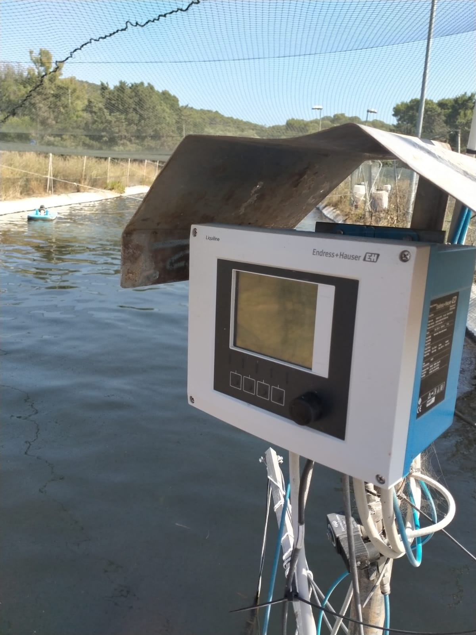
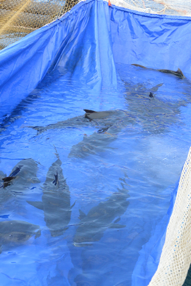
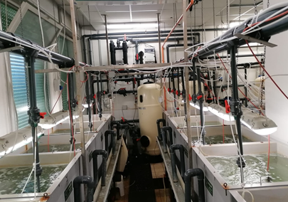
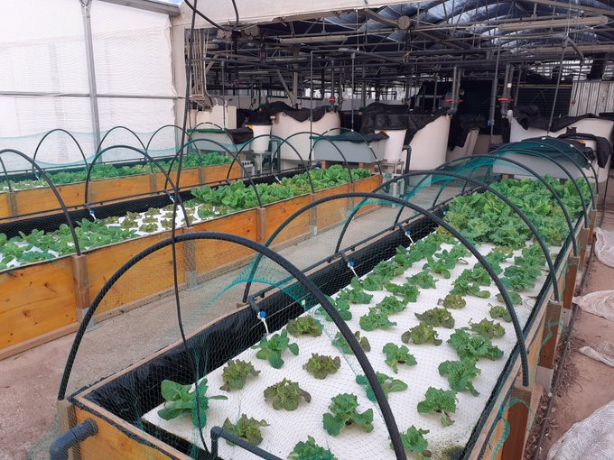
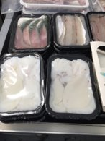
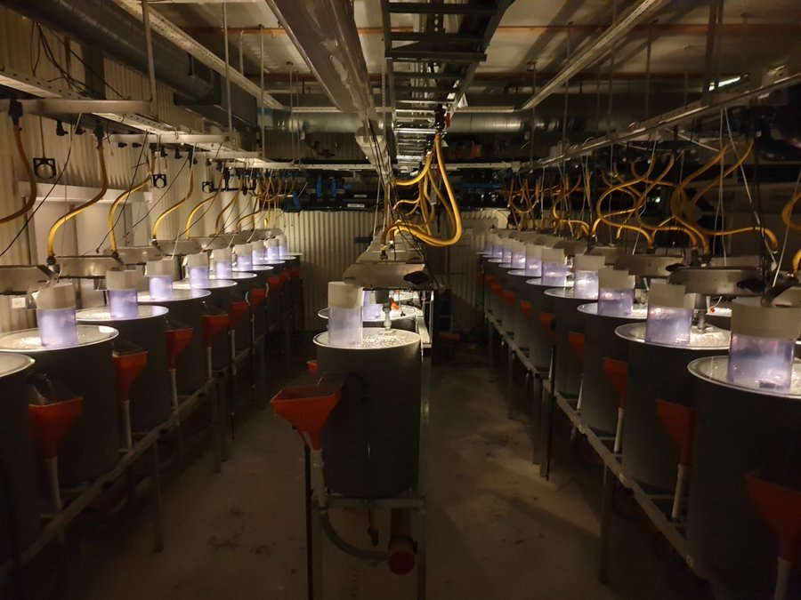
Innovations

Slide 11
New opportunities
HORIZON-CL6-2022-FARM2FORK-01-06: Integrated and sustainable freshwater bioeconomy: Combining aquaculture, biodiversity preservation, biotechnology and other uses
HORIZON-CL6-2022-FARM2FORK-01-07: Biosecurity, hygiene, disease prevention and animal welfare in aquaculture
HORIZON-CL6-2022-FARM2FORK-02-05-two-stage: Innovative food from marine and freshwater ecosystems

Slide 12
Contacts:
Alessio Bonaldo – University of Bologna
alessio.bonaldo@unibo.it
+393358395218

Slide 13
Thank You.

