Slide 1
ICT ECOLOGICAL WATER MONITORING BY HEART TRADE OF MUSSELS Aleksandar Joksimović, PhD University of Montenegro-Institute of Marine Biology

Slide 2
Institutions and leaders of scienteific researcher teams
IBMK: PhD Aleksandar Joksimović
IPH: PhD Zoran Vratnica ETF: prof. dr Slobodan Đukanović International scientific partner-St. Petersburg Scientific Research Center for Ecological Safety, Russian academy of sciences SRCES RAS: Prof. dr Sergey Kholodkevich
Partner of the economy- Mussels and fish farm-company COGIMAR, Kotor: Ilija Guskić, director

Slide 3
BIOLECTRONIC WATER QUALITY AND ACCIDENTAL POLLUTION PERMANENT ON-LINE MONITORING
Marine organisms very well “know” their environment in the sea, much better than we know it. This “knowledge” is displaying in various way. It could be sharp changes of behavior in a case of accidental environmental toxic pollution, or slow changing of physiological parameters as a result ofabsorption and accumulation of pollutants; Blue mussel (Mytilus galloprovincialis Lamarck, 1819) is most common bottom and fouling community marine animal of Mediterranean area. It is a filtrator, constantly filtering and sensoring surrounding water of its habitat; Mollusks possess a high sensitivity and respond relatively rapidly to contamination, and therefore changes in their physiological (cardiac response) and behavioral (valve gape) characteristics are used for estimation of the environment state;

Slide 4
Researcher team created multi-channel fiber-optic bioelectronic system (Kholodkevich et.al., 2007) allows to measure heart rate simultaneously from several animals in combination with behavioral (valve gapes fine registration) characteristics. Obtained data were analyzed with the use of special software in real time on the base of variational pulsometry method adapted to the invertebrates. The latter allows to have detailed assessment of variability characteristics, which are used as biomarkers for water toxicity biomonitoring.

Slide 5
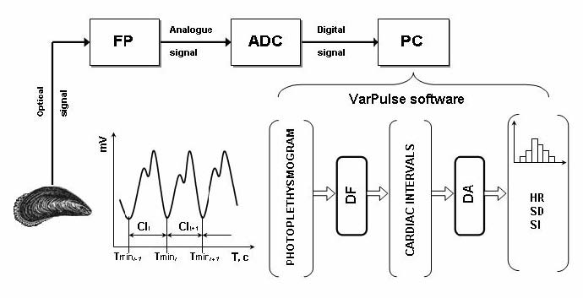
Block diagram showing mussel’s cardiac activity monitoring system(after Kholodkevich et al., 2008)
FP – photoplethysmograph, ADC – analog-to-digital converter, PC – computer, CI – cardiac interval, DF – digital filter, DA – distribution analysis, HR – heart rate, SD – standard deviation, SI – stress index.

Slide 6
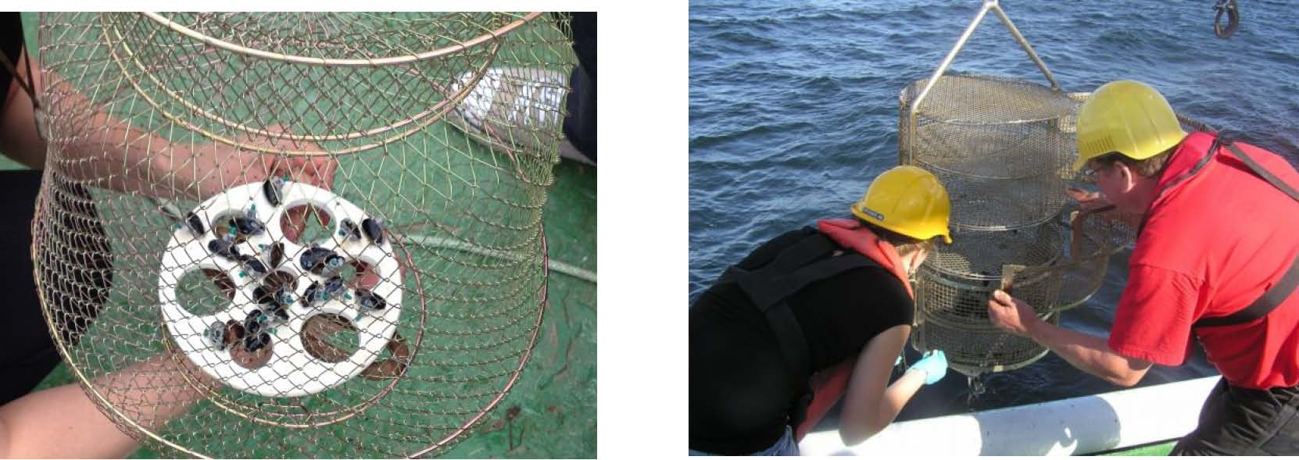
Mussels in preparation in a lab (Black Sea); Mussels with attached fibres in a lab
Small mussels in a cage (Gulf of Finland) Cage with mussels installation (Baltic Sea)

Slide 7
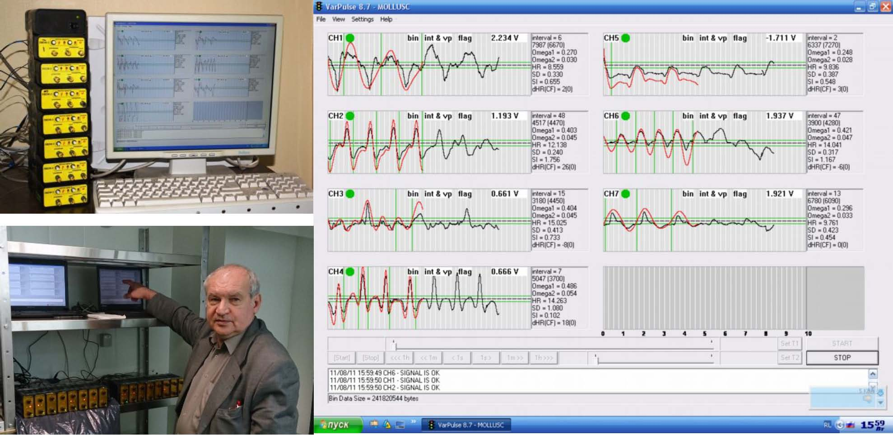
Original patented measuring devices and software (by Kholodkevich)
The software is “learned” to distinguish a false alarm (caused by individual peculiarity in behavior of given mussels) from a real one.
The set of photoplethysmographs, Monitor with moving curves of mussel’s analog-to-digital converters and PC cardiac activity (7 channels in a process)

Slide 8
Cardiogram with stress pik

Slide 9
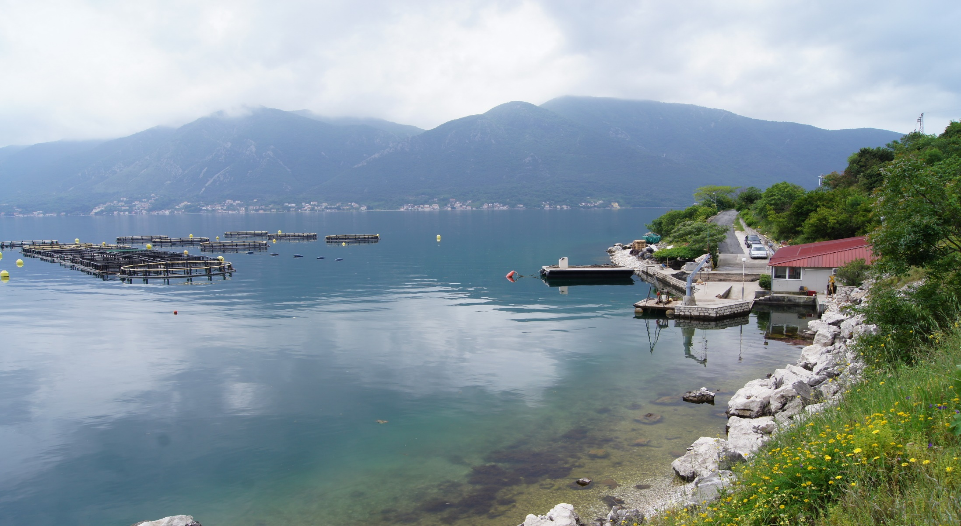
Location of measurement-COGI-Orahovac_Kotor Bay
Monitoring dynamics: On-line during the project duration.

Slide 10
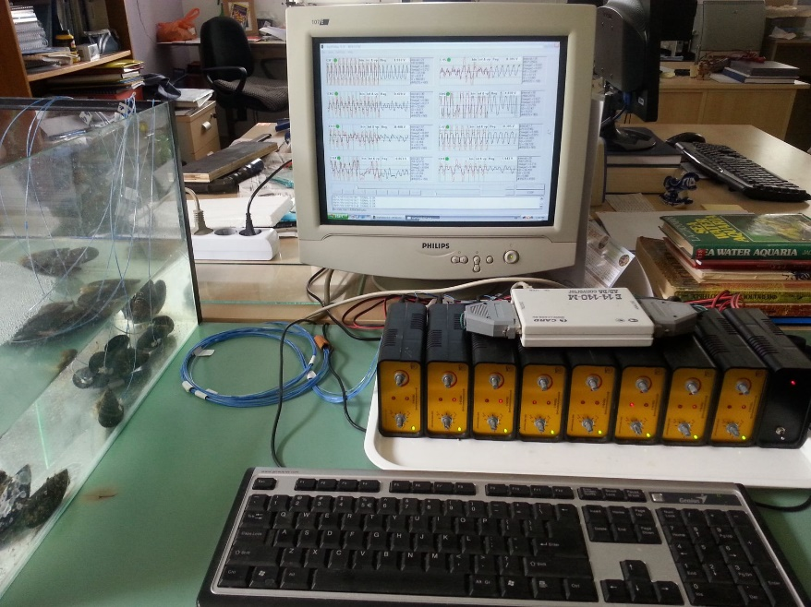
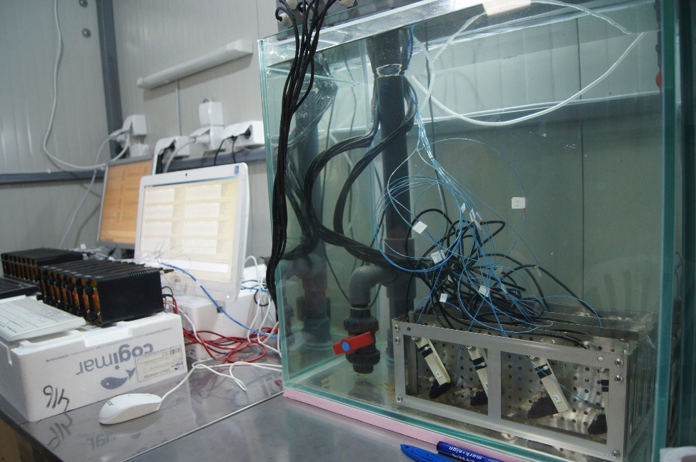
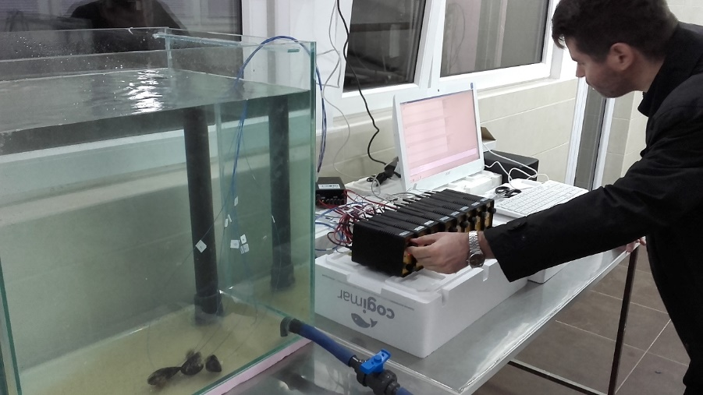
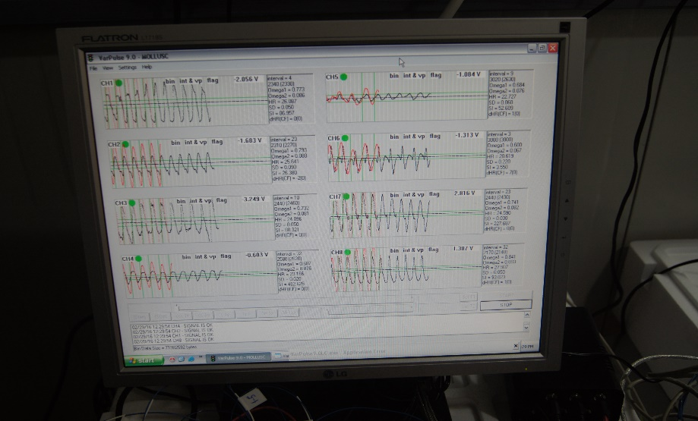

Slide 11
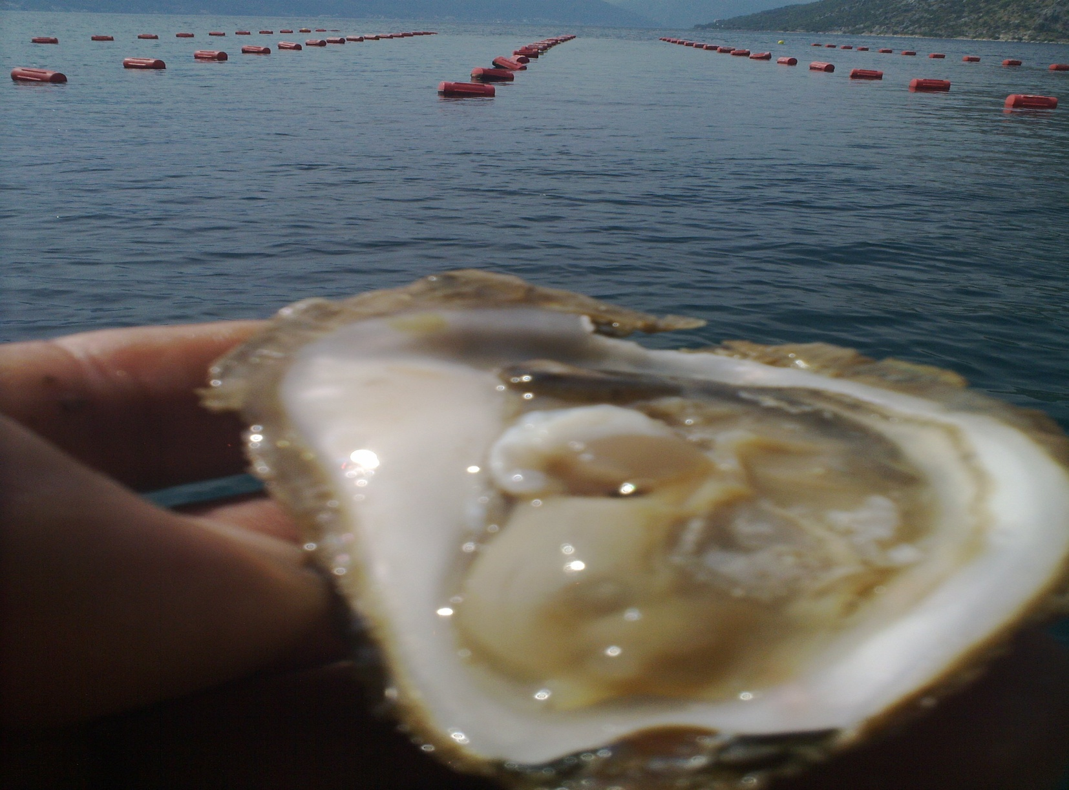

Slide 12
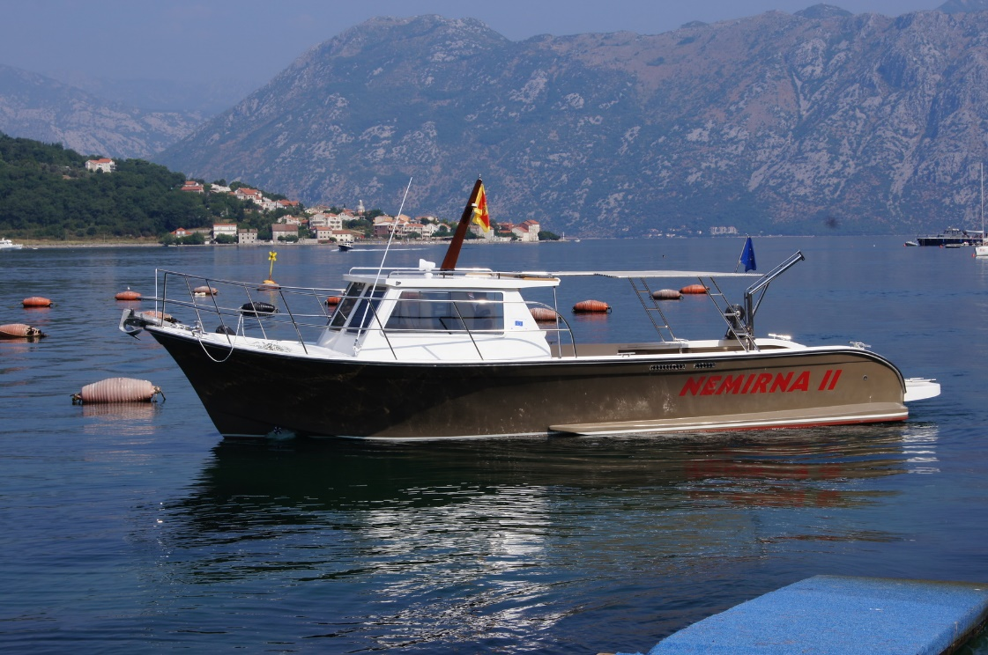
THANK YOU FOR YOUR ATTENTION !!!
E-mail: acojo@ucg.ac.me

