Slide 1

Joint Research Centre - JRC
"S3 as an Opportunity for Enhanced R&I Cooperation in the EUSAIR"
First EUSAIR S3 Governance
Representatives Meeting
Izola, 23 September 2020
#S3platform
Dr. Ales Gnamus JRC
JRC Seville - B3 Territorial Development
https://s3platform.jrc.ec.europa.eu/

Slide 2

Concept of Smart Specialisation (S3)
Economic potential
Innovative potential
Societal challenges
Scientific potential
Opportunities to Move up the Value Chains
Niches to Compete at international markets
Adding Value to existing activities
Create New Solutions
…at the crossroads of
Industrial strategy
Inclusive growth
Globalisation
Multi-annual Financial Framework
Cohesion Policy pre- and post-2020
European value chains

Slide 3
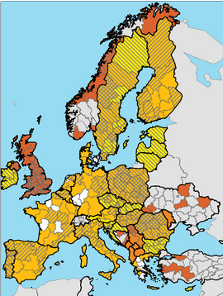
    Policy Premise: S3 as a Tool to Enhance R&I Cooperation in the SEE
    Existing studies: OISAIR mapping of economic, research and innovation potentials in the AI region
    JRC Methodology:
    R&I Benchmarking = Relative R&I Specialisation by H2020
    Clustering S3 Domains/Priorities
    Specialisation by clustered S3 Domains/Priorities encoded in Eye@RIS3 (JRC S3 Platform)
    Recommendations for the enhanced EUSAIR & SEE R&I cooperation
S3 in Europe
Adriatic-Ionian region (EUSAIR)

Slide 4
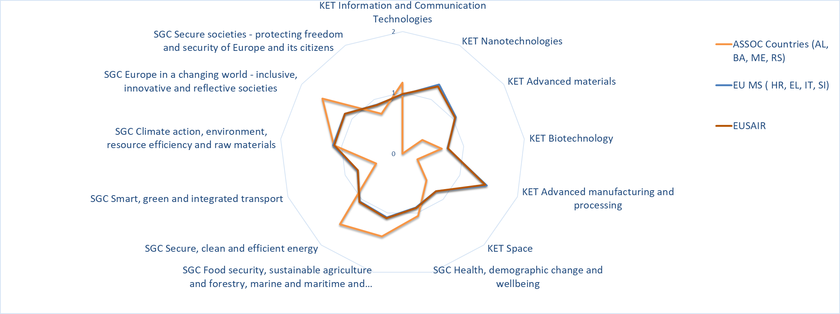


Relative R&I Specialisation by H2020 Projects in Clustered S3 Domains (concentration of funding)

Slide 5
More Information: S3 Platform R&I Viewer H2020/ERDF
  Benchmarks between regions/countries with ERDF and H2020 coverage
  Specialisation indicators (KETs and SGCs)
  Beneficiaries and projects information and more…
  https://s3platform.jrc.ec.europa.eu/synergies-tool

Slide 6
JRC Study on S3 priorities alignment in the Adriatic-Ionian Macro-region
Clustered S3 Domains /Priorities | Main Keywords
Better Societies | Governance, Social and Societal issues, Culture, Creative, Arts, Services, Leisure, Entertainment, Tourism, Business, Financial, Security, etc.
Electronic Technologies & ICT | Industry 4.0, Computers, Software, Optics, Photonics, etc.
Sustainable Energy | Energy Efficiency, Renewables, Smart Grids, Energy technologies, etc.
Climate & Environmental Sciences | Biotechnology, Natural sciences, Conservation, Climate mitigation, Earth observation, Flora & Fauna, Pollution, Ocean & Seas, etc.
Advanced Manufacturing & Materials | Process Industries, Machinery, KETs, Micro- & Nano-technology, Advanced materials, etc.
Agro-Food | Farming, Rural, Sustainable agriculture, Healthy food, Wine, Beverages, Agricultural products, Food Processing, Forestry, Wood, Freshwater and Marine foods, Food Safety, Biotechnology, etc.
Health & Wellbeing | Medicine, Medical technologies, Pharmaceutical, Leisure, Spa, Healthcare, etc.
Transport & Mobility | Vehicles, Aero/Space, Shipping, Transport Safety, Transport Security, Urban issues, Smart Cities, Logistics, etc.
Other | Basic sciences, Mathematics, Physics, Fundamental research, Blue sky research, etc.
(JRC Study, in preparation 2020)

Slide 7
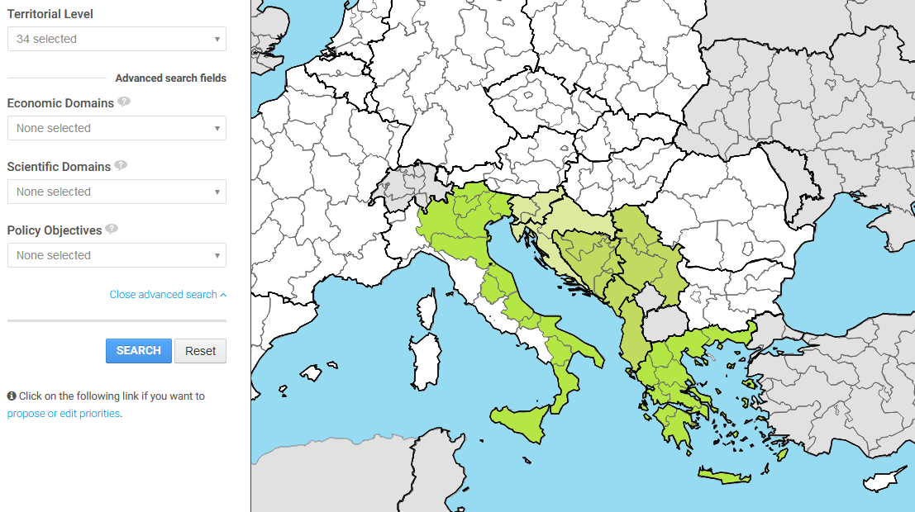
S3/R&I specialisation of the AI-territories as encoded by Eye@RIS3
AI: 34 territorial units (countries/regions) with info at relevant territorial level
Encoded S3/R&I priorities grouped and clustered into 8+1 categories/R&I Domains
Note-info for 8/9 EUSAIR countries:
- IT, GR – at regional level;
- SI, HR, AL & BA (only R&I), RS and ME – at national level;
MK – only info at the quantitative mapping of economic, research and innovation potentials in the S3 process at
national level!

Slide 8
    Specialisation by clustered S3 Domains:
    Analysis of S3 Priorities encoded in "Eye@RIS3"
Total 184 S3 (R&I - for Non-EU) priorities clustered in 8+1 S3 Domains
S3 Domain/Priority | No. of related S3 Priorities in the AI territories (MS/regions) | Coverage by EUSAIR Priority Actions
Better Societies (incl. CCI) | 31 | 3 (PAs: 3,9,10)
Electronic Technologies & ICT | 41 | 6 (PAs: 1,4,5,6,9 + PA10)
Sustainable Energy | 34 | 4 (PAs 1,3,6 + PA7)
Climate & Environ. Sciences | 38 | 4 (PAs: 6,7,8 + PA10)
Advanced Manuf. & Materials | 16 | 4 (PAs 1,4,6 + partially PA7)
Agro-Food | 23 | 5 (PA2 + PA9 + partially PAs: 8,9,10)
Health & Wellbeing | 35 | 8 (PAs 2,3,4,5,7,8,9,10)
Transport & Mobility | 12 | 7 (PAs 1,3,4,5,7,9 + PA10)
Other (e.g. Mathematic & Physics) | 1 | -
Total | 184 | All EUSAIR PAs covered
http://s3platform.jrc.ec.europa.eu/map Retrieved: September 2020
(JRC Study, in preparation 2020)
Note: The “Total” mismatch the line sums as in some cases certain S3 priority addresses
more clustered S3 domains, in other cases different S3 priorities address the same domain.

Slide 9
    AI-Strategy Pillars with Priority Areas vs. S3 Domains of Interest:
S3 Domains /Priorities | Blue Growth (PAs 1-3) |  |  | Connecting the Region (PAs 4-6) |  |  | Environmental Quality (PAs 7-8) |  | Sustainable Tourism (PAs 9-10) |  | Total
 | Blue Technol. | Fisheries& Aquacult. | Marit. & Marine Govnance | Maritime Transprt | Intermod. Connect. Hinterland | Energy Networks | Marine Environ. | Transnat. Terrestr. Habitats& Biodiversity | Diversified Tourism Offer | Sust.&Respons. Tourism Management
Better Societies |  |  | 4 |  |  |  | 8 | 9 | 11 | 29 | 31
Electronic Techn.&ICT | 14 | 3 | 5 | 9 | 6 | 13 |  |  | 3 | 9 | 41
Sust.Energy | 4 |  |  |  |  | 29 | 3 |  |  | 2 | 34
Climate & Env.Science |  |  |  | 3 | 5 | 8 | 33 | 8 | 6 | 5 | 38
Advanced Manufact. & Materials | 7 | 3 |  | 7 | 4 | 8 |  |  |  |  | 16
Agro-Food | 4 | 12 |  |  |  |  | 6 |  | 4 | 7 | 23
Health & Wellbeing | 3 | 5 |  |  |  |  | 19 | 4 | 12 | 6 | 35
Transport & Mobility | 6 |  |  | 10 | 8 |  | 2 | 2 | 2 | 3 | 12
Other |  |  |  |  |  |  |  |  |  |  | 2
Note: The “Total” mismatch the line sums partly as in some cases certain S3 priority addresses more AI PAs, in other cases different S3 priorities address one particular PA.
(JRC Study, in preparation 2020)

Slide 10
    Potential for S3 Cooperation in EUSAIR on prevailing S3 Domains:
S3 Domain/Priority | Correlation of S3 Domains with EUSAIR Priority Areas | Potential for EUSAIR wide R&I Collaboration with broader EU impact | No. of related S3 Priorities in the EUSAIR territories (MS/regions)
Better Societies | +++++ | +++++ | 31
Electronic Technologies & ICT | +++ | +++ (++++*) | 41
Sustainable Energy | ++++ | +++++ | 34
Climate & Environmental Sciences | ++++ | +++++ | 38
Advanced Manufacturing & Materials | ++ | ++++ | 16
Agro-Food | +++ | ++++ | 23
Health & Wellbeing | ++++ | +++ (++++*) | 35
Transport & Mobility | +++ | ++ | 12
Other | - | - | 1
*only for WBCs
(JRC Study, in preparation 2020)

Slide 11
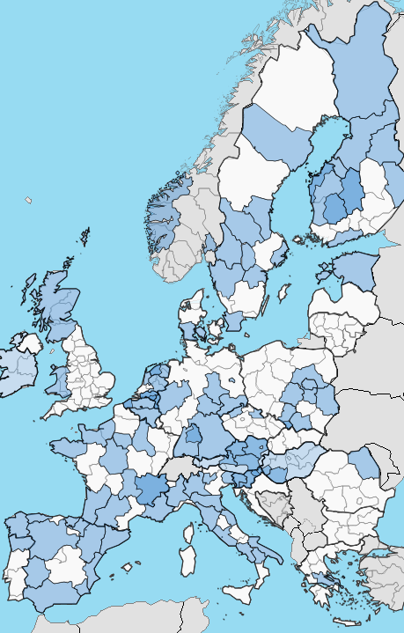
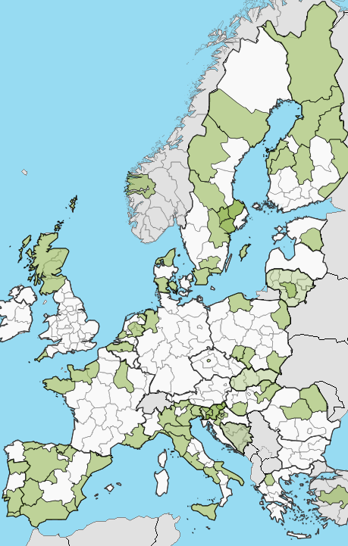
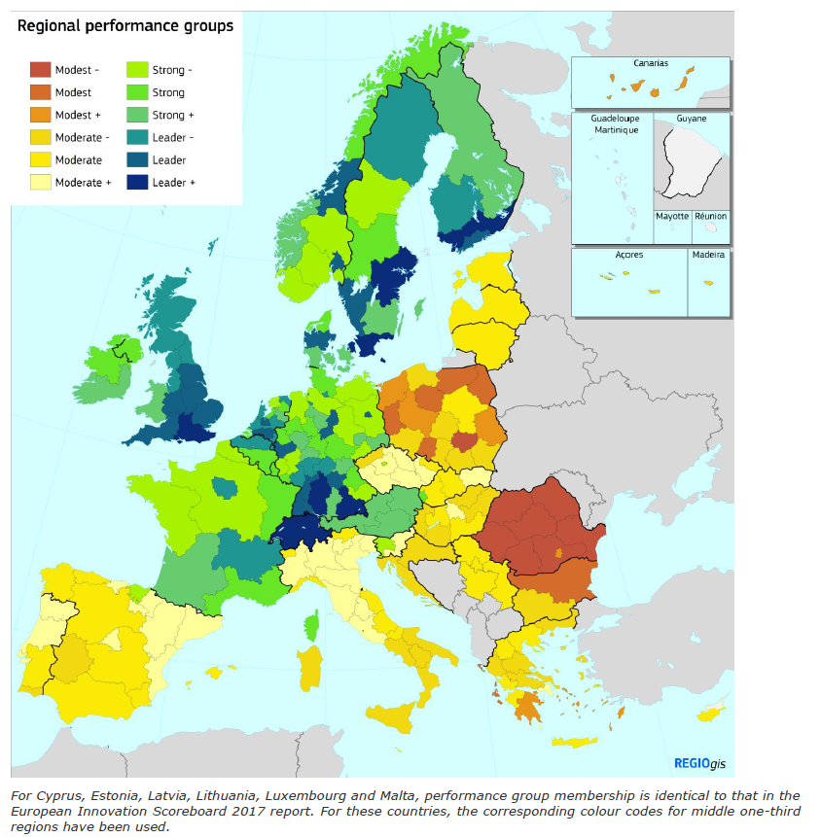
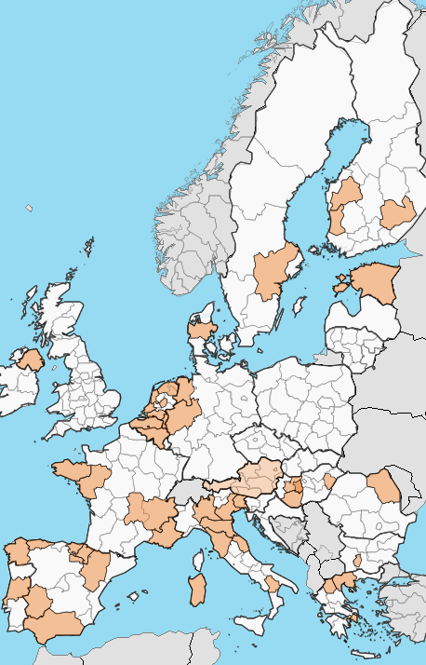
…S3 Forging Strategic Partnerships and Cooperation btw WBC and EU…
Participation in the Thematic S3 Partnerships 2020
Industrial Modernisation
Regional Innovation Scoreboard
2019
Energy
Agri-Food
EUSAIR area
Notes:
Regional diversity
……but regions will be affected by and respond to globalisation differently, as can be seen in the latest map of the Regional Innovation Scoreboard:
There are significant disparities both between and within Member States
It means that no "One-size-fits-all" approach is possible

Slide 12
    Some Recommendations for EUSAIR & SEE R&I Cooperation
    Existing benchmarkings and comparisons show lack of S3/R&I info for WBC partners.
    H2020 collaboration indicates strengths in some domains and relative R&I specialisation of countries/regions and AI territory.
    Better Societies (incl. Services, Tourism, CCI), Sustainable Energy, Climate & Environ. Sciences and Agro-Food are S3 Domains/Priorities with the highest cooperation potential for the AI region with broader EU impact. ICT and Health&Wellbeing are strongly present but with a limited strength of relative R&I specialisation in the region except for the WBC partners.
    Active engagement of EUSAIR & SEE territories in Thematic S3 Partnerships and European Strategic Cluster Partnerships for Smart Specialisation Investment would ensure support though the line EU policies (REGIO, NEAR, GROW, CONNECT, AGRI, ENV, MARE), enhance cooperation of the SEE territories with its EU peers (RTD) and make them more resilient to the Societal Grand Challenges.
    R&I policies and cooperation/support instruments in the region need to be improved to be more efficient.

Slide 13
Thanks for your Attention!
Questions?
You can find us at http://s3platform.jrc.ec.europa.eu/home
Ales.GNAMUS@ec.europa.eu

