Slide 1
Joint Research Centre - JRC
"JRC Acitivites to Support the Innovation coopreation in the EUSAIR and Western Balkans"
MED Coast and EU Macro-regional Strategies Week 2019 Portoroz, 17 September 2019
#S3platform
Dr. Ales Gnamus – S3 Platform, JRC Seville
JRC B.3 Territorial Development
https://s3platform.jrc.ec.europa.eu/

Slide 2
Origins of RIS3
Innovation as driver for regional development policy (RIS, RITTS, PRAI, innovation eco-systems …), does one-size-fits-all work?
Research & innovation policy: Technological / scientific specialisation (centres of excellence, ...), impact on growth?
Smart specialisation
Industry policy:
Cluster, sector analysis,
Demand side innovation support: Lead Market Initiative

Slide 3
Concept of smart specialisation (S3)
Economic potential
Innovative potential
Societal challenges
Scientific potential
Opportunities to move up the value chains
Niches to compete on international markets
Adding value to existing activities
Create new solutions

Slide 4
Smart Specialisation beyond Europe
JRC S3 Platform's S3 Framework for E&N countries in support to smart specialisation in the H2020 associated countries:
Advanced S3 activities: Montenegro & Serbia
Initiated S3 activities: Albania & North Macedonia
+ Neighbourhood: Moldova & Ukraine
Initial S3 awareness activities: Turkey
+ Neighbourhood: Tunisia & Georgia

Slide 5
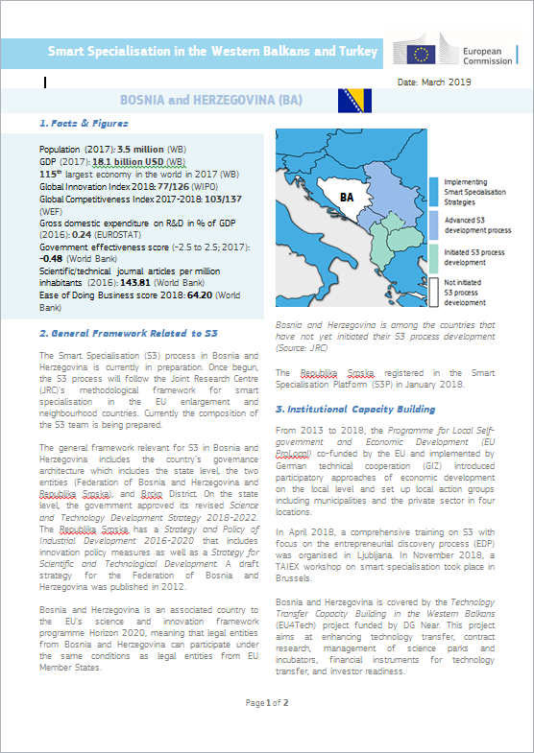
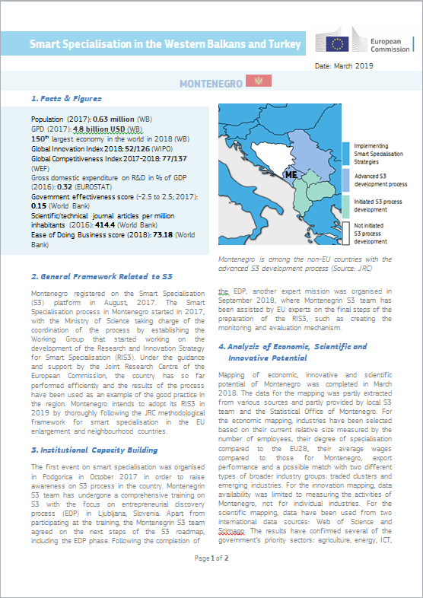
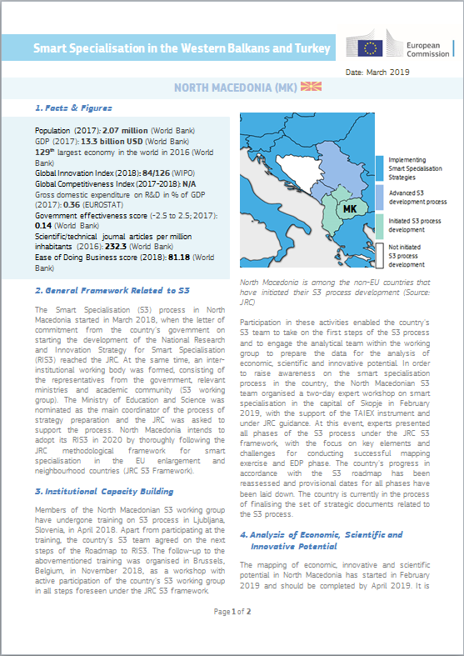
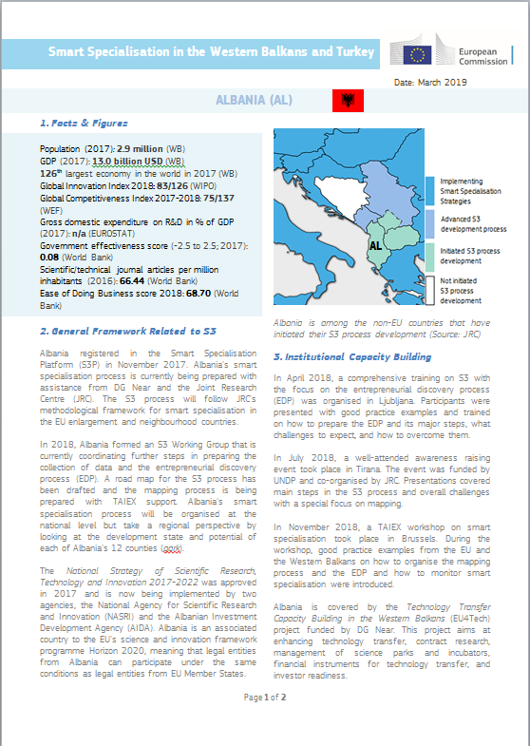
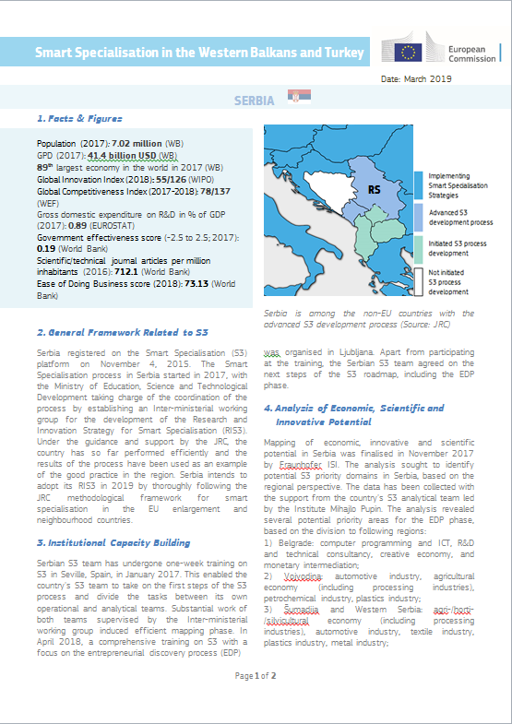
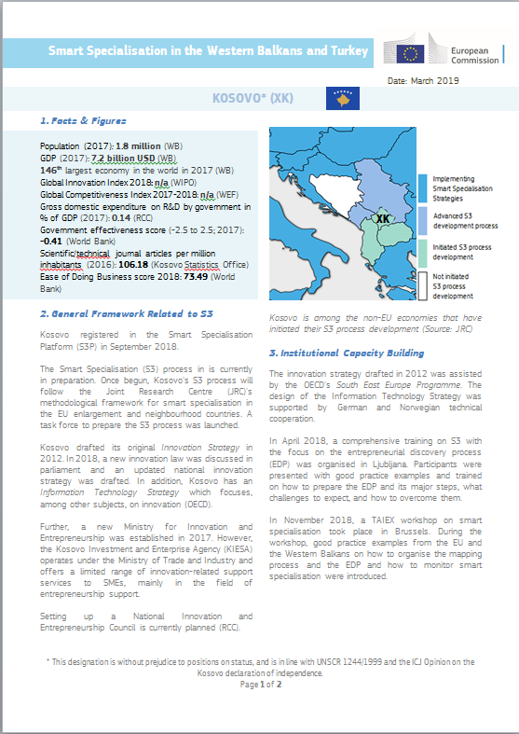
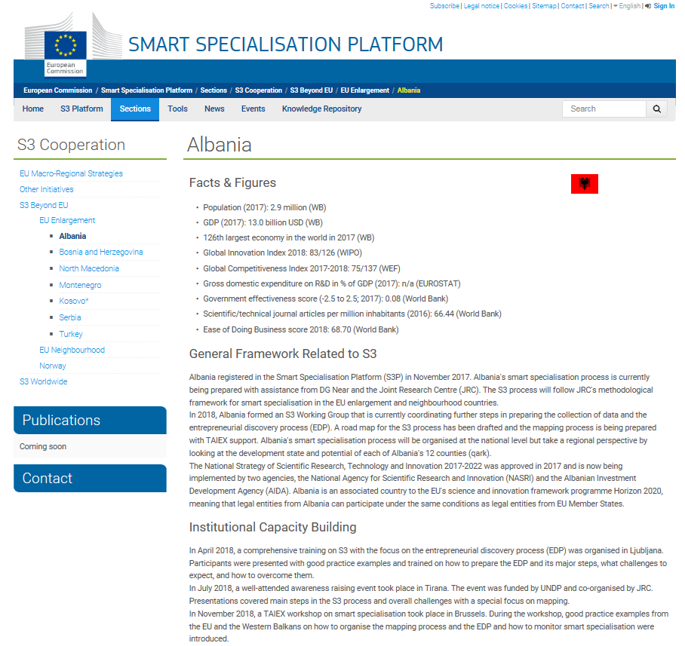
JRC S3 Enlargement countries' activities 2019
Country Fiches: Smart Specialisation in the Western Balkans and Turkey
Country Pages:
S3P-Website "EU Enlargement"

Slide 6
S3 in the EU Enlargement countries - March 2019
Strategy approval
EDP phase
Mapping exercise
AL BA MK ME MD RS XK TR (regional)
Notes:
ME – strategy approved; inter-DG consultation are ongoing, improvements are to be implemented in the upcoming Action Plan to the RIS3 for Montenegro (probably Oct/Nov 2019)
RS – EDP completed, currently working on the monitoring and evaluation mechanism; draft planned for Oct/Nov 2019
MK – mapping analysis ongoing

Slide 7
S3 Framework for E&N Countries
INSTITUTIONAL CAPACITY BUILDING
MAPPING EXERCISE
ENTREPRENEURIAL DISCOVERY PROCESS
INSTITUTIONAL CAPACITY FOR IMPLEMENTATION
FINAL S3 STRATEGY
Step 1!

Slide 8
JRC S3 Framework for E&N Countries
1. Institutional capacity building
Decision to start S3
Analysis of strategic mandates
2. Mapping exercise
Quantitative analysis
Qualitative analysis
3. Stakeholder dialogue
EDP training
Consultation with stakeholders in workshops
4. Institutional capacity for implementation
5. Final strategy approval
Design of monitoring system
Draft strategy consultation
Creation of mechanism for implementation
National approval
EC approval
EDP input for S3
Final draft submission
Notes:
Why Framework?
JRC EIA 2017-2018
WB reports; strategy overhaul; solidify evidence-based approach

Slide 9
Upcoming activities 2019-2020 – through relevant programmes/cooperation frameworks
AA with DG NEAR: July2019-June2022 focusing Enlargement countries:
Project's Kick-off 17 Oct. 2019 in Belgrade – WBC S3 country teams invited with reimbursement!
Western Balkans and Turkey with some potential spill-overs for Neighbourhood countries
EDP trainings & other events for WB6 & Turkey – planned but kick-off depends on the AA signature!
Numerous S3 related activities planned across the region – few started prior project commencement
EU Macro-regional Strategies Annual Forums and Events with WBC (Danube, Adriatic-Ionian)
+ Travel, Accommodation and Conference Facility (TAC) - IPA funding for meetings/conferences involving candidate countries and potential candidates.
+ TAIEX (Technical Assistance and Information Exchange instrument of the EC)

Slide 10
Thematic S3 Platforms
Agri-Food
Industrial Modernisation
Energy
To support interregional cooperation in new growth areas, aiming to build an investment pipeline of bankable projects
To help regions establish links between business and research communities and provide tailored advice
To help regions develop shared infrastructure such as testing facilities, pilot plants, etc.
Notes:
On the 2nd of June 2016, during the Smart Regions conference, the European Commission has launched two Smart Specialisation Platforms: for Industrial Modernisation and Agri-Food, in addition to the existing S3 Platform for Energy.
These platforms are to offer hands-on support to regions to foster interregional cooperation based on matching smart specialisation priorities related to these three areas - such as Key Enabling Technologies, service innovation or resource efficiency.
The aim of this initiative is to create an investment pipeline of mature projects in new growth areas across the EU, by providing tailored advice and helping regions establish links with the business and research communities.
The platform could help regions develop or share infrastructure such as testing facilities, pilot plants, data centres, and Fab-Labs.
Particular support will be given to regions to combine different EU investment instruments, such as the European Structural and Investment (ESI) Funds, COSME, Horizon2020 and the European Fund for Strategic Investments (EFSI), the heart of the Investment Plan.

Slide 11
Thematic S3 Platforms
Supporting (currently 5/19) 32 Thematic S3 Partnerships:
Outward perspective for RIS3: positioning of S3 priorities & upscaling regional innovation efforts
Exploit complementarities between RIS3 investments in co-creating EU value-chains
Coalitions of politically committed partners: pro-active lead-regions + active partners (leading-by-example)
Organising shared spaces for joint demonstration of solutions
Mobilising bottom-up cluster actors for forging new business opportunities

Slide 12
Thematic S3 Platforms
Role in Inter-regional & Macro-regional cooperation:
Joint execution of projects within the S3 partnerships
Mutual trans-national learning activities:
Identification of common problematic areas across regions and development of thematic advice
Match-making amongst regions with specific interests
Organisation of discussions and exchanges
Sharing of good practices

Slide 13
Innovation Cooperation Levels (stemming from the Vanguard Initiative Pilots)
LEARN
CONNECT
DEMONSTRATE
COMMERCIALISE
Investment Projects
SCALE-UP
Business Plan
and
Funding mix
Industry cooperation and design of projects
Mapping of Competencies and Matching of business opportunities
Scoping Note
Demonstration Projects (TRL6/7)
Joint Pilots
Access to new funding and
New Markets
New Products
and Services
New Value Chains
Areas of
Shared Interest
Co-funded
Joint Calls

Slide 14
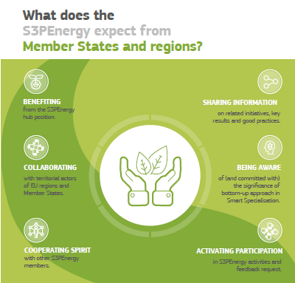
Thematic S3 Platform: Energy

Slide 15
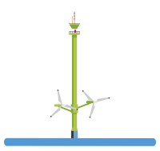
Thematic S3 Platform: Energy
Supporting 5+1 Energy S3 Partnerships
5 fully operational partnerships + 1 upcoming
73 regional and national authorities participating
10 leading/co-leading regions
Many participating regions come from: IT(9), ES(8), SI(7), FI(6), FR(5) and SE(4)
EUSAIR coverage: IT(9), SI(7), HR(2), GR(1) + BA(1) ☺
2 partnerships were selected for 8 DG REGIO's Interregional Pilot Actions (2018-19)
EC DGs involved: REGIO, ENER, RTD, JRC
SUSTAINABLE BUILDINGS
BIOENERGY
MARINE RENEWABLE ENERGY
SMART GRIDS
SOLAR ENERGY
+
HEATING & COOLING

Slide 16
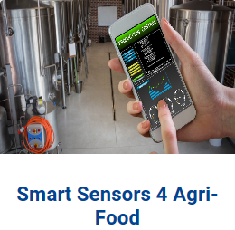
Thematic S3 Platform: Agri-Food
Supporting 5 Agri-Food S3 Partnerships
5 fully operational partnerships
50 regional and national authorities participating
7 leading/co-leading regions
Many participations from: IT(12), ES(8), FR(5), HU(4) and NL(4)
EUSAIR coverage: IT(10), SI(2), GR(3) ☺
2 partnerships were selected for 8 DG REGIO's Interregional Pilot Actions (2018-19)
EC DGs involved: AGRI, REGIO, RTD, JRC

Slide 17
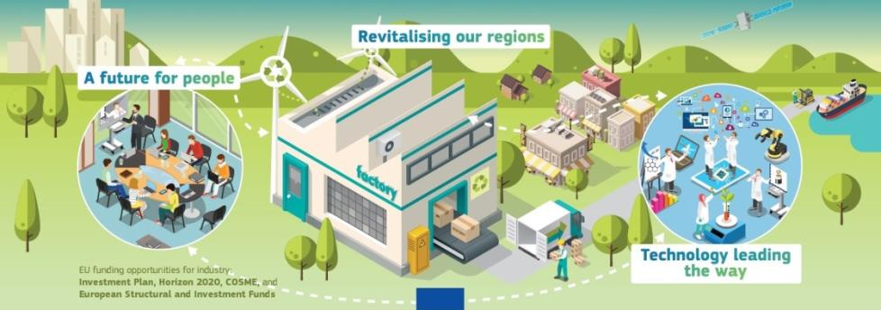
Thematic S3 Platform: Industrial Modernisation
Aims to support EU regions committed to generate a pipeline of industrial investment projects following a bottom-up approach - implemented through interregional cooperation, cluster participation and industry involvement.

Slide 18
Thematic S3 Platform: Industrial Modernisation
Supporting 21 IM S3 Partnerships

Slide 19
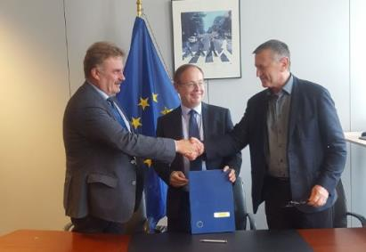
S3P Industrial Modernisation - Overview
30 lead regions
Steering committee governing the S3P Industrial modernisation
DG GROW, DG REGIO, DG RTD and JRC
representing
21 qualified partnerships
in which there are
Over 100 participating regions
Many participations come from: IT(12), ES(11), FR(10), DE(10),
BE(9), NL(9), SI(9)
EUSAIR coverage: IT(10), SI(9), GR(1) ☺
4 IM partnerships were selected for 8 DG REGIO's Interregional Pilot Actions (2018-19)
EC DGs involved: GROW, REGIO, RTD, JRC

Slide 20
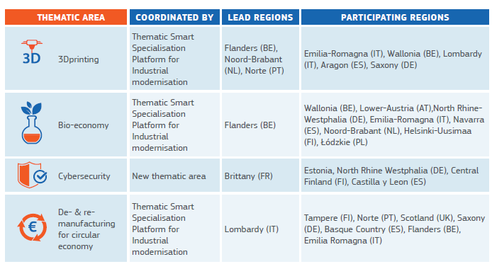
Pilot Action on Partnerships to Pilot Interregional Innovation Projects - 8 selected partnerships

Slide 21
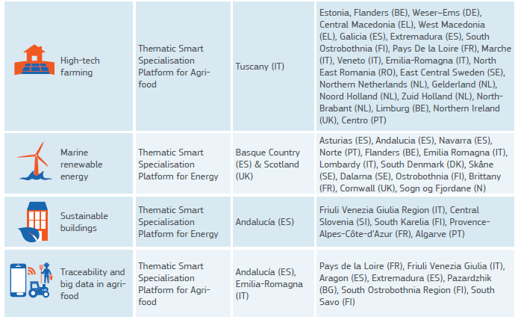
Pilot Action - 8 selected partnerships – Cont.

Slide 22
S3 Strategic Developments - EU
S3 Linking Public Admin.& Businesses at the EU level
REGIO, JRC & Lead policy DGs
Thematic Smart Specialisation Platforms
Regional authorities
Energy
Agri-Food
Industrial Modernisation
+Blue Growth
+ Digital Growth ?
+Health ?
+ Circular Economy etc.
Value chain
Value chain
Value chain
Advanced Manufactu.
KETs
Value chain
Value chain
Value chain
Value chain
Value chain
Joint actions and
investments
Ressource
efficiency
Service innovation
Value chain
Value chain
…
Business
European Strategic Cluster Partnerships
for Smart Specialisation Investments
Cluster organisations
DG GROW

Slide 23
Three steps of the 'Entrepreneurial Discovery Process' at the EU-level
Thematic Smart Specialisation Platform
Lead Policy DGs & Lead Regions
Identifying potential synergies in regional S3 priorities
European Strategic Cluster Partnerships for S3 investments
Lead Clusters & Regions
Intercluster cooperation network for specific value chains/domains
Consortia for co-investments / joint demonstration
Lead Companies & innovation actors in clusters accross regions
Projects and investment cases in particular value chains

Slide 24
S3 Revealed policy weaknesses and capacity issues in the innovation eco-systems across the WB and EUSAIR Countries
Strengths
Weaknesses
Threats
Opportunities
Strong basic research
STEM education
No strategic prioritisation
Lack of funding
Low labour costs elsewhere
Miss the train of thematic cooperation
Focus on key domains (ICT?)
Upgrade traditional sectors
Many industries with low value added
Create trust & learn (S3)
Weak institutional capacities
Non-R&D innovations
Continuous commitment?
Relative cost advantage
Weak linkage HEI-industry

Slide 25
Thanks for your Attention!
Any questions?
You can find us at http://s3platform.jrc.ec.europa.eu/home
Ales.GNAMUS@ec.europa.eu

