Slide 1

ADRION programme past experience, lessons learnt, a reflection into the future
Meeting and workshop
of the EUSAIR key implementers
and programming authorities
Portoroz, 18 September 2019

Slide 2
ADRION PRIORITIES AND FINANCIAL ENVELOPE
MEUR 20,83
PA 3 - Connected Region
MEUR 23,16
MEUR 53,49
Total budget: MEUR 117,9
(TA included)
PA 1 - Innovative and Smart Region
PA 2- Sustainable Region
MEUR 11,50
PA 4 – Supporting EUSAIR

Slide 3
ADRION STATE OF PLAY
 | Priority Axis 1 | Priority Axis 2 | Priority Axis 3 | Priority Axis 4
1st call for proposals | 14 | 10 | 10
2nd call for proposals |  | 22
3rd calls for proposals | up to 2 (call closed on 12/09/2019) |  | up to 2 (call closed on 13/09/2019)
Terms of Reference |  |  |  | 1
Total | 16 | 32 | 12 | 1
Funded projects 2014-2020: 61

Slide 4
TOPICS EXAMPLES
Maritime spatial planning
Integrated coastal zone management
Support to European Network for data collection (e.g.: European Marine Observation and Data Network - EMODnet)
Macro-regional S3 on Blue Growth
Measures promoted by European Shortsea Network in relation to shortsea shipping and intermodal transport
Accessibility and effectiveness of EU TEN-T corridors in the area, especially in accordance with the Berlin Process
S3 in pilot sectors: Agro-Bio Economy; Energy & Environment; Transport & Mobility
Natural and -cultural heritage and biodiversity safeguard and promotion
What ADRION supports
ADRION acts as policy driver and governance innovator fostering European integration through:
Networks
Cooperation agreements
Strategies
Action plans
Pilot actions
Effective contribution to IPA Partner States along their accession process

Slide 5

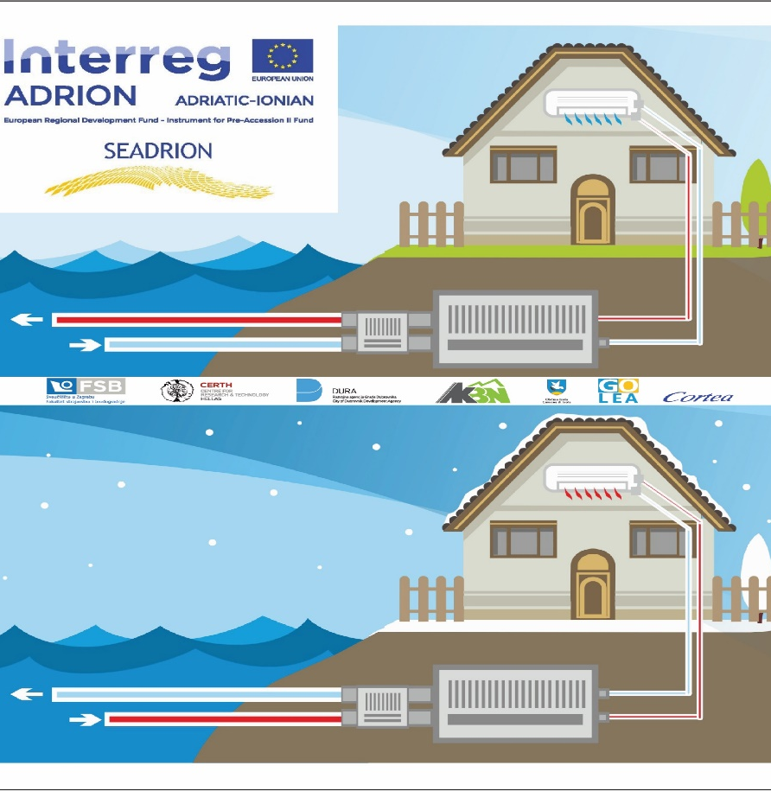
ADRION PROJECT EXAMPLE WITH POTENTIAL OF FUTURE INVESTMENTS
Fostering diffusion of heating and cooling technologies using the seawater pump in the Adriatic-Ionian Region
Innovative use of seawater heat pump of cooling thermal energy in buildings
Transnational seawater heat pump network in the ADRION region to enhance science and technology cooperation between private and public institutions
Testing of the innovation system in 3 pilot sites of small and medium-scale power (Croatia, Greece) and 6 pre-feasibility studies in (Italy, Slovenia, Croatia, Greece, Albania)
Definition of a common strategy for enhancing the use of seawater heat pump
7 partners from 5 Partner States (Croatia, Italy, Slovenia, Greece, Albania)

Slide 6
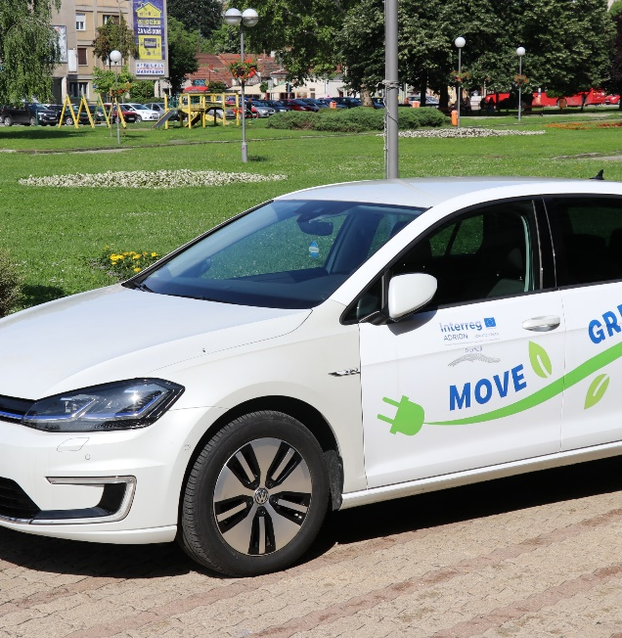
ADRION PROJECT EXAMPLE WITH POTENTIAL OF FUTURE INVESTMENTS
Enhance the use of alternative fuels by properly enabling electric vehicles to promote sustainable mobility
Pilot model of transnational electric transport
Pilot action: purchase of 6 electric vehicles; set up of 16 electric vehicle charging points; future upgrading to 4 Photovoltaic electric vehicles charging stations
Identification and support to common solutions based on EU advanced best practices, to overcome interurban and interregional limited number of public charging infrastructure
5 partners from 5 Partner States (Italy, Slovenia, Croatia, Greece, Serbia)

Slide 7
ADRION BENEFICIARIES (1ST AND 2ND CALL)
Out of the 508 partners, 140 (28%) are from IPA Partner States.

Slide 8
ADRION BENEFICIARIES (1ST AND 2ND CALL)
52% public administrative bodies (national, regional, local)
17% high education and research centres, training centres and schools
13% sectoral agencies and (public) service providers
7% business support organizations
2% SMEs and enterprises not SMEs

Slide 9
OVERVIEW OF ADRION IMPLEMENTATION THROUGH CALLS FOR PROPOSALS
Start new programming
Pre-identified topics & actions relevant both for ADRION & EUSAIR
(Priority Axis 1-3)
Open call
Bottom up & awarding score to support EUSAIR
(all Priority Axes)
Targeted call
ADRION gap analysis and EUSAIR priorities
(Priority Axis 2)
2nd call
3rd calls
1st call
Programme rules on partnership structure to ensure fair and equal participation of all Partner States and territories

Slide 10
HARVESTING ADRION SEEDS OF COOPERATION
Capitalization activities to promote achieved outcomes shall start in the second part of 2019
Ad hoc Working Group composed by Monitoring Committee representatives to agree on future capitalization activities (1st meeting scheduled on 7 October 2019)
Cooperation with EUSAIR through its Facility Point could be envisaged

Slide 11
LESSONS LEARNED
Post-2020 Cooperation Programme should take more into account the programme area specificities/characteristics through territorial, swot analyses, and definition of future scenarios for TN cooperation thus to make use of EU funds more effective
More prominent role of dissemination and capitalization activities to be considered
TN cooperation still perceived as an “enlarged CBC cooperation”: a step forward has not been fully done yet
Synergies and cooperation with the other existing programmes (TN and CBC) operating on the same geographical area are currently weak; need to reduce potential overlapping
Programme design and implementation
Projects design and management
Guided approach to potential beneficiaries (e.g.: with regard to topics, actions) already in the design of calls for proposals aimed at receiving higher quality project proposals
Beneficiaries suffer from difficulties in spending funds due to structural/internal organization/Partner States rules (e.g.: long public procurement processes, institutional changes)
Closer support at national level to be considered

Slide 12
ADRION PROGRAMMING: WHAT TO FUND
Identification of leading distinctive elements characterising ADRION goals in accordance with the EU Strategic Agenda 2019-2024, e.g.:
A more environmentally sustainable area: strong/horizontal focus on environmental sustainability in all identified topics;
A more innovative area: strong/horizontal focus on innovation in all identified topics, including the conceiving and implementing S3s at macro-regional level;
A more cohesive area: strong/horizontal focus on possible future enlargement, enhance institutional capacity of public authorities and stakeholders, preserve and increase area way of life, including people-to-people actions.

Slide 13
ADRION PROGRAMMING: WHOM TO FUND
Reflection on potential beneficiaries, how to intercept them and their capacity in mobilizing the necessary project co-financing.
Beneficiaries robustly contribute to the definition of the programme vision, achievements and visibility: if majority of potential beneficiaries will be, for example:
Programme partially visible to the wide public; supported activities effective in the medium-long period
Politicians and decision-makers
(proposed output indicator: joint strategies/action plans developed or implemented)
Programme visible to a selected public; supported activities effective in the short-medium-long period
Specific sector stakeholders
(proposed output indicators: joint pilot activities implemented in projects; participants in joint training schemes; projects across national borders leading to network/clusters)
Civil society, citizens, education
and training centres
Programme visible to the wide public; supported activities effective in the short-medium period
(proposed output indicators: joint pilot activities implemented in projects; participants in joint training schemes)

Slide 14

LINKS WITH OTHER COHESION AND IPA PROGRAMMES – BOOSTING SYNERGIES
Example:
EUSAIR
EUSAIR
Enhancement of maritime transport for goods
MED
Support to the realization and implementation of plans ensuring security and environmental protection
ADRION
Danube
….
Proposed coordination
….
Support to the realization of specific CBC infrastructures/ tools
CBC programmes
Support to the training, purchase of equipment, direct support to companies involved in the sector
Mainstream/IPA programmes

Slide 15
LINKS WITH OTHER ETC PROGRAMMES
Coordination among ETC programmes should include (indicatively):
With TN programmes: the adoption of complementary and synergic features/types of action in relation to the presence of eventual common topics to avoid the funding of similar activities in the area; and
With CBC programmes: the adoption of complementary features/types of action (at least with those CBC programmes with the highest financial allocation/high relevance for the Adriatic-Ionian area).
From a technical point of view, elements to be streamlined could be:
  Chosen strategies and identified topics already in the programming phase;
  Calendar and content of calls for proposals;
  Capitalization activities (with TN programmes);
  Joint monitoring tools to boost anti-fraud measures, controls on double funding etc.;
  Meetings with the affected MAs.

