Slide 1
Adriatic Ionian Region Masterplan for Transport Interconnectivity (AIM-TI)
Masterplan elaboration steps and development of the EUSAIR Multimodal Transport Model
EUSAIR - 11th TSG2 Meeting, November 2019

Slide 2
Content
Adriatic Ionian Region Masterplan for Transport Interconnectivity – AIM-TI
Structure
Indicative content
Development path
EUSAIR Multimodal Transport Model – EMTM
Purpose of the EMTM
EMTM zoning system
EMTM road, rail and IWW networks
EMTM network model inputs validation and integration
Annex A: EMTM Zoning System Technical Note

Slide 3
Adriatic Ionian Region Masterplan for Transport Interconnectivity (AIM-TI)
Structure, content and development path

Slide 4
Structure of the Masterplan
Masterplan purposes:
Support the coordinated implementation of the macro-regional strategy in the framework of the EU policies for the Union’s Enlargement and Cooperation with Neighbouring Countries, Territorial Integration and Cohesion, Single European Transport Area;
Identify projects of macro-regional relevance and support their implementation towards a more competitive and resource efficient transport system in the Adriatic-Ionian Region with a focus on:
The maritime dimension of the macro-regional transport and economic systems; and
The promotion of green and multimodal accessibility to urban, transport and touristic nodes
Main components of the Adriatic Ionian Region Master Plan for Transport Interconnectivity – AIM-TI:
Adriatic Ionian Region Master Plan for Transport Interconnectivity – AIM-TI - Maritime dimension
Adriatic Ionian Region Master Plan for Transport Interconnectivity – AIM-TI - Land and air accessibility
EUSAIR Multimodal Transport Model – EMTM

Slide 5
Indicative content of the Masterplan
Adriatic Ionian Region Masterplan for Transport Interconnectivity: Towards an Interconnected Growth
 | Executive summary
 | Introduction
Ch01 | The Masterplan in the framework of the EU policies for the Union’s Enlargement and Cooperation with Neighbouring Countries, Territorial Integration and Cohesion, Single European Transport Area
Ch02 | The Masterplan as a tool for the implementation of the EUSAIR Macro-regional Strategy
Ch03 | Adriatic Ionian Region socio-economic evolution
 | Socio-economic characteristics of the Adriatic Ionian Region
 | The Adriatic Ionian Region at the crossing of global trade and logistics routes to Europe
Ch04 | Transport sector overview
 | The backbone of the Adriatic Ionian Region transport infrastructure
 | Passengers and freight transport flows across the Adriatic Ionian Region
Ch05 | Masterplan vision, policy and strategy
 | Review of the national transport plans
 | Macro-regional transport priorities
 | Infrastructure projects for the development of the Adriatic Ionian Region transport system
 | Soft measures for the development of the Adriatic Ionian Region transport system
 | Labelled projects
 | Cross-pillar initiatives
 | Capacity building initiatives
 | Promotion of the masterplan and synergies with other international actions (i.e. TCT, ADRION, other Macro-regional strategies… TEN-T CNCs implementation process)
Ch06 | Transport scenarios
 | The baseline scenario at 2017
 | The do nothing scenario at 2030
 | The project scenario at 2030
Ch08 | Conclusions
Annexes | Report
Main report

Slide 6
Indicative content of the Masterplan
Report 1 | Waterborne transport sector
 | Introduction
Ch01 | Overview of the maritime sector
 | Maritime infrastructure
 | Last mile and hinterland connections
 | Cruise terminals accessibility
 | Main routes interconnecting ports in the Adriatic Ionian Region
 | Maritime traffic at Adriatic Ionian Region ports
 | VTMIS and eMaritime solutions
 | Port electrification, hydrogen and LNG supply facilities
Ch02 | Overview of the IWW transport sector
 | IWW routes and ports
 | Last mile and hinterland connections of ports
 | IWW traffic at Adriatic Ionian Region ports
 | RIS and ICT solutions
 | Port electrification, hydrogen and LNG supply
Ch03 | Waterborne planned investments
 | Review of the national transport plans
 | Labelled projects
 | Project impact assessment and gap analysis with respect to TEN-T standards and targets
Ch04 | Key investments and recommendations for the development of waterborne transport
Report 2 | Waterborne transport and intermodality
 | Introduction
Ch01 | Overview of the intermodal infrastructure at ports
 | Bi-modal and tri-modal terminals and logistics platforms at ports
 | Last mile connections of ports
 | Intermodal traffic volumes
 | ICT and innovative transport measures to promote intermodality
Ch02 | Planned investments to promote intermodality at ports
 | Review of the national transport plans
 | Labelled projects
 | Project impact assessment and gap analysis with respect to TEN-T standards and targets
Ch03 | Key investments and recommendations for the development of intermodality at ports
Maritime dimension

Slide 7
Indicative content of the Masterplan
Report 1 | Rail transport sector and intermodality
 | Introduction
Ch01 | Overview of the rail sector
 | Rail infrastructure
 | Rail terminals and Rail-road terminals
 | Traffic volumes on the rail network and at terminals
 | Rail transport performance at BCPs
 | ERTMS deployment
Ch02 | Rail planned investments
 | Review of the national transport plans
 | Labelled projects
 | Project impact assessment and gap analysis with respect to TEN-T standards and targets
Ch03 | Key investments and recommendations for the development of the rail sector
Land and air accessibility: road and rail sectors
Report 2 | Road transport sector
 | Introduction
Ch01 | Overview of the road sector
 | Road infrastructure
 | Road traffic volumes
 | Road transport performance at BCPs
 | Road transport safety
 | ITS solutions for traffic and demand management
 | Alternative clean fuels
Ch02 | Road planned investments
 | Review of the national transport plans
 | Labelled projects
 | Project impact assessment and gap analysis with respect to TEN-T standards and targets
Ch03 | Key investments and recommendations for the development of the road sector

Slide 8
Indicative content of the Masterplan
Report 3 | Air transport sector
 | Introduction
Ch01 | Overview of the air transport sector
 | Airport infrastructure
 | Traffic at airports
 | Airport accessibility from main urban and touristic nodes
 | Interconnection between airports and the main logistics platforms
 | SESAR and alternative clean fuel deployment
Ch02 | Airport planned investments
 | Review of the national transport plans
 | Labelled projects
 | Project impact assessment and gap analysis with respect to TEN-T standards and targets
Ch03 | Key investments and recommendations for the development of the rail sector
Land and air accessibility: air sector, urban transport and tourism accessibility
Report 4 | Urban transport and tourism accessibility
 | Introduction
Ch01 | Overview of the major urban and touristic sites in the EUSAIR
 | Description of the rail and road infrastructure system interconnecting the urban and main touristic sites in the EUSAIR with its backbone infrastructure
 | Description of the infrastructure and services for cycling mobility interconnecting main urban nodes and touristic sites
 | Interconnecting services between the main transport nodes, urban nodes and touristic sites
 | Future oriented mobility solutions to improve accessibility at urban nodes and touristic sites
 | City logistics solutions at urban nodes and touristic sites
 | Solutions and strategies for the diffusion of alternative clean fuels at urban nodes and touristic sites
Ch02 | Urban transport major planned investments
 | Check availability and review of SUMPs and SULPs and or dedicated tourism accessibility strategies
 | Labelled projects
 | Project impact assessment and gap analysis with respect to TEN-T standards and targets
Ch03 | Key investments and recommendations for the development for an improved accessibility at urban nodes and touristic sites

Slide 9
Indicative content of the Masterplan
The Masterplan supports the elaboration of feasibility studies in view of the implementation of specific projects:
3 studies related to the maritime sector and associated intermodality
4 studies in the field of land transport and related intermodality/accessibility
Feasibility project report
 | Executive summary
 | Introduction
Ch01 | Project objectives and targets
Ch02 | Project technical scope and description
Ch03 | Demand analysis
Ch04 | Options Analysis
Ch05 | Cost Benefit Analysis
Ch06 | Implementation and funding strategy
Ch07 | Conclusions
Feasibility analyses

Slide 10
Masterplan development path 2019-2022
Autumn 2019
Feb. 2020
Sept. 2020
Feb.
2021
Sept. 2021
Feb. 2022
Sept. 2022
Main report
Set up WG on Masterplan
Start of activities
Overviewof current system
Masterplan vision policy strategy
Draft Final report
Transport scenarios
Final report
Multimodal transport model
Start of activities
Draft network model
Final network model
Base year model scenario
Future model scenarios
Maritime dimension
ToR/ Tender
Start of activities
Analysis of current system
Analysis of future system
Draft results of feasibility analyses
Final report
Land and air accessibility
ToR/ Tender
Start of activities
Analysis of current system
Analysis of future system
Final report
Draft results of feasibility analyses
Input to 11°
TSG2
Input to 12° TSG2
Input to 13°
TSG2
Input to 14°
TSG2
Input to 15°
TSG2
Input to 16° TSG2
Input to 17° TSG2

Slide 11
EUSAIR Multimodal Transport Model - EMTM
Scope of the model

Slide 12
Purpose of the model
Transport model in support of the elaboration of the Adriatic Ionian Region Master Plan for Transport
Describe the current situation of the road and rail networks
Describe and map the network parameters
Identify gaps with reference to relevant regulations (TEN-T)
Assess the performance of the road, rail and short sea shipping (limited to freight) transport system
Analyse and map traffic flows along the network
Support the identification of capacity bottlenecks
Assess the impact of the planned projects on the road and rail network
2030 scenarios (2014-2020 and 2021-2027 programming periods)
Identify persisting gaps in terms of infrastructure performance and capacity
The model will cover the full national network for all countries
GIS based maps in support of the elaboration of the Adriatic Ionian Region Master Plan for Transport
Rail, Road and Inland Waterways

Slide 13
EUSAIR Multimodal Transport Model - EMTM
Zoning system and preliminary analysis of socioeconomic parameters

Slide 14
Traffic Analysis Zones (TAZs)
In transport models the study area needs to be disaggregated into zones that are usually referred to as Traffic Analysis Zones (TAZs)
TAZs are used to describe the distribution of Origin and/or Destination of transport flows in the study area
The number and size of the TAZs depends on the geographic scale and purposes of the models
As a general praxis for large scale models, TAZs correspond to individual or aggregated statistical units as defined by national or international institutes of statistics
As part of modelling exercises demand for transport is estimated based on socioeconomic information with reference to TAZs, i.e. population, GDP, employment, motorisation, household structure…
Zoning system of the EMTM
For the EMTM NUTS 3 regions as defined by EUROSTAT will be used for the following EU Member States and Candidate Countries, i.e. Albania, Croatia, Greece, Italy, North Macedonia, Serbia, Slovenia
For Montenegro where only one NUTS 3 is defined, it was decided to divide this unit in smaller units (aggregating data on the basis of municipality information) that are generally comparable in terms of area with NUTS 3 regions
For Bosnia and Herzegovina and Kosovo TAZs have been defined based on administrative/statistical units that are comparable to NUTS 3

Slide 15
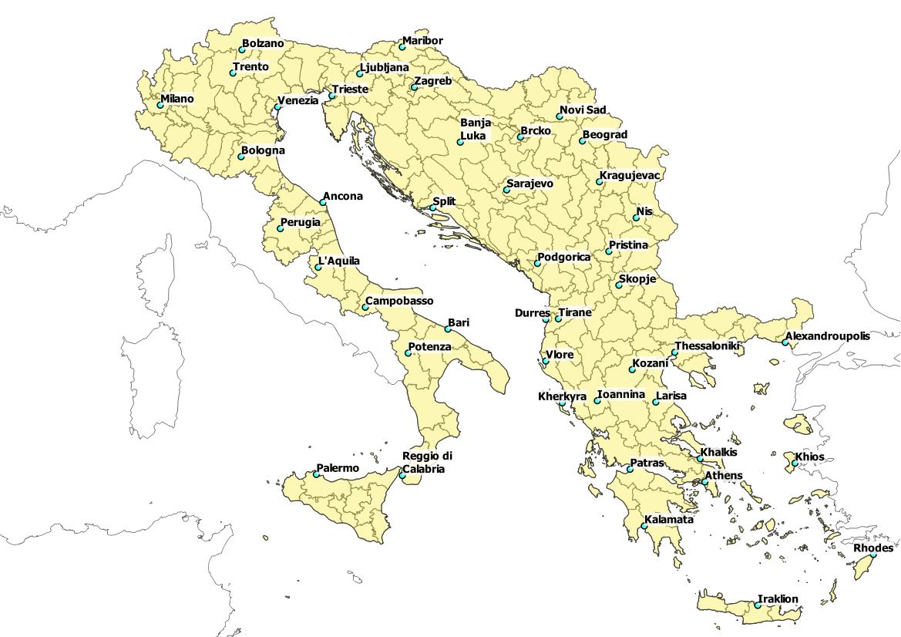
Study area and zoning system
NUTS3 or equivalent level of detail zones:
COUNTRY | ZONES
ALBANIA | 12
BOSNIA AND HERZEGOVINA | 18
CROATIA | 21
GREECE | 52
ITALY | 69
KOSOVO (under United Nations Security Council Resolution 1244/99) | 7
MONTENEGRO | 8
NORTH MACEDONIA | 8
SERBIA | 25
SLOVENIA | 12
TOTAL | 232

Slide 16
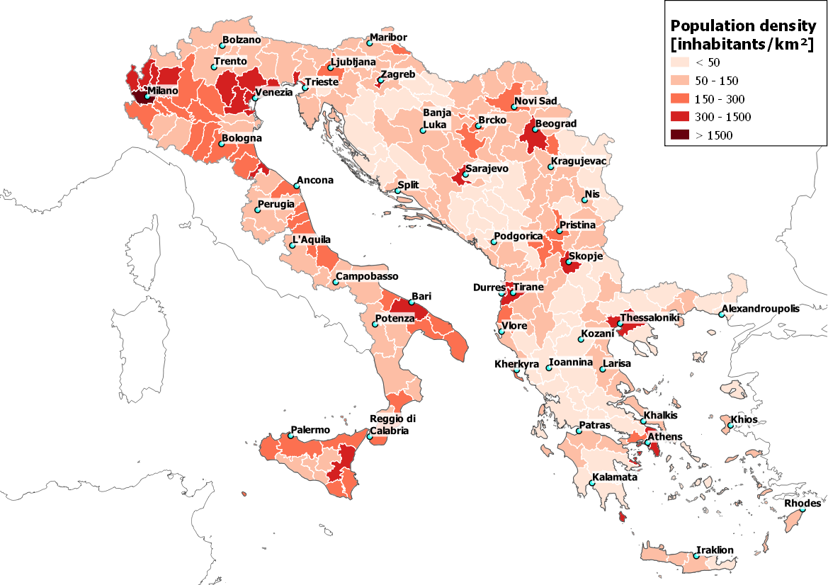
Socio-economics data: population density
Population data refer to 2017 for most countries except for Federation of Bosnia and Herzegovina and Brcko District (2013), and Kosovo (2016)

Slide 17
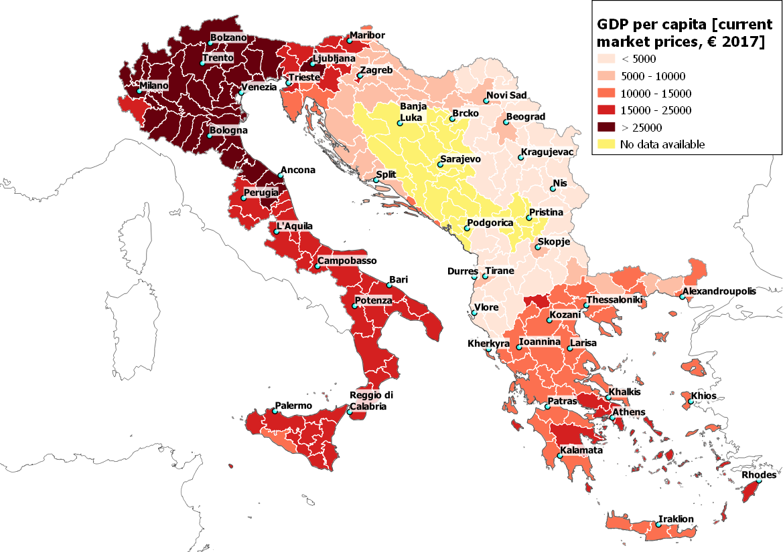
Socio-economics data: GDP per capita
GDP per capita data refer to 2016 for most countries except for Albania (2017) and Slovenia (2017). No data are available for Bosnia and Herzegovina, Kosovo and Montenegro

Slide 18
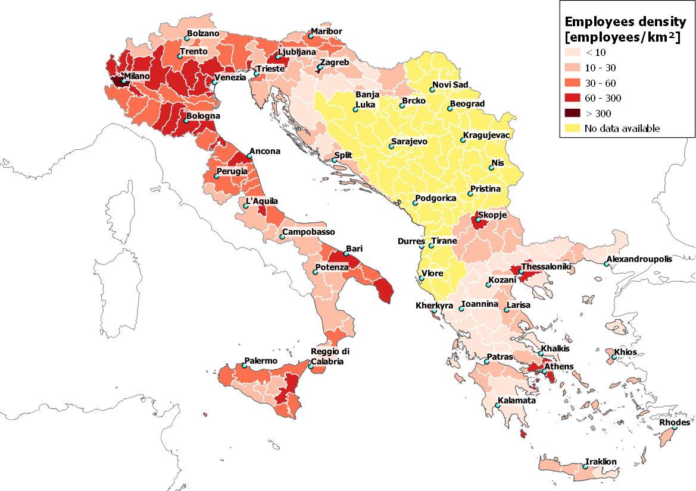
Socio-economics data: employees density
Employment data refer to 2016 for most countries except for Slovenia (2017). No data are available for Albania, Bosnia and Herzegovina, Kozovo, Montenegro and Serbia

Slide 19
EUSAIR Multimodal Transport Model - EMTM
GIS Rail, road and IWW networks

Slide 20
GIS Networks
Rail network
Elaborated on the basis of the European network developed as part of the ETISplus European Project and TENtec
Updated on the basis of OpenRailwayMap encoded information and data from the network statements of the national Infrastructure Managers
Road network
Elaborated on the basis of the European network developed as part of the ETISplus European Project and TENtec
Updated on the basis of information available in documents published by European motorway concessionaires
IWW network
Elaborated on the basis of the TENtec

Slide 21
Classification of the links
Road and/or rail links
Primary links
Links of highest importance for long-distance traffic across and beyond the borders of the Adriatic Ionian Region (generally corresponding to core network links and additional comprehensive links where appropriate)
Secondary links
Links of highest importance for interconnecting the main regions (NUTS 2) within the Adriatic Ionian Region (generally corresponding to the comprehensive links not classified as primary roads)
Tertiary links (i.e. regional roads and railways)
Other links not belonging to the primary and secondary networks, providing connectivity between the EMTM TAZs (NUTS 3)
Inland waterway links
Single classification corresponding to the core network

Slide 22
Road and IWW parameters
Road parameters
Number of traffic lanes
Classifies the road network according to the number of traffic lanes per direction
Tolled/toll free
Classifies the road network according to the application of tolls (direct /indirect) to users
IWW parameters
CEMT class
Classifies the IWW network according to the lowest categories of navigable inland waterways on the section (Class (length/beam) I to III, IV, V a, V b, VI a, VI b, VI c, VII). According to the definition in 1992: see also http://www.itf-oecd.org/resolution-no-922-new-classification-inland-waterways
Maximum draught of vessel/convoy (cm)
Classifies the IWW network according to the maximum allowed vessel/convoy size in draught in centimetres at reference water level. A default value is provided based on the CEMT classification (CEMT class). Please encode 999 for “no limit”.
Minimum bridge clearance (cm)
Classifies the IWW network according to the minimum height under bridges in centimetres on the section at reference high water level available for vessel/convoy to pass the section. A default value is provided based on the CEMT classification (CEMT class). Please encode 999 for “no limit”.

Slide 23
Rail parameters 1/3
Number of tracks
Classifies the rail network according to the number of tracks
Traction
Classifies the rail network according to the electrification (electrified / non-electrified)
Voltage (Volt)
Classifies the rail network according to the voltage for electrified sections (25000 Volts, 50Hz AC / 15000 Volts, 16 2/3 Hz AC / 3000 Volts DC / 1500 Volts DC / Other)
Track gauge (mm)
Classifies the rail network according to the track gauge in mm (1000, 1435, 1520, 1524, 1600, 1668)
Structure gauge (EN 15273)
Classifies the rail network according to the structure gauge. 3 international gauges defined in EN 15273, UK gauges W9 and above defined in Railway Group Standard GE/RT8073. GA GAUGE: Total height 3.85 m above the rail and 1.28 m on either side of the track axis / GB GAUGE: Total height 4.08 m above the rail and 1.28 m on either side of the track axis / GC GAUGE: Total height 4.65 m above the rail and 1.45 m on either side of the track axis. W GAUGES (for UK only) to indicate W9 and above (see reference Railway Group Standard GE/ RT8073). Other (to be noted according to the Standard EN 15273 Annex C and D)

Slide 24
Rail parameters 2/3
Combined transport profile for swap bodies
Classifies the rail network according to the combined transport profile for swap bodies, as defined in UIC Code 596-6. The technical number is made up of the wagon compatibility code (1 letter) and the standard combined transport profile number (2 digits when width ≤ 2500 mm or 3 digits when, 2500 < width ≤ 2600 mm). (C 22, C 32, C 38, C 45, C 50, C 55, C 60, C 65, C 70, C 80, C 90, C 341, C 349, C 351, C 357, C 364, C 380, C 385, C 390, C 395, C 400, C 405, C 410, C 420, Other)
Combined transport profile for semi-trailers
Classifies the rail network according to the combined transport profile for semi-trailers, as defined in UIC Code 596-6. The technical number is made up of the wagon compatibility code (1 letter) and the standard combined transport profile number (2 digits when width ≤ 2500 mm or 3 digits when 2500 < width ≤ 2600 mm). (P 32, P 38, P 45, P50, P 55, P 60, P 65, P 70, P 80, P 90, P 341, P 349, P 351, P 357, P 380, P 385, P 390, P 395, P 400, P 405, P 410, P 420, Other)
Maximum operating speed for passenger trains (km/h)
Classifies the rail network according to the highest operating speed allowed for passenger service taking into account technical characteristics of the infrastructure (No speed limit set, V<80, 80<=V<100, 100<=V<120, 120<=V<160, 160<=V<200, 200<=V<250, 250<=V<300, V>=300)
Maximum operating speed for freight trains (km/h)
Classifies the rail network according to the highest operating speed allowed for freight service taking into account technical characteristics of the infrastructure (No speed limit set, V<80, 80<=V<100, 100<=V<120, 120<=V<160)

Slide 25
Rail parameters 3/3
Maximum axle load (tonnes)
Classifies the rail network according to the maximum axle load (m < 16 t, 16 t <= m < 18 t, 18 t <= m < 20 t, 20 t <= m < 22,5 t, 22,5 t <= m < 25 t, 25 t <= m < 27,5 t, 27,5 t <= m < 30 t, m >= 30 t)
Maximum train length (m)
Classifies the rail network according to the maximum train length (L<200 m, 200<=L<400 m, 400<=L<500 m, 500<=L<600 m, 600<=L<740 m, 740<=L<1050 m, 1050<=L<1500, m L>=1500 m)
Sources for the analysis of the rail network and related parameters:
TENtec data 2015 for Italy, Slovenia, Croatia and Greece
Network statement 2019 for Serbia
Network statement 2019 for Montenegro
Network statement 2017 for North Macedonia
Network statement 2015 for Kosovo
No sources available for Bosnia and Herzegovina and Albania

Slide 26
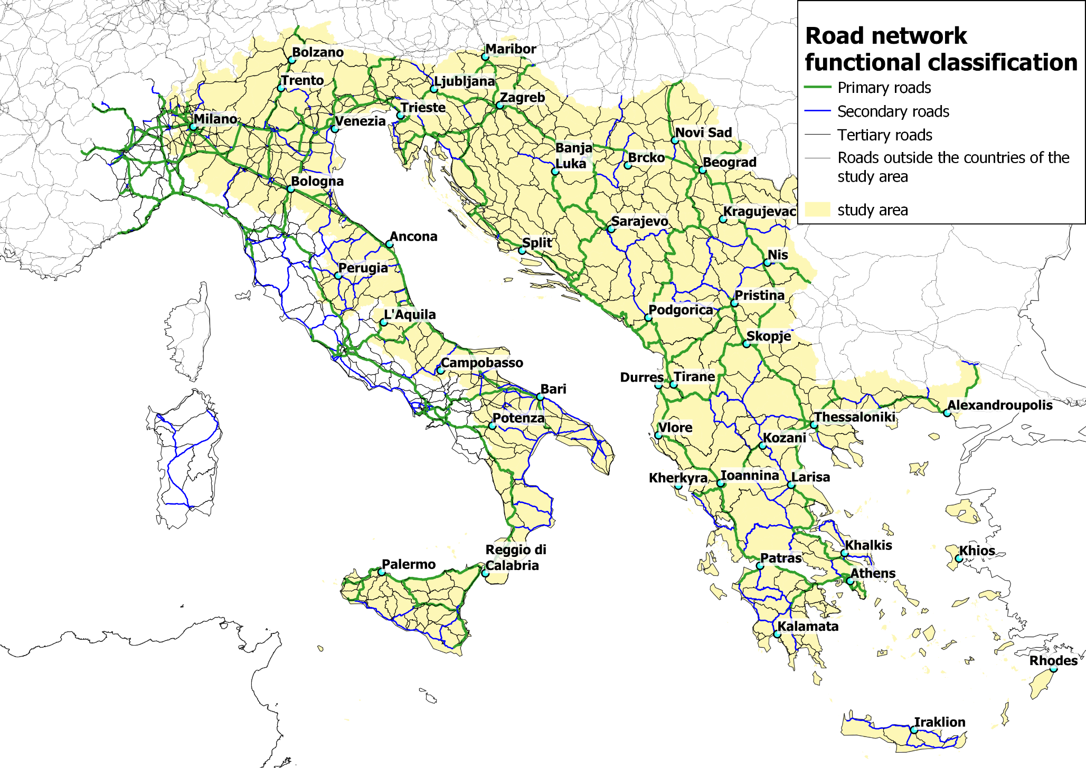
Example
Road network layout

Slide 27
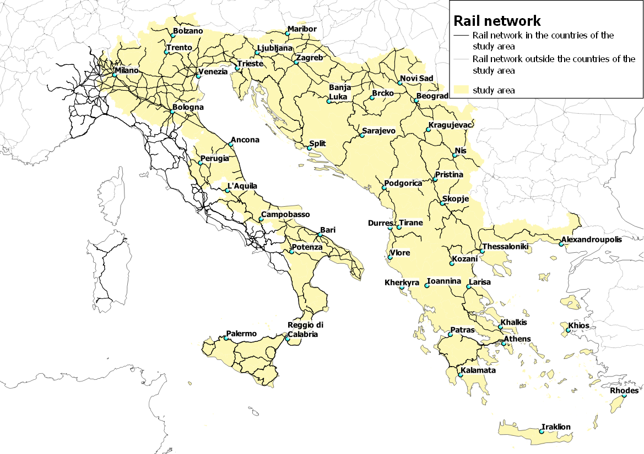
Rail network layout

Slide 28
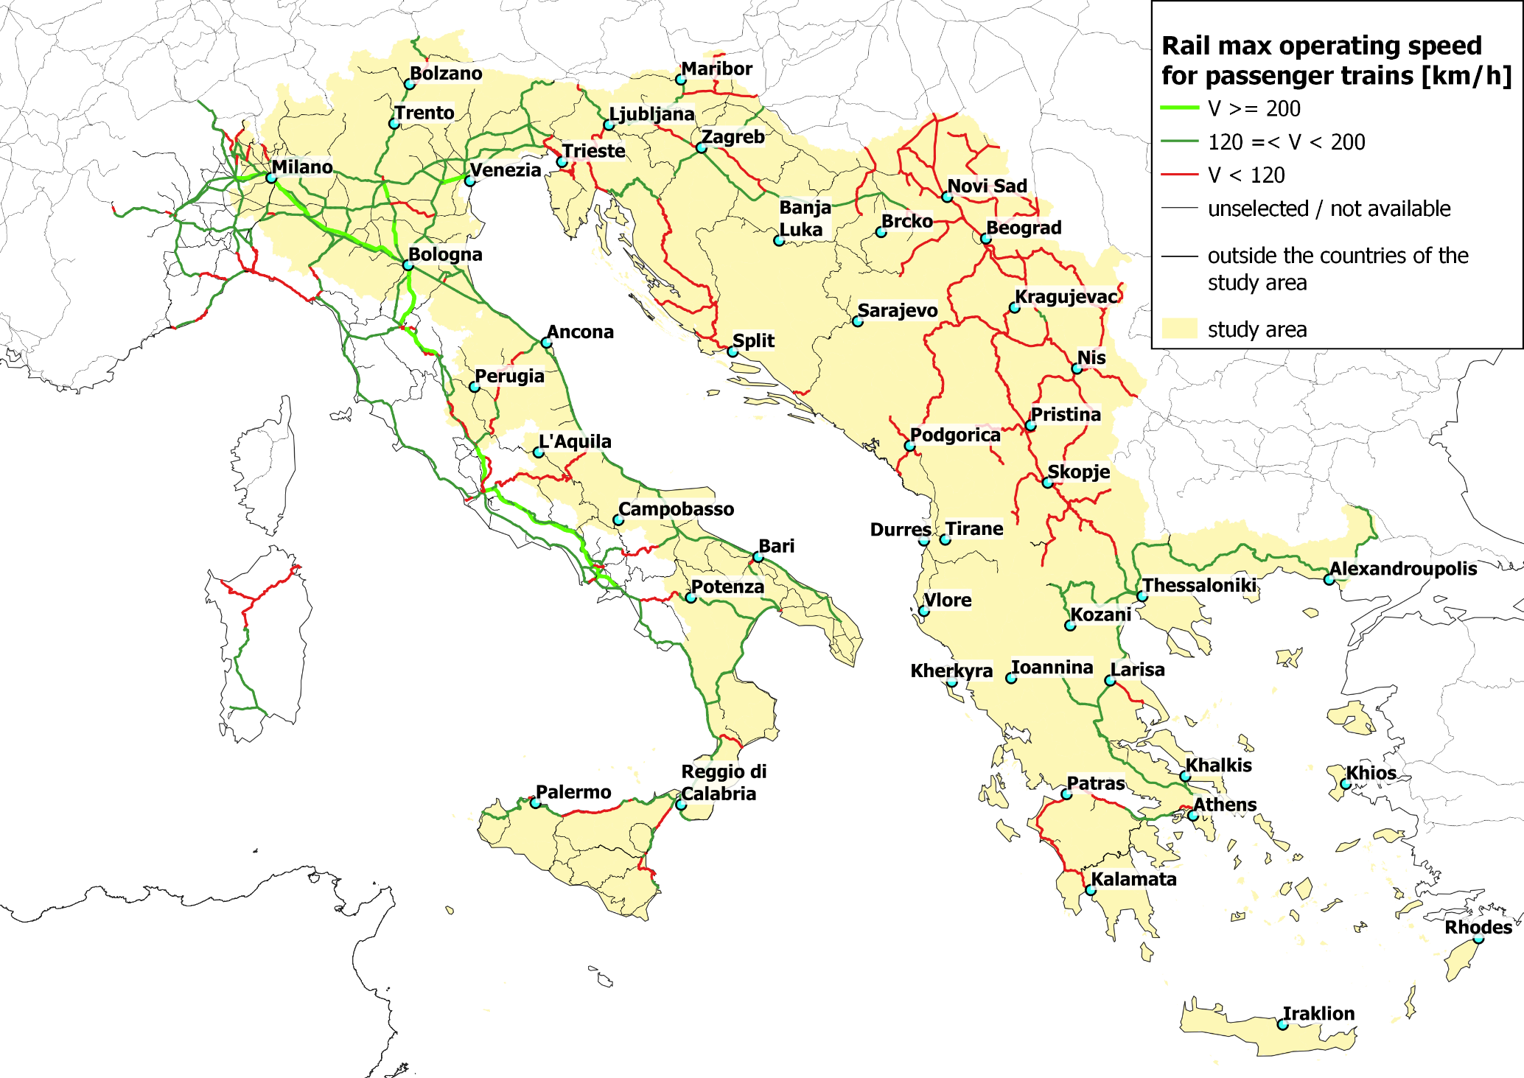
Example
Rail network: max operating speed (passenger trains)
V > 200 km/h for high speed network in Italy
V > 120 km/h for almost entire main network in Italy
V < 120 km/h for almost entire network in Serbia, Kosovo (under United Nations Security Council Resolution 1244/99), Montenegro and North Macedonia rail networks
No data available for Bosnia Herzegovina and Albania

Slide 29
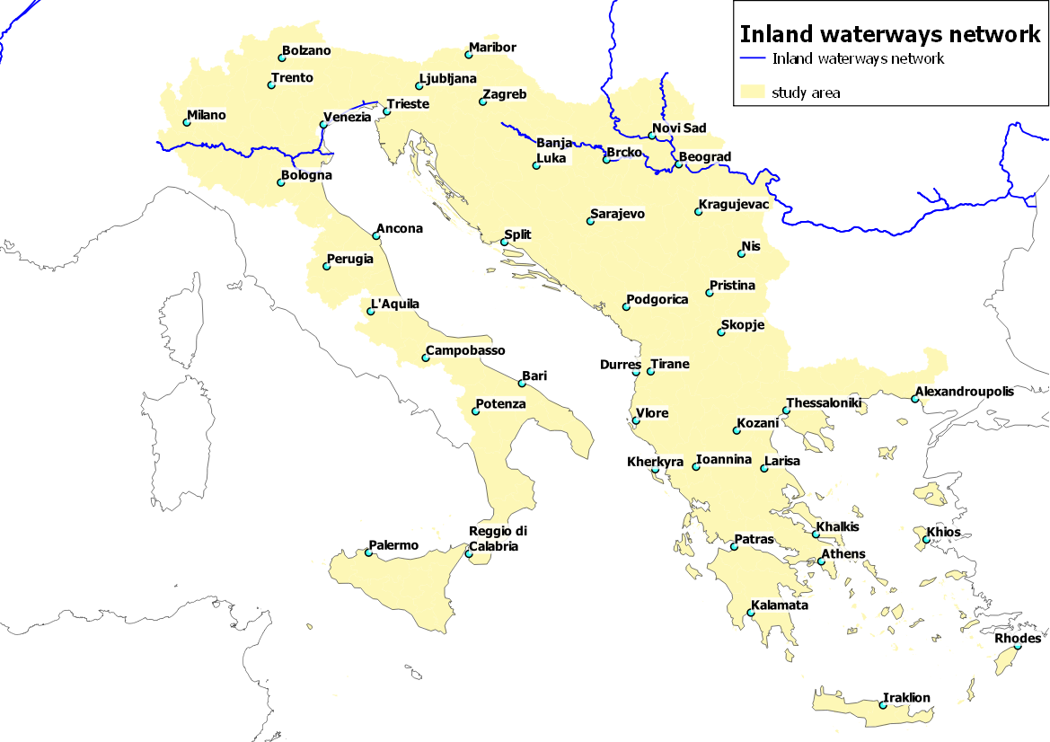
Inland waterways network (IWW)

Slide 30
EUSAIR Multimodal Transport Model - EMTM
Inputs validation and integration

Slide 31
Tasks between 11th and 12th TSG2
Task | Deadline | Responsibility
Send feedback to Consultant on the presentation given at the 11th TSG2 Meeting and related EMTM zoning system technical note | End November 2019 | TSG2 Members
Identify members of the Working Group on Masterplan and provide contact details to Coordinators/Consultant | End November 2019 | TSG2 Members
Provide maps by country on road, rail and IWW sections of the EMTM to WG and TSG2 Members | Mid December 2019 | Consultant
Validate and integrate network maps provided by Consultant | Mid of January 2020 | TSG2 Members
Meeting of the WG on Masterplan on the elaboration process of the EMTM, and monitor data collection process towards its finalisation | First week of February 2020 | WG Members
Elaboration of an updated documentation on the EMTM network model and traffic data collection in view of the 12° TSG2 Meeting | March 2020 | Consultant
Presentation on the progresses of the elaboration of the ETMT at the 12th TSG2 Meeting | April 2020 | Consultant

Slide 32
Data validation and integration
Road, rail and IWW networks:
Validate and integrate where required and available the data processed by the Consultant on the basis of the maps that will be provided by country for each network and their main parameters by the Consultant by mid of December 2019
Demography and economy
Validate and integrate where required and available the data provided by the Consultant in the Technical Note on the EMTM Zoning System annexed to this presentation and concerning Population, Employment and GDP
Other input data for modelling
Additional socioeconomic data (Registered vehicle fleet, trade)
Road, rail and IWW traffic by section and traffic volumes at nodes (ports and airports)
Data formats and requirements to be discussed in the first meeting of the WG on Masterplan in February 2019 if set up, or at the 12th TSG2 meeting

Slide 33
EUSAIR Masterplan Transport Model
www.tplan.consulting
www.fitconsulting.it

