Slide 1


EUSAIR supporting Enlargement
EUSAIR Facility Point, August 2025

Slide 2
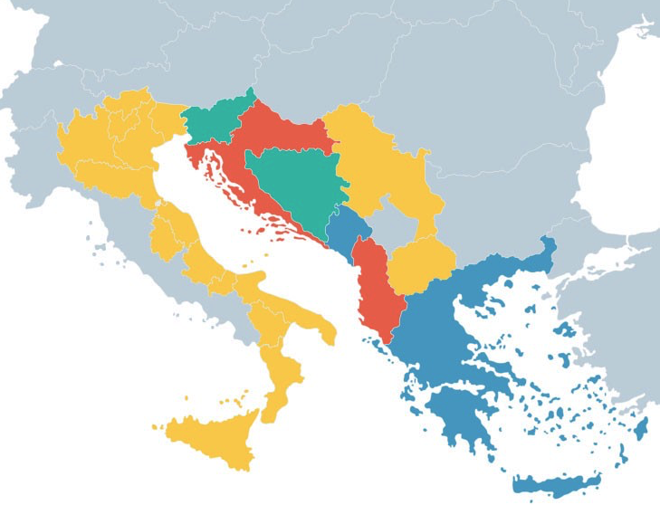
www.adriatic-ionian.eu
EUSAIR Pillars
Pillar 1 – Blue Sustainable Economy
Pillar 2 – Connecting the Region (Transport, Energy)
Pillar 3 – Environmental Quality
Pillar 4 – Sustainable Tourism
Pillar 5 – Improved Social Cohesion
EUSAIR cross cutting topics:
- Circular Economy
- Green rural development
- Digitalisation
EUSAIR horizontal topics:
- Enlargement
- Capacity Building
- Innovation and Research
How can the EUSAIR with already established structures, contacts and collaboration support its candidate countries in faster integration into the EU?

Slide 3
Purpose and objective
Purpose: Strengthening capacities of EUSAIR five candidate countries Albania, Bosnia and Herzegovina, Montenegro, North Macedonia and Serbia for EU accession in the areas addressed by the Strategy and its Action Plan
Objective: Establish an EUSAIR Community of Practice
  A knowledge sharing and learning network of peers, experts and practitioners
  Supporting administrations and other stakeholders in EUSAIR candidate countries by accessing tacit knowledge and skills
  Enabling effective integration with EU policies and frameworks

Slide 4

Our focus
Our strengths
EUSAIR connects Members States and non-EU countries
Already established contacts and cooperation at different levels
Collaboration on equal footing
Broad and inclusive stakeholder engagement
Enlargemet embedded in the MRS and its Action Plan
Access to knowledge and practices, sharing among peers
EUSAIR Governance Point (3 projects supporting the implementation of the EUSAIR Action Plan)
EUSAIR Pillars and Topics
Multicountry approach
Sub-national approach
Implementa-tional aspects
Acquis
chapters
Notes:
Main chapters to explore:
13 – fisheries
27 – environment
14-transport
19- social policy and employment
26 – education and culture
28 – consumer and health protection
22- regional development
25- science and research

Slide 5
Concept
Making knowledge available for other users:
Repository of presentations
Records of public events
Other
Knowledge management
Knowledge and skills transfer and co-creation
Implementation:
Organisation of various types of support, e.g.
Online sharing of practices
Trainings
Consultations
Study visits, …
Developing a community of peers, experts and practitioners
Design support: Who can help provide knowledge, skills, share experience? What kind of activities will best serve identified needs? How can already existing activities be used as a setting for Enlargement support?
Mapping: Where do candidate countries stands concerning acquis in the area of EUSAIR pillars and topics? What are main challenges? What kind of support is needed and for whom specifically?
Continous Needs Identification

Slide 6
Approach
Assumptions
Commitment of MS to actively participate in the exchanges
Coordination between the EUSAIR governnance structures and other stakeholders in the region
Synergies between the EUSAIR support projects
Phase 1: Piloting (by end of 2027)
Phase 2: Further implementation (post 2027)
2025: agreeing on the concept with key stakeholders
1st needs assessment
2026: planinng
implementation and monitoring
continous needs assessment
2027: contiunous support
evaluation and recommendations
for future implementation

