Slide 1

EUSAIR
Visual Identity

Slide 2
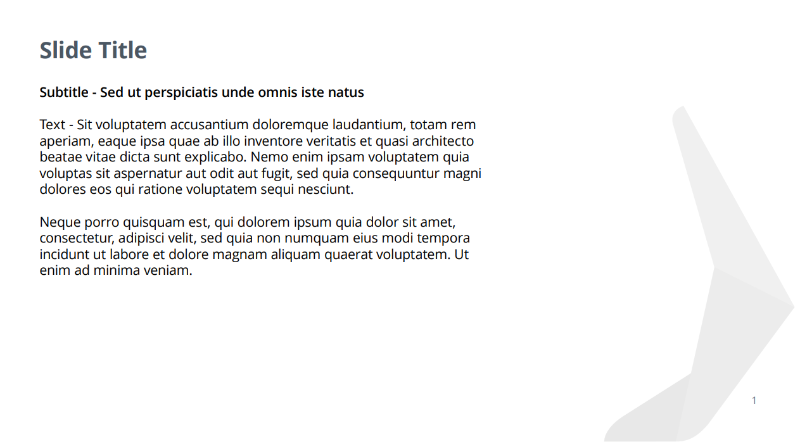
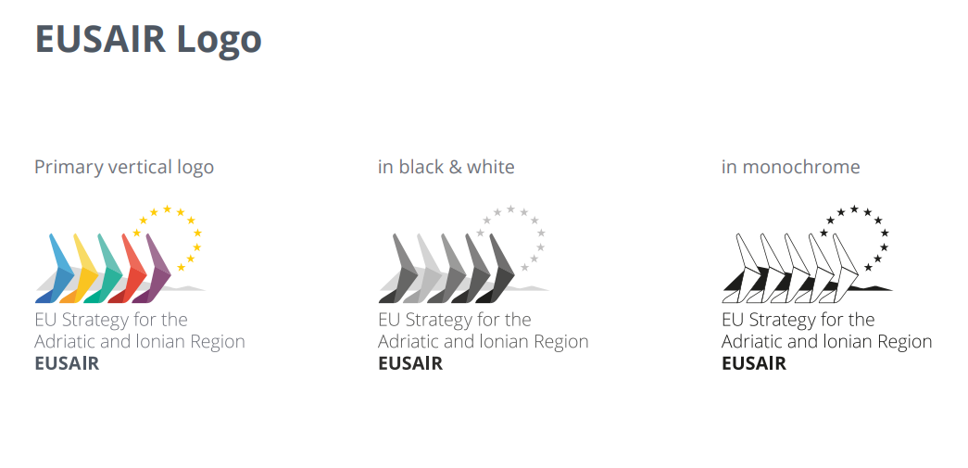


Slide 3

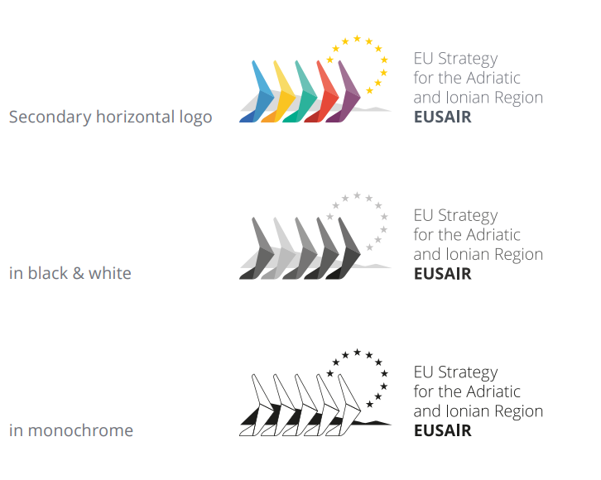

Slide 4



Slide 5



Slide 6

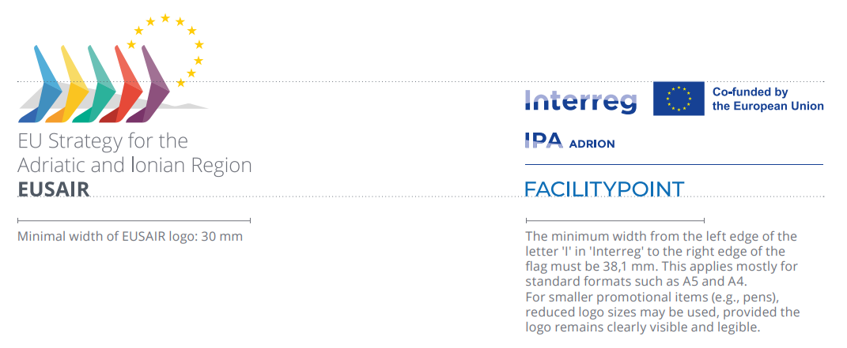

Slide 8


Slide 9
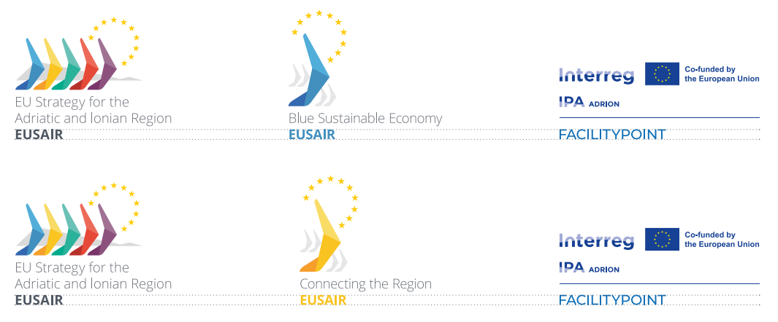

Slide 10


Slide 11



Slide 12
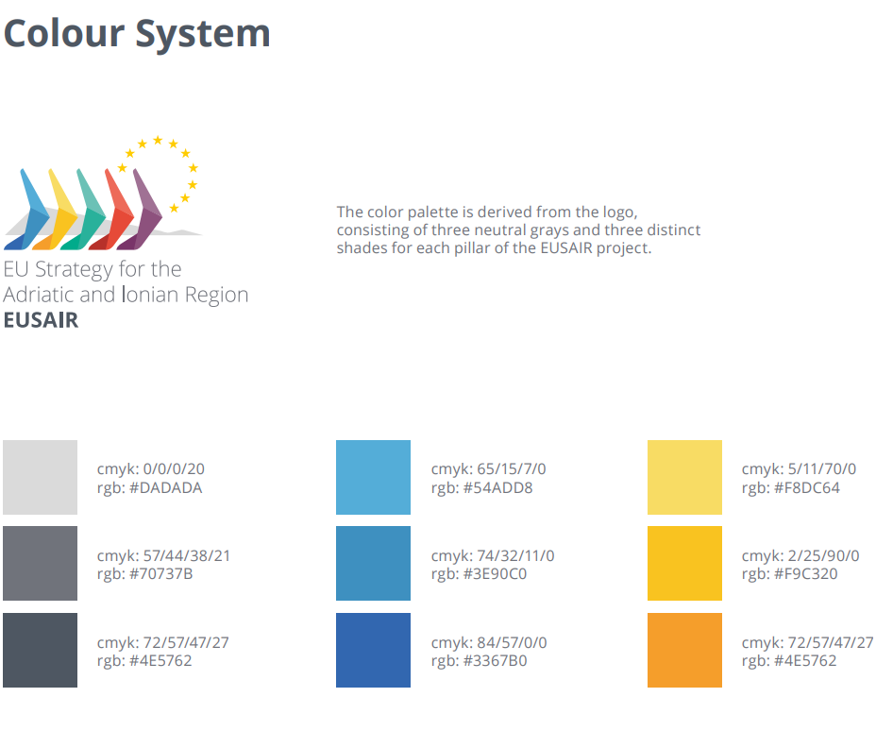

Slide 13
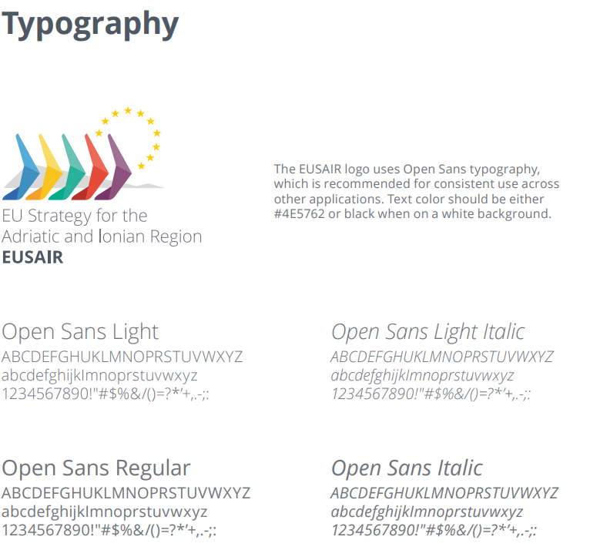

Slide 14

To be continued….
tomaz.arh@gov.si

