Slide 1
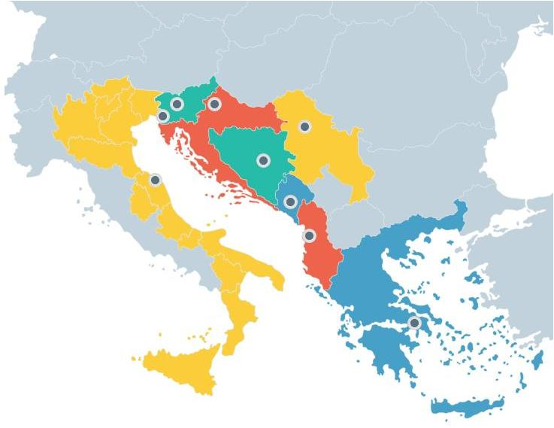
WP3: MONITORING AND EVALUATION OF EUSAIR
Preliminary Findings of the IDEAL EUSAIR Study (Pillar 1-related study)
12th meeting
of the EUSAIR TSG for Pillar 1 - Blue Growth
7/12/2020

Slide 2
IDEAL EUSAIR STUDY SURVEY (Preliminary Findings)
OBJECTIVES OF THE STUDY
The overall objective of the study is to identify important information gaps, needs and opportunities to facilitate and foster the design and implementation of EUSAIR Flagship actions and projects in the Adriatic - Ionian macro-region.
The specific objectives include:
Assistance to EU MS mandated Institutions to the design of the new programming period 2021-2027
Assistance to EUSAIR MS to fine-tune actions and to specify practical procedures that will safeguard the implementation of the flagships in Pillar 1.
Assistance to macro-region MS to consider streamlining their national Pillar 1 EUSAIR strategy in order to render them more specific to their priorities, needs and vision.

Slide 3
IDEAL EUSAIR STUDY SURVEY (Preliminary Findings)
TASKS & STATE OF PLAY
Tasks | State of Play
Task 1 – Mapping and Networking | Task completed regarding a) a list of experts per country and topic, b) a mapping template, c) the inventory of the Blue Growth institutions/stakeholders in the AI-M
Task 2–Identifying network potential, categories of ideas and eligible actions per topic (Task 2.1: Blue technologies, Task 2.2: Fisheries and aquaculture, Task 2.3: Maritime and marine governance and services) | Task completed regarding the design of the questionnaires (October, 2020) • Online survey: It was launched on October 29, 2020 and completed by end of November. A total of 526 questionnaires for all topics were delivered to the list of experts/stakeholders identified in Task 1 • Database responses: In progress (to be completed by mid-December, 2020)
Task 3 – Focus groups | Task in progress (to be completed in December 2020 / January 2021)
Task 4 – Final Report and road map | The Task will be carried out after the completion of the previous three Tasks (scheduled for February, 2021)

Slide 4
IDEAL EUSAIR STUDY SURVEY (Preliminary Findings)
BASIC SURVEY DATA
Survey started on 29 October 2020 and was completed by end of November 2020
Conducted with online questionnaires
A total of 526 questionnaires have been successfully sent via e-mail to stakeholders
Topic 1: 213 questionnaires
Topic 2: 238 questionnaires
Topic 3: 75 questionnaires

Slide 5
IDEAL EUSAIR STUDY SURVEY (Preliminary Findings)
RESPONSE RATE
The total number of responses is 77 with a 14,6% average response rate for all topics based on the total number of 526 questionnaires sent
Topic 1
Topic 2
Topic 3
Average
8,9% (19 responses)
16,0% (38 responses)
26,7% (20 responses)
14,6% (77 responses)

Slide 6
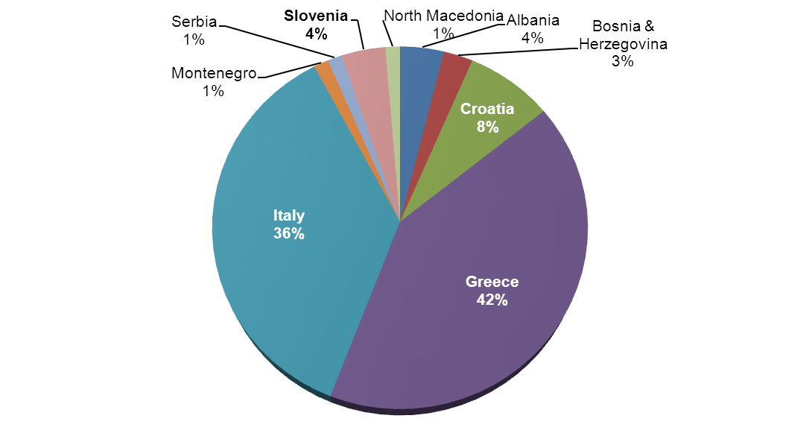
IDEAL EUSAIR STUDY SURVEY (Preliminary Findings)
RESPONSES PER COUNTRY
The responses per country are mainly from EU Member States (90%) and especially Greece & Italy (78%)

Slide 7
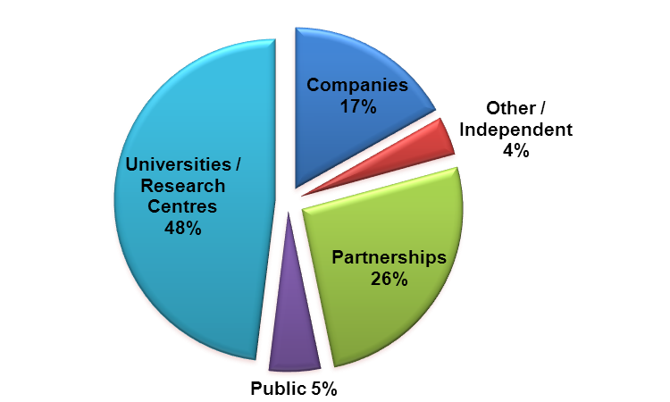
IDEAL EUSAIR STUDY SURVEY (Preliminary Findings)
RESPONSES PER ORGANISATION TYPE
Categorisation per organisation is rather difficult to be accurate. A provisional categorisation is shown below:

Slide 8
IDEAL EUSAIR STUDY SURVEY (Preliminary Findings)
TOPIC 1 – Blue Technologies
out of 19 responses
Most important priorities
Easier access to finance and promotion of the creation of start-ups (78,9%)
Increased networking between researchers, SMEs and clusters (63,2%)
Stronger RDI and cooperation among SMEs and between SMEs, large enterprises and research centres operating in the Adriatic-Ionian Macroregion (57,9%)

Slide 9
IDEAL EUSAIR STUDY SURVEY (Preliminary Findings)
Most observed Strength / Weakness / Opport./ Threat
Blue Bio-technologies (TOPIC 1 – Blue Technologies/out of 19 responses)
STRENGTH: Interest on the sector, Good level of expertise & human skills, Research infrastructures, Existing networks, Diverse marine wild life
WEAKNESS: Lack/insufficient support in terms of national & regional funding & marketing operations, Lack of clear legislation/policies/ national strategies, Fragmented R&D activities, High costs
OPPORTUNITY: New boost for investments, Employment opportunities & development of new skills, Innovative applications, Upgrade of infrastructures, Links with other strong sectors such as pharmaceutical & agri-food
THREAT: Economic environment, Bureaucracy, Lack of funding, Unclear legal framework, Lack/Insufficient interest

Slide 10
IDEAL EUSAIR STUDY SURVEY (Preliminary Findings)
Most observed Strength / Weakness / Opport./ Threat
Marine technologies (TOPIC 1 – Blue Technologies out of 19 responses)
STRENGTH: Extensive experience, Highly-specialized scientists, Strong R&I capacity, Expansion of the sector, Extended coastline
WEAKNESS: Lack/insufficient support in terms of funding & marketing operations, Environmental policy, institutional & regulatory gaps, Weak R&D in small companies, Weak exploitation of marine resources
OPPORTUNITY: New jobs in manufacturing, construction & operation, phase, Ιnnovative applications, Digitalization, Continuous training in techniques & skills
THREAT: Economic environment, External factors (COVID19), Bureaucracy, Inadequate legislation, Lack/Insufficient infrastructures,
Sea-use conflicts

Slide 11
IDEAL EUSAIR STUDY SURVEY (Preliminary Findings)
TOPIC 2 – Fisheries & Aquaculture
out of 38 responses
Most important priorities (Fisheries)
Better management and sustainable exploitation of fish stock (65,8%)
Compliance & implementation of measures to combat illegal, unreported, unregulated fisheries and elimination of destructive fishing practices (65,8%)
Most important priorities (Aquaculture)
Creation of new jobs (60,5%)
Improve the environmental footprint of aquaculture (55,3%)

Slide 12
IDEAL EUSAIR STUDY SURVEY (Preliminary Findings)
TOPIC 2 – Fisheries & Aquaculture
out of 38 responses
Most observed Strength / Weakness / Opport./ Threat
STRENGTH: • Large variety of fisheries products
• Abundant water resources
WEAKNESS: • Lack of fishing infrastructure,
• Age of fleet, Old, inadequately trained fishermen
• Seasonality of the tourist offer
OPPORTUNITY: • High quality fishery & aquaculture products
• Cooperation with scientific/research institutions
THREAT: • Marine pollution & climate and biological changes in the sea (Invasive Alien Species)
• Conflict over space and resources

Slide 13
IDEAL EUSAIR STUDY SURVEY (Preliminary Findings)
TOPIC 3 – Maritime and Marine governance & services
out of 20 responses
Most important priorities
Enable the sustainable blue growth development of coastal and island communities (75,0%)
Improve governance of maritime space and creation of appropriate tools and services to improve the management capacity of competent authorities (65,0%)
Strengthening networks establishment of academics, training organisations and professional organisations of maritime sectors in the macro-region (65,0%)

Slide 14
IDEAL EUSAIR STUDY SURVEY (Preliminary Findings)
TOPIC 3 – Maritime and Marine governance & services
out of 20 responses
Most observed Strength / Weakness / Opport./ Threat
STRENGTH: Maritime Tradition, Scientific competences, EU framework
WEAKNESS: Lack of a comprehensive consultation mechanism in local and regional level, administrative fragmentation, delays in planning and implementation
OPPORTUNITY: Upgrade of infrastructure, digitalization, brain gain through integrated governance, new services
THREAT: economic environment, external factors (COVID19),unplanned development, bureaucracy, absence of expertise in central and local level

Slide 15
IDEAL EUSAIR STUDY SURVEY (Preliminary Findings)
PROJECT IDEAS
Projects or categories of ideas proposed by the responders
Topic 1
Low Emission Energy Supply & Production-Sustainability-Blue Bio-technologies
Production of electricity from RES in shipyards
Green Hydrogen infrastructures in ports, inland terminals, etc.
Development of hybrid installations for marine & offshore wind energy combined with aquaculture, fish-farming, etc.
Development of new technologies able to produce alternative fuel
Use of marine biotechnology to develop concrete prototypes & processes in the societally relevant fields: health and wellbeing, food & feed, environment.
Use of aquaculture wastewater for phytoplankton culture
Digitalization & Innovation
Using AI and Big Data in Maritime technologies
Digitalization of naval industrial
Knowledge Transfer
Mapping competences & innovative skills
Implementation of a Blue Innovation Voucher mechanism
Alternative Financing for Blue Technologies
Crowdfunding for Enterprises in Blue technologies

Slide 16
IDEAL EUSAIR STUDY SURVEY (Preliminary Findings)
PROJECT IDEAS
Projects or categories of ideas proposed by the responders
Topic 2
Studies on marine pollution and ghost nets (Albania)
Fishery activity diversification, fish-tourism, fish processing, smoking, filleting, labelling (Albania)
Green technology applied to fishery and aquaculture (Italy)
Key role of the organisation of fishermen/farmers as cooperatives (Italy)
Rapid detection and prevention of disease outbreaks in fish farms (Greece) (Resolve ichthyopathology and treatment issues related to farming)
Central database of genetic & biological data on fish stocks and regular genetic monitoring of all certified fish farms (Bosnia & Herzegovina)

Slide 17
IDEAL EUSAIR STUDY SURVEY (Preliminary Findings)
PROJECT IDEAS
Projects or categories of ideas proposed by the responders
Topic 3
Lab for insular blue innovation
-A common system for implementing circular economy in blue growth sectors
-Common guidelines and tools for climate adaptation and greening of blue growth sectors
-Share data system at sea basin level, including remote sensing data
-Adoption of technologies for marine liter adoption- 3D modelling tools
-Maritime surveillance/monitoring based on drones and satellite-engagment of general public through mobile applications
-Cultivating blue skills through innovative educational and training tools
- Promoting blue entrepreneurship through hard skills curricula, research simulations, incubating and coaching
-Building identities based on Heritage, local traditions and social innovation
-Generating new knowledge on blue economy sectors through research for collecting and monitoring critical data for climate change and cyclical economy by involving local communities through citizens' science techniques and the market players through platforms

Slide 18
Thank you very much
for your attention!

