Slide 1
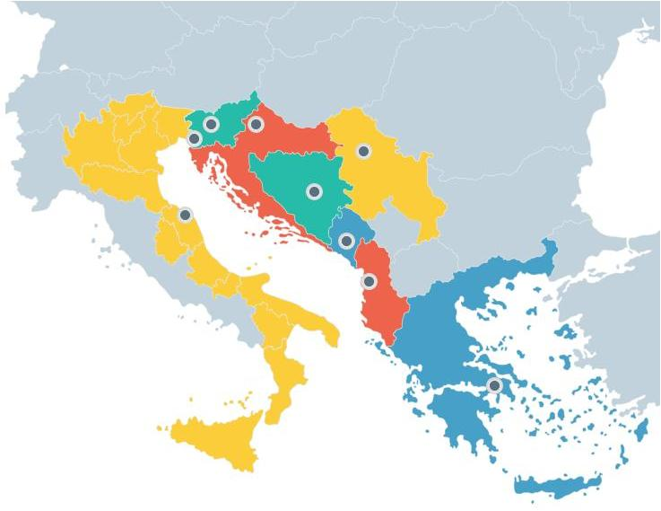
WP3: MONITORING AND EVALUATION OF EUSAIR
12th meeting
of the EUSAIR TSG for Pillar 1 - Blue Growth
7/12/2020

Slide 2
THREE (3) MAIN ACTIVITIES
Activity 1:
Building the Knowledge Base (KB) relevant to Pillar 1 (Blue Growth)
Activity 2:
Establishing the EUSAIR Monitoring and Evaluation Framework
Activity 3:
Capacity building for public authorities / administrations

Slide 3
Activity 1: Building the knowledge base relevant to Pillar 1 (Blue Growth)
State of play
Task completed. The Pillar 1 KB comprises three parts:
Relevant studies (83)
Databases (11) + ESPON European and Macro-Regional Territorial Monitoring tool
Statistics
Group A: DataSet A1: Fisheries and Aquaculture, DataSet A2: Science and Technology)
Group B: Socio-economic and other statistics
An executive summary of Pillar 1 KB has been delivered to the TSG1 members in September 2020
Inventory of existing resources at Pillar level
Pillar 1-related study
Task in progress (to be delivered by end of February, 2021)
Identification study of important information gaps, needs and opportunities to facilitate and foster the design and implementation of EUSAIR flagship actions and projects in the Adriatic - Ionian macro-region (Acronym: Ideal EUSAIR)

Slide 4
Activity 2: Establishing the EUSAIR Monitoring and Evaluation Framework (1)
State of play
Identification of actors involved in monitoring and evaluation activities / Set up of the EUSAIR Monitoring & Evaluation System→ Task completed
Monitoring and evaluation framework
Pillar 1 SWOT analysis → Task completed
Defining Pillar 1 monitoring indicators (context indicators, output and result indicators, impact indicators) → Task completed
Annual Pillar/TSG Monitoring Reports
1st Pillar 1 Annual Monitoring Report 2019 → Task completed
2nd Pillar 1 Annual Monitoring Report 2020 → Task in progress (revised version was delivered in November 2020; approval is pending)

Slide 5
Activity 2: Establishing the EUSAIR Monitoring and Evaluation Framework (2)
State of play
Annual Synthetic EUSAIR / Action Plan Monitoring Reports
1st EUSAIR Annual Synthetic Monitoring Report 2019 → Task completed
2nd EUSAIR Annual Synthetic Monitoring Report 2020 → Task in progress (to be delivered in December 2020)

Slide 6
Activity 3: Capacity building for public authorities / administrations
State of play
Organisation of 2 macro-regional and 8 national capacity building events
1st macro-regional event (November 7th, 2019, Athens, Greece) → Task completed
2nd macro-regional event & national capacity building events → (2021, to be defined)

Slide 7
Thank you very much
for your attention!

