Slide 1


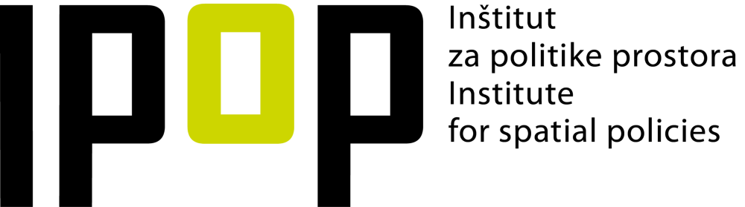




ESPON TEVI 2050
Territorial scenarios for the Danube and the Adriatic Ionian macro-regions 2050

Slide 2
The ESPON TEVI 2050 project

Slide 3
Aim and outcomes of the project
The ESPON project Territorial Scenarios for the Danube and the Adriatic Ionian macro-regions 2050 (TEVI 2050) belongs to the Specific Objective 2 of the ESPON Programme and aims to ‘develop territorial scenarios for the European Union Strategy for the Danube Region and European Union Strategy for the Adriatic Ionian Region. The project has:
  Identified the main processes, factors, obstacles and drivers that will shape the territorial development and spatial integration of the Danube Region and the Adriatic and Ionian Region in 2050.
  Identified synergies and conflicts between the above-mentioned factors, obstacles and drivers (in particular, from the perspective of the key policy processes).
  Formulated baseline territorial development scenarios for the Danube Region and for the Adriatic and Ionian Region for 2050.
  Produced alternative territorial development scenarios for the Danube Region and for the Adriatic and Ionian Region through a participatory dialogue with the steering committee and other stakeholders.
  Developed of policy recommendations on possible policy pathways for the two macro-regional strategies.

Slide 4
Aim and outcomes of the project
The project has built along the territorial foresight method, which is characterised by (a) critical, lateral thinking concerning long-term developments and their impacts on territorial development; (b) wider participatory engagement that entail the use of qualitative and quantitative information and (c) informing public and / or private decision making.
The project has built along a thorough desk research, as well as a thorough co-creation and paritcipatory approach organised through a detailed paritcipatory plan. This involved the development of the EUSDR and EUSAIR steering committees for the ESPON TEVI 2050 project, which participated in several workshops throughout the project and guided the foresight process.
The Terms of Reference had identified key topics for each macro-region as starting point. Key topics for the EUSDR are digitalisation, migration and demographic change and climate change and sustainable development. Key topics for the EUSAIR are blue economy and innovation, mobility and connectivity and green deal and sustainable development.

Slide 5
The Danube and Adriatic regions: from today…
2

Slide 6
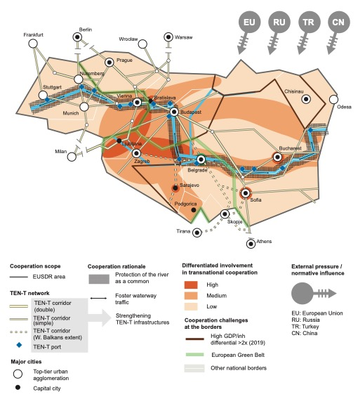
The Danube Region today
The Danube region is a large and very diverse territory, home to several capital and top-tier urban agglomerations with the Danube River being the common denominator for cooperation.
Cooperation appears to be higher in the mid-west part of the region, around Slovenia, Croatia, Austria and Hungary. Developments from the outside, such as from the EU, Russia, Turkey and China play a role in the region’s development.
Navigation, improved accessibility and multi-modal transport with ports along the Danube play an important role in freight transport and in fostering waterway transport.
TEN-T networks and connections exist in the area, there is still progress to be made in finalising the network connections in the Western Balkans part.

Slide 7
The Danube Region today
Digitalisation in the Region remains challenging. enterprises are characterised by a lack in innovation in the region and slow in taking up changes related to industry 4.0 and innovation. The lack of skilled human capital contributes to this challenge.
Migration and demographic change – urban-rural and East-West divides. migration from lagging behind rural areas to more developed urban areas, both within countries, as well as from the East to the West of the region.
The Danube Region has a rich natural habitat and biodiversity with existing European Green Belts, climate change remains one of the key challenges in the region, affecting its’ flora and fauna.

Slide 8
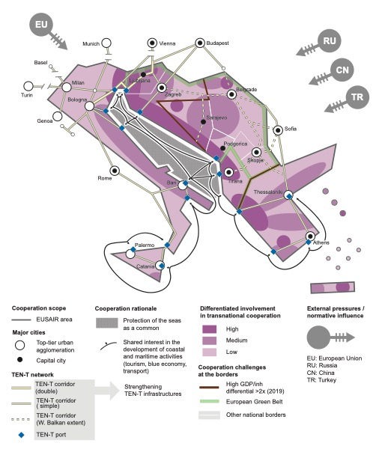
The Adriatic Ionian Region today
The Adriatic and Ionian region is a large transnational area with several capital and top-tier urban agglomerations and a unique natural and cultural characteristics. The common denominator for cooperation of the region is the Adriatic Ionian Sea and its protection as a common, bringing its own challenges and potential.
Cooperation in the Adriatic Ionian macro-region, there is high cooperation mainly between EU member states, with the highest cooperation observed in the centre north to south of the region.
At the same time, land connections regarding road and rail networks face challenges particularly in the Western Balkans networks, with freight and passenger traffic volumes by rail decreasing.

Slide 9
The Adriatic Ionian Region today
Blue economy and aquaculture are sectors offering opportunities for the Adriatic Ionian macro-region. A challenge is the outdated technologies that hamper marine technologies from thriving.
Mobility and connectivity brings land and sea coming together. Maritime transport and port infrastructure are pivotal, in both local traffic and in tourism, as the latter heavily depend on ports, cruise ships, yachting, as well as seaplanes transport networks.
Green deal and sustainable development. The Adriatic Ionian macro-region has a very rich biodiversity, with numerous areas being protected under the Natura 2000 framework, vulnerable to natural hazards, such as earthquakes, floods, wildfires, storms, droughts etc.

Slide 10
The Danube and Adriatic regions: … to tomorrow
3

Slide 11
The Danube and Adriatic Ionian regions: …to tomorrow
Different political, economic, environmental, social and technological trends, factors and developments influence the Danubeand the Adriatic Ionian macro-regions to a different extend.
Examples are climate change, land and marine biodiversity loss, clean energies and pollution, the shift towards net-zero societies, loss in bioeconomy, sustainable mobility, increasing circular economy, increasing sustainable tourism and increase of local economy, ageing, and domestic and intra-European migration, as well as brain drain and increasing attention to quality of life and well-being, digitalisation, robotisation, biotechnology, platform economy point to the direction of making digital transitions, increasing EU integration, collaborative governance approaches and increasing influence of global powers.

Slide 12
The Danube and Adriatic Ionian regions: …to tomorrow

Slide 13
The most probable future for the Danube and Adriatic Ionian Regions by 2050
4

Slide 14
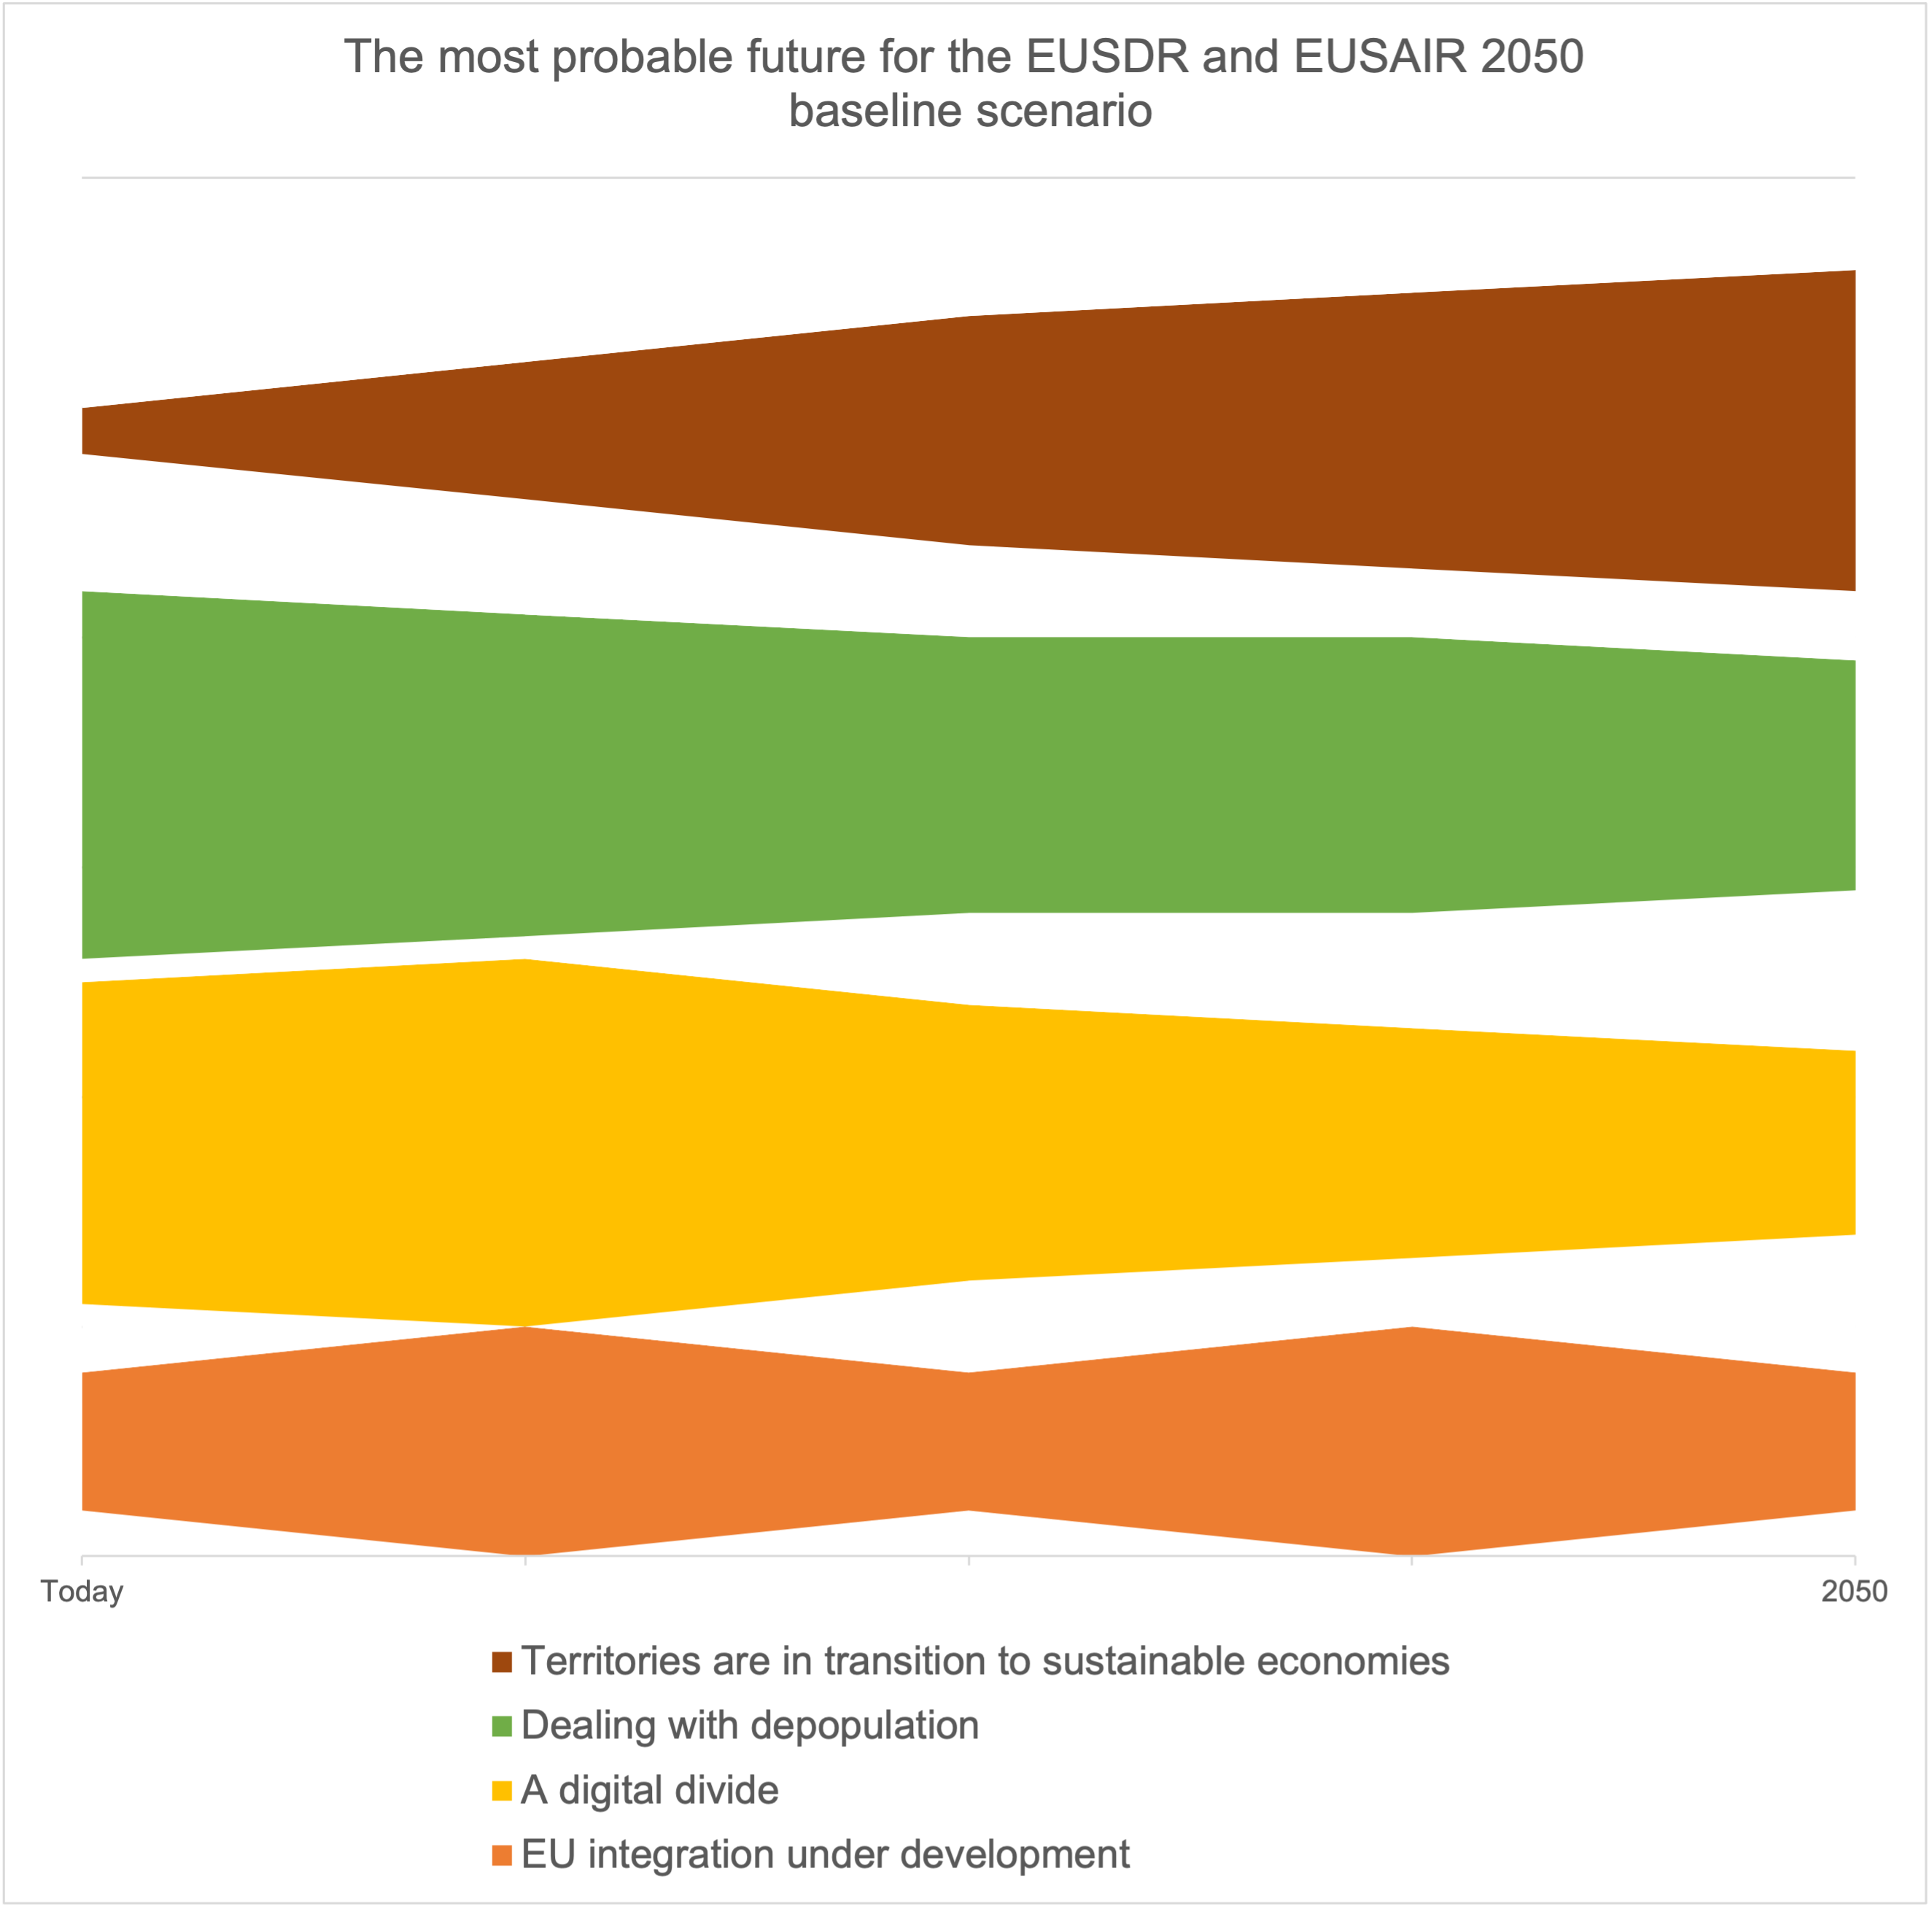
The baseline scenario
Following the trend collection and selection through the participatory approach, the baseline scenario is based on the following four assumptions:
Territories are in transition to sustainable economies. The trend analysis shows close relation between economic and environmental trends. Many economic trends are driving or hampering factors for environmental trends and vice-versa.
Dealing with depopulation. Societal trends highlight continuation of existing ageing and migration tendencies in the Danube and Adriatic Ionian macro-regions. Ageing is mainly driven by natural forces and economic prosperity as well as by brain drain.
Notes:
Summing up the key findings presented in Chapter 3 depict the following assumptions for a baseline scenario for 2050:
Territories are in transition to sustainable economies. The trend analysis shows close relation between economic and environmental trends. Many economic trends are driving or hampering factors for environmental trends and vice-versa. Objectives for the European Green Deal have a similar interlinkage between environmental and economic aspects. The trend analysis shows however challenges to achieve the objectives of the European Green Deal. Ongoing pollution challenges for example achieving fresh air, clean water, healthy soil and biodiversity. Also, the reliance on fossil fuel and importance of this industry for employment hampers cutting CO₂ emissions. At the same time, the bioeconomy demands high quality of resources and net-zero societies need 100% renewable energy production. By 2050, Danube and Adriatic Ionian regions are thus in transition to sustainable economies.
Dealing with depopulation. Societal trends highlight continuation of existing ageing and migration tendencies in the Danube and Adriatic Ionian macro-regions. Ageing is mainly driven by natural forces and economic prosperity as well as by brain drain. Migration is driven by economic opportunities elsewhere, predominantly in capital cities or beyond the two macro-regions. Economic trends, such as local economy or bioeconomy, as well as technological trends, such as digitalisation, provide opportunities for rural places to deal with depopulation. However, these trends remain emerging by 2050 and are thus unable to reach their full potential to deal with the negative effects of migration and ageing. As a result, societal trends accelerate depopulation by 2050.
A digital divide. The trend analysis highlights the uncertainty of technological trends and their possible regional applicability in societies until 2050. Technological breakthroughs advance the transitions to sustainable economies, making production and consumption more resource efficient (section 3.2). As such more investments in required skills and infrastructure are likely. In these places, technological advancements are part of a positive feedback loop. At the same time, a lack of infrastructure, skilled labour, and cautious attitudes to digital solutions and robotisation slows down the adoption of technological breakthroughs in societies. This applies particularly to depopulated areas (section 3.3). As a result, the macro-regions are characterised by a digital divide by 2050. In which few places reap benefits of technological breakthroughs due to an adequate infrastructure and well a trained labour force.
EU integration under development. Economic advancement as well as increasing interconnectedness and territorial cooperation facilitate European integration in the Danube and Adriatic Ionian macro-regions. This implies the accession of countries to the European Free Trade area, EU, the Schengen Area and Eurozone. The level of integration is however very different per country due to a set of volatile hampering factors to EU integration. For example, building institutional capacities and diffusing of powers to lower administrative levels or to non-state actors is a bumpy road. Such aspects require long-term approaches but are often interrupted by political, economic and societal changes. As a result, EU integration is under development by 2050.

Slide 15
The baseline scenario
A digital divide. The trend analysis highlights the uncertainty of technological trends and their possible regional applicability in societies until 2050.
EU integration under development. Economic advancement as well as increasing interconnectedness and territorial cooperation facilitate European integration in the Danube and Adriatic Ionian macro-regions.
Notes:
Summing up the key findings presented in Chapter 3 depict the following assumptions for a baseline scenario for 2050:
Territories are in transition to sustainable economies. The trend analysis shows close relation between economic and environmental trends. Many economic trends are driving or hampering factors for environmental trends and vice-versa. Objectives for the European Green Deal have a similar interlinkage between environmental and economic aspects. The trend analysis shows however challenges to achieve the objectives of the European Green Deal. Ongoing pollution challenges for example achieving fresh air, clean water, healthy soil and biodiversity. Also, the reliance on fossil fuel and importance of this industry for employment hampers cutting CO₂ emissions. At the same time, the bioeconomy demands high quality of resources and net-zero societies need 100% renewable energy production. By 2050, Danube and Adriatic Ionian regions are thus in transition to sustainable economies.
Dealing with depopulation. Societal trends highlight continuation of existing ageing and migration tendencies in the Danube and Adriatic Ionian macro-regions. Ageing is mainly driven by natural forces and economic prosperity as well as by brain drain. Migration is driven by economic opportunities elsewhere, predominantly in capital cities or beyond the two macro-regions. Economic trends, such as local economy or bioeconomy, as well as technological trends, such as digitalisation, provide opportunities for rural places to deal with depopulation. However, these trends remain emerging by 2050 and are thus unable to reach their full potential to deal with the negative effects of migration and ageing. As a result, societal trends accelerate depopulation by 2050.
A digital divide. The trend analysis highlights the uncertainty of technological trends and their possible regional applicability in societies until 2050. Technological breakthroughs advance the transitions to sustainable economies, making production and consumption more resource efficient (section 3.2). As such more investments in required skills and infrastructure are likely. In these places, technological advancements are part of a positive feedback loop. At the same time, a lack of infrastructure, skilled labour, and cautious attitudes to digital solutions and robotisation slows down the adoption of technological breakthroughs in societies. This applies particularly to depopulated areas (section 3.3). As a result, the macro-regions are characterised by a digital divide by 2050. In which few places reap benefits of technological breakthroughs due to an adequate infrastructure and well a trained labour force.
EU integration under development. Economic advancement as well as increasing interconnectedness and territorial cooperation facilitate European integration in the Danube and Adriatic Ionian macro-regions. This implies the accession of countries to the European Free Trade area, EU, the Schengen Area and Eurozone. The level of integration is however very different per country due to a set of volatile hampering factors to EU integration. For example, building institutional capacities and diffusing of powers to lower administrative levels or to non-state actors is a bumpy road. Such aspects require long-term approaches but are often interrupted by political, economic and societal changes. As a result, EU integration is under development by 2050.

Slide 16
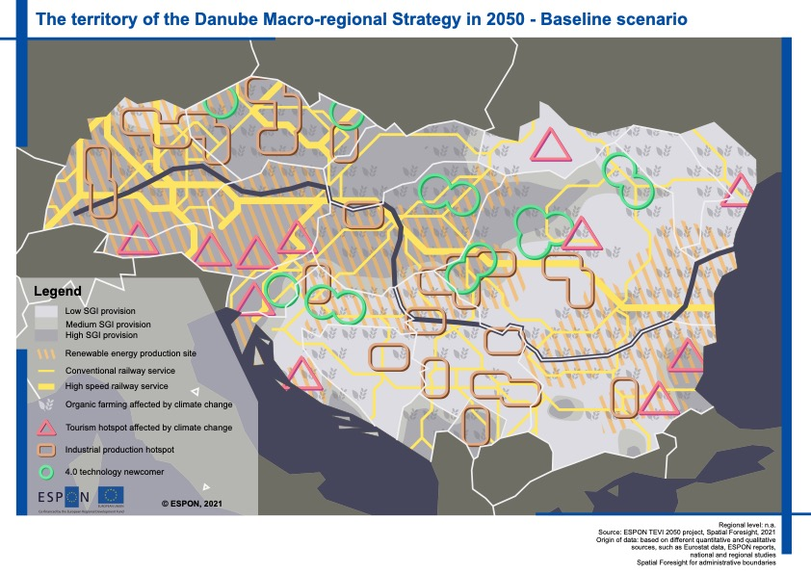
The baseline scenario – EUSDR
The Danube macro-region is polarised by 2050.
Natural areas, tourism areas, agricultural areas and industrial areas are among the places most negatively impacted in the baseline scenario, as they are challenged by biodiversity loss and increasing need for space for clean energy. Population dynamics reinforce these challenges in several territories.
By 2050 climate change and pollution are intensified due to an incomplete transition to sustainable economies and failing to achieve European Green Deal objectives.

Slide 17
The baseline scenario – EUSDR
By 2050, sustainable transport and digitalisation increase the demand for electricity.
Industrial areas, transport hubs and natural areas experience the energy transition most negatively.
By 2050, a shift to sustainable economies requires major investment for industrial processes, among others to reduce greenhouse gas emission and to improve efficient use of resources. Reduced competition levels of industry are most evident in territories with high employment in industry.

Slide 18
The baseline scenario – EUSDR
By 2050, most territories in the Danube macro-region are declining in population. These places lack a critical mass to sustain public services for health care, education, culture and leisure.
Early adopters of 4.0 technologies are most visible as islands innovation and population growth. The 4th industrial revolution leads to fusions of technologies and the lines between physical, digital and biological systems becoming blurred, transforming the labour market significantly.

Slide 19
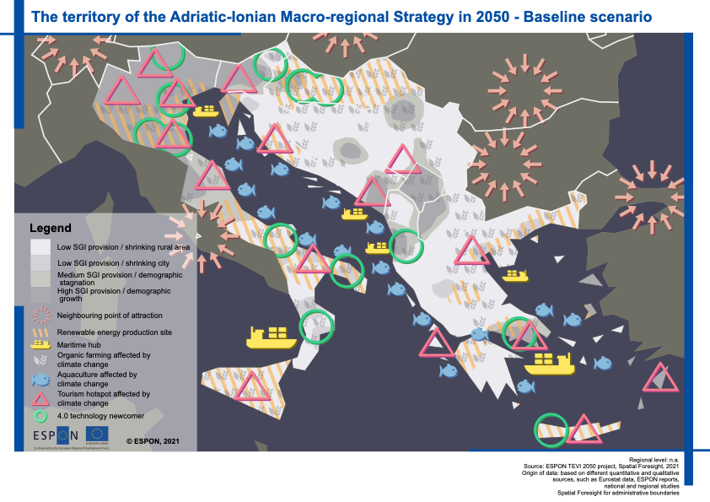
The baseline scenario – EUSAIR
The Adriatic Ionian macro-region is polarised by 2050.
Natural areas, tourism areas, rural areas and transport hubs are among the territories most challenged by in the baseline scenario, as natural land and maritime areas face a loss of biodiversity and suffer from the effects of climate change.
By 2050 climate change and pollution are intensified due to an incomplete transition to sustainable economies and failing to achieve European Green Deal objectives.

Slide 20
The baseline scenario – EUSAIR
By 2050, transportation hubs have changed location in the Adriatic Ionian macro-region. The transition to sustainable economies and stricter rules to encourage sustainable transport makes intra-European transport more costly. Particularly marine shipping is subject to severe changes.
By 2050, the transition to sustainable economies leaves its mark on the tourism sector. Particularly, the thrive for sustainable transport defines the amount of tourism in many places by 2050.

Slide 21
The baseline scenario – EUSAIR
Tourism offers rural communities an opportunity to develop even without mass tourism. Depopulation hinders the utilising this opportunity as well as other economic opportunities of rural places, including agriculture. Most territories in the Adriatic Ionian macro-region are declining in population, posing thus a treat for the tourism industry.
Early adopters of 4.0 technologies are most visible as islands innovation. The 4th industrial revolution leads to fusions of technologies and the lines between physical, digital and biological systems becoming blurred, transforming the labour market significantly.

Slide 22
Alternative territorial scenarios for the Danube and the Adriatic Ionian regions
5

Slide 23
Flourishing in green and social wellbeing – EUSDR and EUSAIR
The first two alternative territorial scenarios for the EUSDR are based on five key core assumptions for both macro-regions. These have different territorial implications on the two macro-regions.
The assumptions change over time, with different high and lows over time. By 2050:
Digital transition supports citizen involvement and open and democratic societies.
EU’s new global role increases integration.
Focus on quality of life increase, ecological and socaul enablers, leaving GDP growth aside.
Green transition achieved through strong regulations.
EU values become stronger and a EU identity is achieved

Slide 24
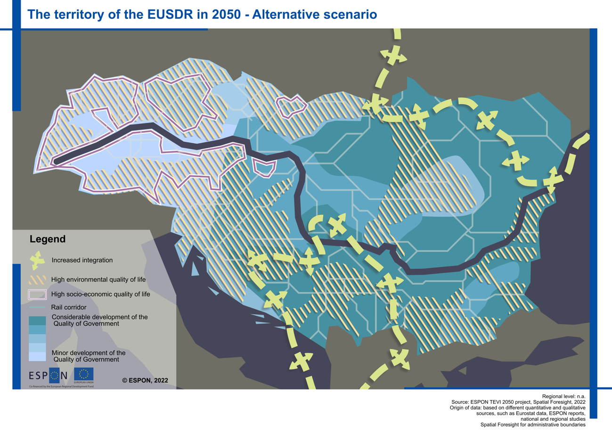
Flourishing in green and social wellbeing – EUSDR & EUSAIR
Highly policy-driven, EUSDR and EUSAIR are in transition to a green and just future.
Green wellbeing is highly linked to places with ecological enablers, as green infrastructure and protected areas. Furthermore, places with protected areas or large natural parks, such as the Danube Delta.
Regions where the quality of governance was low have shown substantial leaps in increasing their trust to governance and hence increasing the governance quality by 2050 and increase quality of life.

Slide 25
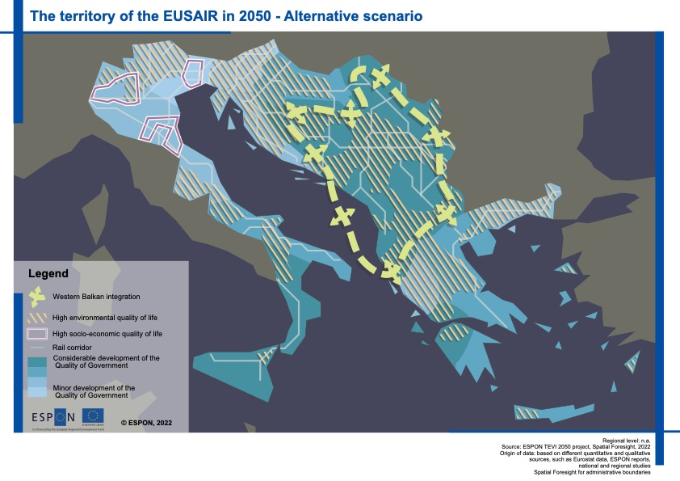
Flourishing in green and social wellbeing – EUSDR & EUSAIR
Regions where the quality of governance was low have shown substantial leaps in increasing their trust to governance and hence increasing the governance quality by 2050.
EU capitalising in strategic economy, makes the EU integration a political priority for non-EU member states in the neighbourhood.
The shift shows a change in the way of travel, as rail gets back on track, developing by 2050 an interconnected and multimodal transport system.

Slide 26
Transforming to a hyper-digital economy – EUSDR
The Danube-specific alternative scenario builds along the extreme implementation of the digital transition.
the Danube region’s prosperity on achieving high economic growth through a shift and a full implementation of hyper-digitalisation.
Industries adjust and walk the industry 5.0 path, applying industrial symbiosis mechanisms.
People’s lives are influenced by virtual reality and the metaverse.
EU integration is highly driven by economy and adjusts to these developments.
The Danube River becomes the key transport element for trade in the region.

Slide 27
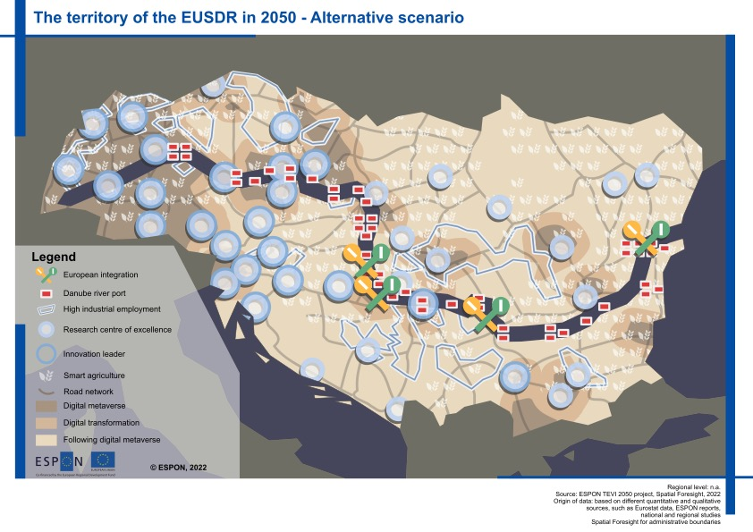
Transforming to a hyper-digital economy
Places in the Danube Region that had strong in innovation profiles already in the 2020s had a faster transition to establishing industry 4.0. Regions that had a strong profile in research were those who were strong players in skilled employees and further research developments to be applied in the innovation leading industries.
Digital metaverse leapfrogs digital connectivity, bridging digital gaps.
Places with high industrial employment are highly affected by the shift towards industrial symbiosis.
Danube river ports increase importance as the river waterways become the key transport way.

Slide 28
Restoring nature for a revived ecosystem – EUSAIR
The Adriatic Ionian-specific alternative scenario builds along the extreme implementation of a green transition.
People decide to give back to nature to protect the region’s natural habitat.
People move to key vibrant urban centres from shrinking and rural areas to urban ones.
Supported by the new geography of work, allowing to work from anywher.
The sea has become the key transport node for trade and also short-term shipping.
EU integration has become a priority in the region, re-branding the EUSAIR.

Slide 29
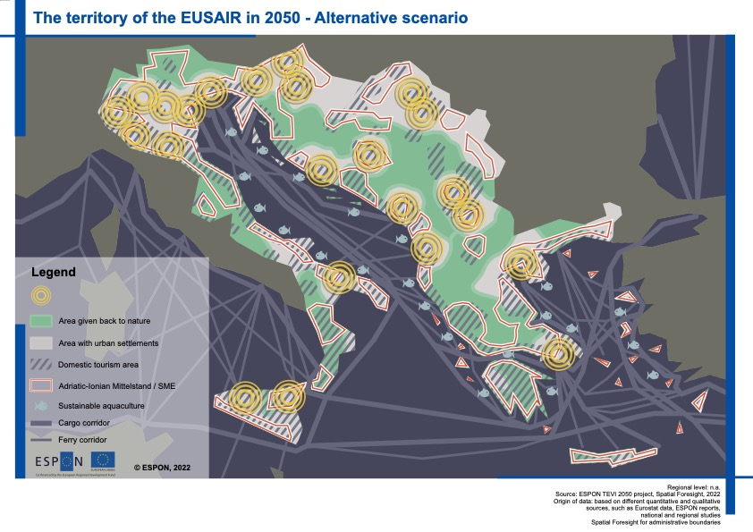
Restoring nature for a revived ecosystem
Large green protected areas by Natura 2000, nature reserves, national parks, habitat/species management areas, protected landscapes and protected areas are of outmost importance.
Giving back to nature resulted in concentration in urban vibrant centres have been places all across the Adriatic Ionian Region, mainly capital and second-tier cities, increasing also SME presence.
Cargo and ferry corridors and links importance increases.
Domestic and sustainable tourism prevails.

Slide 30
Policy recommendations
6

Slide 31
Policy recommendations EUSDR
EUSDR master plan & road map for green mobility
EUSDR transnational body for the reduction of border barriers
EUSDR digitalisation in green transformation of transport
EUSDR concept and pilot actions on valorisation of eco-system services
Boost educational, people-to-people and local level cooperation
Notes:
EUSDR master plan & road map for green mobility
Idea: The pressure of climate change effects, the EU Green Deal and not least the concerns about rising energy prices raised by the war in Ukraine increase the pressure to accelerate the shift to green energy. This does concern not only the transport sector. The shift towards green mobility needs to be realised at macro-regional or European level to not jeopardise the integration of the Danube region due to different technical solutions and standards put forward in different parts of the region.
EUSDR transnational body for the reduction of border barriers
Idea: National borders are still barriers to macro-regional cohesion, development and in particular to a seamless transport of goods and people. This is true to EU internal borders e.g. related to different national regulations. It is especially true to EU external borders which are crossed by the Danube. These barriers are hindering integration and economic development.
EUSDR digitalisation in green transformation of transport
Idea: Over the next decade a digital and a green transition will be unavoidable. In many regards these two major transitions of our economies and societies have the potential to reinforce each other. This is e.g. the case in the shift towards sustainable transport and the attempts to reduce transport flows without reducing people’s mobility or quality of life. Digital transport platforms and mobility services can play a crucial role. This ranges form ride sharing platforms to travel or mapping services showing how to get from one place to another.
EUSDR concept and pilot actions on valorisation of eco-system services
Idea: Ecosystem services are direct and indirect contributions of ecosystems to human well-being. They are essential for e.g. providing fresh air, clean water, ensuring biodiversity, regulating disease and climate, supporting the pollination of crops and soil formation, and providing recreational, cultural and spiritual benefits. Therefore, it is essential to nourish them. At the same time, they often have no immediate price tag, and are not accounted for when it comes to development potentials in terms of GDP or jobs.
Mitigating climate change and ensuring no net loss of ecosystem services and biodiversity might change the focus of thinking on regional development potential incl. the division of labour between places. Places with high biodiversity or generating significant ecosystem services (e.g. clean air or clean water) could develop these into an economic specialisation. Of course, this does not imply lower ambitions with respects to a healthy living environment for citizens in other places. To some degree existing approaches, including the Common Agricultural Policy could adapt from a compensation logic to a regional development logic. This would mean delivering ecosystem services becomes an economic activity generating income for a local and regional economy rather than compensating rural areas and burdening them with the charge to take care of the environment while others do not.
Boost educational, people-to-people and local level cooperation
Idea: Integration and place-based development is not limited to cooperation between regional and national authorities or trade. It involves also the cooperation at local level and between people at interpersonal level. To simulate this and sensitise young people for macro-regional issues, cooperation between schools and other education and training centres is important. Similarly, to the efforts to bring Europe closer the citizens, also the EUSDR should be brought closer to the citizens.

Slide 32
Policy recommendations EUSAIR
EUSAIR Territorial vision for demographic change
EUSAIR spatial action plan for green and blue transition
EUSAIR biodiversity plan
EUSAIR taxation agreement for the digital workforce
EUSAIR masterplan for future-wise tourism
Notes:
EUSAIR Territorial vision for demographic change
Idea: Demographic change is one of the major challenges for social, economic territorial development in the next decades. This includes migration, aging, shrinkage, etc. leading to increasing territorial imbalances and difficulties for some places to access to services of general interest and avoid a vicious circle of economic and demographic decline. These issues are relevant at all geographical and administrative levels, from the local to the European.
EUSAIR spatial action plan for green and blue transition
Idea: The green and blue transition of our economies and societies is essential for Europe to meet the challenges of climate change and loss of biodiversity. As places – their economies & societies – are highly interdependent, a successful transition cannot only rely on the individual strategies of cities, regions or countries, but require some overarching framework as well.
EUSAIR biodiversity plan
Idea: The loss of biodiversity poses a substantial challenge to the future delivery of ecosystem services and the well-being of species. Ensuring ‘no net loss’ of ecosystem services and biodiversity might change the focus of thinking on regional development potentials and land use in the coming decades.
EUSAIR taxation agreement for the digital workforce
Idea: The digitalisation of our economies and societies offers increasing possibilities for people to work remotely. This can take very different formats. In some cases, people stay where they are and work for employers in one or several different locations. In other cases, people move between locations more frequently and work temporarily from another location than their usual offices. Digital nomads are one examples for this. While such solutions are becoming more frequent and popular, they still pose considerable challenges in terms of labour laws, taxation and social security payments.
EUSAIR masterplan for future-wise tourism
Idea: Many tourism initiatives aim at reducing the negative effects of travel, accommodation, catering and activities on the environment. Tourism has to become also more responsible and respectful to the territory and local communities. Decarbonisation of tourism, as far as possible, is an objective of many new strategies and actions. Sustainable tourism goes beyond green and environmentally friendly offers at the destinations. Indeed, it requires rethinking the entire value chains of the tourism sector, linking tourism with local development issues and it has to comprise the full travel experience, from the moment the tourist leaves its home to the moment when it enters it again after the tourism experience. This means it also needs to address places´ dependency on tourism and possible alternative tourism concepts such as long-term tourism.

Slide 33
Cross-cutting recommendations
Cooperation between macro-regional strategies
  Drive future-oriented debates.
  Think macro-regional sector plans & strategies
  Consider transnational bodies and agreements
ESPON
  Build up repositories of national and regional plans & strategies
  Support the development of macro-regional masterplans & sector strategies
  Strengthen continuous macro-regional monitoring
Notes:
Cooperation between macro-regional strategies
Many of the points identified in the scenario work might be of relevance for all macro-regional strategies and thus a topic either for the European Commission or the cooperation and coordination between macro-regional strategies.
Drive future-oriented debates. Managing the challenges and transitions ahead also requires moving societal discourses and finding answers beyond the current framing of local and regional development. Examples for this include:
Move the debate on internalising external costs across sectors to achieve the Green Deal objectives.
Move the debate on quality of life & beyond GDP, including testing of alternatives at the level of macro-regional strategies.
Advance the debate on improved EU data eco-system, including data security, privacy, data governance, blockchain technology, digital hazard resilience etc.
Move the debate on citizen engagement in governance processes and macro-regional cooperation.
Think macro-regional sector plans & strategies. Given the high levels of spatial interdependencies new formats must be developed to develop macro-regional strategies, plans or roadmaps for particular sectors. Examples for this include:
Consider macro-regional transition plans on green, digital and just transitions.
Consider macro-regional biodiversity plans and strategies.
Consider macro-regional plans for carbon-neutral long-distance mobility.
Consider macro-regional strategies on changing settlement patterns in times of demographic decline and aging.
Consider transnational bodies and agreements. In many cases plans and strategies will not be sufficient to move forward. Binding agreements between countries will be needed, and in some cases even transnational bodies of some sort to ensure continuity over time. Examples for this include:
Discuss possibilities for multinational agreements on taxation of digital nomads, workcation and alike.
Discuss possibilities for multinational agreements reducing border obstacles of various kind, between EU member states and especially between EU and non-EU member states.
Discuss possibilities for establishing transnational bodies of some sort for specific tasks related to the monitoring (and reduction) of border obstacles.
These are just a few examples for possible fields of action which go beyond the scope of individual macro-regional strategies.
ESPON
ESPON is highly committed to supporting macro-regional strategies and could possibly consider some fields of action to further support their work with territorial evidence:
Build up repositories of national and regional plans & strategies of spatial characters to facilitate the work on connecting the dots and bringing them together in joint macro-regional plans or strategies. This could e.g. regard green and digital transition strategies, biodiversity strategies or spatial development plans.
Support the development of macro-regional masterplans & sector strategies, which help to better coordinate sector policies with wider territorial implications. This could include thematic studies providing territorial evidence or targeted cross-analysis of sector policies in the countries of a macro-regional strategies, as well as opening up the data available from different projects. Possible topics are green and digital transition, green & blue growth, demographic change, biodiversity, tourism and quality of life.
Strengthen continuous macro-regional monitoring, e.g. related to spatial inequalities, quality of life or cross-border obstacles. This could be an opportunity to establish databases or evidence on the listed aspects for the western Balkans part of both macro-regions.

