Slide 1
Communication Strategy and the Role of EUSAIR Communication Network
Online, 24 February 2026

Slide 2
  Key Elements of the EUSAIR Communication Strategy
  Build the EU Strategy for the Adriatic and Ionian region (EUSAIR) into a recognizable brand among citizens and institutions across the Adriatic-Ionian region.​
  Plan and execute communication activities within the constraints of available resources (people, money, time).​
  ​
  Our VISION drives our messages: We want to be the key reference for joint multi-level solutions addressing common challenges toward a stronger Adriatic and Ionian region.

Slide 3
  Basic Mechanisms for Implementing the Communication Strategy
  Actively manage owned media channels:
    EUSAIR website (ESP integrated),
    social networks (Linkedin, Facebook, Instagram),
    email newsletters,
    events and meetings organised under the strategy.
  Establish and maintain strong, consistent relationships with journalists.
  Prioritise high-quality content and visual materials that encourage sharing and engagement.
  Although we target multiple groups through communication channels that also reach the general public, we should use language that is clear and understandable to everyone.

Slide 4
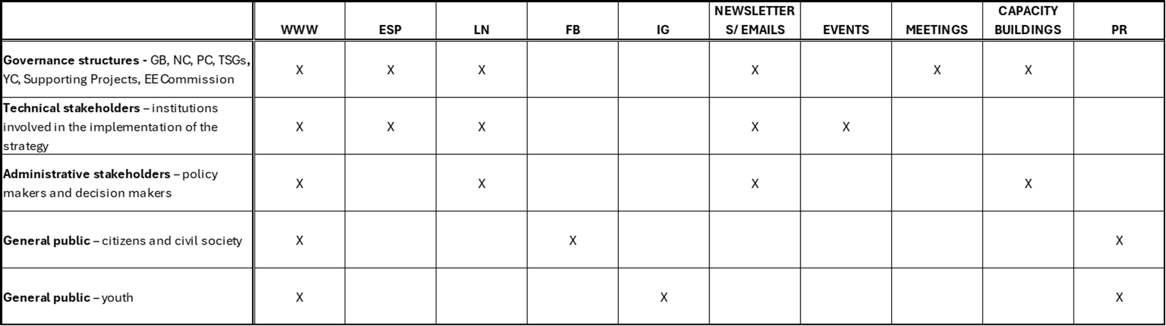
  Key Target Groups and Communication Channels

Slide 5
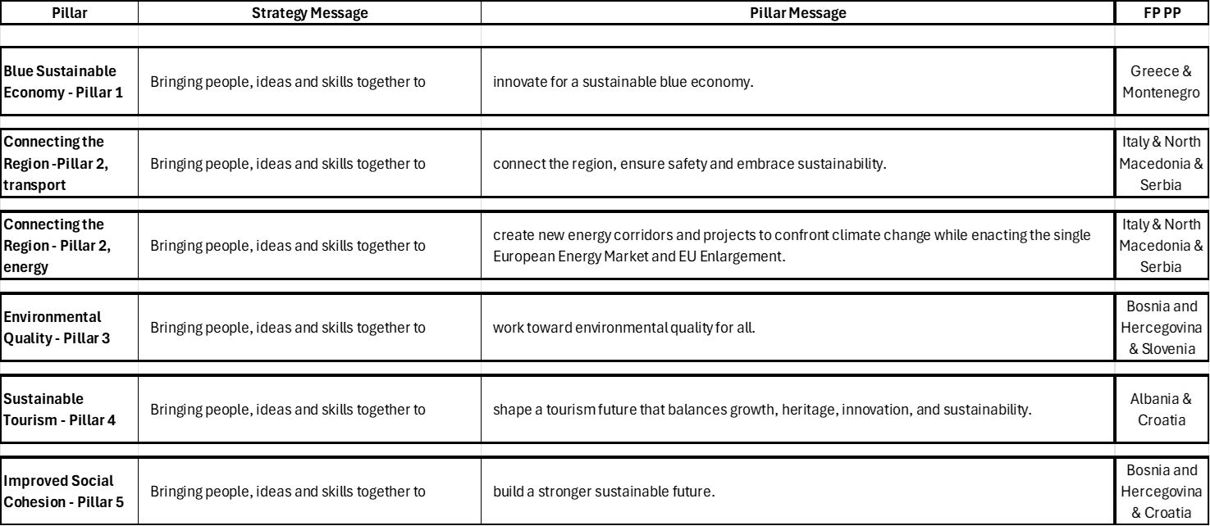
  Key Messages per Pillar

Slide 6
  Implementing the EUSAIR Communication Strategy is Our Shared Responsibility
  Managed by the FP LP Communication Manager.
  With the active participation of the EUSAIR Communication Network members from:
    all FP PP: country and Pillar dedicated,
    supporting projects (FP, StEP and SP4EUSAIR),
    YC.

Slide 7
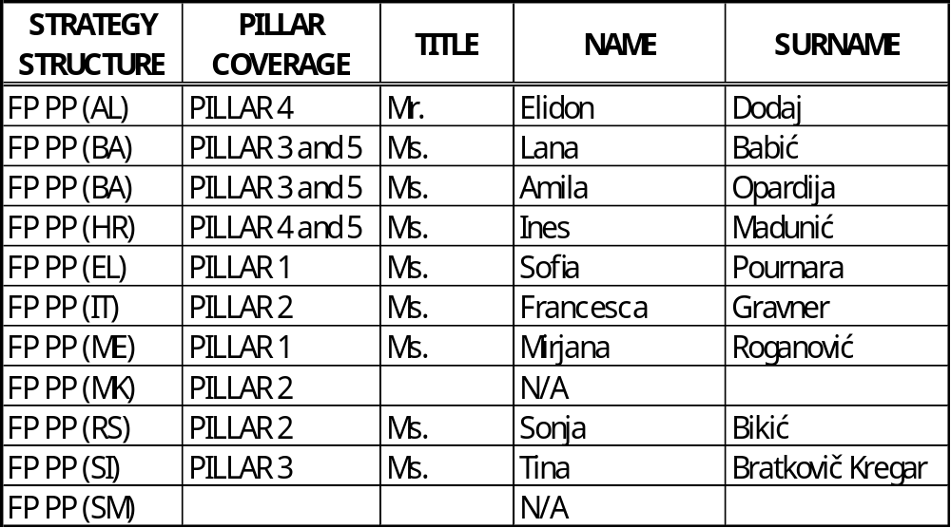
  Members of the EUSAIR Communication Network Covering a Specific Pillar

Slide 8
  Support Needed and Expected from the Pillar Coordinators and Pillar Thematic Experts
  Providing timely information to the dedicated Communicator Network member regarding:
    events and meetings,
    activities,
    achievements,
    any other Pillar-related content that needs or is considered important for communication,
    any other Pillar-relevant content, even if not directly conected to EUSAIR.

Slide 9
  Responsibilities of the Pillar Dedicated Communication Network Members
  Oversees and coordinates all Pillar-related communication activities.
  Plays an active role in preparing the Annual Communication Plan, including:
    what will be communicated, and
    where it needs to be communicated.
  Prepares/writes news items to be published (at least 1/month).

Slide 10
EUSAIR Website Renewal –
Planned Structure of Pillar Presentation
Online, 3 February 2026

Slide 11
Guidelines for Website Renewal
The website supports the EU strategy for the Adriatic and Ionian region.
Target audience:
  Navigation adaptation: All stakeholders involved in the strategy.
  Language adaptation: General public for basic descriptions and key informations.
Upgrade objectives:
  Improved informative value.
    Clear and logical menu structure.
    Clear and well-structured presentation of information

Slide 12
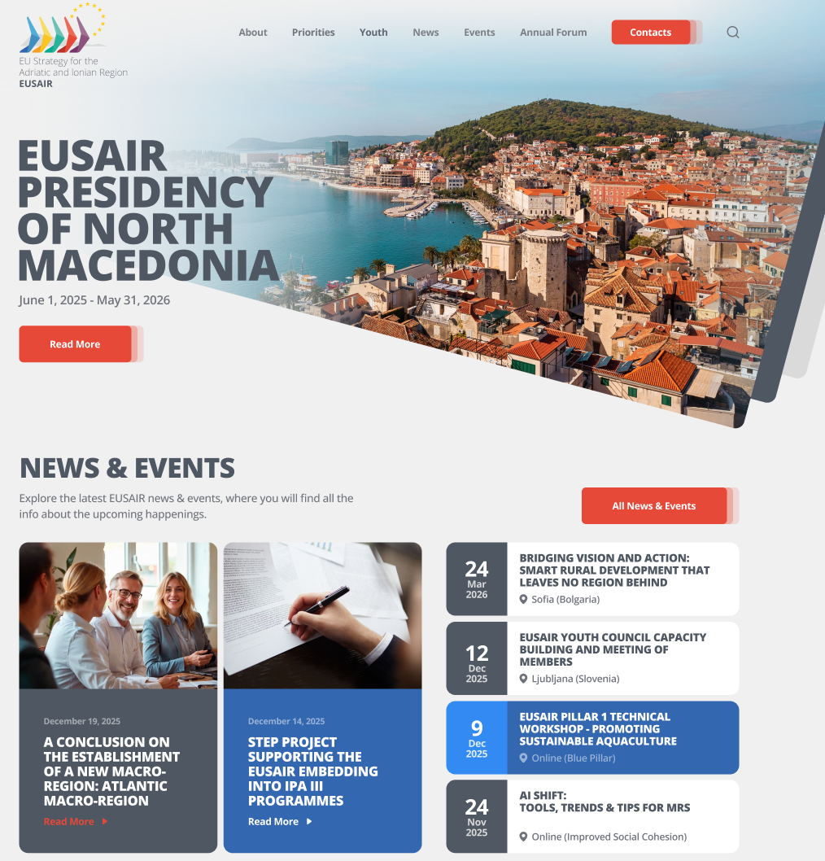
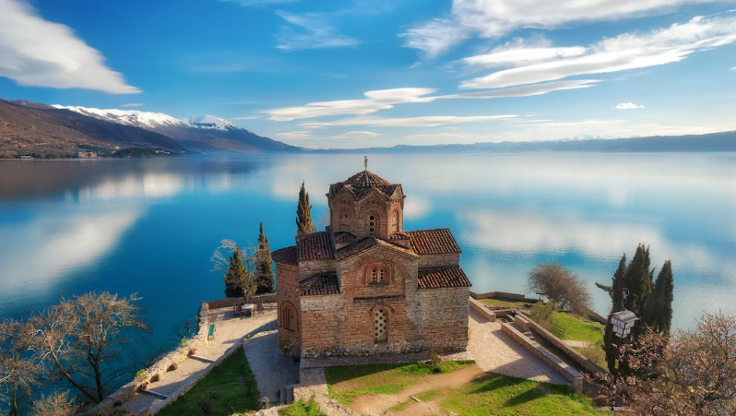
Design of the upgraded EUSAIR website

Slide 13
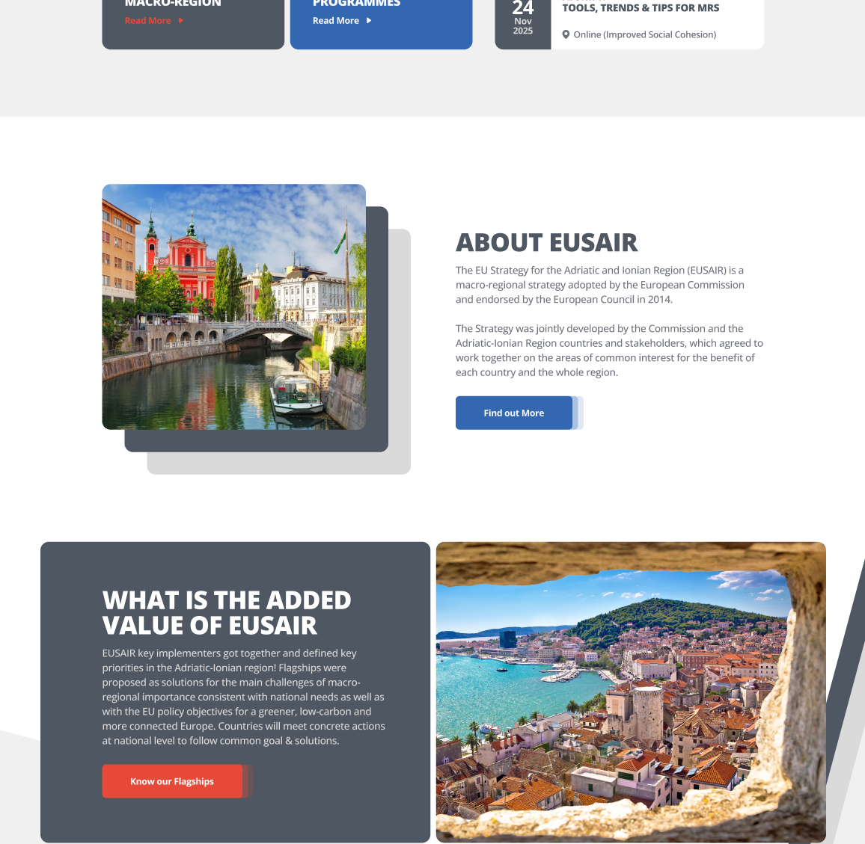
Design of the upgraded EUSAIR website

Slide 14
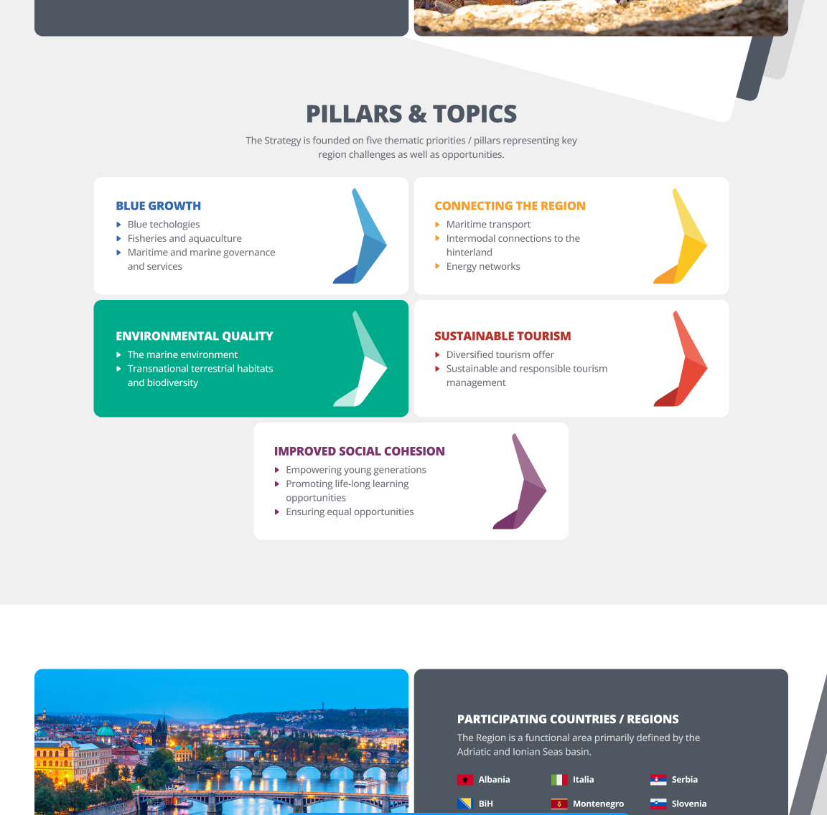
Design of the upgraded EUSAIR website

Slide 15
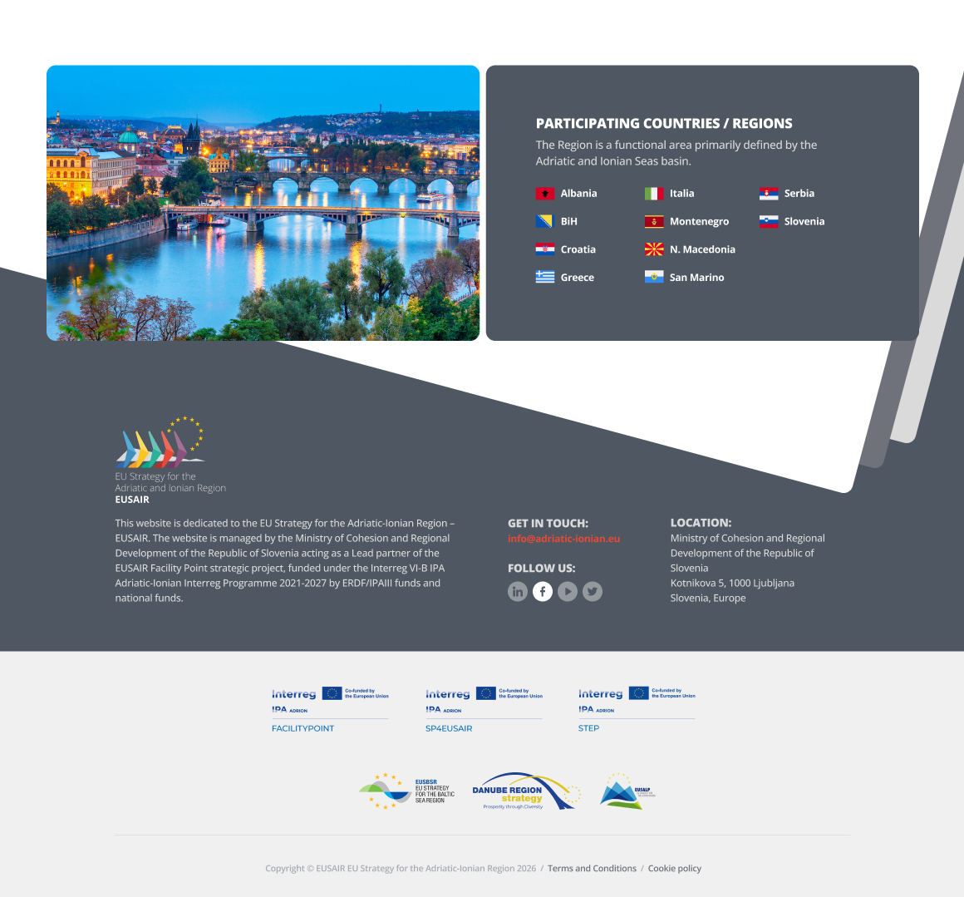
Design of the upgraded EUSAIR website
North Macedonia

Slide 16
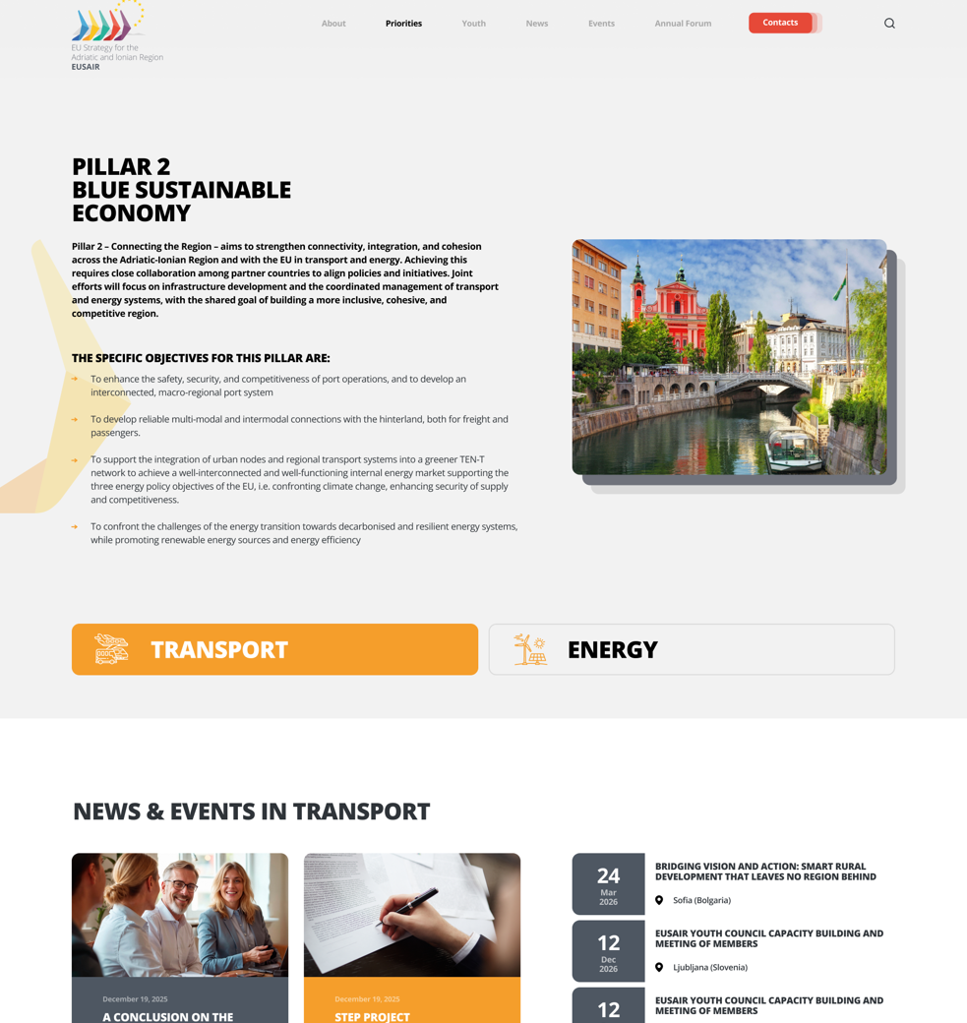
Design of the Pillar presentation on the upgraded EUSAIR website
North Macedonia

Slide 17
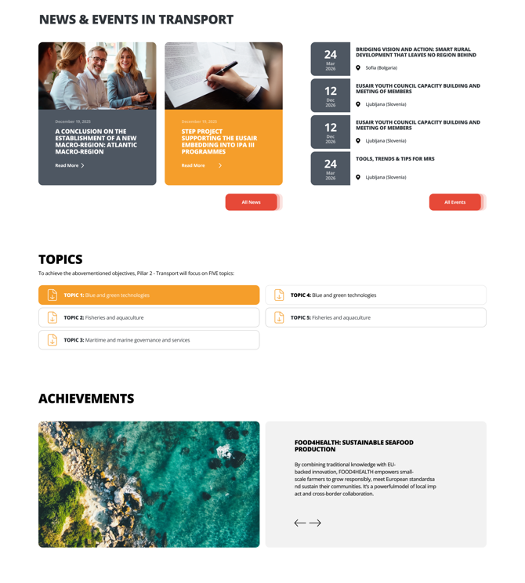
Design of the Pillar presentation on the upgraded EUSAIR website

Slide 18
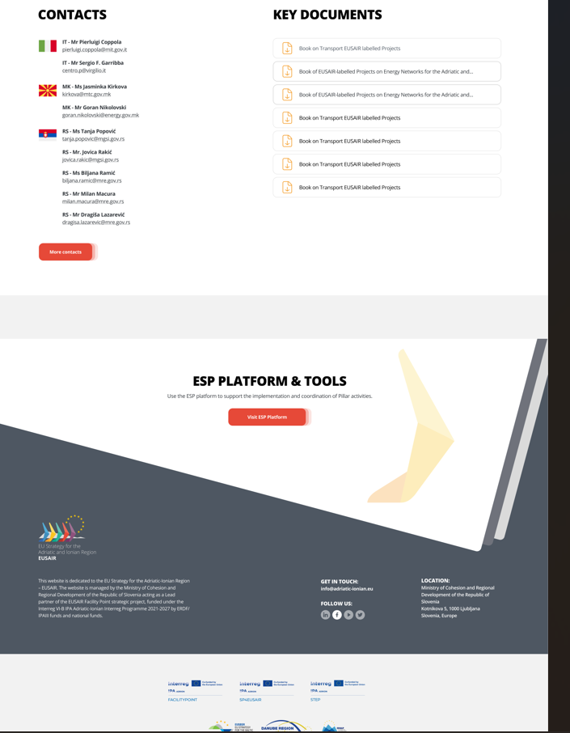
Design of the Pillar presentation on the upgraded EUSAIR website

Slide 19
Design of the Pillar presentation on the upgraded EUSAIR website

Slide 20
eusair.point.mkrr@gov.si

