Slide 1


A TSG 3 FRAMEWORK PROJECT:
TO PROMOTE A SUSTAINABLE GROWTH IN THE AI REGION BY IMPLEMENTING ICZM AND MSP
ALSO TO CONTRIBUTE TO CRF ON ICZM OF BARCELONA CONVENTION
(ICZM&MSP)
TSG-3 Meeting 4-5 March 2020 – Belgrade SR

Slide 2
CONTENTS
A modular approach for ICZM/MSP project development in the AIR
The framework project on ICZM and MSP
Main features
Objectives and expected results
Target groups
Activities
Durability
Preliminary budget breakdown

Slide 3
ICZM AND MSP PROJECT DEVELOPMENT IN THE AIR
A MODULAR APPROACH can be envisaged for the development of projects on trans-boundary and cross-border ICZM and MSP in the AIR:
A FRAMEWORK PROJECT + 3/4 CROSS-BORDER PROJECTS
1. THE FRAMEWORK PROJECT
To identify/refine common approaches and tools, capitalizing on previous initiatives
To implement dialogue and actions at the macro-regional and sub-regional level
To contribute to knowledge transfer across the macro-region
To develop pilot cases where to test approaches and tools.
2. THE CROSS-BORDER PROJECTS
To provide in-depth analysis on ICZM and MSP needs and opportunities for specific areas
To focus on specific coastal and maritime sectors and related transboundary or cross-border issues
To activate focused and long lasting dialogue with stakeholders in the area
To implement specific actions in areas of interest.

Slide 4
MAIN FEATURES OF THE FRAMEWORK PROJECT
Project duration: 30 months
Project budget: 3M€ + 7M€ expected budget for cross-border projects for a total expected budget on ICZM and MSP actions of 10M€
Number of project partners: 12-14 with participation from all 9 member countries of EUSAIR
Typology of partners: national institutions with responsibility on ICZM and MSP, research institutions, regional/sub-regional entities with competence on ICZM and MSP

Slide 5



OBJECTIVES AND EXPECTED RESULTS
1. Identification and operationalization of common tools and data bases
1. Ready-to-use tools to support ecosystem vulnerability and ecosystem impact assessment
2. Transfer of knowledge and practices across the region
2. ICZM/MSP Knowledge Brokerage Service (KBS)
3. Implementation of practical means of cooperation
3. Cooperation actions:
  - Macroregional level: common strategy on ICZM and MSP.
  - Sub-regional level: shared visions and vocational analysis.
  - 4 Pilot cases : joint measures for environmentally sustainable management of coastal/maritime activities.

Slide 6
TARGET GROUPS
Public authorities with responsibilities under ICZM and MSP: national and sub-national/local authorities, including not only the authorities responsible for the planning process, but also all the authorities concretely involved in the planning process.
Representatives of maritime economic sectors at national or sub-national scale: engagement of the sectors is particularly envisaged in the framework of implementation actions at pilot areas level where consultation with users of the sea/coast will help framing a planning scenarios for sustainable use of the space and natural resources.
Local communities, youths, NGOs and society at large: communication activities will be focused on bringing this target group closer to the scope and the activities of coastal and maritime planning. Particular attention will be given to the engagement of the youth in ICZM/MSP in order to make the new generations acquainted with the need for - and the advantages of - participation and engagement in the choices regarding their coastal and marine areas.

Slide 7
ACTIVITIES
WP1: Project management
WP2: Establishing shared knowledge platforms
WP3: Capitalization mechanism and identification of knowledge gaps
WP4: Implementation
WP5: Communication
Expected results
Tools to support ecosystem vulnerability and impact assessment
ICZM/MSP Knowledge Brokerage Service (KBS)
Cooperation actions
Relevance of timing: considering the progresses of national MSP processes and the expected change of framework conditions, the project activities will need to be adjusted in the moment of implementation, to be adapted to the new conditions.

Slide 8
INTERVENTION LOGIC
WP2 - Establishing shared knowledge platforms | WP3 - Capitalization mechanism and identification of knowledge gaps | WP4 - Implementation
Regional scale | Regional scale | Regional scale
Sub-regional scale | Sub-regional scale | Sub-regional scale
Pilot cases | Pilot cases | Pilot cases
MEANS OF IMPLEMENTATION
- Desk activities: reports, tools, data, maps
- Dialogue and exchanges: workshops, meetings, conference calls, webinars

Slide 9
WP 2: ESTABLISHING SHARED KNOWLEDGE PLATFORMS
Consolidate, enrich and use the Geoportal of Adriatic-Ionian Region (GAIR), recently developed under the PORTODIMARE project
Refine, adapt and further operationalize the available tools to assess vulnerability, cumulative impact and carrying capacity of coastal and marine ecosystems (e.g. Tools4MSP CEA from Portodimare; Vulnerability assessment from CAMP Montenegro)
Gather data needed in pilot cases
Address additional tool needs in the AIR

Slide 10
WP 3: CAPITALIZATION MECHANISM AND IDENTIFICATION OF KNOWLEDGE GAPS
Activate a Knowledge Brokerage Service (KBS) to be run for the entire duration of the project to ensure capitalization of existing knowledge, practices and experiences available in the AIR and beyond.
easy access to results from projects and research
promotion of successful practices e.g. Blue-Green Corridor; multi-level governance.
Stimulate and organize discussions about specific environmental monitoring and investigation needs at regional and sub-regional level, having a transboundary component and agree on joint actions (e.g. joint monitoring programs for marine litter, coordinated studies on climate change adaptation, etc.).
Update and complement the assessment of environmental status and maritime activities in the AIR (the so called "initial assessment") prepared under the SUPREME project, by including the status of the non-EU countries in the AIR.

Slide 11
WP 4: IMPLEMENTATION
Identify options for environmentally sustainable planning and management of coastal and maritime activities in the AIR.
MACRO-REGIONAL LEVEL. Capitalizing on previous work done under previous projects and the recent GEF Adriatic project (UNEP/MAP PAP/RAC, 2019 -Pan Adriatic Scope on MSP in the Adriatic), prepare a strategic document for ICZM and MSP in the AIR to be adopted under EUSAIR
SUB-REGIONAL LEVEL. Prepare four vision documents, one for each sub-region. Major trans-boundary / cross-border challenges are identified in each area. Common visions for coastal and marine future development are agreed for each area and specific high level goals and management objectives are identified.
CASE STUDY LEVEL. Pilot cases will assess environmental implications of present and future uses of the sea and identify transboundary/cross-border measures (both spatial and non-spatial) needed to maximize environmental sustainability,
The following concepts/approaches will be considered (i.a.): blue-green corridors can be envisaged; analysis of land-sea-interactions; measures to contribute to CC-mitigation and adaptation etc.

Slide 12
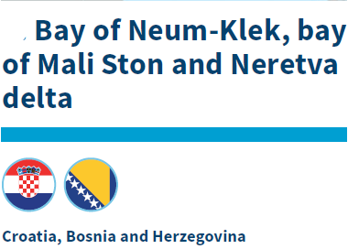
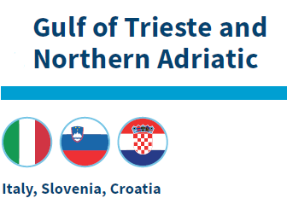
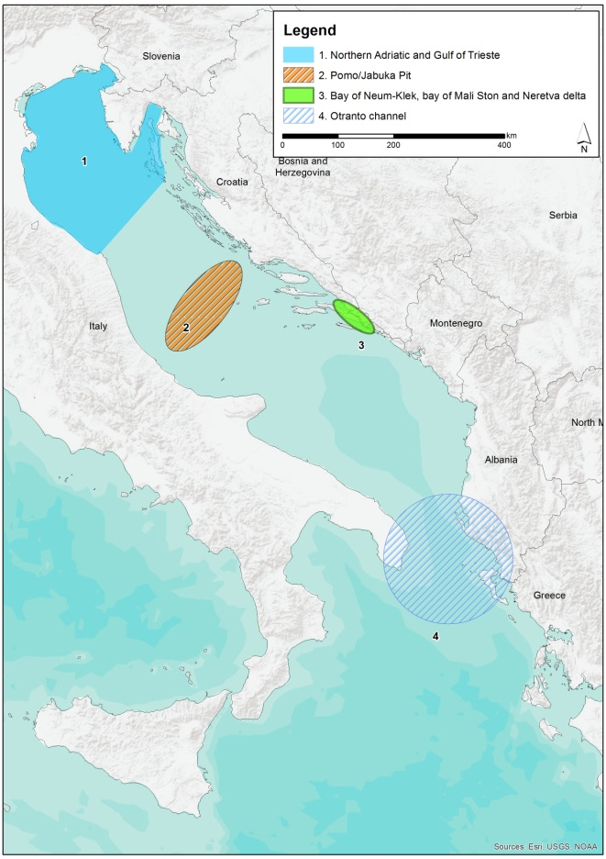
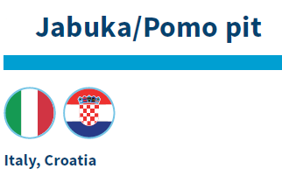
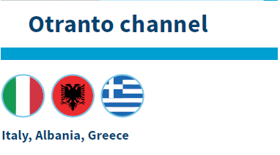
PILOT CASES

Slide 13
PILOT CASES
Pilot cases will assess environmental implications of present and future uses of the sea and identify transboundary/cross-border measures (both spatial and non-spatial) needed to maximize environmental sustainability, to guarantee good ecological status is reached or maintained and biodiversity is adequately protected/improved
Pilot cases will focus on relevant challenges calling for transboundary cooperation, such as for example:
Coastal and marine ecosystems protection
Eco-connectivity enhancement
Sustainable fisheries management
Marine litter management
Sustainable shipping and port management
Sustainable O&G resources management
Underwater Cultural Heritage protection
Sustainable coastal and maritime tourism management.
(from GEF Adriatic project – UNEP/MAP PAP/RAC 2019 – Pan Adriatic Scope)

Slide 14
WP 5: COMMUNICATION
To local communities: develop communication tools/initiatives aiming at highlighting concrete benefits of MSP and ICZM (e.g. job creation, better quality of the environment, valorization of local UCH resources, etc.)
Brochure and public events engaging local communities
To young people: ensure involvement of young generations in the discussion about MSP and in promotion of best practices.
Customized materials events in high schools and colleges
To the large public: disseminate information on the meaning and the advantages of MSP and ICZM
A specific section of the Knowledge Brokerage Service portal will be dedicated to "non-conventional" target users
The EUSAIR Platform: http://esp.aimacroregion.eu/ will be used to disseminate the KBS on MSP-ICM.

Slide 15
DURABILITY AND TRANSFERABILITY
The PORTODIMARE Geoportal will be further developed and enriched with data useful for ICZM and MSP in the AIR. This tool already represent a durable result from previous projects (SHAPE, ADRIPLAN, SUPREME, PORTODIMARE) and its durability will be further ensured through additional development and practical use in pilot cases.
The improved vulnerability and impact assessment tools will be made available through the PORTODIMARE Geoportal and will be open for free use from anybody in the AIR. In order to facilitate access and use of the tools in coastal and maritime planning processes in the AIR the project will implement training sessions with ICZM/MSP responsible administrations.
The durability of the Knowledge Brokerage Service will be targeted by the preparation of a Plan for a ICZM/MSP Knowledge Platform for the AIR, which will also detail mechanisms for its long-term duration (e.g. responsible institution; funding opportunities). This Platform would represent the extension of the KBS beyond the termination of the project and it would become a practical tool to support EUSAIR in implementing MSP and ICZM in the macroregion in the years to come.

Slide 16
PRELIMINARY BUDGET BREAKDOWN
WP1 - Project management | € 300,000
WP2 - Shared knowledge platforms | € 600,000
Geoportal and data | € 300,000
Tools and applications | € 300,000
WP3 - Capitalization and gaps | € 800,000
Knowledge Brokerage Service | € 600,000
Updated Initial Assessment | € 100,000
Knowledge Gaps | € 100,000
WP4 - Implementation | € 1,000,000
Pilot case 1 | € 200,000
Pilot case 2 | € 200,000
Pilot case 3 | € 200,000
Pilot case 4 | € 200,000
All the other activities | € 200,000
WP5 - Communication | € 300,000
TOTAL | € 3,000,000

Slide 17


THANKS FOR YOUR ATTENTION!
EUSAIR FACILITY POINT Project Partner:
www.adriatic-ionian.eu
eusair@izola.si
Eusair Facility Point
@EusairPoint
EUSAIR Facility Point

