Slide 1
TSG3 workshop with Interact - The opportunities of European Green Deal for macro-regions
EUSAIR PILLAR 3 – Environmental Quality
Mediterranean coast and macro-regional strategies week
Izola, 17 December 2020
TSG 3 Pillar coordinators:
Mitja Bricelj, PhD
Senad Oprašič, PhD

Slide 2
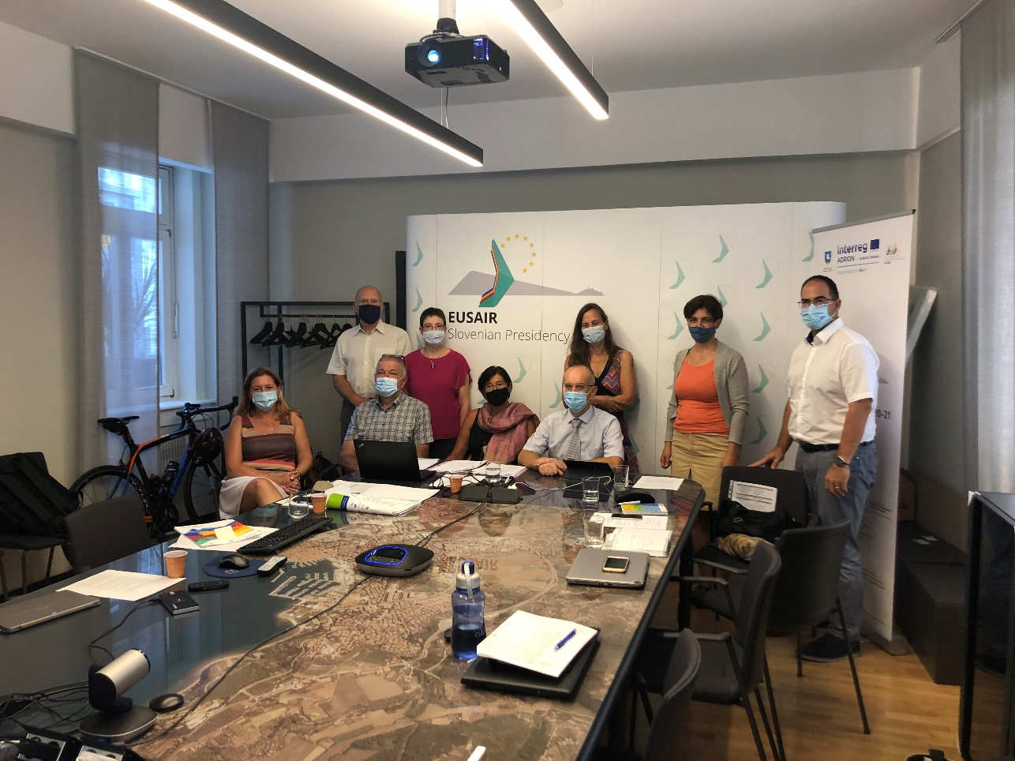
Key messages – Day 1
MRS can deliver EU Green Deal on a regional scale- closer to citizens.
Modern RB, Costal and Marine management recognise the potential of Blue and Green infrastructure for sustainable solutions
Blue and Green corridors in MSP recognising importance of ecoconectivity and biodiversity for the GES, reproductive and HEALTHY Sea.

Slide 3
Key messages – Day 2
Investing in Green infrastructure is investing in our future. MRS translate EU policies into local implementation.
Need to recognise and accept MRS framework as a framework to overcome sectoral approach in countries – acceptance; recognition; use the MRS as a tool for integration and transboundary solutions.
The MRS and the EDG have common priorities and challenges that can be efficiently tackled only in an integrated way considering the links with the SDGs. Feasible green recovery measures planned for each West Balkan country should also be included in IPA programming process.
MRSs are a tool for the implementation of Green Deal on the regional level. Countries must design and implement policies going "Greener" and "Smarter" and with much more synergies and cooperation among states and at a regional level.

Slide 4
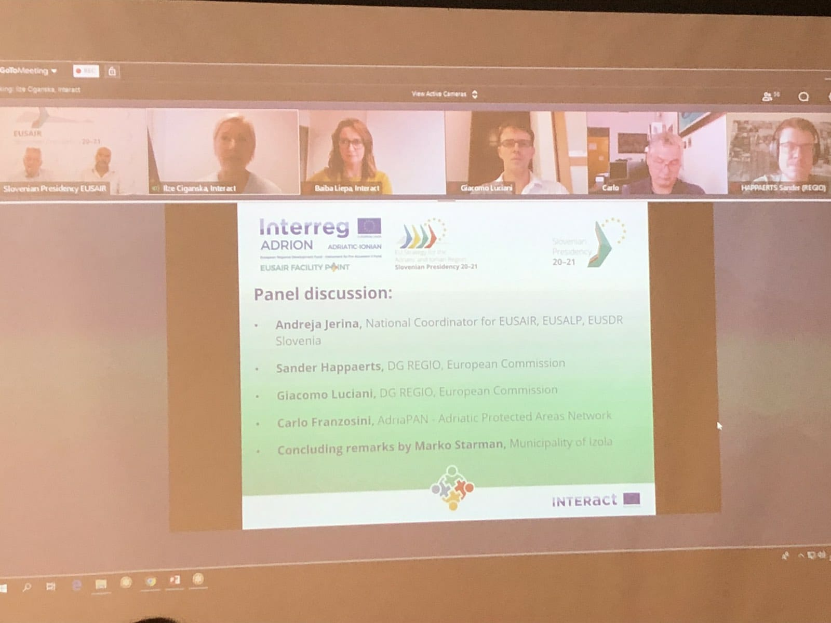
Concluding remarks
Andreja Jerina, National Coordinator for EUSAIR, EUSALP and EUSDR in Slovenia
Humberto Delgado Rosa, DG ENVIRONMENT (Director, Directorate D-Natural Capital), European Commission
Jean Pierre Halkin, DG REGIO (Head of Unit D1, Macro-regions, Transnational/Interregional/External Cooperation, Enlargement), European Commission
Mitja Bricelj, EUSAIR Pillar 3 ‘Environmental
Quality’ Coordinator, Slovenia
Senad Oprašić, EUSAIR Pillar 3 ‘Environmental
Quality’ Coordinator, Bosnia and Herzegovina

Slide 5
EUSAIR Facility Point Project team EU Strategy for the Adriatic-Ionian Region (EUSAIR) FACILITY POINT – Supporting the Governance of the EUSAIR Republic of Slovenia,
www.adriatic-ionian.eu
eusair@izola.si
Eusair Facility Point
@EusairPoint
EUSAIR Facility Point

