Slide 1
Project Idea title: The Effects of anthropogenic pressures and climate change in the nutritional and commercial value of two small pelagic fish species of importance to ADRION region fisheries: Biodiversity and energy flow from the Ecosystem to the final product Acronym: EURYNOME EUSAIR: Pillar 1 Blue Growth 12th TSG1 meetting – 07.12.2020
HELLENIC AGRICULTURAL ORGANIZATION
FISHERIES RESEARCH INSTITUTE

Slide 2
The Effects of anthropogenic pressures and climate change in the nutritional and commercial value of two small pelagic fish species of importance to ADRION region fisheries: Biodiversity and energy flow from the Ecosystem to the final product
(EURYNOME)
Main Objectives:
to understand how the diet composition of two small pelagic fish, the sardine (Sardina pilchardus) and the European anchovy (Engraulis encrasicolus), is affected by different climatic conditions and/or geographical areas, and
how this may affect the qualitative characteristics of the fish that are of particular interest to human nutrition,
provide insight into possible effects of climate change in the fisheries of the two species, as well as to the qualitative components of energy flow in the marine environment and consequently to the human consumer
(Blue Growth Pillars 1 & 3)
HELLENIC AGRICULTURAL ORGANIZATION
FISHERIES RESEARCH INSTITUTE
09-12-2020 EURYNOME: Dr. Grigorios Krey

Slide 3
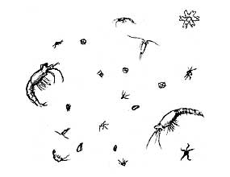
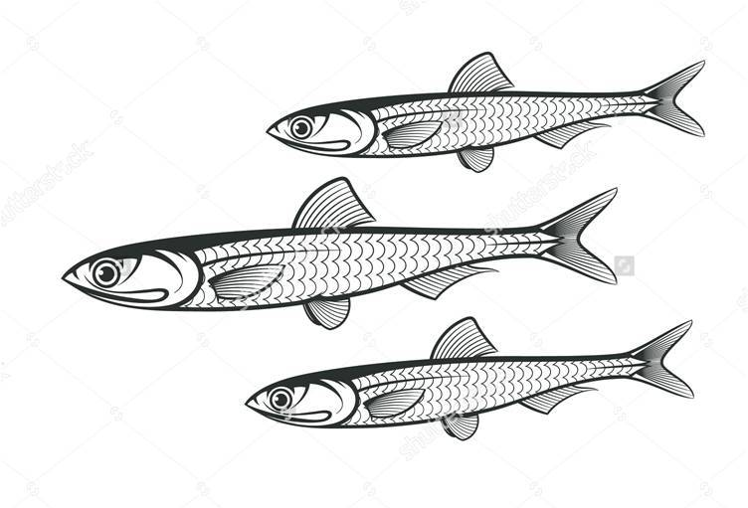
The Concept:
Phytoplankton (primary producers)
Zooplankton
(1st intermediate)
Energy
+
EPA & DHA
Small pelagic fish
(2nd intermediate)
Higher trophic levels
and/or processing
HELLENIC AGRICULTURAL ORGANIZATION
FISHERIES RESEARCH INSTITUTE
09-12-2020 EURYNOME: Dr. Grigorios Krey

Slide 4
Workflow and expected outcomes (1)
Examine the effects of climatic conditions on the qualitative and quantitative aspects of plankton richness in the areas of study, as well as in the uptake and storage of energy by the two fish species of interest.
qualitative and quantitative evaluation of planktonic richness
qualitative and quantitative evaluation of the diet of the two fish species
Effects of diet quality on the biochemical components in the muscle tissue of the fish of interest to human nutrition
Models to predict possible effects of climate change in the energy flow between the primary producers and higher trophic levels.
Climate change:
How does it affect
biodiversity and/or qualitative
characteristics?
Phytoplankton
Zooplankton
Energy
+
EPA & DHA
Use as a “biomarker” for
the effects of climate change
Higher trophic levels and/or processing
HELLENIC AGRICULTURAL ORGANIZATION
FISHERIES RESEARCH INSTITUTE
09-12-2020 EURYNOME: Dr. Grigorios Krey

Slide 5
Workflow and expected outcomes (2)
Relate environmental conditions to plankton biodiversity and to the qualitative characteristics, of interest to human nutrition, in the tissues of the fish.
Increase the valorization of these two important fisheries resources by promoting their nutritional value and underscoring probable regional/climate-related qualitative characteristics through the combined effort of the relevant regional pelagic fisheries associations, fish mongers, and regional/local authorities.
Provide the processing industry with valuable information regarding the regional/seasonal qualitative aspects of the raw material for its optimal suitability in different processing methods (marinated, salted, frozen) in order to preserve and offer the maximum of its nutritional value.
Contribute to the rational exploitation of the regional stocks by defining (regional) fishing periods during which the qualitative characteristics of the two species provide maximum nutritional value as fresh products and/or optimal conditions for the production of high quality processed ones.
Involvement: Research centers, Fisheries sector, Industry, Regional/National Authorities/EU
Phytoplankton
Zooplankton
Energy
+
EPA & DHA
Valorizing the fish:
Benefits in human
nutrition and health
HELLENIC AGRICULTURAL ORGANIZATION
FISHERIES RESEARCH INSTITUTE
09-12-2020 EURYNOME: Dr. Grigorios Krey

Slide 6
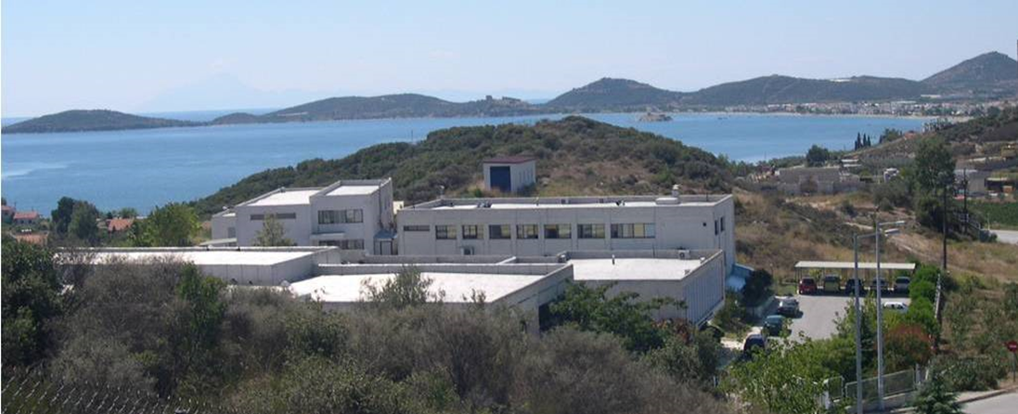
The Fisheries Research Institute
Nea Peramos, Kavala, Greece
Personnel:
Researchers: 11
Technical and Administrative Personnel: 19
Contracted scientific collaborators: 70
Research:
>70 EU and Nationally- funded research projects since 1995 (currently 14 projects running)
Total research funding: >30 million €
>300 publications
Research Topics:
Fisheries biology: marine & freshwater, physiology, population genetics
Aquatic environment: Marine, coastal, freshwater, and transitional waters
Oceanography: Coastal and fisheries oceanography
Aquaculture: metabolism and nutrition, algae
Fisheries products: development & analysis
HELLENIC AGRICULTURAL ORGANIZATION
FISHERIES RESEARCH INSTITUTE
09-12-2020 EURYNOME: Dr. Grigorios Krey

